Slide 1


Youth Bioinformatics Symposium 2016
Cecilia Arighi Hongzhan Huang
Karen Ross C.R. Vinayaka
Cathy Wu
Protein Information Resource
Georgetown University Medical Center
University of Delaware

Slide 2
Outline
Historical Background
Searching for Protein Information in “Free-Text” Resources
The UniProtKB database
Protein Sequence Similarity Search
Multiple Sequence Alignment (MSA)

Slide 3
I. Historical Background

Slide 4
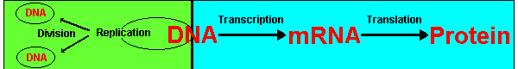
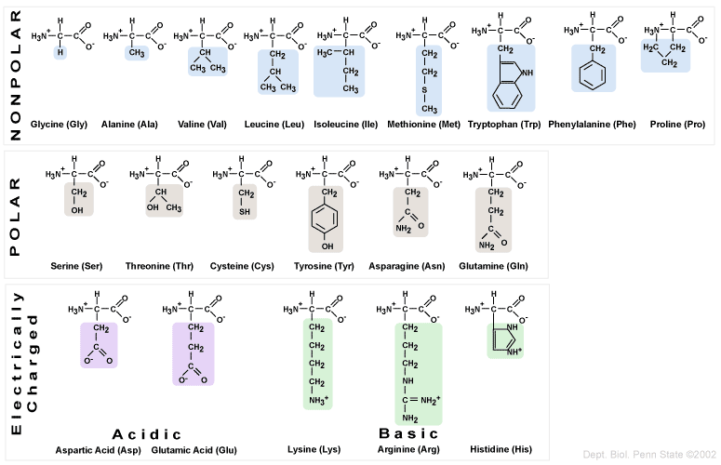
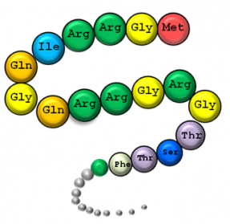
The Central Dogma of Modern Biology
• Proteins are composed of chains of amino acids
• Size and chemical properties of amino acids vary
www.worldofteaching.com

Slide 5
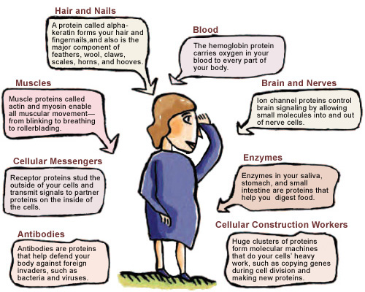
What Do Proteins Do?
https://publications.nigms.nih.gov/structlife/chapter1.html

Slide 6
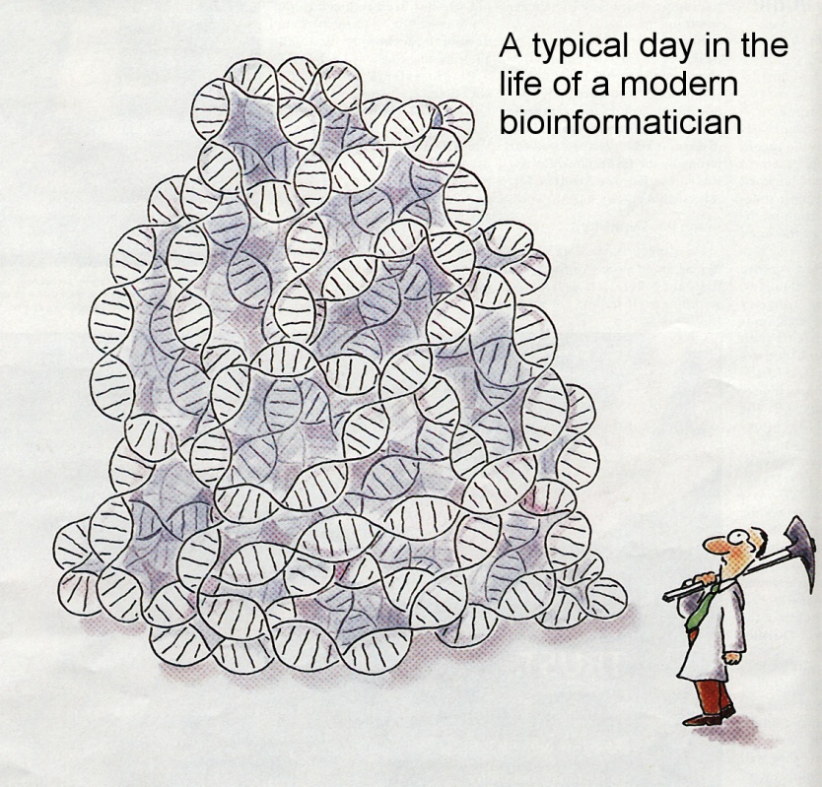
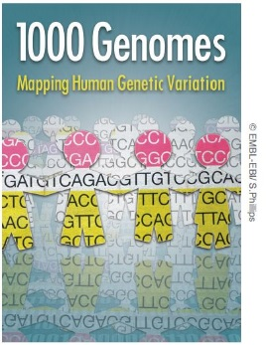

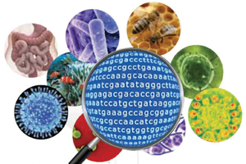
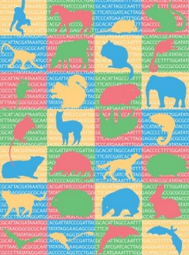
Deluge of sequence data
Source:http://1001genomes.org/
Source:http://www.scigenom.com/metagenomics
Source:https://www.broadinstitute.org/
Courtesy of the Swiss-Prot group (SIB Swiss Institute of Bioinformatics)

Slide 7
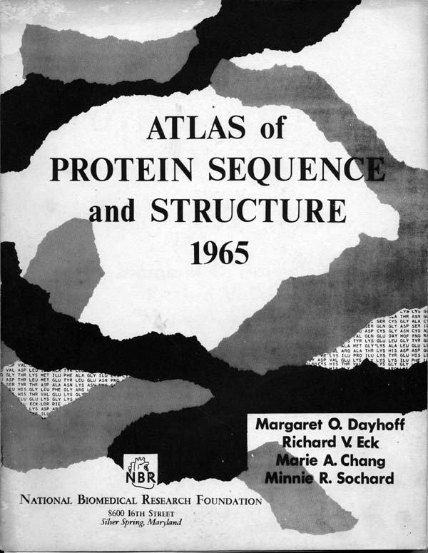
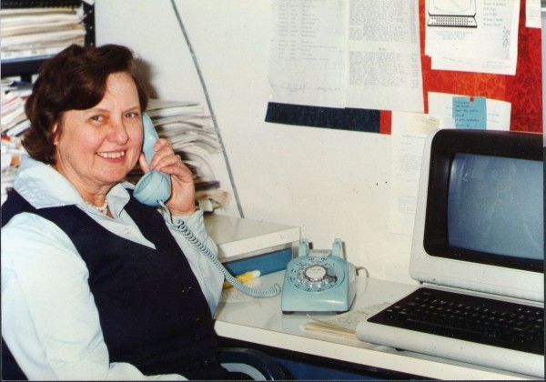
Dr. Margaret Dayhoff
(1925 – 1983)
Interested in the possibility of deducing the evolutionary connections of the biological world from sequence evidence
Formulated the first probability model of protein evolution - PAM substitution matrix
The origin of the single-letter AA code
Published the Atlas of Protein Sequence and Structure (1965-79), which became the Protein Information Resource Protein Sequence Database (PIR-PSD)

Slide 8
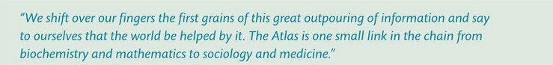

Margaret O. Dayhoff to Susan Tideman, 18 October 1968, National Biomedical Research Foundation Archives
Margaret O. Dayhoff to Carl Berkley, 27 February 1967, National Biomedical Research Foundation Archives
Quoted in: An Introduction to Molecular Evolution and Phylogenetics by Lindell Bromham

Slide 9
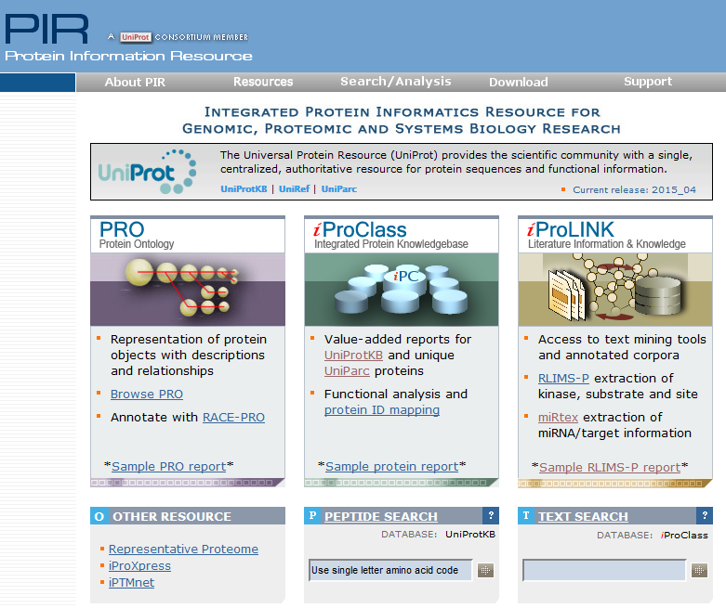









Protein Information Resource
http://proteininformationresource.org
Hub for protein functional information
Data warehouse
Ontological representation of proteoforms and protein complexes
Access to text mining tools
Text Mining and Data Mining Integration
National and international collaborative networks

Slide 10
II. Searching for Protein Information in “Free-Text” Resources

Slide 11
Question
If you wanted to find information about a protein and the diseases it was associated with, where would you look? What would search for?

Slide 12







Some Possible Answers
Web Search Engines
Protein name

Slide 13



Biomedical Literature Resource: Medline/PubMed
• Medline
• ~26 million references to journal articles in life sciences with a concentration on biomedicine.
• Indexed with NLM’s Medical Subject Headings (MeSH®)
• PubMed (http://www.ncbi.nlm.nih.gov/pubmed)
• Provides free access to MEDLINE
• Links to full-text articles found in PubMed Central or at publisher web sites, and other related resources.
• Provides Advanced search, and special filters.
Source:http://www.nlm.nih.gov/pubs/factsheets/medline.html

Slide 14
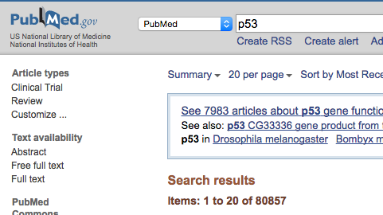
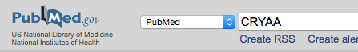
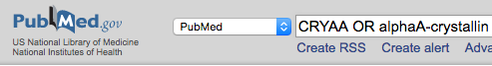
Common issues
-Too many articles , e.g keyword p53
Possible solutions: Use Filters, MeSH terms, or Boolean operators to scope results
-Retrieval of a subset of articles due to narrow search (not including synonyms), e.g compare CRYAA alone and including alphaA-crystallin
110 Articles
510 Articles
Possible solutions: Include relevant synonyms

Slide 15
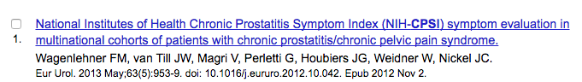
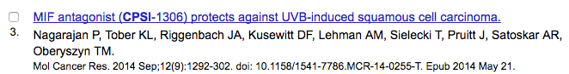
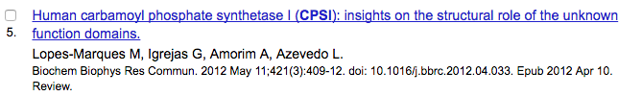
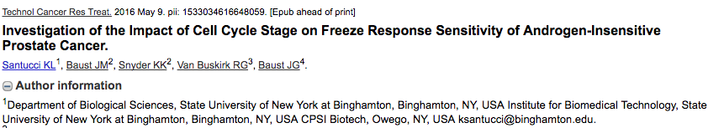
Common issues
-Articles not relevant to the query due to many possible meanings for the word, e.g. CPSI

Slide 16
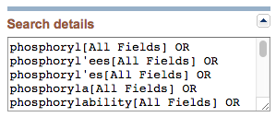
Some Tips for PubMed Searches
• Use Filters to narrow your search
e.g. selecting species human
• Use Advanced Search to narrow your search:
Boolean operators AND, OR, NOT
e.g. to retrieve articles on CPSI that are less likely to be about prostatitis score,
search for CPSI NOT prostatitis
• Search for phrases in quotes
e.g. “breast cancer”
• Use Wildcards * to expand your query
Phosphoryl*
*Results can be saved locally, so you can review them at a later time
Expanded Query

Slide 17
Hands-On #1: Protein Search
• Search for information about HEXA
-What is its biochemical function?
-What disease is it associated with?
-Other information?
Divide into groups and each group use a different searching method (Google (not Wikipedia), Google Scholar, Wikipedia, PubMed)

Slide 18
Discussion
• Did you find the information you were looking for?
• What were some pros and cons of the search method/resource you used?

Slide 19
III. Protein Resources UniProtKB Database

Slide 20



The Universal Protein Resource
www.uniprot.org
comprehensive
high quality
freely accessible
The mission of UniProt is to provide the scientific community with a comprehensive, high-quality and freely accessible resource of protein sequence and functional information.
Modified from Michel Schneider, UniProt

Slide 21

UniProtKB, the Knowledge base component of UniProt
Where data becomes structured knowledge
Central hub for the collection of functional information on proteins. The core data mandatory for each UniProtKB entry:
amino acid sequence
protein name or description
taxonomic data
citation information
Shigeo Fukuda
Courtesy of the Swiss-Prot group (SIB Swiss Institute of Bioinformatics)

Slide 22
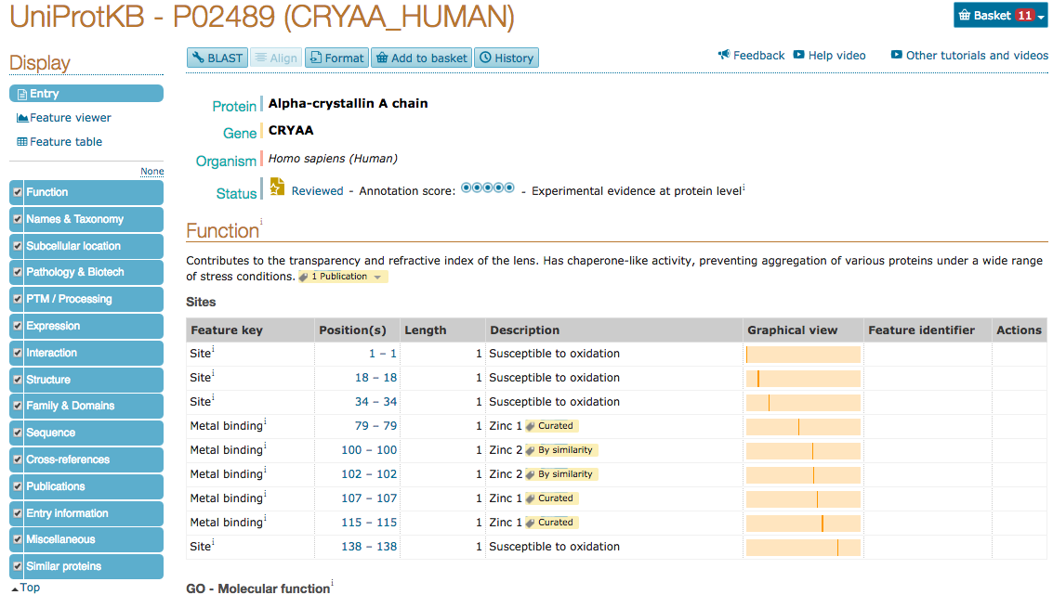

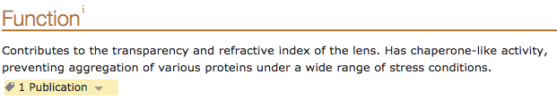
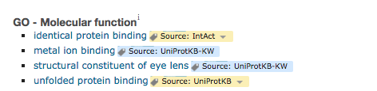
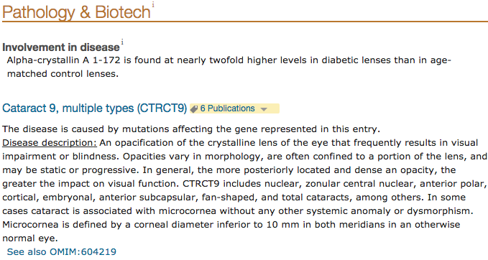
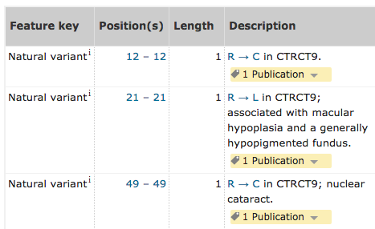
What’s in UniProtKB?
Unique
Identifier
Records for ~62.5 million proteins
• ~500K manually reviewed
• 62 million unreviewed
(automated annotation)
Sections of the Record
∂
Evidence
∂

Slide 23
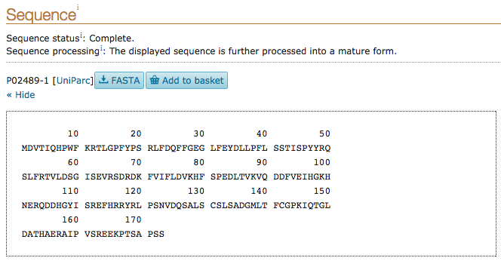
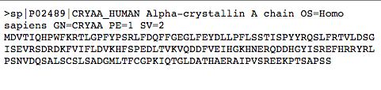
What’s in UniProtKB?
Sections of the Record
Download Sequence
FASTA Format:
Common input format for sequence analysis
Header Line:
• Starts with “>”
• Contains ID and description
Sequence

Slide 24
Hands On #2 – UniProtKB
Go to UniProtKB (http://www.uniprot.org/) and search for the entry for human HEXA
What is the UniProtKB identifier for this protein?
What is the function of this protein?
What disease is associated with defects in this protein?
Give an example of a genetic variant with publication support that leads to the infantile form of the disease.
Download the sequence of Isoform 1 in FASTA format

Slide 25
Hands On #2 – UniProtKB (Answers)
Go to UniProtKB (http://www.uniprot.org/) and search for the entry for human HEXA
What is the UniProtKB identifier for this protein? P06865
What is the function of this protein? Degrades GM2-gangliosides. A ganglioside is a type of glycolipid (sugar + lipid).
What disease is associated with defects in this protein? GM2-gangliosidosis 1 (aka Tay-Sachs Disease)
Give an example of a genetic variant with publication support that leads to the infantile form of the disease. Several examples in the variant table in the Pathology & Biotech section of the entry.

Slide 26
Hands On #2 – UniProtKB (Answers)
6. Download the sequence of Isoform 1 in FASTA format. Click FASTA button in above Isoform 1 sequence in Sequence section.
>sp|P06865|HEXA_HUMAN Beta-hexosaminidase subunit alpha OS=Homo sapiens GN=HEXA PE=1 SV=2
MTSSRLWFSLLLAAAFAGRATALWPWPQNFQTSDQRYVLYPNNFQFQYDVSSAAQPGCSV
LDEAFQRYRDLLFGSGSWPRPYLTGKRHTLEKNVLVVSVVTPGCNQLPTLESVENYTLTI
NDDQCLLLSETVWGALRGLETFSQLVWKSAEGTFFINKTEIEDFPRFPHRGLLLDTSRHY
LPLSSILDTLDVMAYNKLNVFHWHLVDDPSFPYESFTFPELMRKGSYNPVTHIYTAQDVK
EVIEYARLRGIRVLAEFDTPGHTLSWGPGIPGLLTPCYSGSEPSGTFGPVNPSLNNTYEF
MSTFFLEVSSVFPDFYLHLGGDEVDFTCWKSNPEIQDFMRKKGFGEDFKQLESFYIQTLL
DIVSSYGKGYVVWQEVFDNKVKIQPDTIIQVWREDIPVNYMKELELVTKAGFRALLSAPW
YLNRISYGPDWKDFYIVEPLAFEGTPEQKALVIGGEACMWGEYVDNTNLVPRLWPRAGAV
AERLWSNKLTSDLTFAYERLSHFRCELLRRGVQAQPLNVGFCEQEFEQT

Slide 27
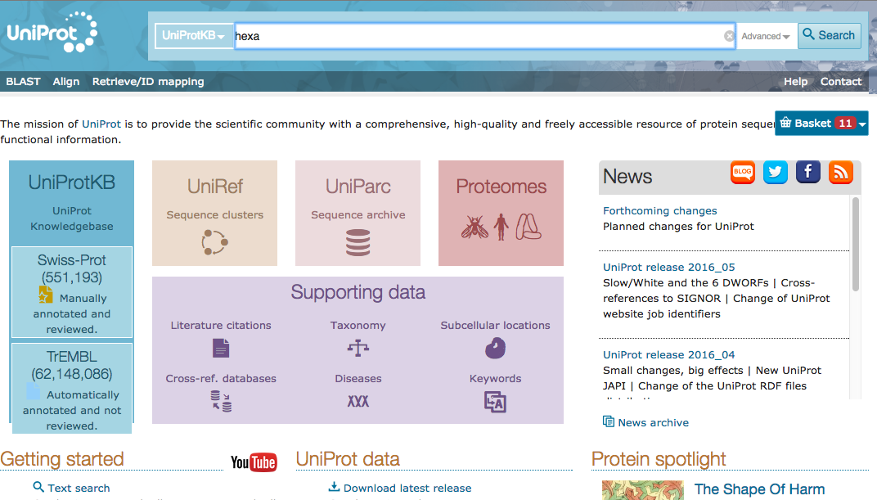
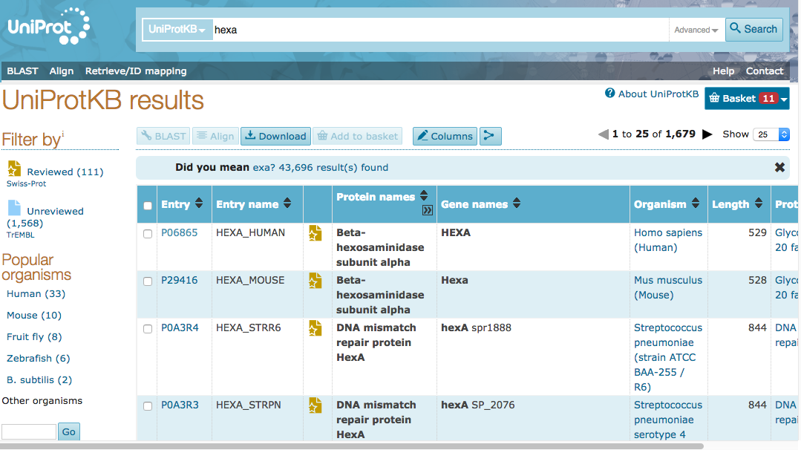
Hands On #2 – UniProtKB (Answers)
Searching for a protein in UniProtKB
Filter to refine search
UniProtKB (http://www.uniprot.org/)

Slide 28
Hands On #2 – UniProtKB (Answers)
Search Results
UniProt
Identifier

Slide 29
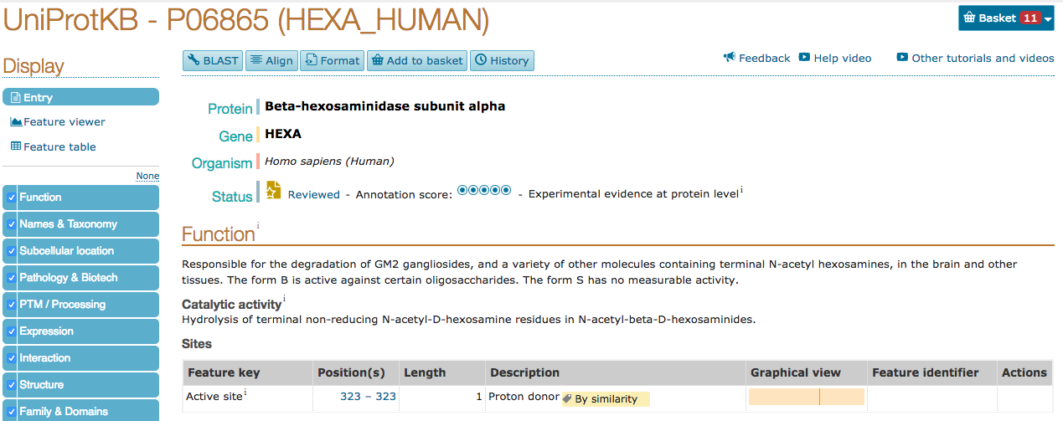
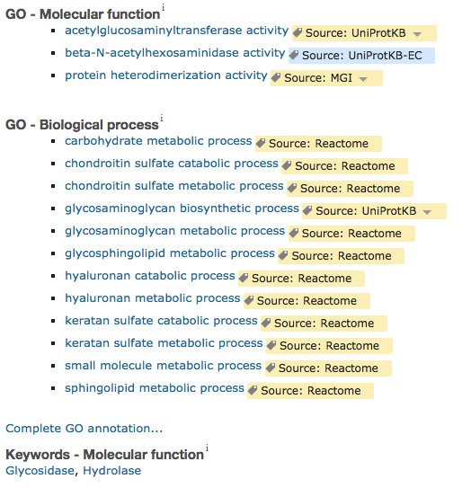
Hands On #2 – UniProtKB (Answers)
UniProtKB Entry Page I
Sections of the Record
Basic Info
Functional
Information
Functional
Information
(Controlled
Vocabulary)

Slide 30

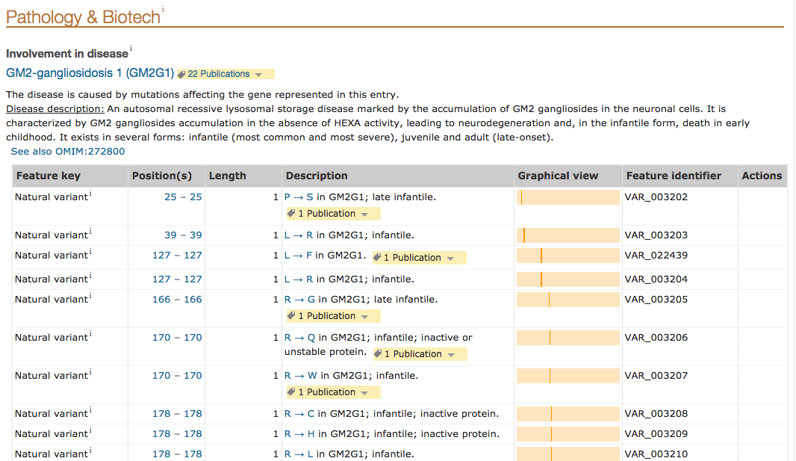
Hands On #2 – UniProtKB (Answers)
Disease and Variant Information

Slide 31
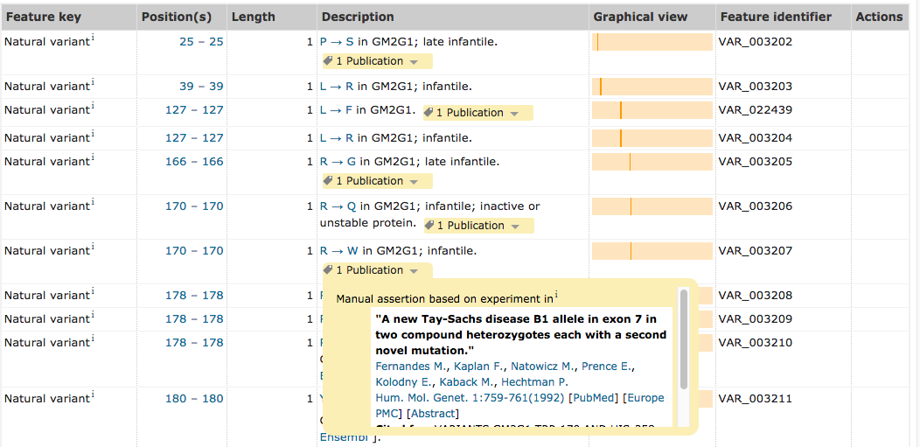
Hands On #2 – UniProtKB (Answers)
Disease and Variant Information

Slide 32

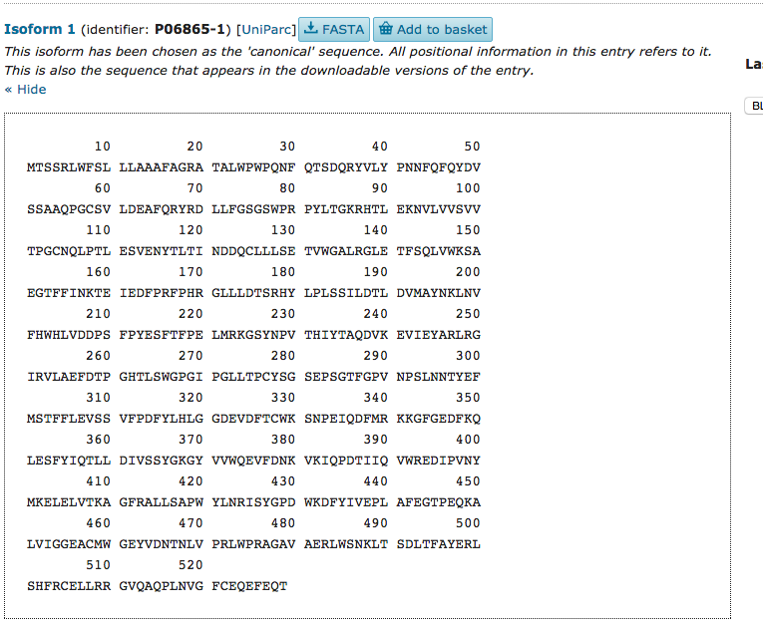
Hands On #2 – UniProtKB (Answers)
Sequence Information
Download Sequence

Slide 33
Question
How did searching UniProtKB compare to searching other resources (e.g., Google, PubMed) for finding information about a protein and associated diseases?

Slide 34
IV. Protein Sequence
Similarity Search

Slide 35
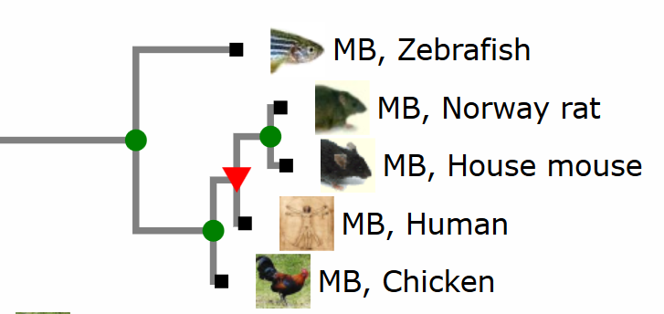
Important Concepts
Homologous sequences share a common ancestor
Myoglobin gene
Ancestral
Myoglobin gene
Known function in these organisms:
Serves as a reserve supply of oxygen and facilitates the movement of oxygen within muscles.
From: http://www.treefam.org/family/TF332967
At the molecular level, homology is similarity between sequences that is due to their shared ancestry
We use sequence similarity that is statistically significant as evidence of homology

Slide 36

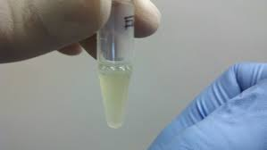
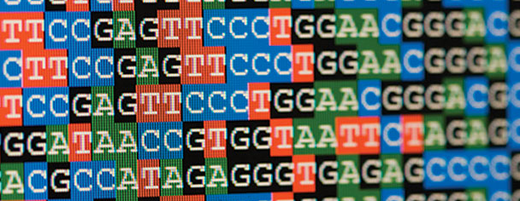
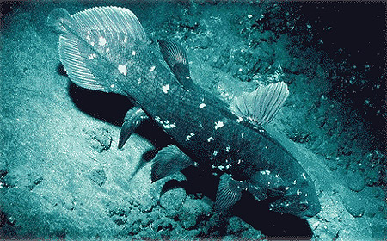

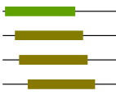
Searching for similar sequences
Sequence Database (Target)
>protein 1
MLSPDDIEQWFTEDPGP
QIIRGNMYYENSYALA
?
>protein 2
MRPSGTAGAALLALLAALCPASRALEEKKVCQGTSNKLTQLGTFEDHFLSLQRMFNNCEVGNLEITYVQRNYDLSFLKTIQEVAGYVLIALNTVERIPLENL
Query Protein Sequence
MRASLLSAGALIALLAALCPASRALEEKKVCQGTSNKLTQLGTFEDHFLSLNKMFNNCEVGNLEITYVQRNYDLSFLKTIQEVAGYVLIALNTL
>protein 3
MTEQMTLRGTLKGHNGWVTQIATTPQFPDMILSASRDKTIIMWKLTRDETNYGIPQRA
List of entries similar to the query
BLAST
….
Protein 2
>protein n
MEVQLGLGRVYPRPPSKTYRGAFQNLFQSVREVIQNPGPRHPEAASAAPPGASLLLLQQQ QQQQQQQQQQQQQQQQQQQQETSPRQQ
Protein 5
% identity
Score
E-value
Protein 180
:
:
:
Notes:
You have just finished sequencing the genome of your favorite organism.
• You have identified some potential protein coding genes and have predicted the protein sequences.
How can you predict the function of these proteins?
By sequence similarity to proteins of known function.

Slide 37
Basic Local Alignment Search Tool (BLAST)
Use of a set of algorithms to compare a query sequence to all the sequences in a specific database and find high scoring pairs of alignments
Based on Pair-Wise Alignments
The score of each comparison reflects the degree of similarity between the two sequences (the higher the greater the degree of similarity)
The Expectation value or E-value tells you how many alignments with a given score are expected by chance (the closer to 0 the better)

Slide 38
Sequence comparison
Sequences are compared directly, position by position.
S I M I L _ A R I T Y
| | | | | | | |
F AM I L I A R I T Y
Matches=
No matches=
Gaps=
8
2
1
Score Key
match: +1
no match: -1
gap: –1
Score= 8*(+1)+2*(-1)+1*(-1)=5
In reality, some amino acid substitutions are more likely than others to be tolerated during natural selection/evolution
The frequency of occurrence of the 20 amino acids within proteins varies a lot
Leucine, Isoleucine, Alanine are frequently found in proteins
Tryptophan and Cysteine occur with less frequency

Slide 39
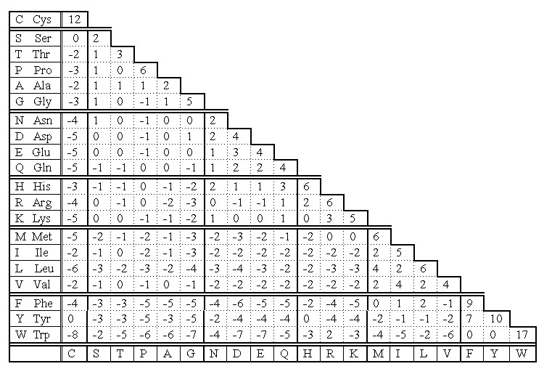
Scoring Matrix Example
W E L D I N G
| | | |
C E I L I N G
Substitution is typically selected against
Substitution is tolerated
Notes:
PAM (Point Accepted Mutation)
Used to score alignments
Positive values: substitution is tolerated
Zero: substitution occurs with same frequency as random event
Negative value: substitution is typically selected against

Slide 40
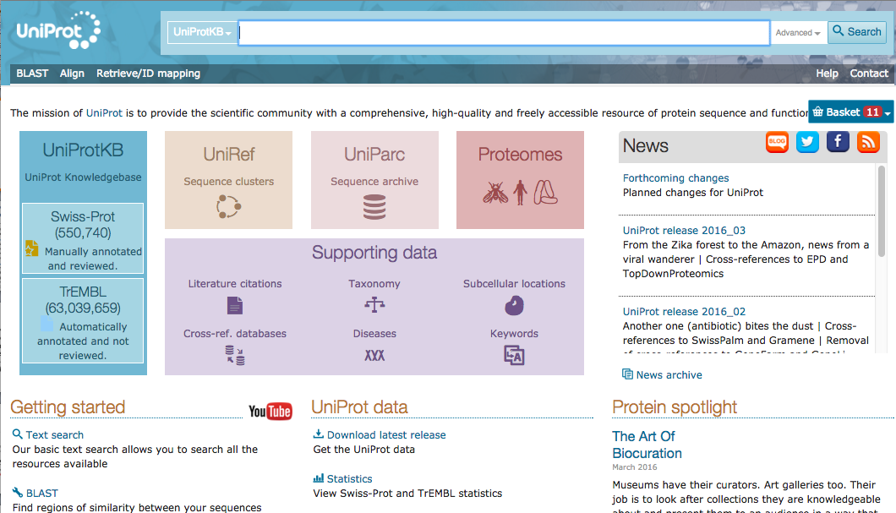
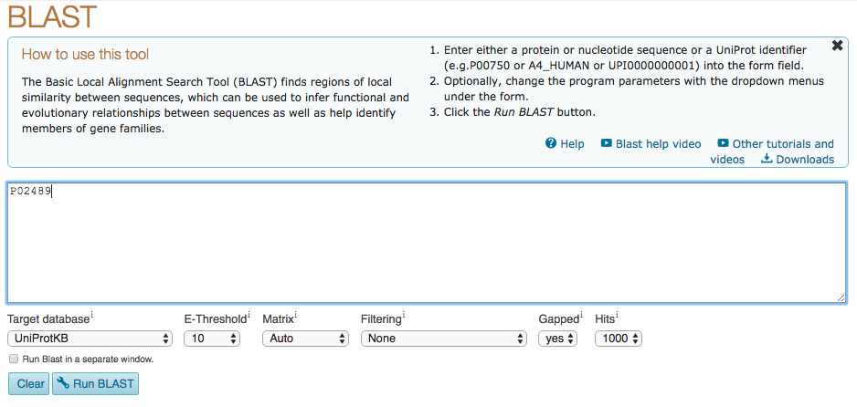
Running Protein BLAST from UniProt
(http://www.uniprot.org)
UniProt identifier of human alpha crystallin
BLAST
Parameters

Slide 41
Protein BLAST Parameters
Adjusting BLAST parameters can affect the outcome of your analysis.
• Target database: database against which the search is performed
• E-Threshold: maximum E-value that will be displayed
• Matrix: scoring matrix that will be used (common scoring matrices are call PAM or BLOSUM followed by a number (e.g., BLOSUM62)
• Filtering: allows you to filter out regions of low-complexity sequence that tend to give meaningless matches
• Gaps: sets whether gaps in alignments are allowed
• Hits: sets the number of returned hits

Slide 42
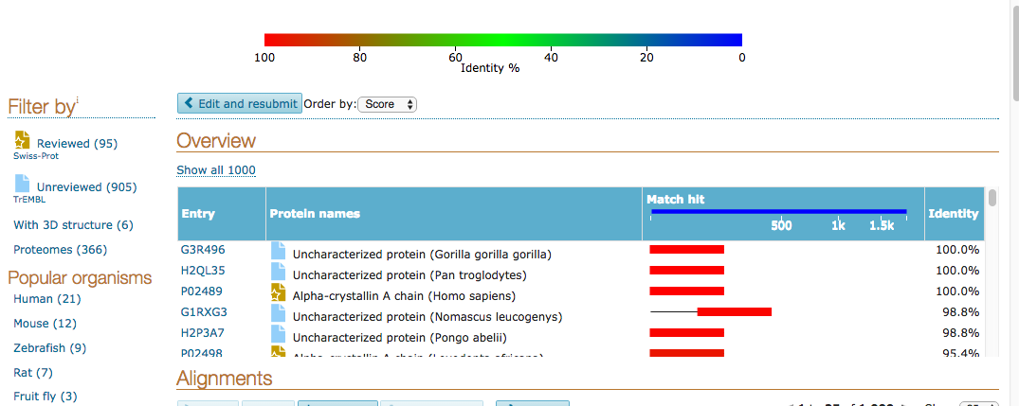
BLAST Results I
• Overview box shows UniProt identifier, name, matched region, and percent identity ranked in order of score
• Filters can be used to restrict results to reviewed entries only or to particular organisms of interest

Slide 43
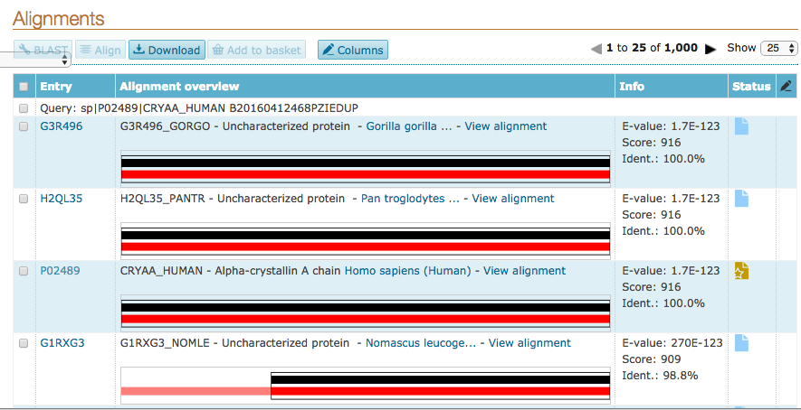
BLAST Results II
• Alignments panel shows matching regions as well as E-value, score, and percent identity for each result.
• Color indicates percent identity.

Slide 44
Hands On #3 – Protein BLAST
Go to http://www.uniprot.org and run protein BLAST on the following sequence. The sequence is an uncharacterized protein from Latimeria chalumnae (West Indian ocean coelacanth).
>Mystery Sequence
ALEYKCNINMTAETADCFNSSQITASEQEALVKPKQLLLKLLKCAGAQKDIFTMKEVIYY
LGQYIMAKQLYDKNQQHIVHCSNDLLGELFGVQSFSVKEPRRLYAMISKNLLPVNQEDPI
GIHVSMKETRCHRGSETGVKDNTQEVAGEKPAAPVTASCSTTSCRRTFSETEDAVSDDPL
SERRRKRHKSDSISLTFDDSLSWCVISGLRRDRSSSESTESPSNPDSDVVSVSENSKDSW
FDQDSDSDHFSVEFEVESVYSENYSDNEEAQDVTDEDDEFYQVTIYEAEDSDDSFTEDTE
ISVADYWTCTECEEVNPPLPRHCNRCWALRKDWLPENTKSSSCKSLDLKEPDREEGIDVP
DCKKTKEDPSCDSNVDVNEEDMTVQSSESQETNISQPSTSSSFIGGSQEESRETEREESS
ESTLPLTCLEPCVICQSRPKNGCIVHGRTGHLMACYTCAKKLKRRNKPCPVCRQPIQMVV
LTYFS
Latimeria chalumnae
Notes:
BLAST job ID: B2016060214483A1C7ED25EE8374758DF3FD545FD093FEE1

Slide 45
Hands On #3 – Protein BLAST
Look at the BLAST results
What is the top result?
Filter by reviewed entries, and look over the top 10 results.
Do they have significant e-values?
Approximately what % identity do they have to the query protein?
Is the similarity over the full length of the protein?
What are the names of the top hits?
Do not close the window with the BLAST results!! You will need it again.

Slide 46
Hands On #3 – Protein BLAST (Answers)
Look at the BLAST results
What is the top result?
H3APM8 Uncharacterized Protein from Latimeria chalumnae. This is the UniProt record for the sequence you input into BLAST. It shows 100% identity over the full length (as you would expect).
Filter by reviewed entries, and look over the top 10 results.
Do they have significant e-values? Yes—0 to 11E-165.
Approximately what % identity do they have to the query protein? 53%-62%
Is the similarity over the full length of the protein?
For the first eight results, yes. In the last two cases, Q00987-8 and P56950-2 the match does not include the N-terminal region of the query protein.
4. What are the names of the top hits?
E3 ubiquitin-protein ligase Mdm2

Slide 47
V. Multiple Sequence Alignment (MSA)

Slide 48
Multiple Sequence Alignment
• So far, we have talked about BLAST, which aligns pairs of sequences and comes up with a relatedness score based on how similar the amino acids are at each position.
Pairwise alignment:
a b a c d
a b e c d
Protein 1
Protein 2
• Multiple sequence alignment (MSA) extends the same idea and provides more information
Multiple sequence alignment:
a b a c d
a b e c d
c b a c f
Protein 1
Protein 2
Protein 3
…

Slide 49

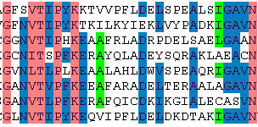
Multiple Sequence Alignment
“Two homologous sequences whisper…
A multiple sequence alignment shouts”
Prof. Arthur M Lesk

Slide 50
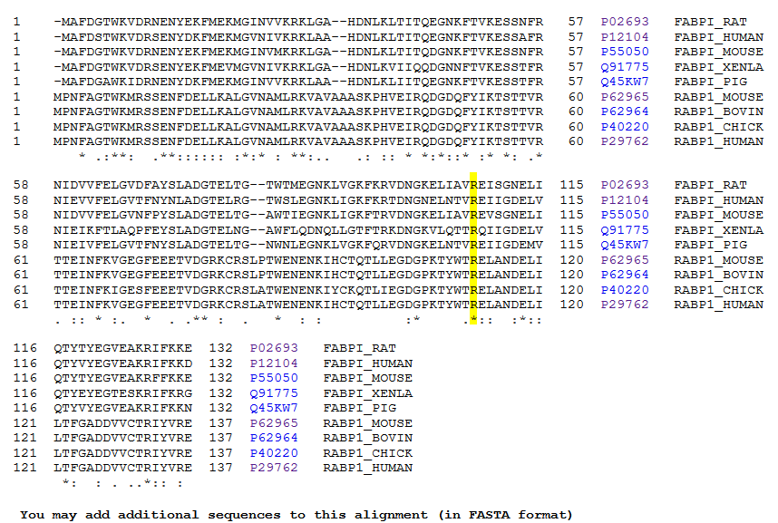
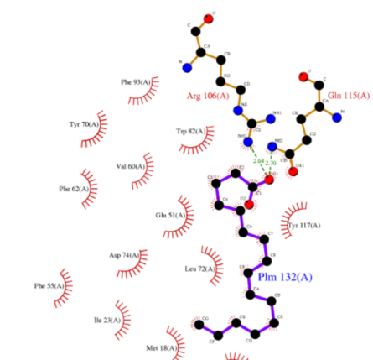
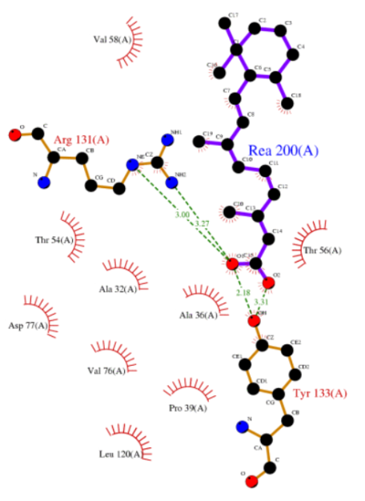
Multiple Sequence Alignment
MSA can reveal patterns of conservation in sequences that allow us to determine which residues are under selective constraint (may be important for protein function)
FABP
CRABP
Arg and Gln conserved in all FABPs
Arg and Tyr conserved in all CRABPs
Gunasekaran et. al, 2004, Proteins: Structure, Function, and Bioinformatics, 54, 2:179-194.

Slide 51
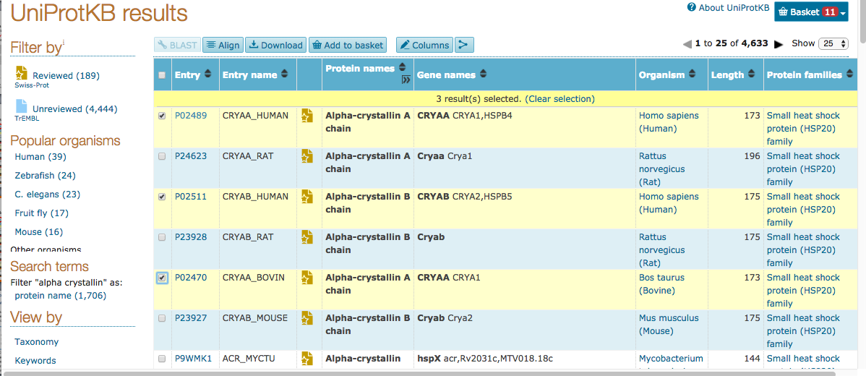
Performing MSA with UniProt
Select several UniProt search results to align…

Slide 52
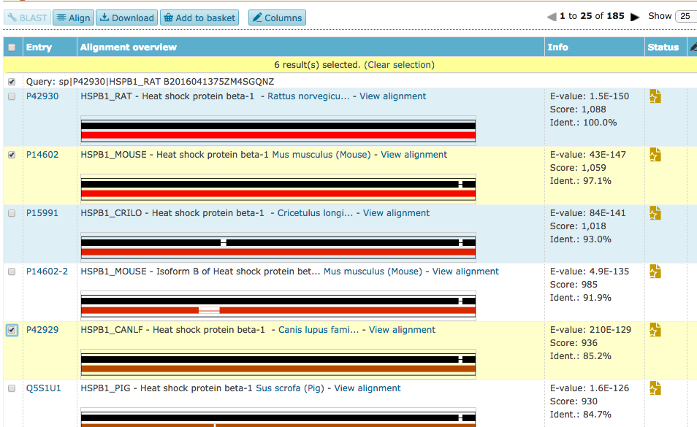
Performing MSA with UniProt
…or select several BLAST results to align

Slide 53


UniProt Alignment Results
Query
Heat Shock
Crystallin
• Modified residues of heat shock group are also found in query
• 3 of 4 metal binding residues of crystallin group are conserved in heat shock group
-> Maybe heat shock group also binds metal at these sites?

Slide 54
Hands On #4 - MSA
• Go back to the results page for your BLAST of the Latimeria chalumnae uncharacterized protein.
• If you have not already done so, filter results for reviewed entries
• Select the query sequence and the top five BLAST results and perform an alignment.
• Experiment with highlighting the alignment according to different annotations or amino acid properties. Observe whether your mystery sequence is conserved in the highlighted regions.
Notes:
Alignment Job ID:

Slide 55
Hands On #4 – MSA Part II
Highlight the alignment according to the mutagenesis annotation. (This means that the UniProt entry has information about mutagenesis experiments for these residues)
Find the highlighted residue at position 374 of the human sequence Q00987. Is this residue conserved in the mystery protein?
In a separate tab, go to the UniProtKB record for Q00987. What was the consequence of mutagenesis at position 374?
In the alignment, find the highlighted residues at positions 452, 455, and 457. Are these conserved in the mystery protein?
What are the consequences of mutagenesis of positions 452, 455, and 457?
Based on these results, do you think it is possible that the mystery protein has ubiquitin ligase activity like the human protein Q00987?
Notes:
Alignment Job ID:

Slide 56
Hands On #4 – MSA Part II (Answers)
Highlight the alignment according to the mutagenesis annotation. (This means that the UniProt entry has information about mutagenesis experiments for these residues)
Find the highlighted residue at position 374 of the human sequence Q00987. Is this residue conserved in the mystery protein? No
In a separate tab, go to the UniProtKB record for Q00987. What was the consequence of mutagenesis at position 374? No loss of ubiquitin ligase activity.
In the alignment, find the highlighted residues at positions 452, 455, and 457. Are these conserved in the mystery protein? Yes
What are the consequences of mutagenesis of positions 452, 455, and 457? Loss or significant decrease in ubiquitin ligase activity.
Notes:
Alignment Job ID:

Slide 57
Hands On #4 – MSA Part II (Answers)
5. Based on these results, do you think it is possible that the mystery protein has ubiquitin ligase activity like the human protein Q00987?
At least some of the residues that are important for ubiquitin ligase activity (452, 455, and 457) are conserved in the mystery protein. The one residue that we checked that was not conserved (374) seems to be less important for activity. These results are consistent with the possibility that the mystery protein has ubiquitin ligase activity, but we would need to check other critical residues and ultimately do experiments on the mystery protein to see if it really does have the activity.
Notes:
Alignment Job ID:

Slide 58
Take Home Messages
• Pubmed (http://www.ncbi.nlm.nih.gov/pubmed) is an excellent resource for searching high-quality scientific literature. Using advanced querying techniques can help to target your searches to articles you are most interested in.
• UniProtKB (http://www.uniprot.org/) is a centralized resource for protein sequence and function information.
• Protein BLAST and multiple sequence alignments (MSA) can help in assigning functions to uncharacterized proteins and in determining evolutionary relationships among proteins.

Slide 59
More Resources
• UniProtKB tutorials on YouTube:
https://www.youtube.com/user/uniprotvideos
• A good introductory paper on BLAST:
Using BLAST to Teach “E-value-tionary” Concepts
Cheryl A. Kerfeld and Kathleen M. Scott
http://www.ncbi.nlm.nih.gov/pmc/articles/PMC3032543/
• Our contact information:
Cecilia Arighi: arighi@dbi.udel.edu
Hongzhan Huang: huang@dbi.udel.edu
Karen Ross: ker25@georgetown.edu
C.R. Vinayaka: CR.Vinayaka@georgetown.edu
Cathy Wu: wuc@dbi.udel.edu

