Slide 1


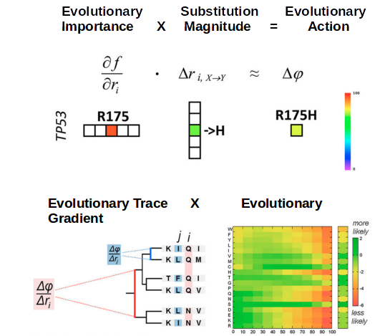
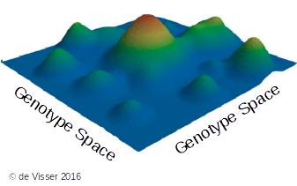
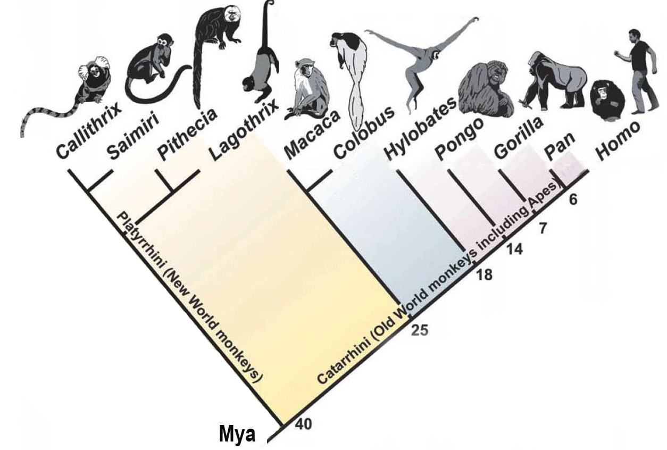
Evolutionary Action as a Tool for Quantifying Divergence Across the Primate Family Tree
Can we estimate how far 2 species have diverged in terms of functional units?
Can this be applied to individual genes to determine which genes may have undergone positive selection to change function faster?
Katsonis and Lichtarge 2014
Related Works: Kimura 1977, Mihalek and Lichtarget 2004, Nielson et al 2005, Ohta 2008, McVicker 2009, Venner et al 2010, Lichtarge at al 2012, Katsonis and Lichtarge 2014, Katsonis and Lichtarge 2017, Passagem-Santos et al 2018
Notes:
FITNESS LANDSCAPE is an abstract concept for visualizing relative fitness in a hypothetical genotype space
-peaks on the landscape can be thought of as individual species adapted to their environments
Specifically, this work focused on several PRIMATES and their relative divergence from Human
--questions
To help answer these questions, we applied Evolutionary Action, a tool that can predict the impact of any given mutation on protein fitness
-importance and relative invariance of the position
-magnitude of the change, given by evolutionary gradient log-odds
FINAL SCORE OF 0 TO 100, where low scores have very little effect on fitness, and high scores are large, potentially protein-altering changes

Slide 2
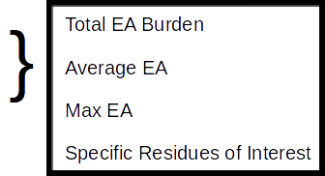
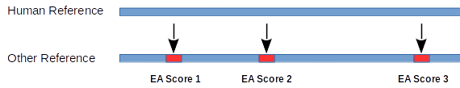
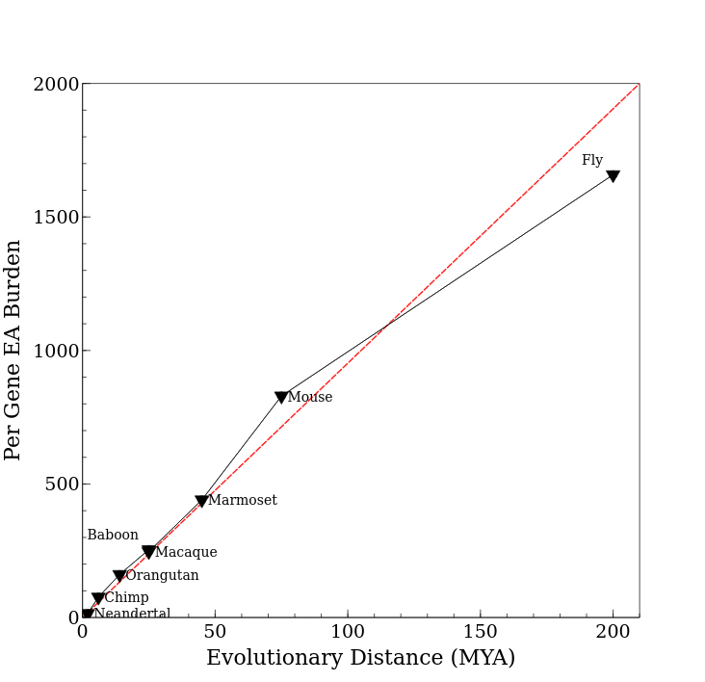
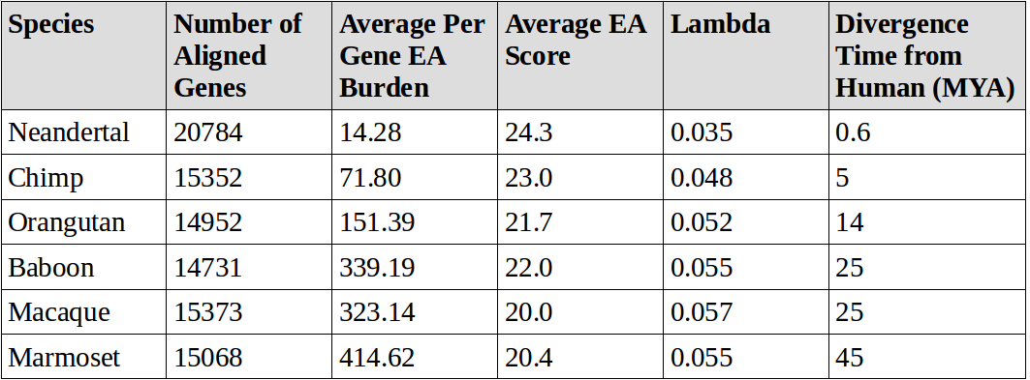
Summation of All EA Scores for a Species Correlates Tightly with Time Since Divergence
R² = 0.99
Notes:
TREATED EVERY CHANGE BETWEEN HUMAN AND OTHER REFERENCES AS A MUT TO SCORE WITH EA
-this enables several metrics with which we can evaluate both whole references and individual genes and residues
-Here are some basic summary stats for ~15,000 proteins we aligned between 5 PRIMATES, HUMANS AND NEANDERALS, in INCREASING DISTANCE we have Chimp, Orangutan, Baboon, Macaque and Marmoset
MAJOR POINT HERE IS THE PER GENE EA BURDEN, which correlates extremely tightly with EVOLUTIONARY DISTANCE, in other words the time since that species diverged from humans
THIS DEMONSTRATES that EA has potential use in ESTIMATING DIVERGENCE TIMES for UNKNOWN SPECIES or GENE SEQUENCES

Slide 3
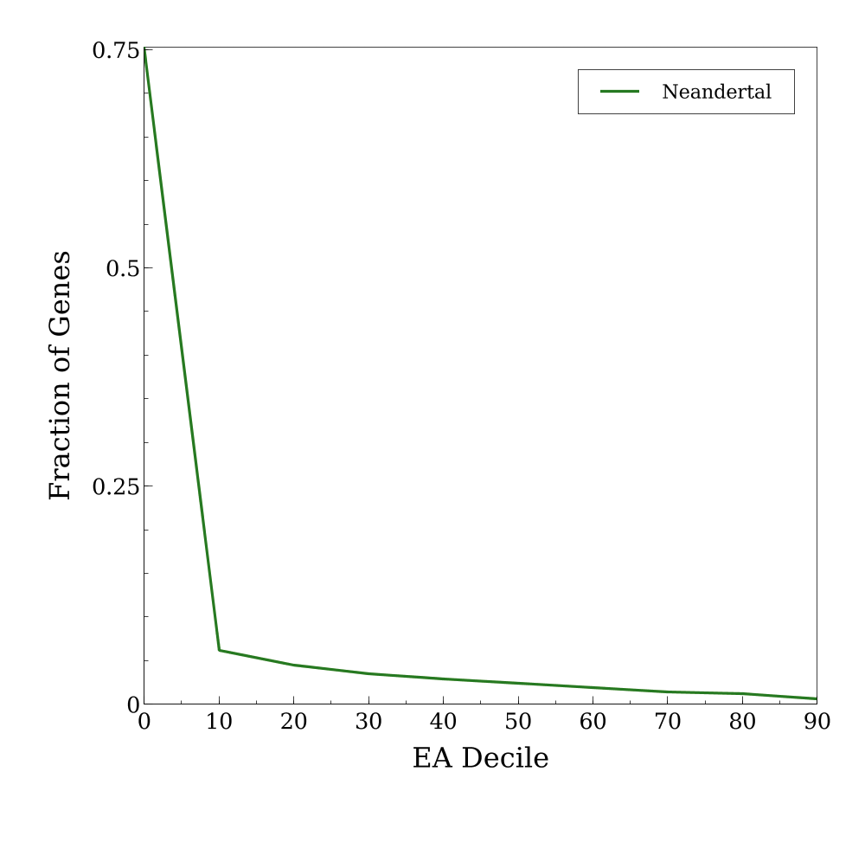
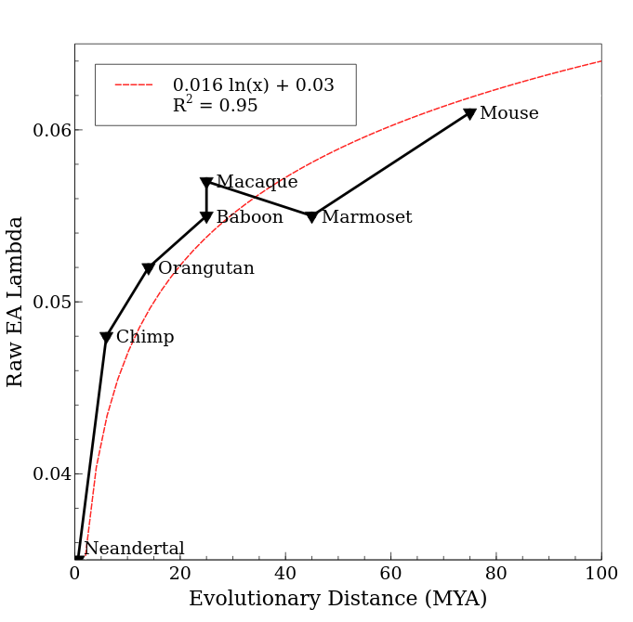
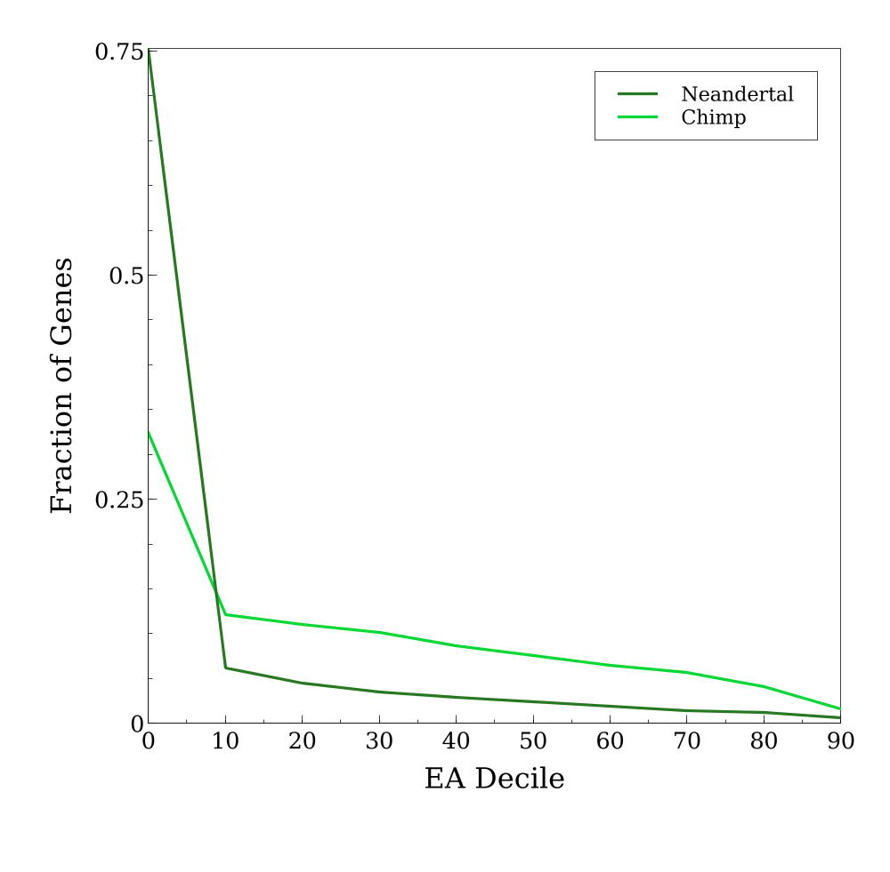
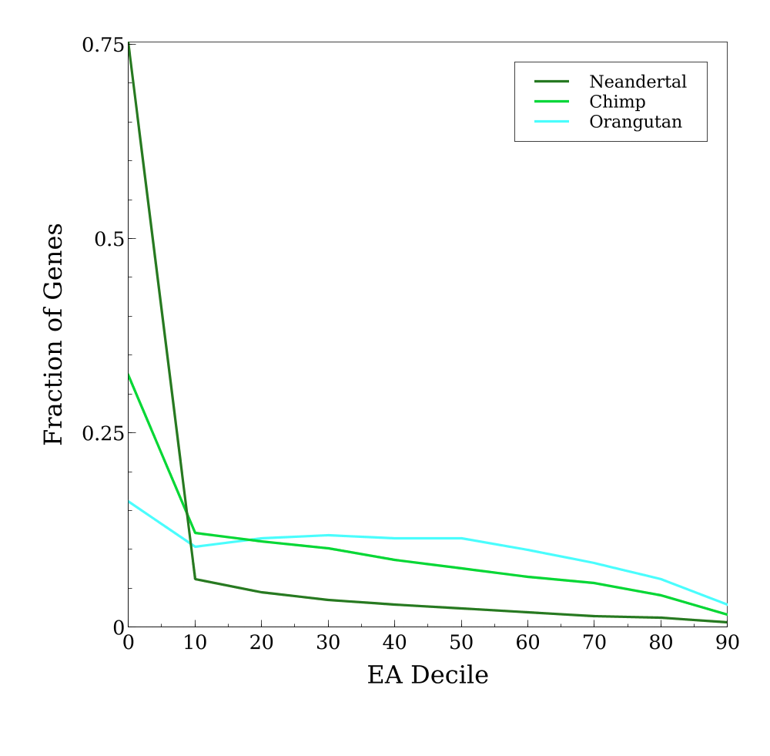
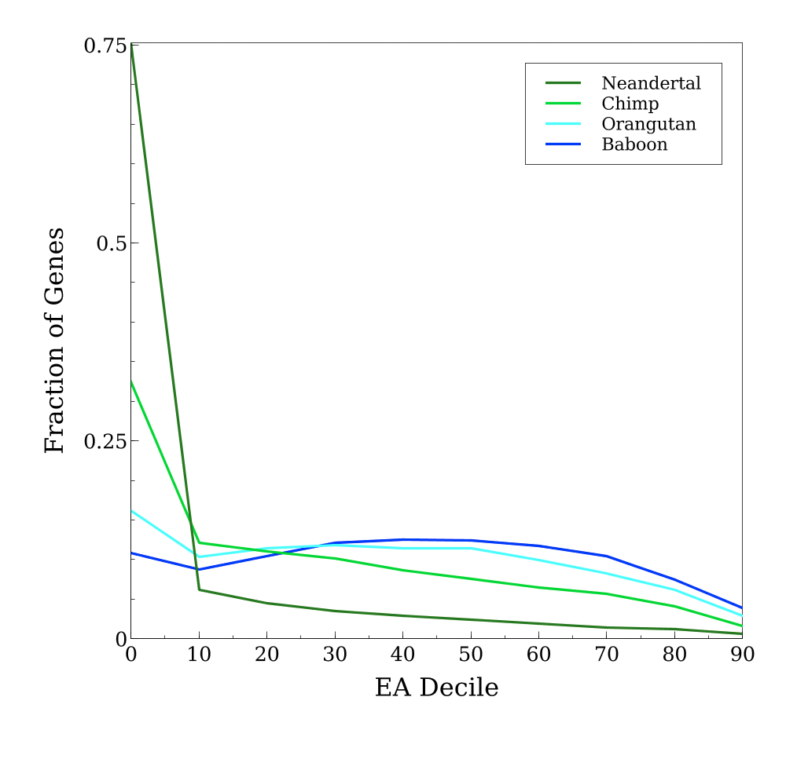
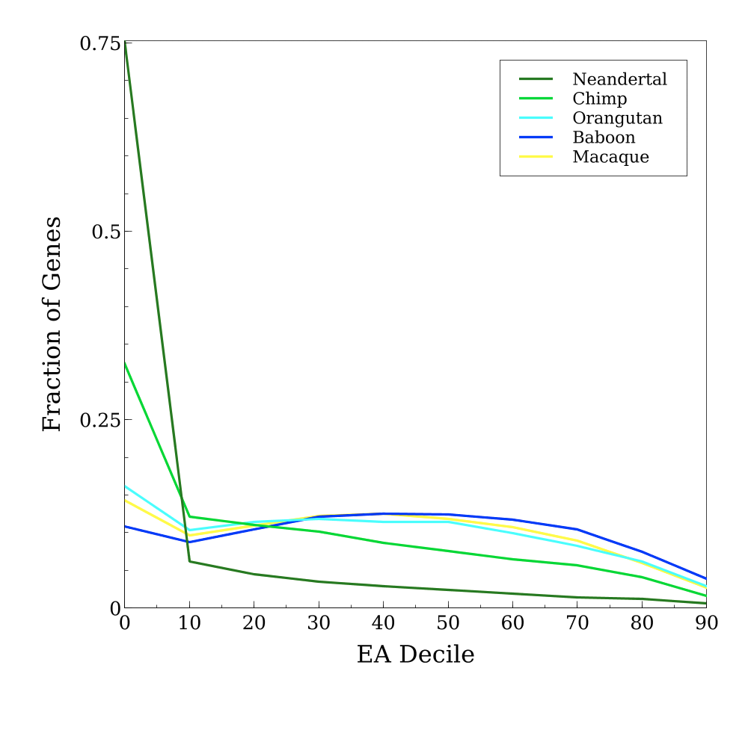
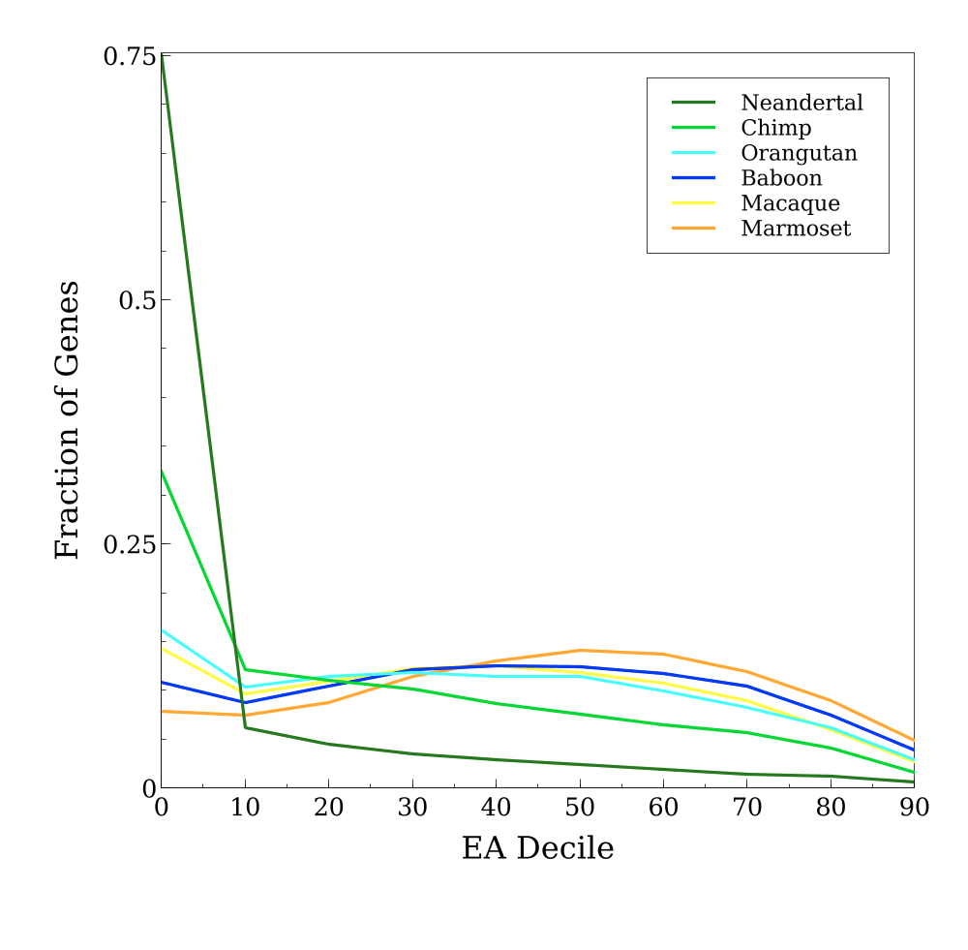
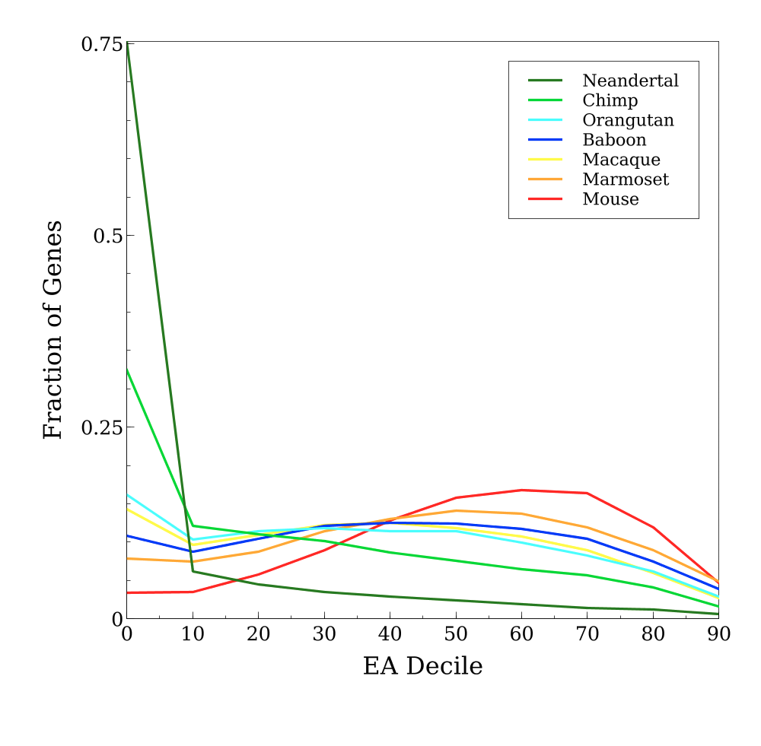
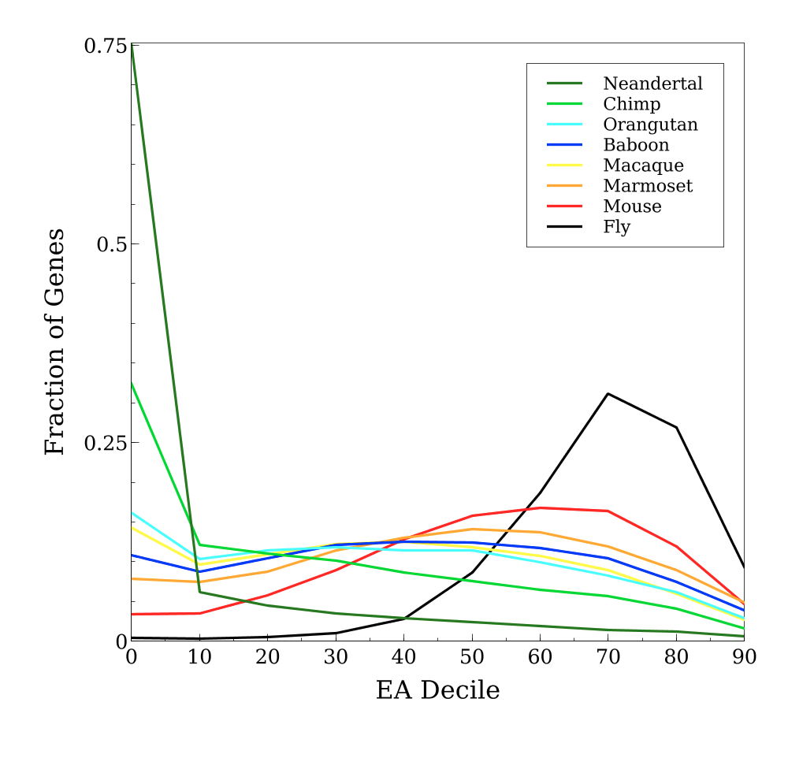
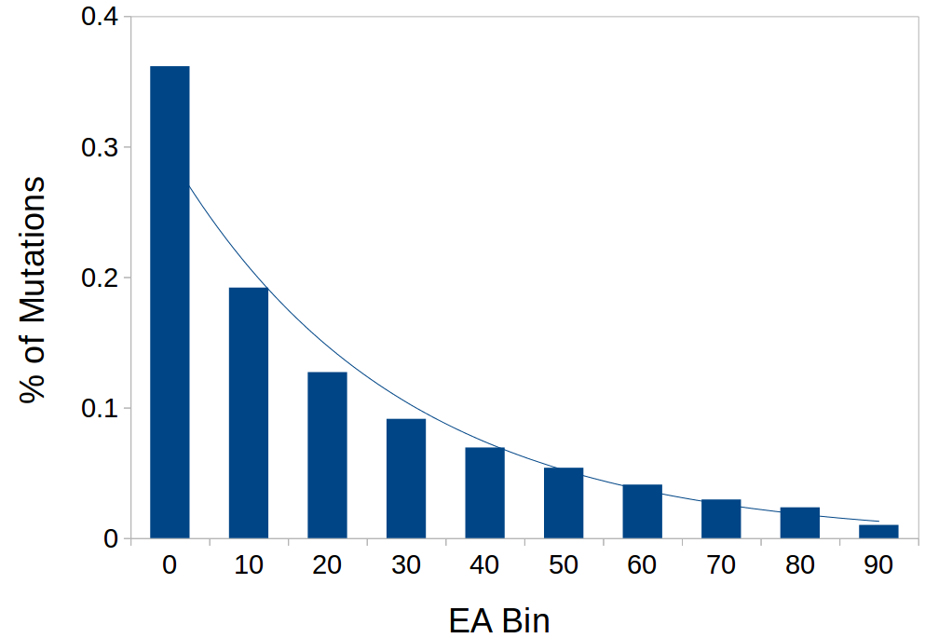
Total EA Distribution Skews Toward Low-Impact Mutations over Evolutionary Time
...however, MAXIMUM EA Values Steadily Increase
- Distribution when each gene is given 1 score, it's Maximum EA
= Lambda (λ)
Notes:
When we analyze a large set of EA scores, for example the raw scores for an entire reference genome, we're interested in the SHAPE OF THE DISTRIBUTION
-the steepness of this distribution is measured with LAMBDA, which is the EXPONENTIAL DECAY CONSTANT that the binned scores follow
-A HIGH LAMBDA indicates MOST OF THE EA SCORES ARE LOW-IMPACT, falling into the first few bins, while a LOW LAMBDA indicates a flatter distribution with MORE HIGH IMPACT MUTATIONS
LAMBDA SCORES for our analyzed species follow a LOG CURVE, with lambda INCREASING with evolutionary distance
-THIS MEANS that despite an ever-increasing number of changes between the reference genomes, these changes tend to be SMALLER AND SMALLER the further away you get
-one possible interpretation of this is that as more and more time has passed, purifying selection has had more and more time to act and remove higher-impact changes
-another consideration is that DIVERSITY OF FUNCTIONAL ALLELES is LIMITED in nature, meaning that the TOLERATED HIGH IMPACT CHANGES happen less and less with greater distance, as NEARLY ALL POSSIBLE CHANGES HAVE BEEN EXPLORED, whereas small, nearly nuetral changes are not limited
We see another side of the story when, instead of taking the raw EA distribution, we consider only the MAXIMUM EA for each gene
In this case, the further out we go in evolutionary distance, we see the MAXIMUM EA DISTRIBUTIONS SHIFTING FURTHER AND FURTHER TO THE HIGH IMPACT BINS, especially so for more distant outgroups of Mouse and Fly
So, while the overall distribution favors many thousands of small changes adding up over time, the AVERAGE MAXIMUM EA shows that the few HIGH IMPACT CHANGES GET HIGHER OVER TIME

Slide 4
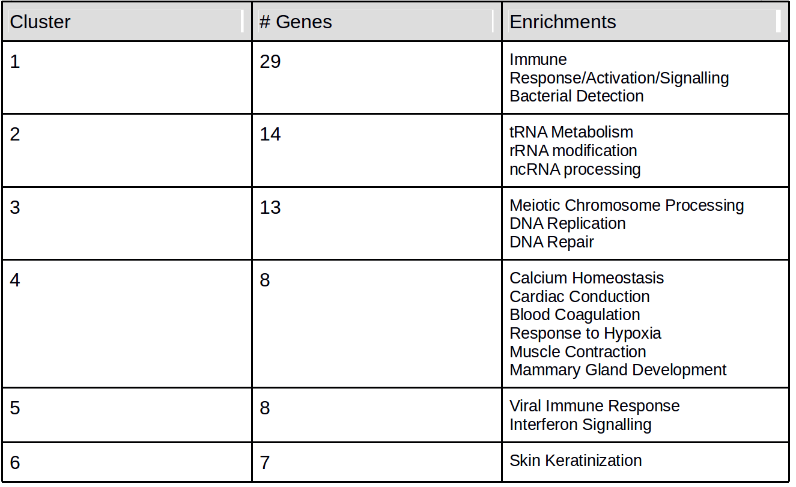
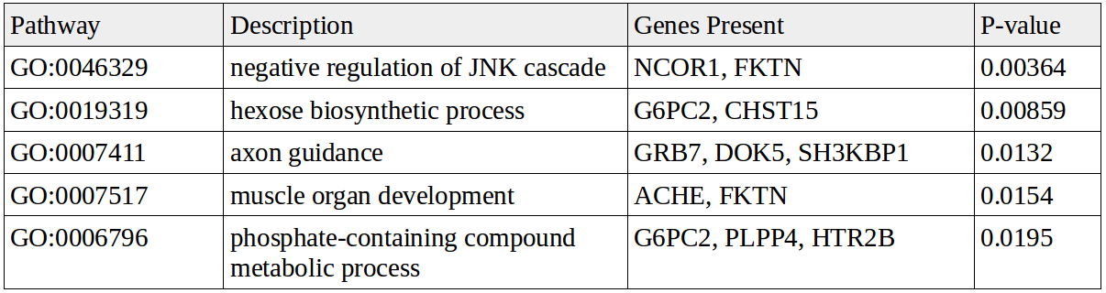
EA-Based Analysis Finds Genes and Pathways that Show Evidence of Positive Selection in Humans vs Primates
Human/Neandertal vs Other Primates
Human Reference vs Neandertal Reference
Observed EA - Randomized EA
Gene A 45.0 - 41.0
Gene B 5.0 - 43.0
Gene C 80.0 - 47.0
...
271 Genes, 6 Clusters of Biological Enrichment
Human Neandertal Great Apes Old World Monkeys Marmoset
Allele A Allele A Allele B Allele B Allele B
EA >= 30
Ranked List EA
Gene C 33.0
Gene A 4.0
Gene B -38.0
Genes Ranked by Average EA after Filtering
62 Genes at 3σ or higher
Notes:
NEXT, we wanted to see what EA could tell us about SPECIFIC GENES AND PATHWAYS that show evidence of changing rapidly between humans and other primates.
TO DO THIS, we filtered all residues to find ones where HUMANS AND OUR CLOSEST RELATIVES, neandertals, SHARED A DERIVED STATE ALLELE relative to THE OTHER PRIMATES. We also filtered for A MINIMUM EA OF 30, meaning this change to DERIVED STATE was likely functionally significant
WHEN RANKED BY AVERAGE EA POST-FILTERTING, we found 271 genes with REFERENCE CHANGES MEETING THESE CRITERA, which fell into 6 FUNCTIONAL CLUSTERS, some with enrichments previously reported in works looking for positive selection in humans (1 4, 5 6), and others with novel results (2,3)
NEXT, we compared the HUMAN and NEANDERTAL references closely, generating a RANDOMIZED CONTROL for each gene, allowing us to RANK GENES by their Observed Vs Expected EA scores, to see which had diverged MUCH MORE THAN EXPECTED BY CHANCE between HUMAN-NEANDERTAL
The 3 sigma outliers from this ranking included SEVERAL BIOLOGICAL ENRICHMENTS, again with some NOVEL RESULTS

Slide 5
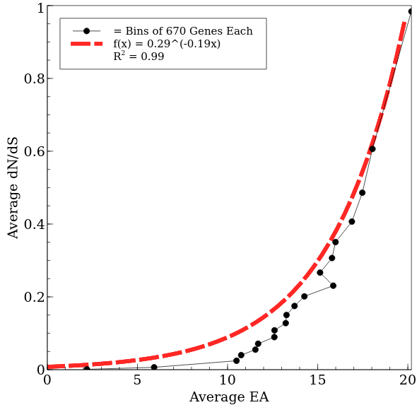
EA Correlates Well with dN/dS
dN/dS based methods:
- most widely used for protein evolution studies
- involve relative counts of mutations
- entire gene or region is given 1 overall score
EA methods:
- involves the relative impact of mutations
- single residues responsible for high scores can be identified

Slide 6
Conclusions Implications
Visit poster P64
for more Info!
Summation of EA scores between 2 species correlates very tightly with evolutionary time
EA may be applicable as a novel tool for measuring time-since-divergence for new reference genomes or protein sequences
As evolutionary distance increases, the raw EA distribution skews towards a larger fraction of low-impact variants
EA can illuminate the distribution of fitness effects between species and reveal broad patterns of fitness shifts over time
EA can identify specific residues/genes/pathways that have higher levels of divergence expected by random chance
EA is useful for providing evidence of positive selection having occurred over time in specific residues/genes/pathways
EA scores show strong correlation with dN/dS, despite being based on entirely separate metrics
EA is a promising tool for studying protein evolution, adding a complementary, novel dimension to dN/dS based work
Related Works: Kimura 1977, Mihalek and Lichtarget 2004, Nielson et al 2005, Ohta 2008, McVicker 2009, Venner et al 2010, Lichtarge at al 2012, Katsonis and Lichtarge 2014, Katsonis and Lichtarge 2017, Passagem-Santos et al 2018
Notes:
IN CONCLUSION, EA may be useful as a metric for estimating evolutionary distance, given its very tight correlation with known distances
EA informs us about the distributions of fitness effects that have accumulated between distanct species
And finally EA can be applied to specific pathways, genes or residues to identify significant changes in biological systems between species, providing evidence for the occurance of SELECTION PRESSURE

