Slide 1
An online end-to-end pipeline for virus phylogeography that leverages Natural Language Processing for finding host locations
Matthew Scotch, PhD, MPH, Arjun Magge, Davy Weissenbacher, PhD
Karen O’Connor, Graciela Gonzalez, PhD
Rocky 2019
Funding
  R01LM012080
  R01AI117011

Slide 2
Virus Phylogeography Requires Geospatial Metadata
Represents the location of the infected host
Discrete phylogeography
  Locations assigned to virus sequences as traits
  Ancestral state reconstruction on observed locations
CO
CO
UT
UT
CO

Slide 3
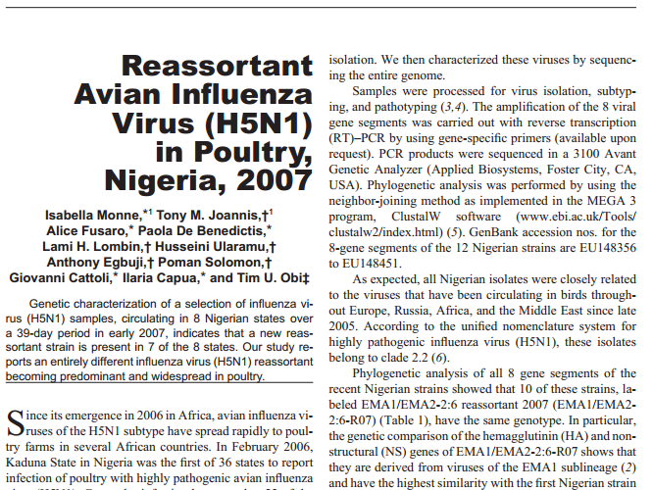
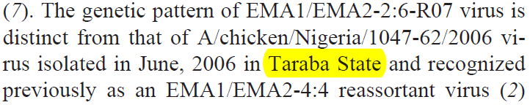
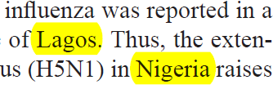
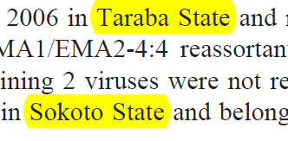
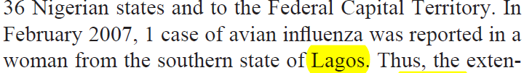
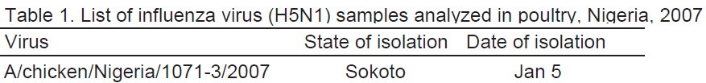
IE Pipeline for Geospatial Metadata
R:
Accession | PMID | Strain | Country
GeoNames
EU148365 | 18394282 | A/chicken/Nigeria/1071-3/2007 | null
ISO table
Nigeria
Not Sufficient
No
PMC2570913
Yes
L1: (13.06092, 5.23902)
L2: (6.45306,3.39583)
Sokoto, Lagos, Nigeria…..
P(L1|R)=0.97
P(L2|R)=0.03
Sokoto
Sokoto, Nigeria (L1); Lagos, Nigeria (L2)
Notes:
In the illustrated example for record EU148365, the only geospatial information available from GenBank metadata is “Nigeria” “from the strain field. This is not a sufficient location by our definition and therefore, we try to use information from relevant PMC articles, if available, to increase the specificity of this location of collection. The PMC article related to this record is PMC2570913 and our system pre-processes text in this article for further analysis. Toponym resolution is performed to extract and disambiguate all geospatial information available within the paper. Next, our system uses a pattern-based and rule-based approach to determine which of these locations are actually relevant for this specific record. The rules are used to link a location to a record based on available GenBank metadata. As you can see in this example, “Taraba State” was not chosen at this stage since it could not be linked to the record based on our rules while Lagos was kept since the sentence containing lagos also contains the year “2007” which is the year of collection of the record. In addition to analyzing free text in the article, our system also extracts information from relevant tables within it. In this case, our system was able to link the record to the specific location “Sokoto” based on its strain field. In the location integration step, our system integrates all geospatial information extracted from the record, text and table to produce a coherent set of possible locations. Any location that contradicts information from the record is not kept at this stage. Next we find geo-coordinates for all possible locations of collections for the record and assign observation error estimates to each coordinate

Slide 4
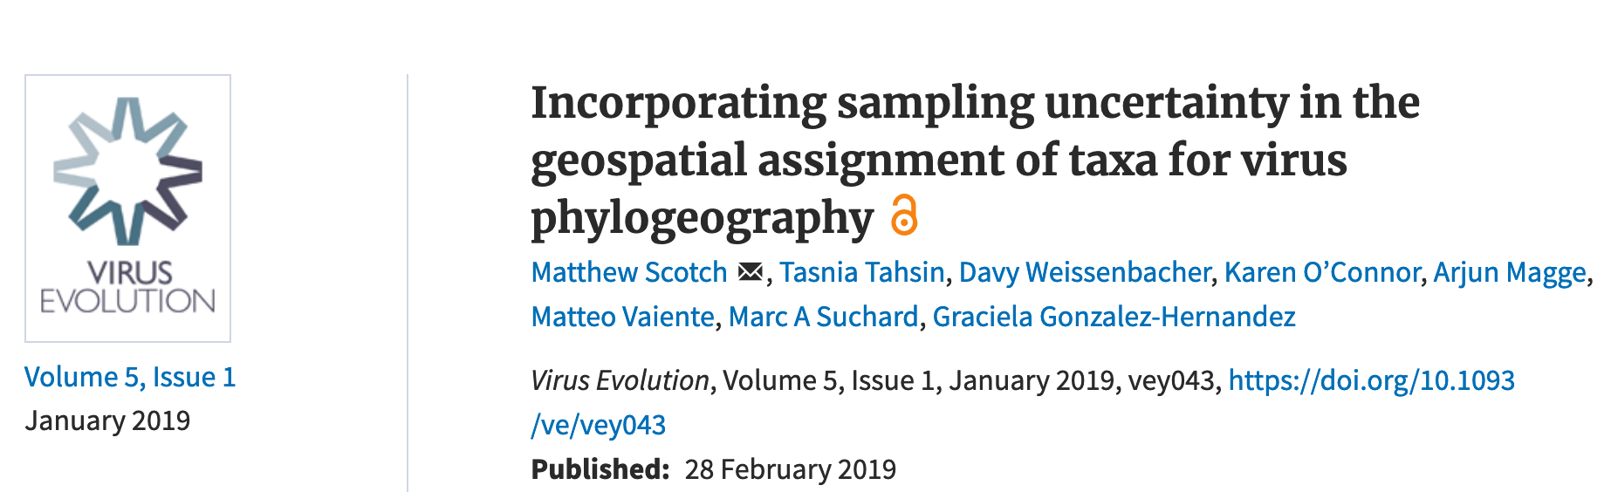
Integration into BEAST 1.10
Source: Suchard, M. A. et al. Bayesian phylogenetic and phylodynamic data integration using BEAST 1.10. Virus Evol 4, vey016, doi:10.1093/ve/vey016 (2018).

Slide 5
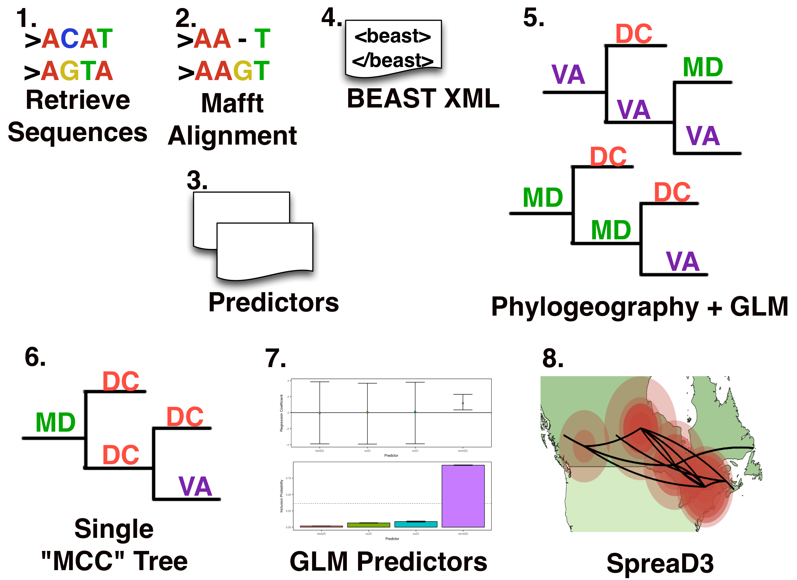
With Sampling Uncertainty

Slide 6
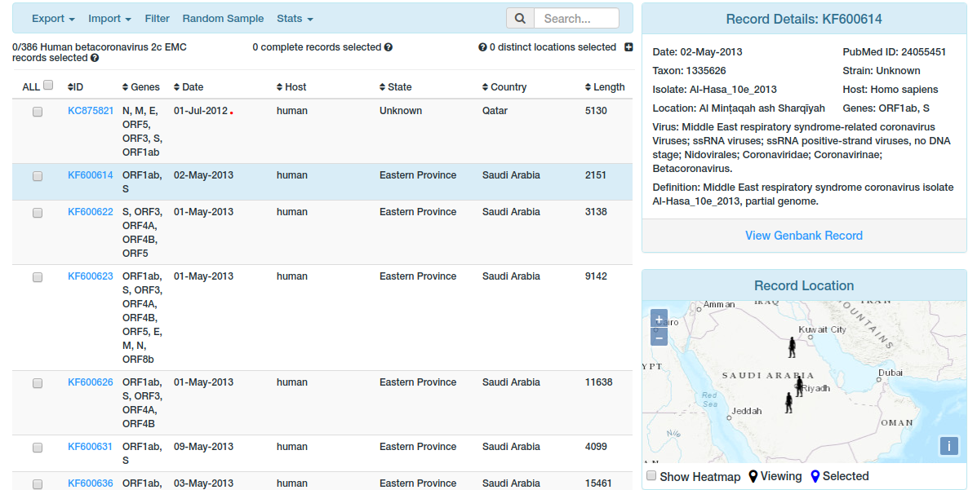
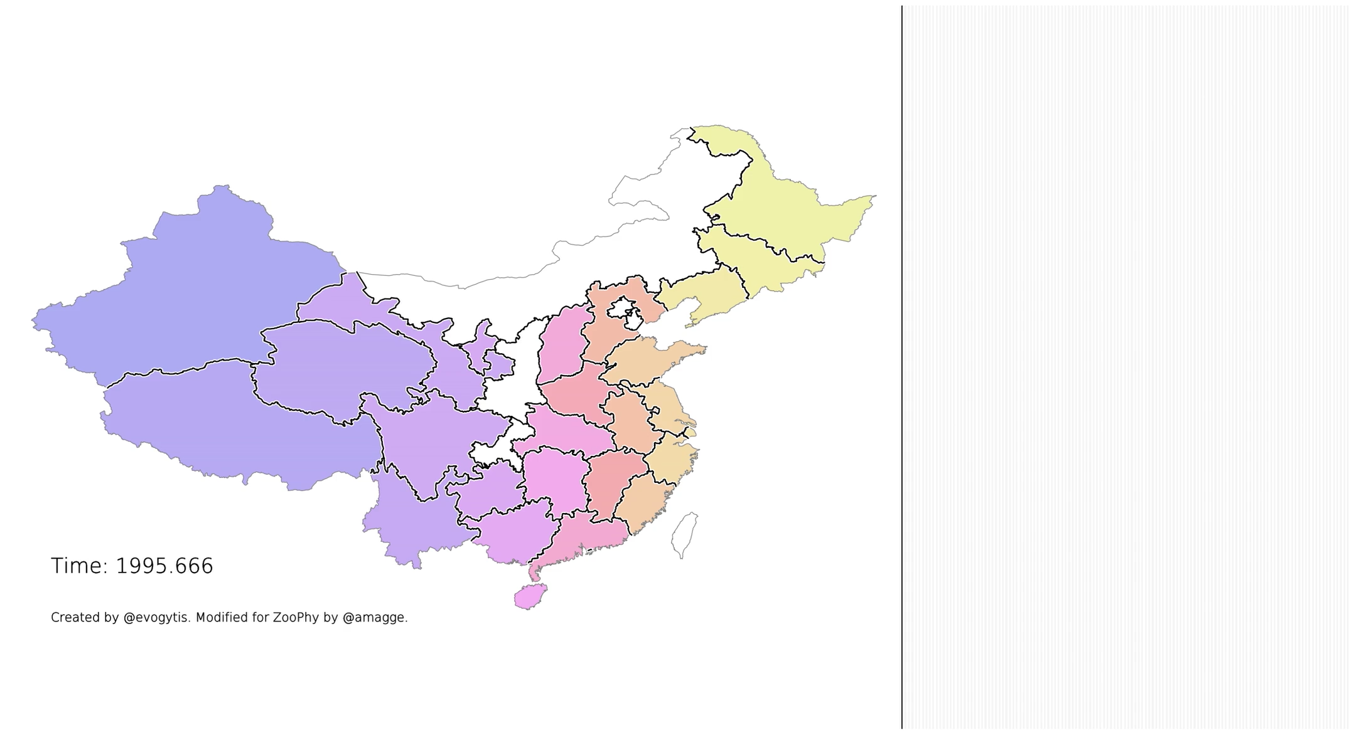
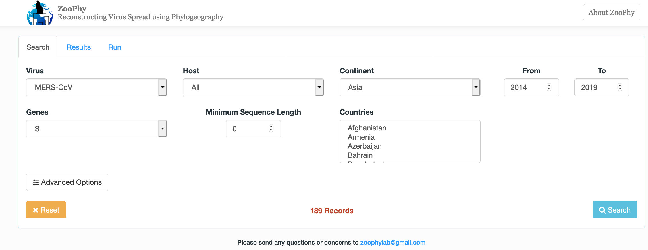
https://zodo.asu.edu/zoophy/

