Slide 1
The design of an interactive lung map for studying premalignant lesions in the lung over time
Carsten Görg Wilbur Franklin Dan Merrick
Colorado School University of Colorado Medical School
of Public Health
Carsten.Goerg@CUAnschutz.edu
Funding: NCI 1U2CCA233238
Notes:
Thank you. Acknowledge collaborators and funding.
Lung squamous cell carcinoma and adenocarcinoma are the most common subtypes of lung cancer;
both are associated with recognized and unique premalignant lesions, and
their pre-cancers have distinct histologic appearances and tissue distribution.
We would like to take advantage of that.

Slide 2
Goals and Study Setup
Goals:
Facilitate a comprehensive analysis of these precancerous lesions
Understand mechanisms of progression and identification of risk markers
Longitudinal prospective pre-cancer cohort:
240 cases from previously established bronchoscopy-based screenings at 4 sites
3 serial bronchoscopies (baselines, 1 year, 2 years)
Notes:
This project has two overall goals.
If we could know how a lesion develops we could either treat it early or just observe it.

Slide 3
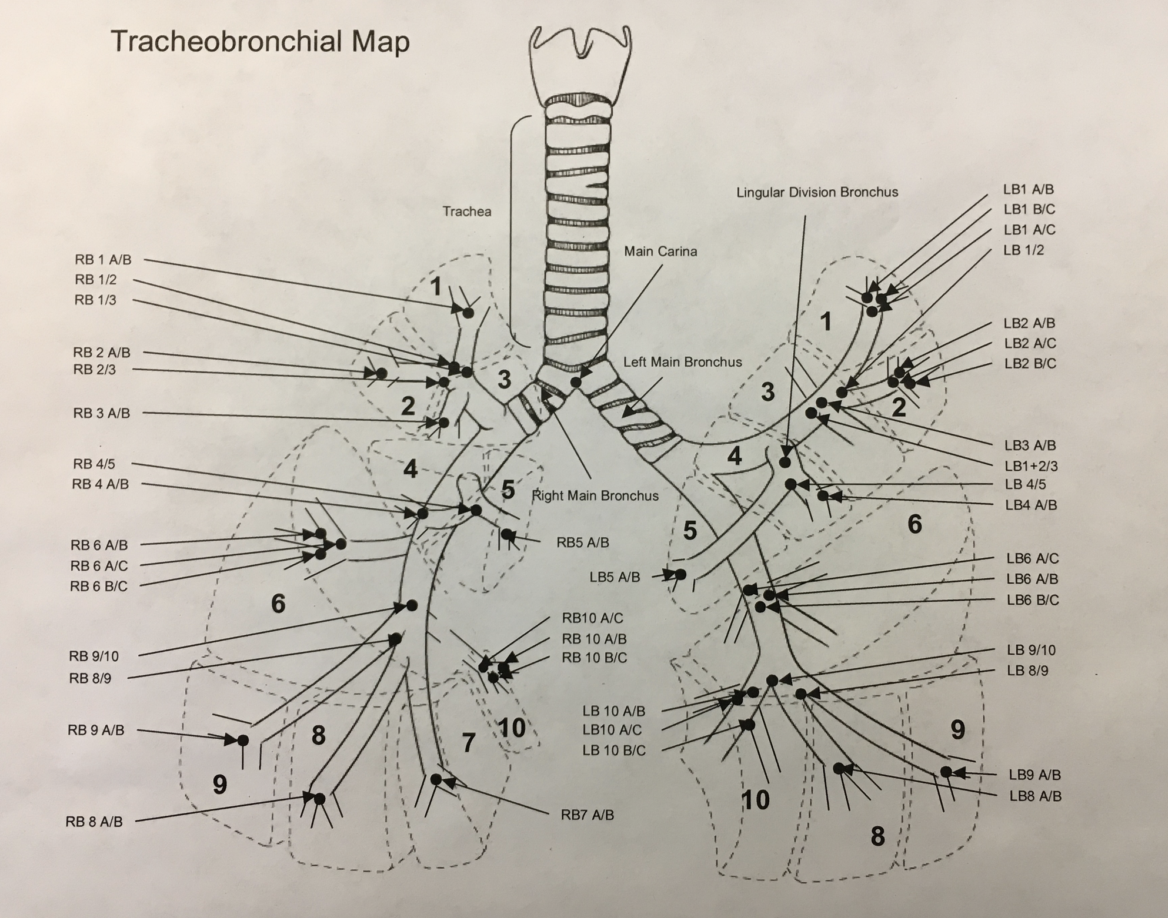
Data Collection
Bronchoscopies:
Location of sites in lung
Histological reports
Clinical Report:
Patient history: smoking, drinking, lung function, family history, known genetic mutations, etc.
Notes:
Data harmonization
So many ways to record smoking history!

Slide 4
Use Cases and Tasks
(1) Pathologists and radiologists:
Patient-centric: analyzing one patient at a time
Exploring spatial and temporal context of multiple identified lesions
(2) Secondary research purposes:
Utilize histologic diagnoses, genomic features, and clinical history to define patient cohorts
Study progression within and across cohorts
Notes:
(1) pathologists and radiologists, usually analyzing one patient at a time, can explore the spatial and temporal context of multiple identified lesions by comparing lesions at different sites to each other as well as comparing the progression of lesions over time; (2) for secondary research purposes, users can utilize histologic diagnoses, genomic features, and data elements in the clinical history to define patient cohorts and study the heterogeneity and progression of lesions within and across cohorts.

Slide 5
Design Considerations
Representing space at multiple scales:
Overview to show aggregated data
Detail to show selected features
Representing time:
Animation
Juxtaposition
Superimposition

Slide 6
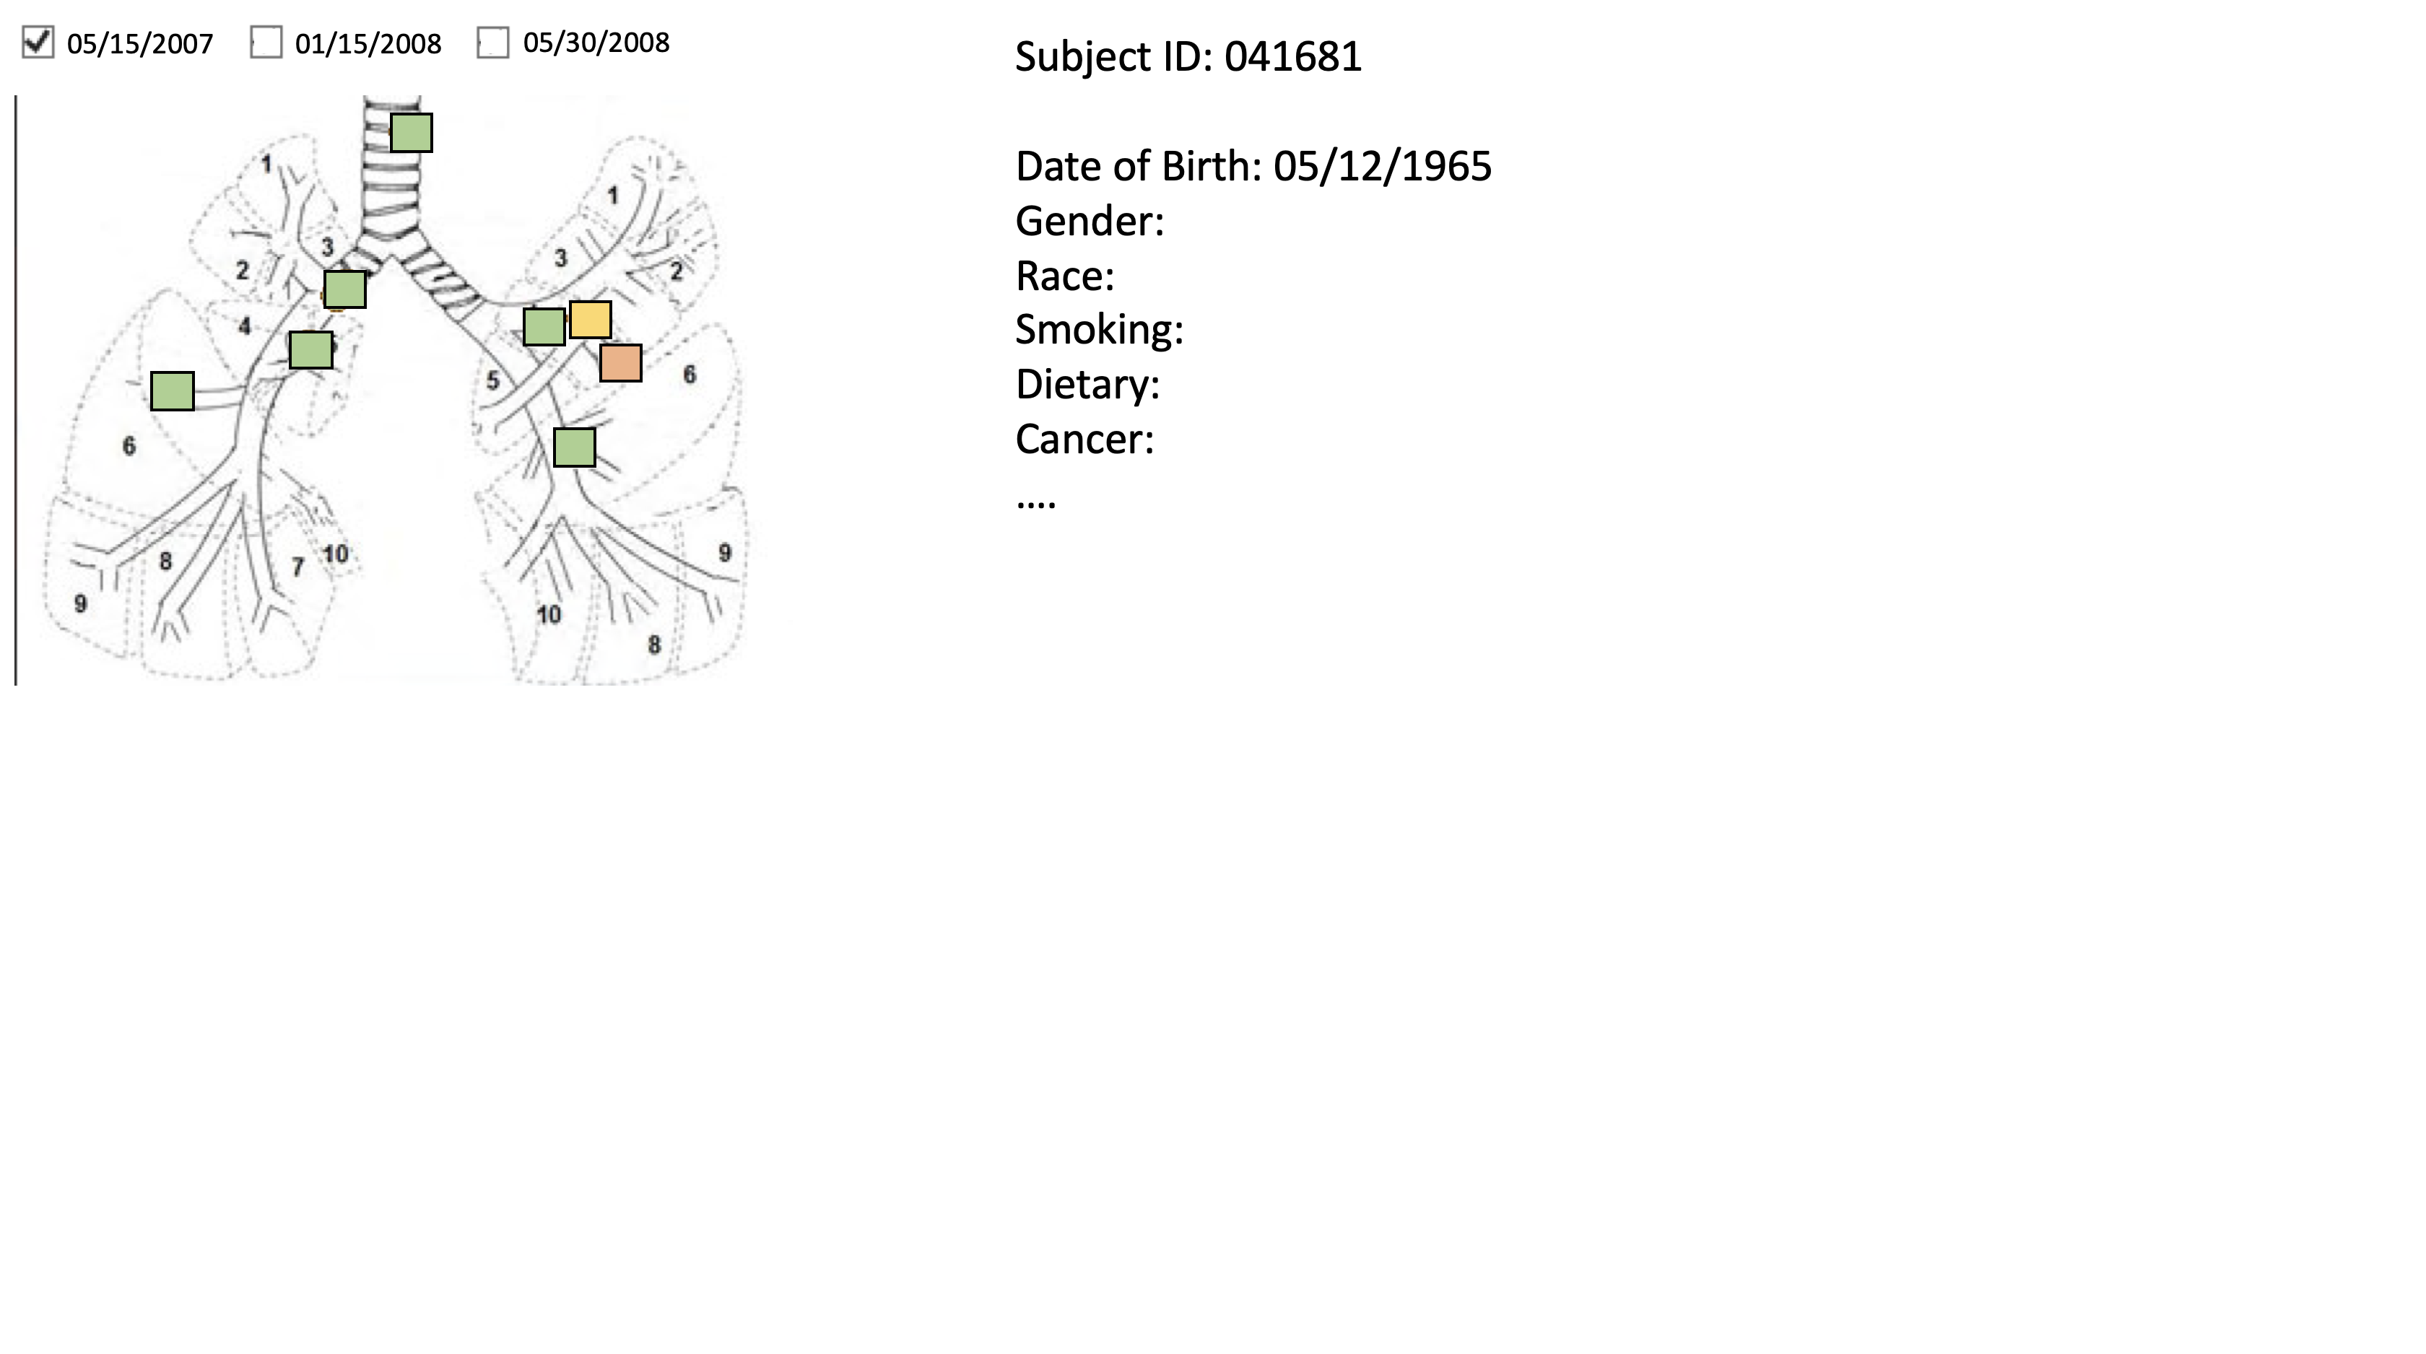
Patient-centric Design

Slide 7
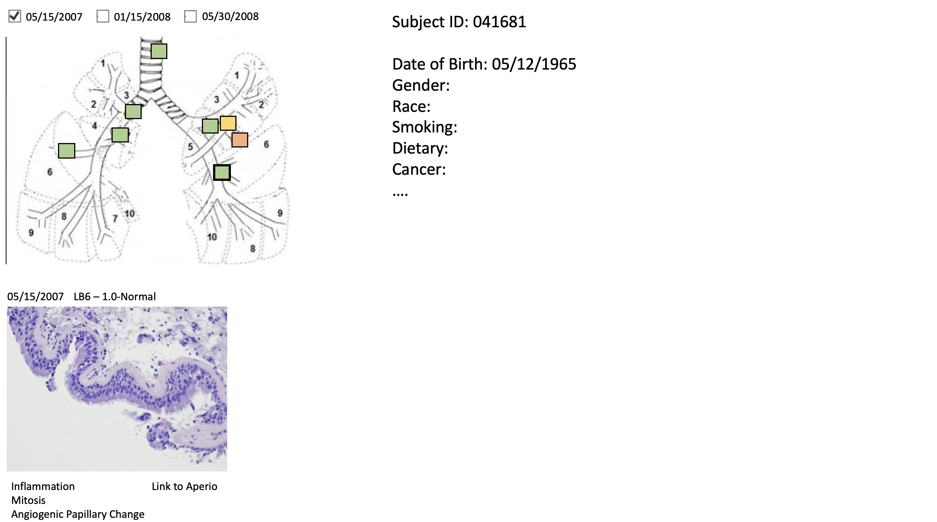
Patient-centric Design

Slide 8
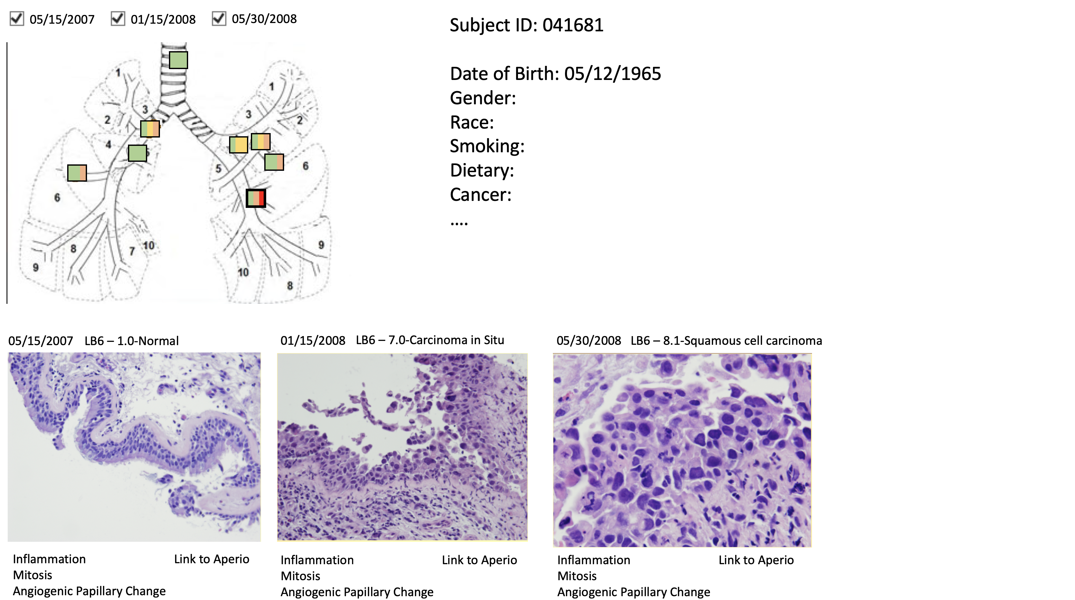
Patient-centric Design

Slide 9
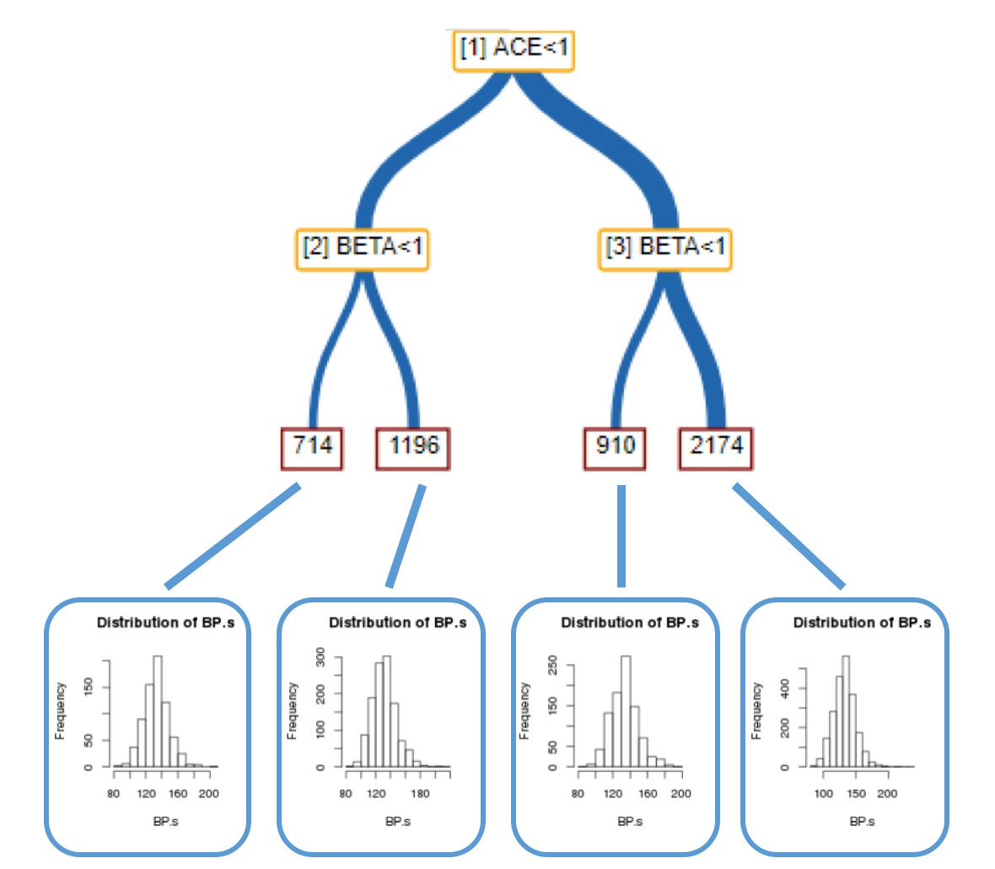
Cohort-centric Design
Smoker
no
yes
F-History
F-History
no
yes
no
yes
20 40 60 80
Age
20 40 60 80
Age
20 40 60 80
Age
20 40 60 80
Age

