Slide 1
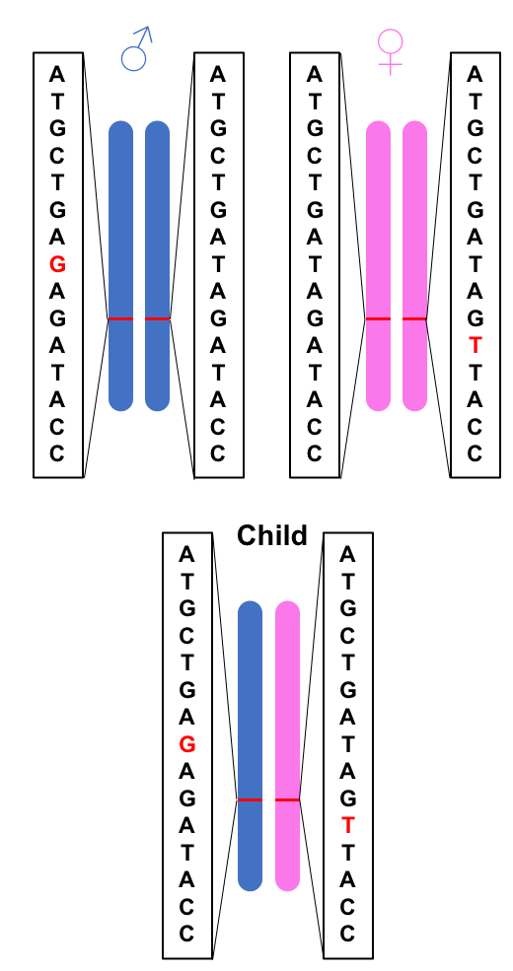
Compound Heterozygous (CH) Variants
What is a CH Variant?
  Child has a recessive allele from each parent with the variant located at a different position within the same gene
How is nucleotide inheritance determined?
  laboratory-based: 10X Genomics or fosmid pool-based strategy
  computer-based: SHAPEIT2, Beagle, Eagle2, HapCUT2
Why study CH variants?
  CH variants are understudied in pediatric disease
  May contribute to early disease onset

Slide 2
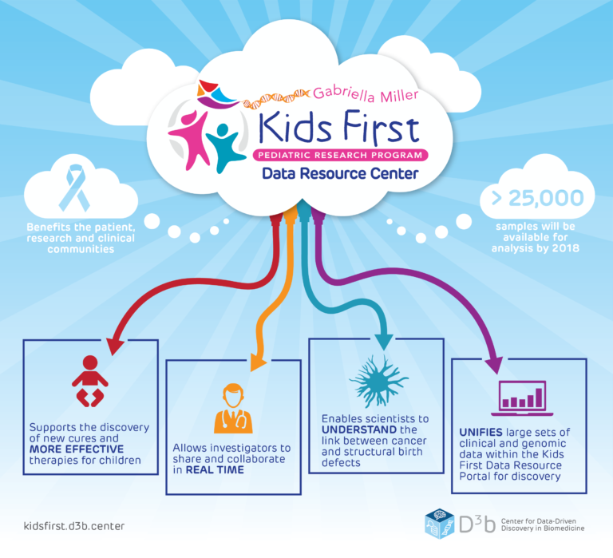
Idiopathic Scoliosis
Background:
  Abnormal spine curvature that typically presents in children 10-12 years old (90% of cases)
  Potential Causes (largely unknown)
    Environmental
    Genetic
Available Trio Data
  Data Source: Gabriella Miller Kids First Data Resource Center
    Contains trio data for various pediatric cancers and structural birth defect diseases
    16 samples with Idiopathic Scoliosis
    gVCF’s generated from WGS data
Image Source: https://d3b.center/kidsfirst/
Notes:
LBX1, GPR126, Intergenic

Slide 3

CH Pipeline
summarize biospecimen, clinical and manifest files
phase with SHAPEIT2
parse gVCF files
revert alt/ref to be congruent with reference and remove sites with Mendel errors
combine individual trios
merge trios into one file
Each step of the pipeline uses a docker container
Within each container a python script is executed
Python scripts may contain python code only or use numerous programs to complete a task
  Example programs:
    GATK
    PLINK
    SAMtools
liftover trios
annotate
remove multiallelic sites, unplaced sites, and sites with missing genotype information
GEMINI database and GEMINI query
separate chromosomes and generate plink files for each trio
Notes:
Advantages of Docker Containers. Keep in context of my project. Docker Logo
In theory it shouldn’t be difficult to identify CH variants but in practice there are tools ;out there to do the steps, but encountered many obs. With the GMKFGRC data. Especially true for someone without command line experience. Tried to reduce barriers to make it easier.

Slide 4
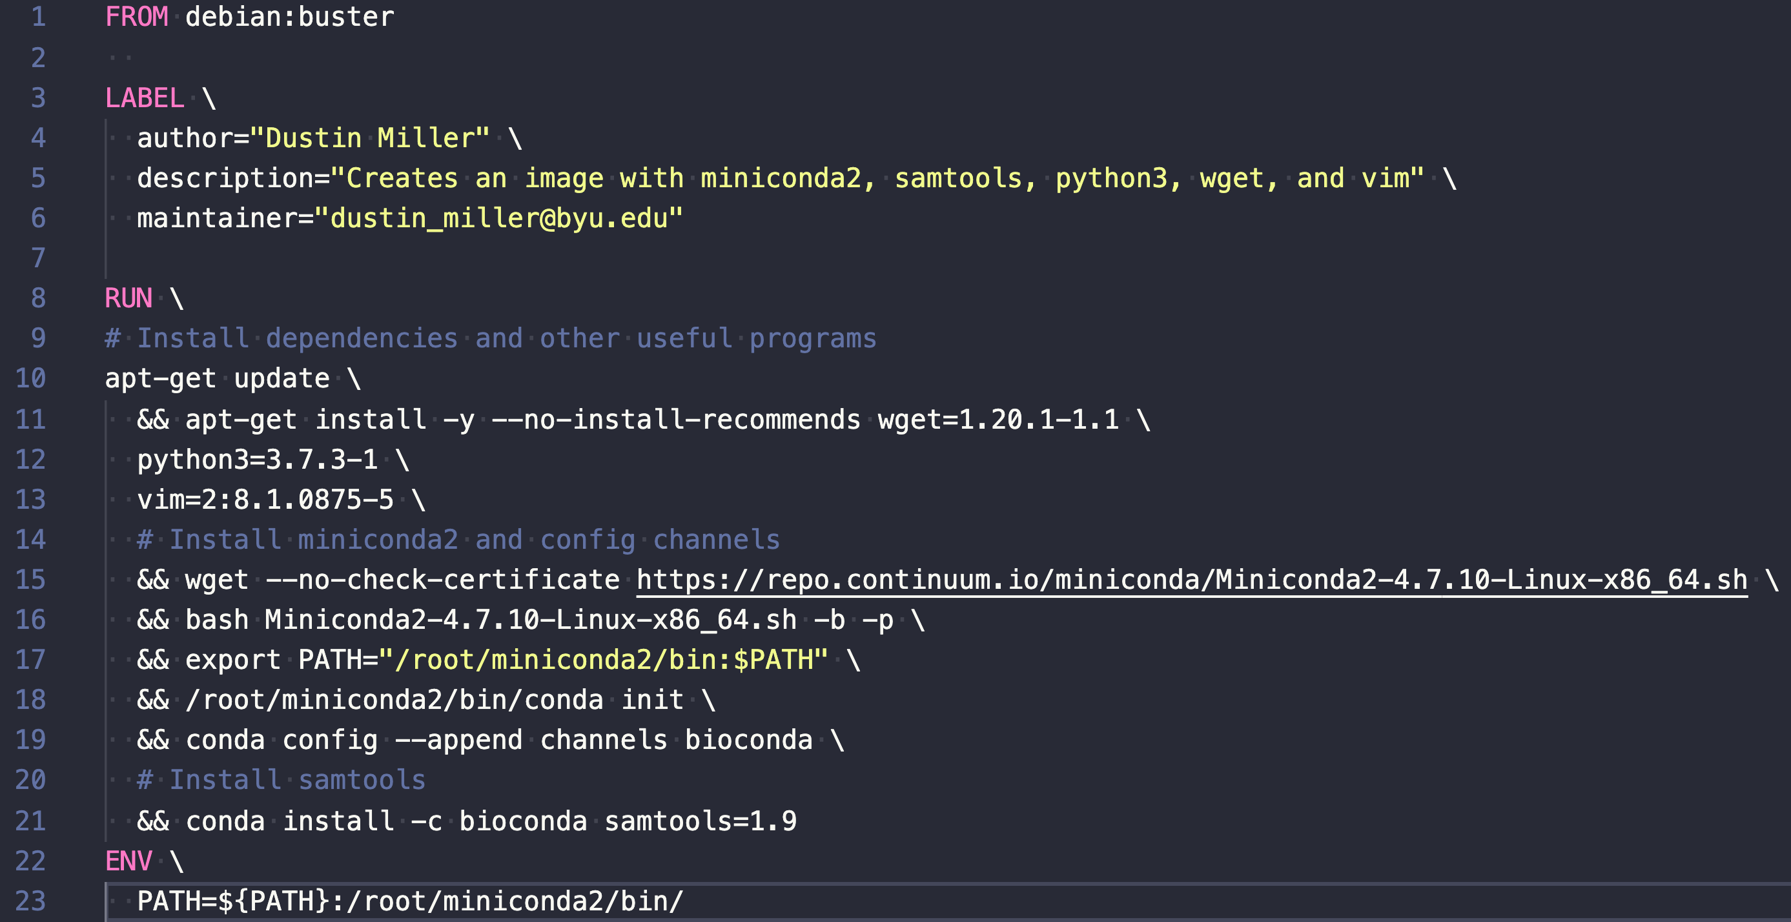
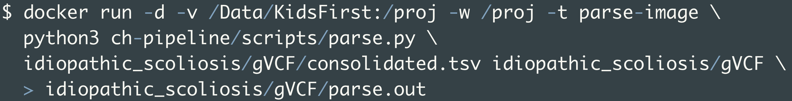
Pipeline Example
Build Docker Image:
Run Docker Container:

Slide 5
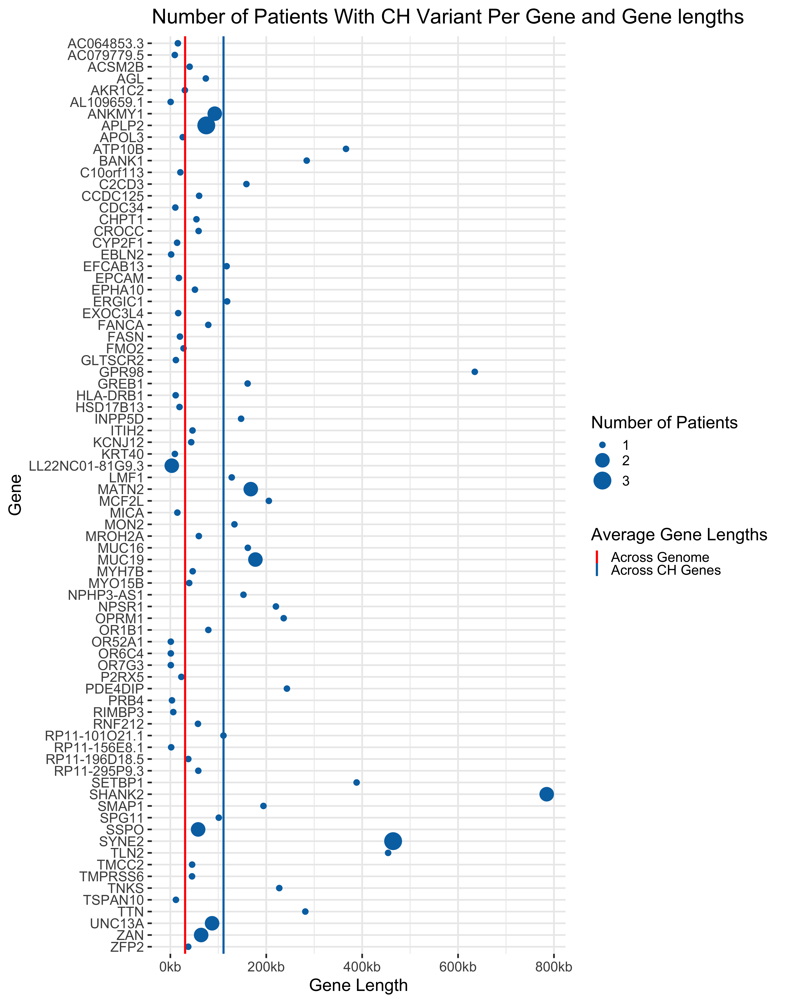
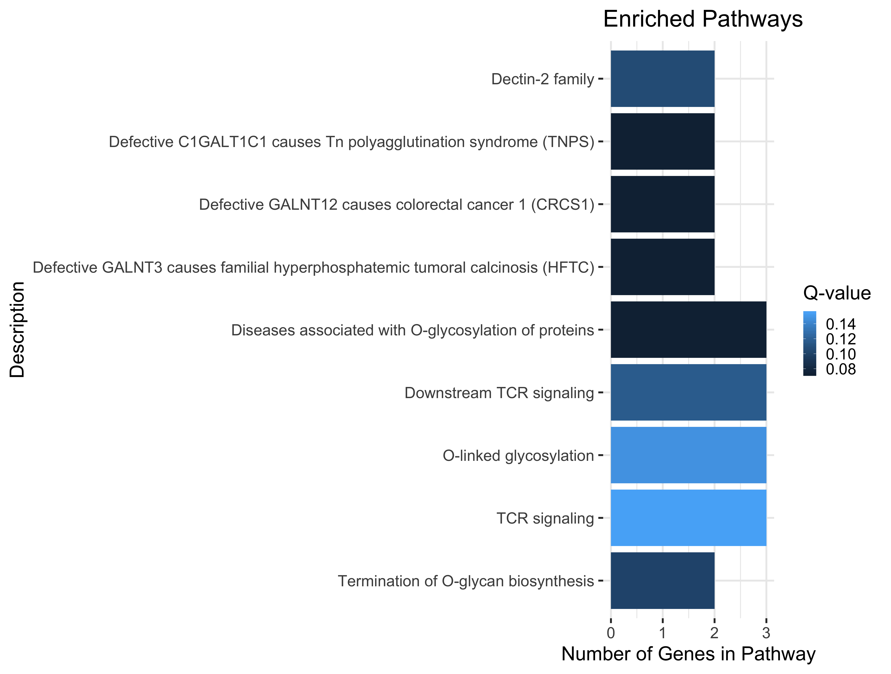
Results
(MUC19/MUC16)
(MUC19/MUC16)
(MUC19/MUC16)
(MUC19/MUC16)
(MUC19/MUC16/SSPO)
(CDC34/INNPP5D/HLA-DRB1)
(MUC19/MUC16/SSPO)
(CDC34/INNPP5D/HLA-DRB1)
(MUC19/MUC16)
Notes:
10 genes with more than 1 patient having a CH variant

Slide 6

Future Directions
Fine tune the CH pipeline
  Implement other phasing software
  Provide test/example data for users
Use the CH pipeline analyze other diseases within the Kids First Data Resource Center
Acknowledgements
Poster: P53
Piccolo Lab
BYU Department of Biology
BYU Office of Research Computing

