Slide 1



Towards Automating Computational Phenotyping:
Exploring the Trade-offs of Different Vocabulary
Mapping Strategies
Tiffany J. Callahan
Jordan Wyrwa, Katy E. Trinkley, Lawrence E. Hunter, Michael G. Kahn, Tellen D. Bennett
Rocky Mountain Bioinformatics Conference - December 5, 2019
  @tiff_callahan
Notes:
I have three amazing advisors, which enables me to engage in translational research
Today, I’d like to briefly tell you about our current work, PheKnowVec, a novel framework for the development and evaluation of CPs

Slide 2
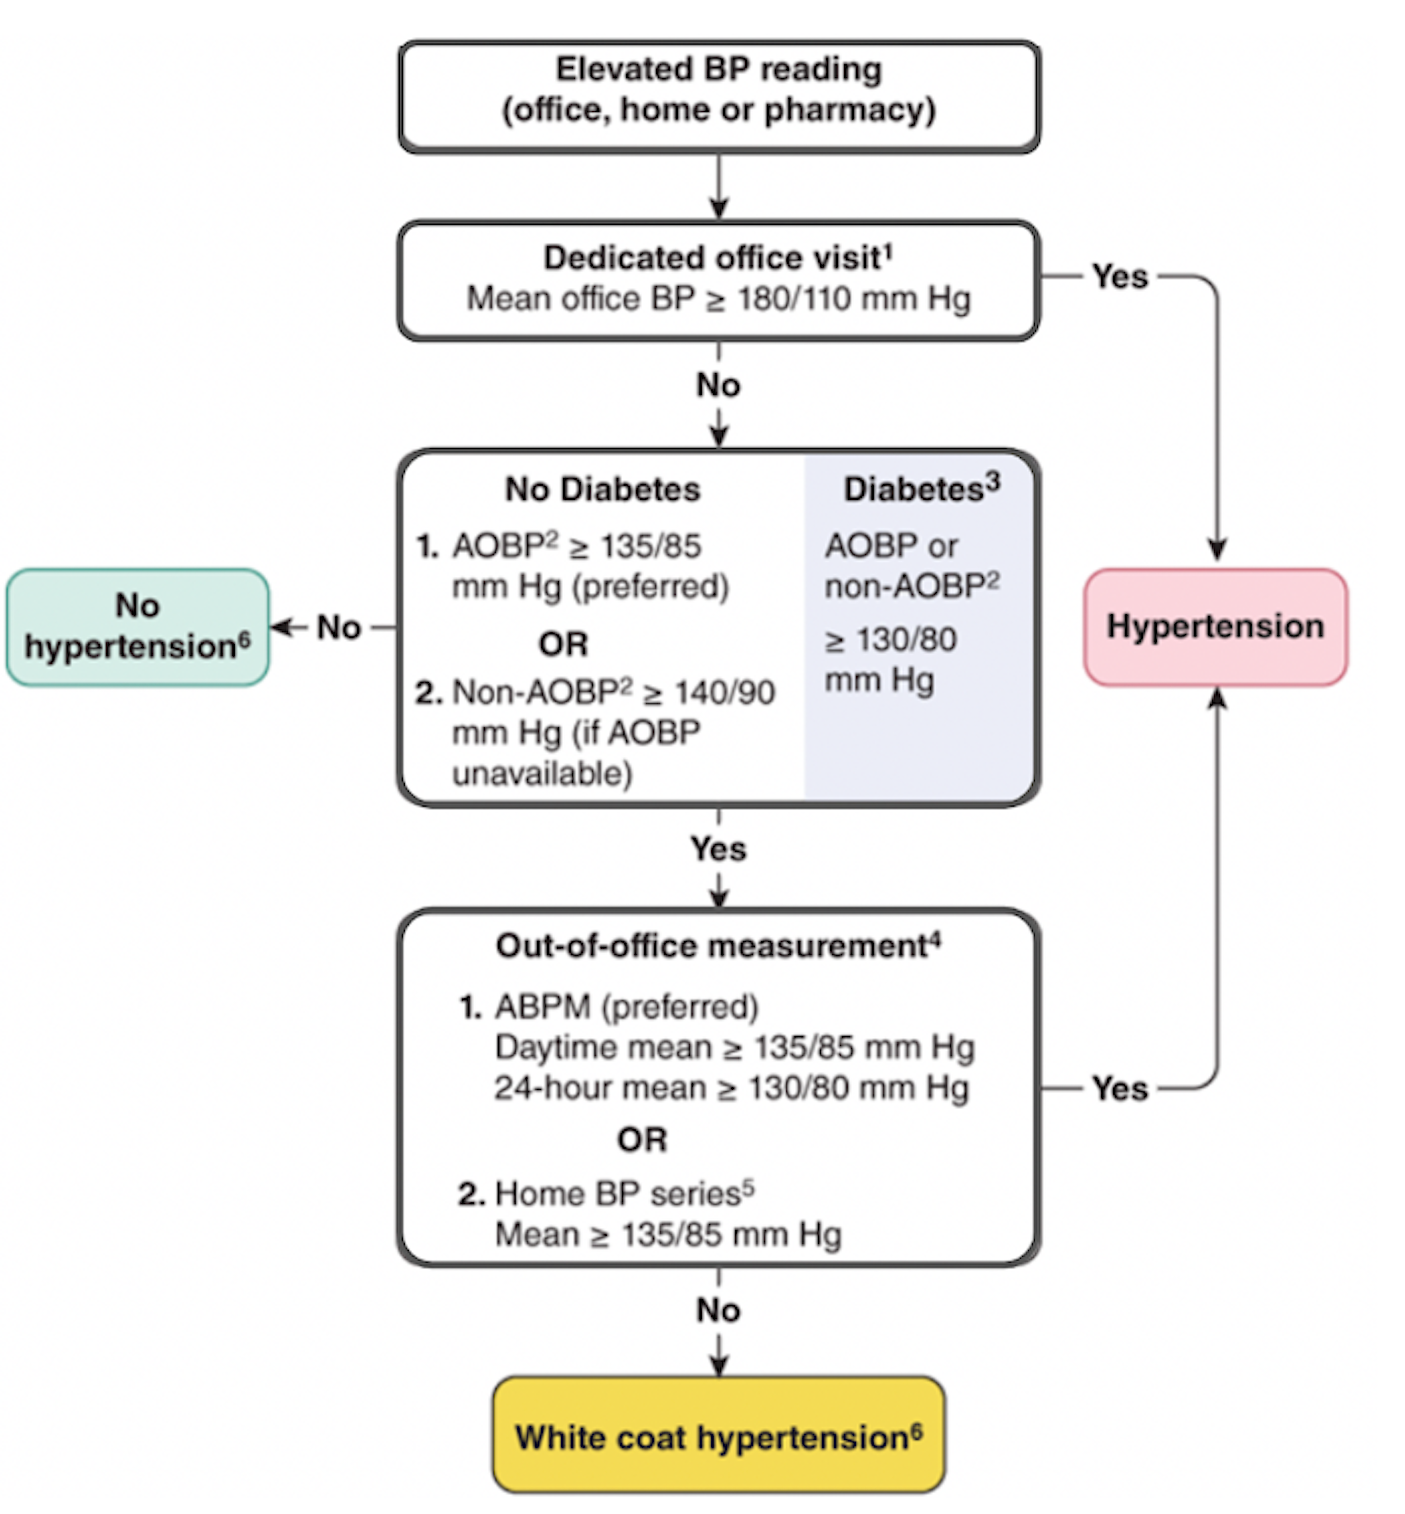
What is Computational Phenotyping?
Machine-readable characterization of patient conditions¹
Typical Workflow:
Identify relevant phenotype codes
Create cohort from EHR using phenotype codes + clinical logic
Review/revise cohort with clinician
Limitations:
Time-consuming
Usually limited to clinical data
Not generalizable to phenotypes
Hypertension (ICD10: I10) Phenotype:
Blood Pressure > 180/110mm Hg
LOINC 76532-1
SNOMED CT: 386534000
MeSH: D001794
Diabetes
ICD10: E23.1
SNOMED CT: 73211009
CIEL: 119481
EHR → Electronic Health Record
¹Shivade et al. J Am Med Inform Assoc. 2013; image:Nerenberg et al. Can J Cardiol. 2018
Notes:
CPs are machine-readable instructions to find patients with/without specific diseases (ex hypertension CP shown on the right)
The typical workflow includes:
Identifying a set of relevant clinical codes (e.g. dxs, rxs, labs), which are combined with clinical logic in order to retrieve a cohort of patients
The resulting cohort is then reviewed with a clinical expert
While effective, this process is incredibly time-consuming and is usually limited to clinical data (i.e. no use of molecular data) from a specific hospital resulting in a process that is not generalizable and CPs that are not reproducible.

Slide 3
Project Objective
Problem: CPs rely on specific hospital vocabularies
CDMs → help EHRs with different vocabularies speak the same language
Existing CP knowledge-bases are not mapped to CDMs
Goal: Examine different vocabulary mapping strategies on patient cohort construction
Task | Hripcsak 2018 Evaluation | Our Evaluation
Cohort Groups | Only Cases | Cases and controls
Query Strategy | Occurrence of > 1 clinical code | Clinical codes only (occurrence of > 1) Clinical codes + clinical logic
Data Types | Conditions (i.e. diagnosis) | All clinical domains (i.e. conditions, medications, measurements, procedures)
Population | New York Presbyterian/Columbia University Irving Medical Center | Children’s Hospital Colorado MIMIC III Adult ICU
CP → Computational Phenotype; CDM → Common Data Model; EHR → Electronic Health Record
Hripcsak et al. J Am Med Inform Assoc. 2018
Notes:
Most existing CPs can’t be easily applied to new data sources b/c they were built using a specific set of clinical concepts
CDMs are tools which help data from different hospitals speak the same language
While CDMs are helpful for future CP development, existing CPs knowledge-bases like eMERGE, still require mapping to CDMs
Hripcsak → First to understand the impact of different ways to map CPs to OMOP CDM, but it was limited
Our work extends Hripcsak by building cases and controls, codes + clinical logic, and using all clinical domain data

Slide 4
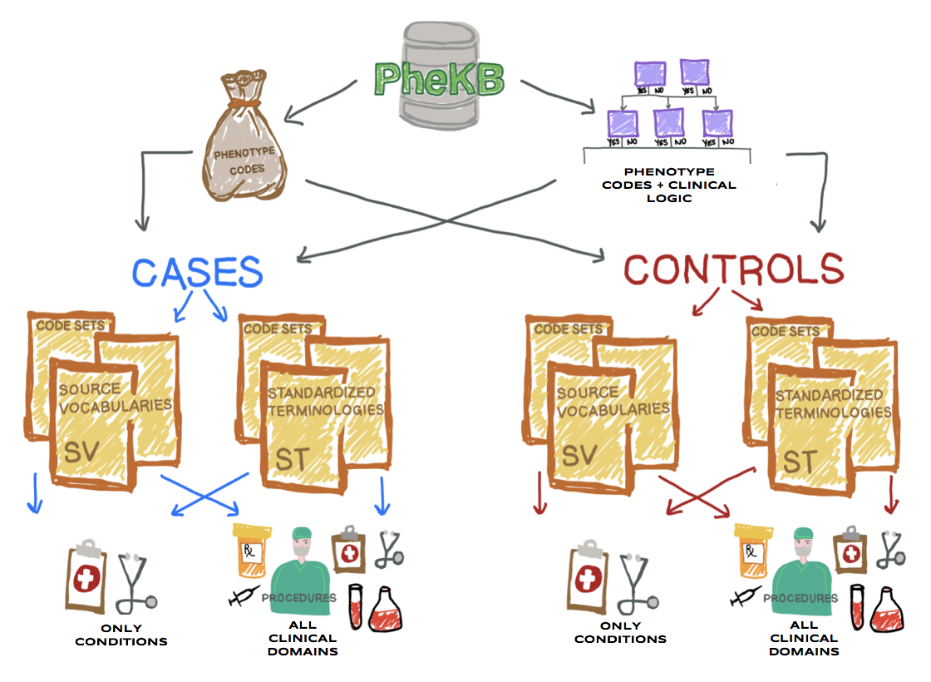
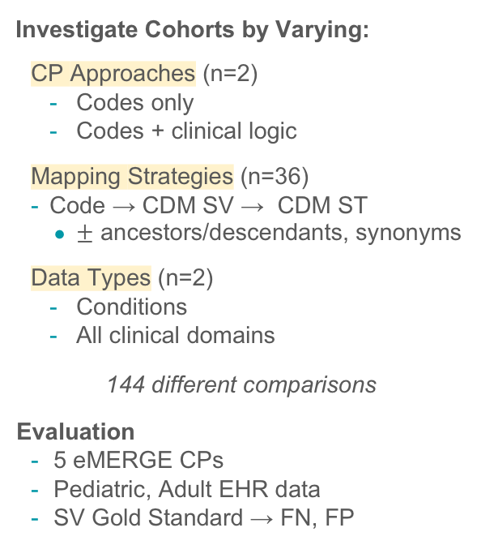
Methods
Investigate Cohorts by Varying:
CP Approaches (n=2)
Codes only
Codes + clinical logic
Mapping Strategies (n=36)
Code → CDM SV → CDM ST
$±$ ancestors/descendants, synonyms
Data Types (n=2)
Conditions
All clinical domains
144 different comparisons
Evaluation
5 eMERGE CPs
Pediatric, Adult EHR data
SV Gold Standard → FN, FP
SV → Source Vocabulary; ST → Standard Terminology; CDM → Common Data Model; CP → Computational Phenotype
Notes:
Figure on left provides a high-level overview of the experimental design
To fully understand the impact of the different ways to map CP definition codes to a CDM, we varied several things:
Approach to building CPs: Codes only vs. codes+logic
Data type: only conditions vs all available clinical data
Code mapping: exact match, fuzzy, or both with and without ancestors and synonyms code vocab to OMOP
All mappings were compared to the exact-mapping between the codes provided in eMERGE and the CDM (this is consistent with Hripcsak)

Slide 5
Results
DATA TYPE | ONLY CONDITION DATA |  |  |  |  |  |  |  | ALL CLINICAL DATA
QUERY STRATEGY | CODES ONLY |  |  |  | CODES + CLINICAL LOGIC |  |  |  | CODES ONLY |  |  |  | CODES + CLINICAL LOGIC
PERFORMANCE (ALL MAPPINGS)* | Actual | Predicted | FP | FN | Actual | Predicted | FP | FN | Actual | Predicted | FP | FN | Actual | Predicted | FP | FN
ADHD | 19980 | 17639-20464 | 0-2853 | 0-4907 | 3624 | 2647-3624 | 0-78 | 0-1056 | 4472 | 4209-8061 | 0-3937 | 0-1567 | 1706 | 1519-2541 | 0-835 | 0-615
Appendicitis | 4178 | 2629-4178 | 0 | 0-1549 | 4178 | 2629-4178 | 0 | 0-1549 | 2948 | 1706-3088 | 0-140 | 0-1247 | 367 | 119-916 | 0-549 | 0-275
Crohn's Disease | 754 | 751-754 | 0-8 | 0-11 | 230 | 230-287 | 0-57 | 0 | 477 | 477-679 | 0-212 | 0-10 | 199 | 199-280 | 0-81 | 0
Sickle Cell Disease | 333 | 333-338 | 0-5 | 0 | 1351 | 1351-1355 | 0-4 | 0 | 333 | 333-338 | 0-5 | 0 | 1308 | 1308-1312 | 0-4 | 0
Systemic Lupus Erythematosus | 446 | 446-447 | 0-1 | 0 | 0 | 0 | 0 | 0 | 0 | 0 | 0 | 0 | 0 | 0 | 0 | 0
*Cell values contain the min-max of all 144 examined mapping strategies. A single number means the min/max were the same.
Lowest error → codes + clinical logic using all clinical domains
Highest error → ADHD (25-88% FN), Appendicitis (37-75% FN), Crohn’s Disease (1-44% FP)
Systemic Lupus Erythematosus cohort → ONLY with codes only + conditions only
Replicated results in CHCO control cohorts and MIMIC case/control cohorts
Notes:
Chart shows the results for CHCO case cohort groups
Actual+Predicted columns → the range of the cohort sizes returned across all mapping strategies
FP+FN → range of false positive and false negative values across all mapping strategies
Yellow column are the gold standard - for the exact-mapped codes to OMOP CDM (consistent with Hripcsak)
Read slide findings

Slide 6






Summary
Preliminary Findings
Extends Hripcsak et al. 2018
Some CPs only found when using codes + conditions
Only codes resulted in highest error
Codes + clinical logic with all clinical data results in lowest error
Next Steps
Evaluate additional phenotypes
Process domain expert reviewed code sets
ACKNOWLEDGEMENTS
Informatics Team
Sara Deakyne Davies
Dr. Michael Kahn
Dr. Lawrence Hunter
Translational Research Team
Dr. Adrianne Stefanski
Dr. Nicole Vasilevsky
Dr. Xingmin Aaron Zhang
Dr. Peter Robinson
Funding: NLM Training Grant
Clinical Team
Dr. Tellen Bennett
Dr. Jordan Wyrwa
Dr. Katy Trinkley
Dr. Whitley Yi
Dr. Catherine Derington
Emily Swenson
Kelsey Andrews

