Slide 1
A Toxicogenomics Approach to Identify
Liver and Kidney Injuries
Patric Schyman, Ph.D.
DoD Biotechnology HPC Software Applications Institute (BHSAI)
Telemedicine and Advanced Technology Research Center
U.S. Army Medical Research and Development Command
Henry M. Jackson Foundation for the Advancement of Military Medicine
Aspen/Snowmass, CO
December 5, 2019

Slide 2





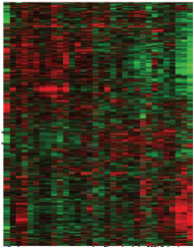

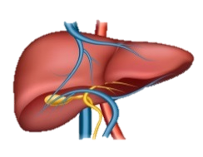
Challenges in Toxicology
Human Studies
Not Possible
Animal (In Vivo) Studies
Resource-intensive and
Time-consuming
Cell-based (In Vitro) Studies
Predict
Liver Injury
RNA
Thioacetamide
1
2
3
Human Cells
Gene Modules

Slide 3
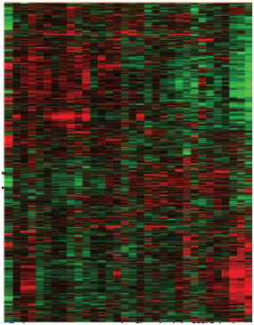
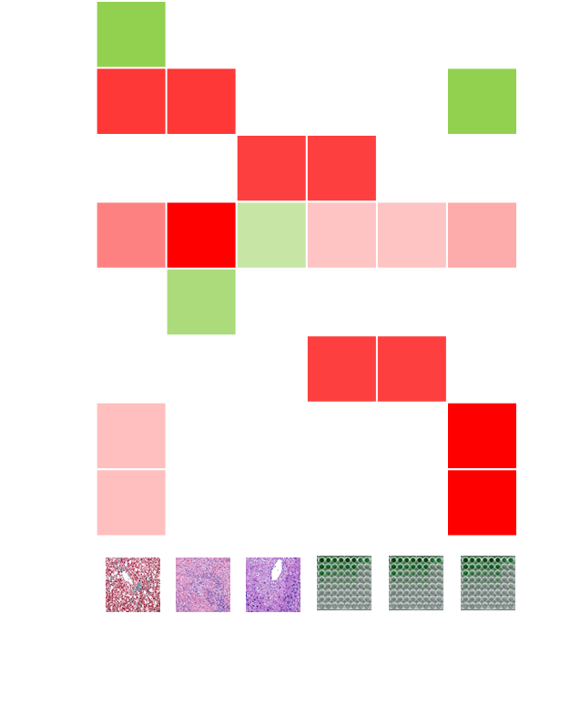
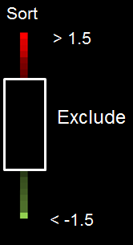
Toxicogenomics Analysis
We identified 19 gene sets (modules) with characteristics
of liver (11) and kidney (8) injuries (endpoints) from TG-GATEs
Gene – Exposure to Module – Endpoint
1
Module
Module
Gene
Up
Down
Activated
Suppressed
Exposure
Histology Endpoint
TG-GATEs: Toxicogenomics Project-Genomics Assisted Toxicity Evaluation System
Te et al., J. Appl. Toxicol., 2016, 36, 1137
Abdulhameed et al., PLOS ONE, 2014, 9, e112193

Slide 4
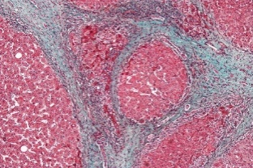

Validation of Toxicity Modules
Gene-expression Response in the Rat 24 h after Thioacetamide Exposure
Injury Module
Activation
Histology
Validation
*
Gene
Fibrosis
Fibrosis &
Cellular Infiltration
Exposure
*Fold change (FC)-based Z-score
$${\text{Z}}_{\text{Module} }\text{=}\frac{{\text{FC}}_{\text{Module}}\text{−}\left\langle \text{FC}\right\rangle }{\text{σ}}$$
up down
Schyman et al., Front. Pharmacol. 2018, 9, 1272

Slide 5

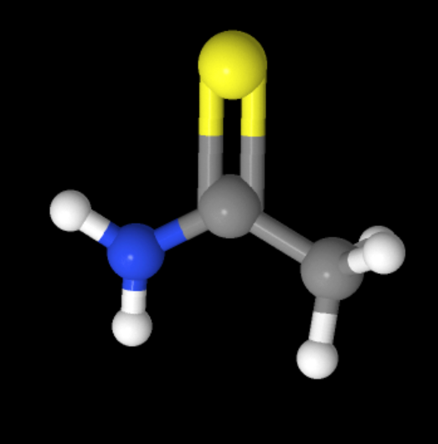


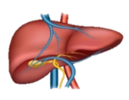

Assessing Liver Injury from In Vitro Data
In Vivo
In Vitro
Liver Toxicant
Thioacetamide
Cell
Cell
Correlation with Rat-in vivo:
R = 0.8
R = 0.8
R = 0.6
Schyman et al., Front. Genet. 2019, 10, 1233

Slide 6
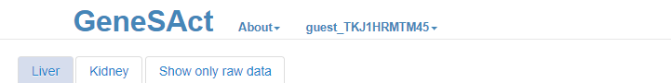
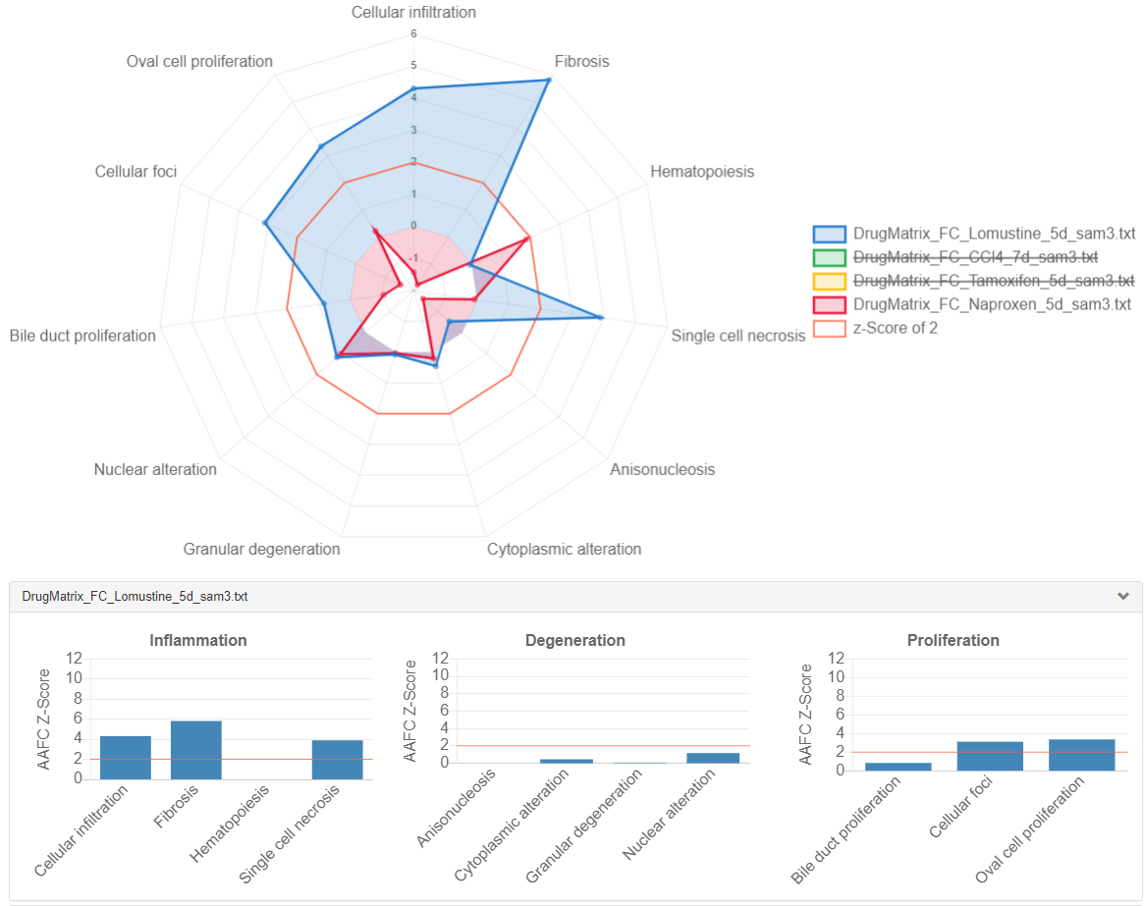
Applications
DoD Biotechnology HPC Software Applications Institute (BHSAI)
www.bhsai.org
Predicting Fibrosis
Website for Gene Set Activation
Source: In vivo DrugMatrix
Acknowledgements
BHSAI
Dr. Patric Schyman
Dr. Anders Wallqvist
BHSAI: IT
Mr. Valmik Desai
Mr. Zhen Xu
Vanderbilt
Dr. Masakazu Shiota
Dr. Richard Printz
Defense Threat Reduction Agency
DoD High Performance Computing Modernization Program
U.S. Army Medical Research and Development Command
6

