Slide 1

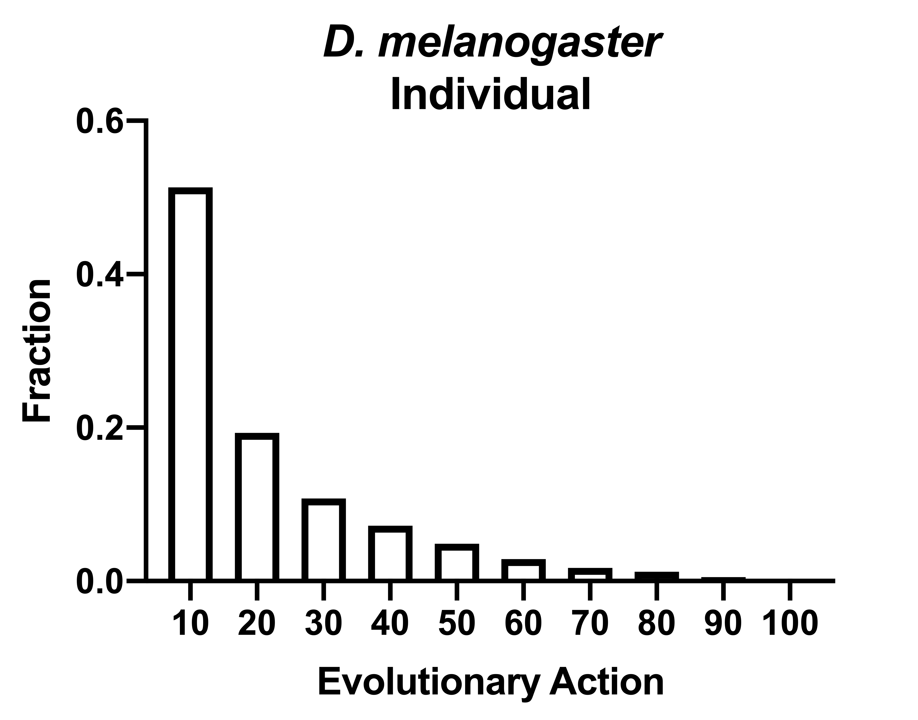
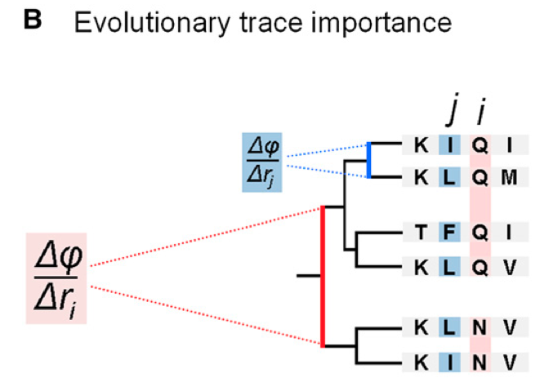
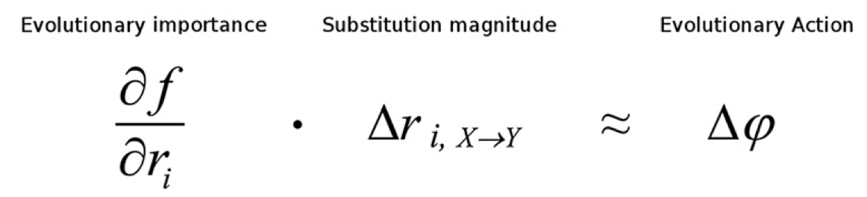
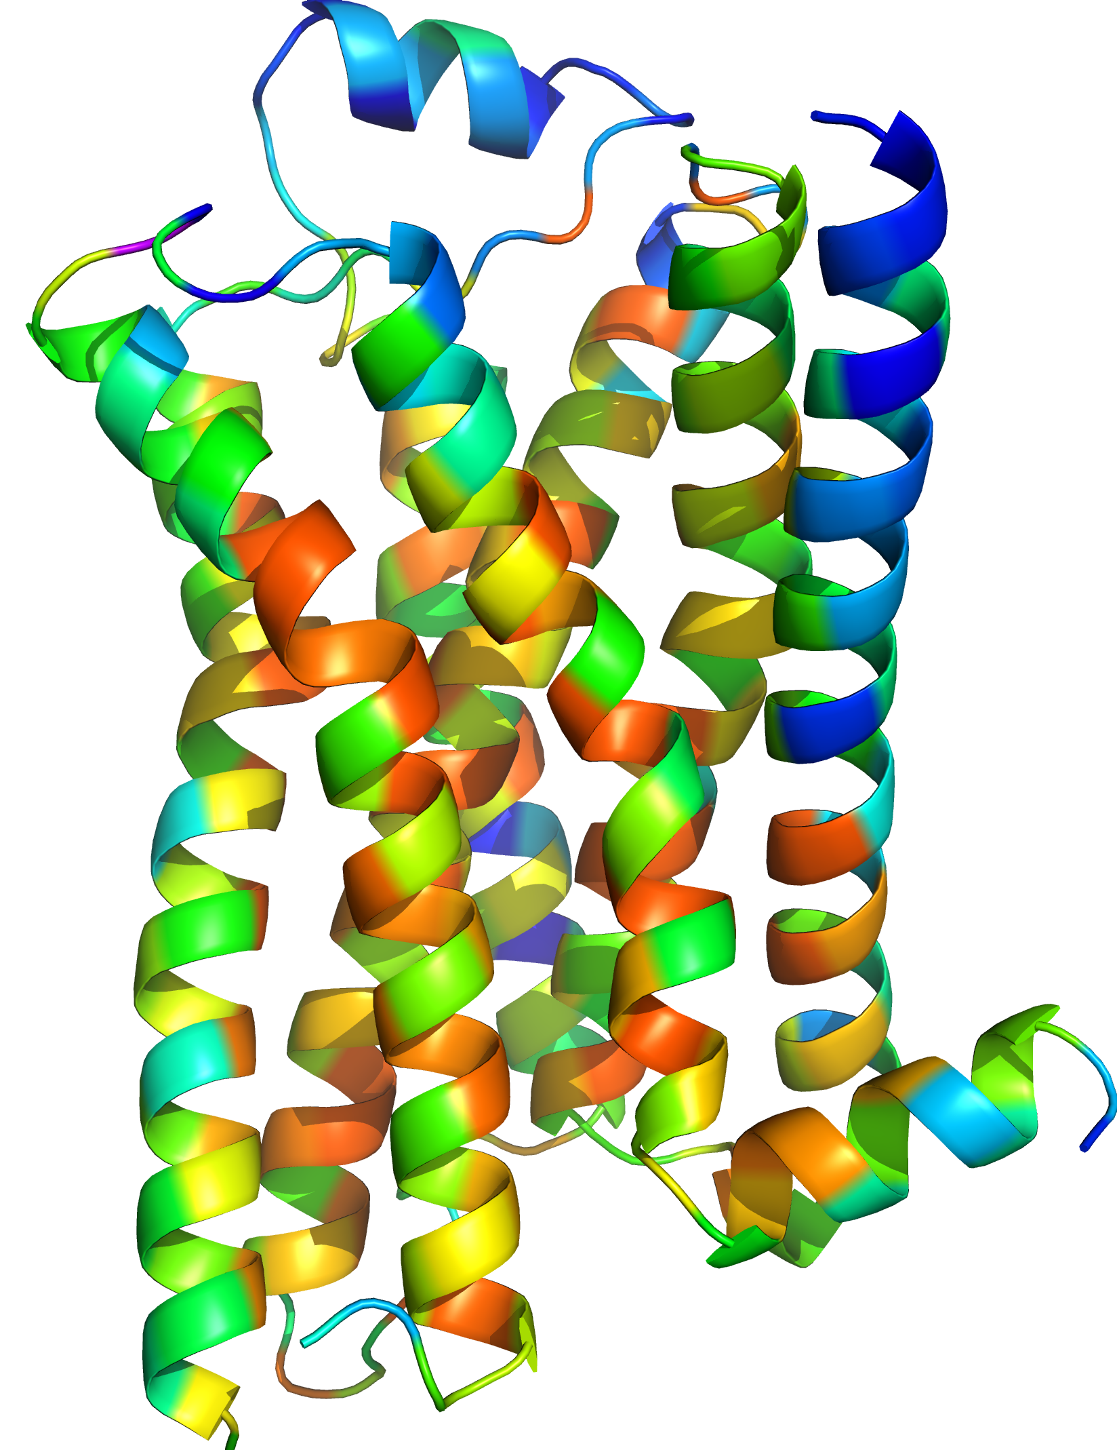

Evolutionary Action is a Unifying Framework for Assessing Missense Variant Structures Within & Across Phyla
Lichtarge Lab
Nicholas Abel
nabel@bcm.edu
Central challenges of Population & Functional Genetics
Predicting Phenotypic Impact of a variant
Inferring the Distribution of Fitness Effects from polymorphism data
Current DFE methods entail substantial statistical uncertainty
A need exists for a non-statistical tool defining DFE!
Evolutionary Trace (ET): Uses evolution to quantify importance of a sequence position
Evolutionary Action (EA): Predicts the impact a variant will have on protein phenotype
ET of B2AR
Evolutionary importance of position
Magnitude of change in the residue substitution
(Tataru et al 2017, Castellano et al, 2019; Sanchez-Garcia, 2017; Katsonis and Lichtarge, 2014)
Notes:
Understanding fitness impact of mutation on phenotype
Already have EA to predict impact
Solution as ET based on conserved position across evolutionary- conserved are more important and as seen here usually fall in the active site
and EA predicts the impact of the mutation from 0-100, with 100 being predicted to be a loss of function mutation
We create a distrivution as seen here for a melanogaster individual, where we see and abundance of low impact mutations in accordance with the nearly neutral theory of evolution

Slide 2
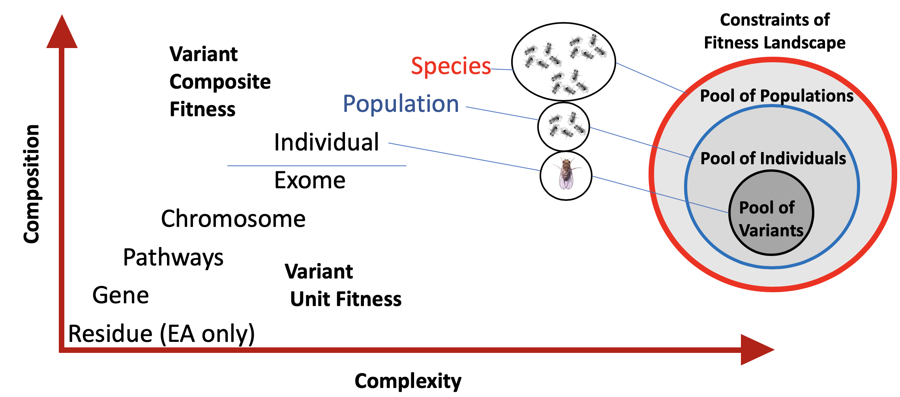

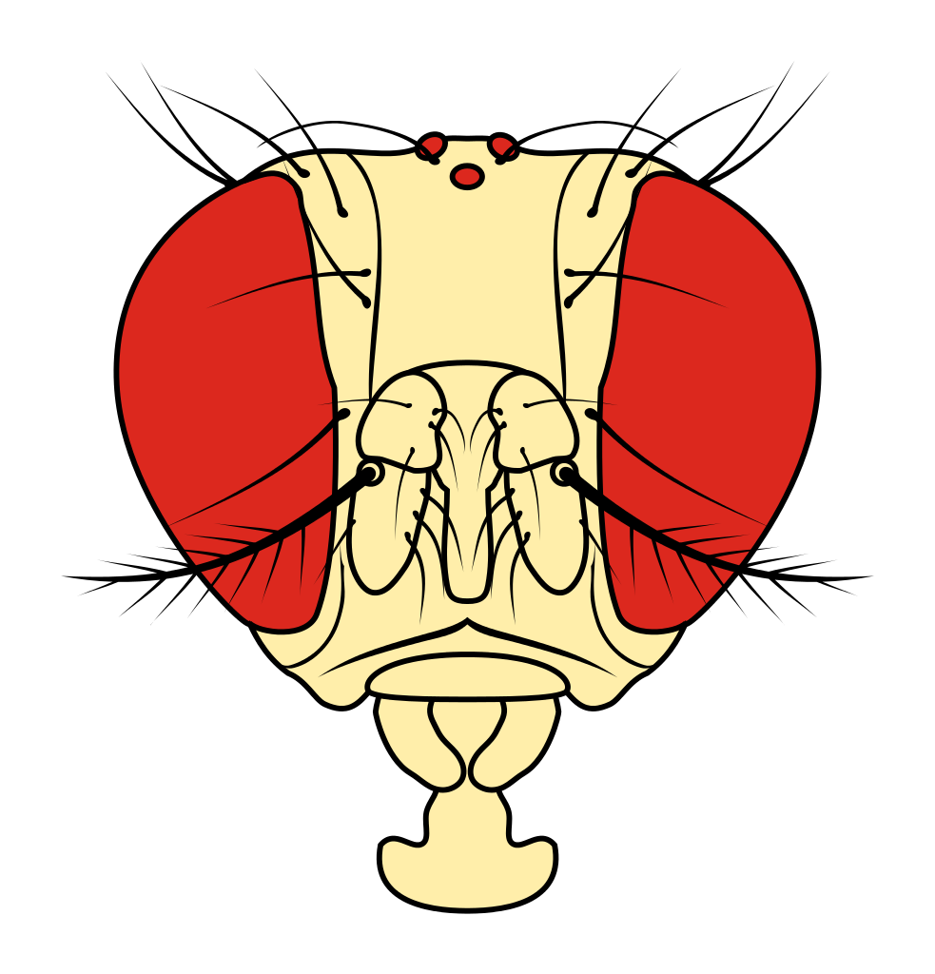

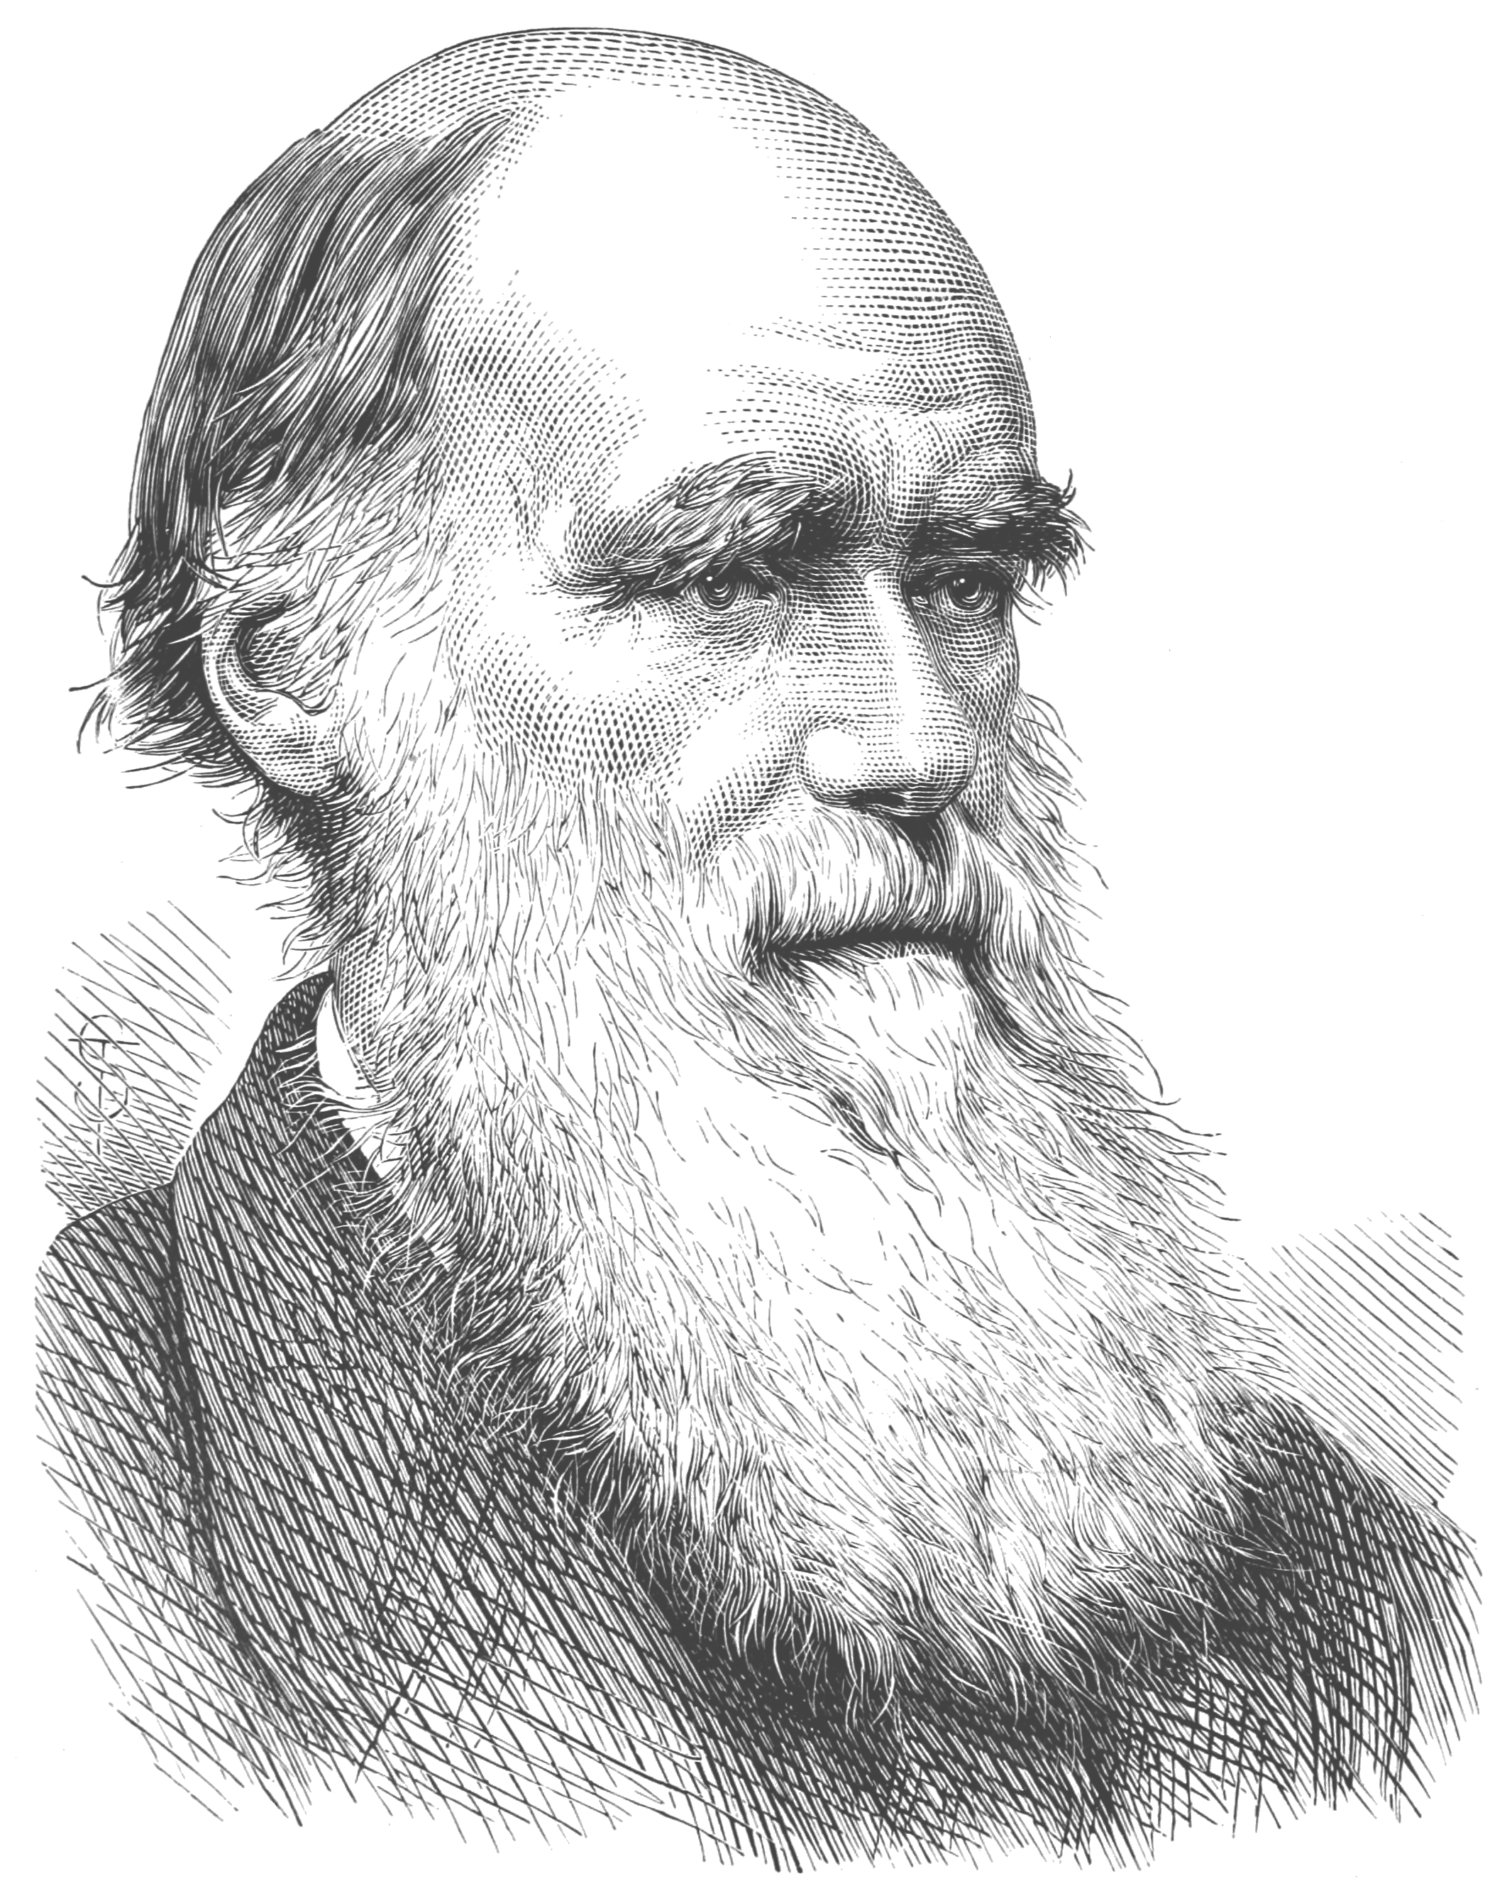


How do we define Selection?
y = 0.7286e^{-0.557x}
R² = 0.9799
Applied EA to Non-synonymous variants from Populations of closely related species among Dipterans and Primates
The strength of selective constraints against mutations with large fitness impacts
How do we quantify Selection:
For individuals and Populations?
Across levels of functional fitness units?
(Lack et al, 2016; Miles et al, 2017; Xue et al, 2016; Auton et al, 2016; Sciencephoto.com, Monkeyhaven.com)
Notes:
From EA distribution we get an exponential decay constant
We define this as lambda
lambda, which represents strength of selection against mutations with large fitness effects
We shoes to apply this
Talking Lambda:
Decay rate as mutations increase in phenotypic impact can be found for Individuals & Species and across functional fitness units
Functional fitness, species composed of populations, of individuals
Talking today about individuals and populations as well as chromsomes and finally pathways
Drosophilids are phenotypically nearly identical
Low lambda: Higher proportion of deleterious mutations in variant population

Slide 3
λ Reveals Differential Selection Pressures of Variant Structures for Individuals, Populations and Allele Frequencies
0.054
0.053
0.047
0.039
0.041
0.034
0.038
0.028
0.032
0.026
Do we observe a similar decay phenomena in Chromosomes?
Do we observe the Faster-X Effect?
Notes:
Similar phenotypes have similar lambdas, at ind level macaques harbor more impactful variants
Stronger selection against high impact muts in diptera,
How do thay decay

Slide 4
The X chromosome is under more purifying selection than the autosomes in Populations
X
Autosomes
Can we use Machine Learning to Differentiate Selection pressures on Pathways and Gene Groups of globally dispersed D. melanogaster populations?
Notes:
Don’t observe at individual level, but do observe at population level
Do we observe this in Humans too, across the metazoan tree?
Indeed we do
Based on this validation of our data…

Slide 5
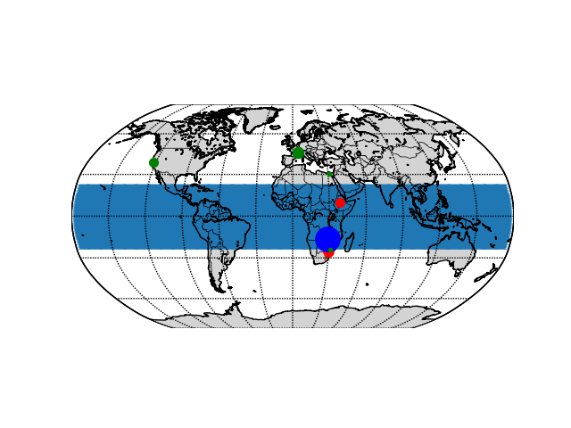
Machine Learning Identifies Pathways and Gene Groups Under Differential Selection Across the D. melanogaster species
Hypothesis: Flies in ancestral range and emigrants have experienced differential selection pressure, which will be recapitulated in differential fitness impacts on Pathways and Gene Groups
Negative Controls
Cytochrome C
Tubulins
RNA Pol II
Actin
Positive Controls
Olfactory & Gustatory
Receptors
Immune system
Xenobiotic degradation
Results
Lysosome
Phagosome
Apoptosis
Spliceosome, DNA replication
Ubiquitin mediated proteolysis
Wnt signaling Pathway
Protein processing in ER
Carbohydrate metabolism
Transcription Factors
Analyzed using two methods:
  Maximal perturbation of protein: Max(EA)
  Loss-of-Function likelihood [EA_{xy} = 1 - (1-EA_{x}) (1-EA_{y})]
  We used Matthews Coefficient Correlation (MCC) to generate final rankings
(Attrill et al, 2016; Fabris et al, 2016; Lack et al, 2016, Clark et al 2007)
Notes:
Ranking is based on which gene groups and pathways Best Separate the given Case and Control groups, hence differential selection
Aggregate impact on function, accounting for nearly neutral mutations
We hypothesized we would find our positive and negative control groups at the top and bottom of the MCC Rankings based on past literature
We find numerous components of endocytic trafficking and recycling, signal transduction, Translation and the spliceosome

Slide 6
These data show…
Pioneer fly populations explored their fitness landscape to adapt in novel environments:
  Recycling endogenous proteins through catabolism
  Spliceosome and DNA replication differences enabled adaptation via mutation
  Metabolic genes adapt to novel food resources
  Transcription Factor changes alter binding affinity; alluding to differential regulation accompanying adaptation
EA is a valuable feature for ML in Evolutionary Genetics
EA permits precise identification of High impact variants
We used a single non-statistical tool to define selection pressures both within and across phyla at multiple levels of functional organization
  Individuals
  Populations
  Chromosomes
  Pathways
Visit poster P01 for more discussion!
Notes:
to Novel habitats

