Slide 1


Rocky 2019
December 7th (Saturday)
Pathway-based Single-Cell RNA-Seq Classification, Clustering, and Construction of Gene-Gene Interactions Networks Using Random Forests
Hailun Wang, Pak Sham, Tiejun Tong and Herbert Pang

Slide 2
Why scRNA-Seq data
Identification of rare cell types / sub-cell types
Heterogeneity within the cell population
Cell lineage and differentiation states
Cell signaling / functional pathways
Propose a pathway-based analytic framework using Random Forests
Identify discriminative functional pathways related to cellular heterogeneity
Cluster cell populations for scRNA-Seq data
Construct gene-gene interactions networks

Slide 3
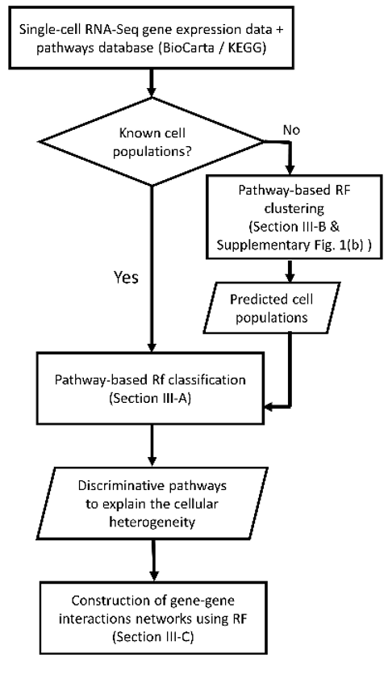
Workflow

Slide 4
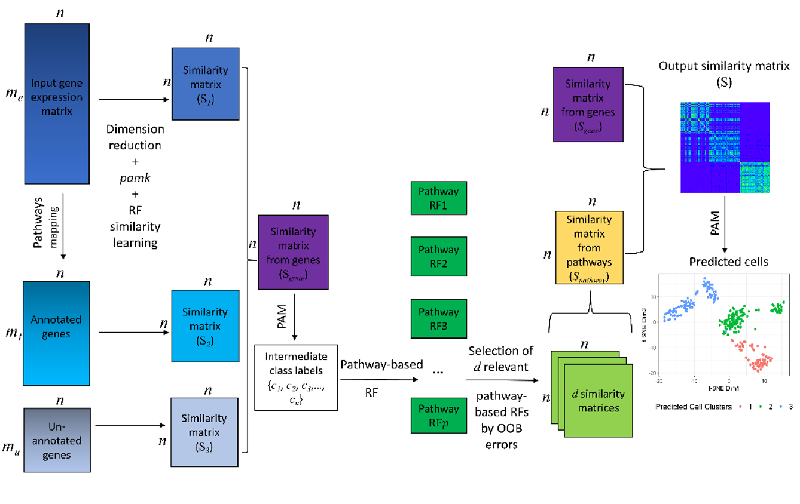

Slide 5
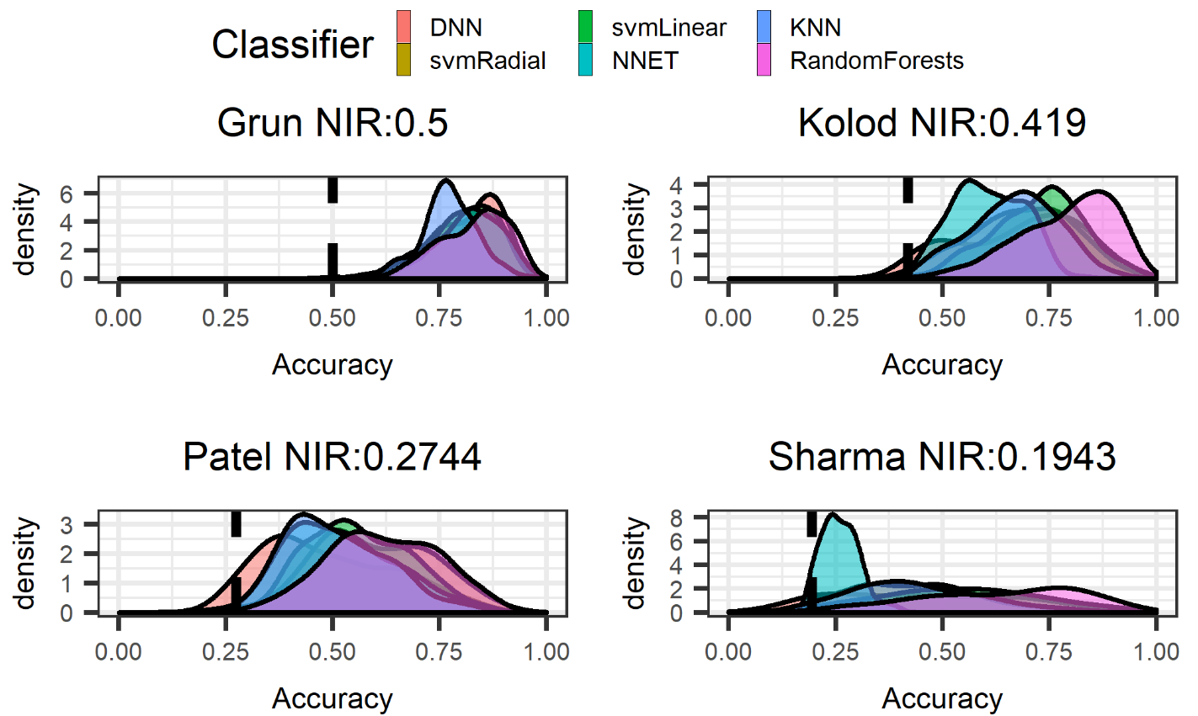
Results

Slide 6
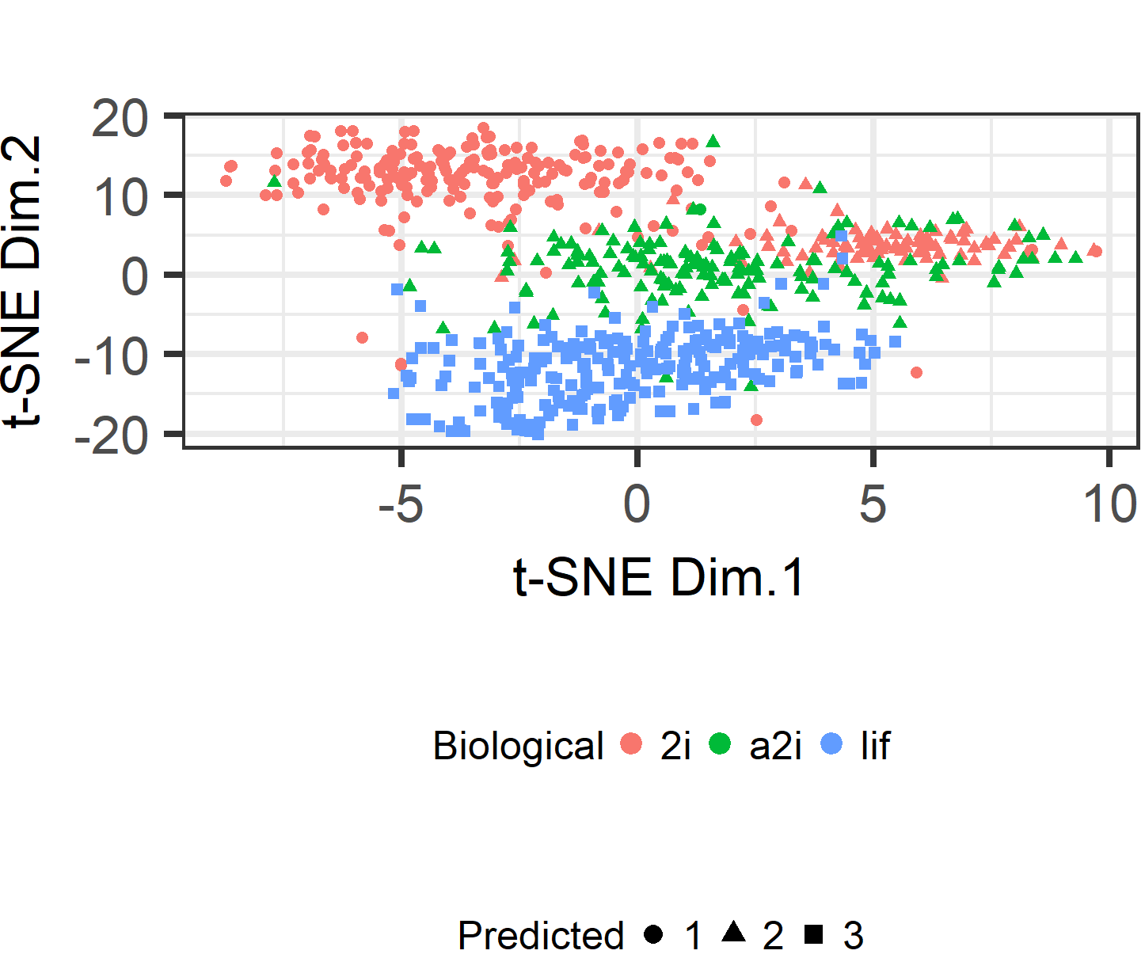
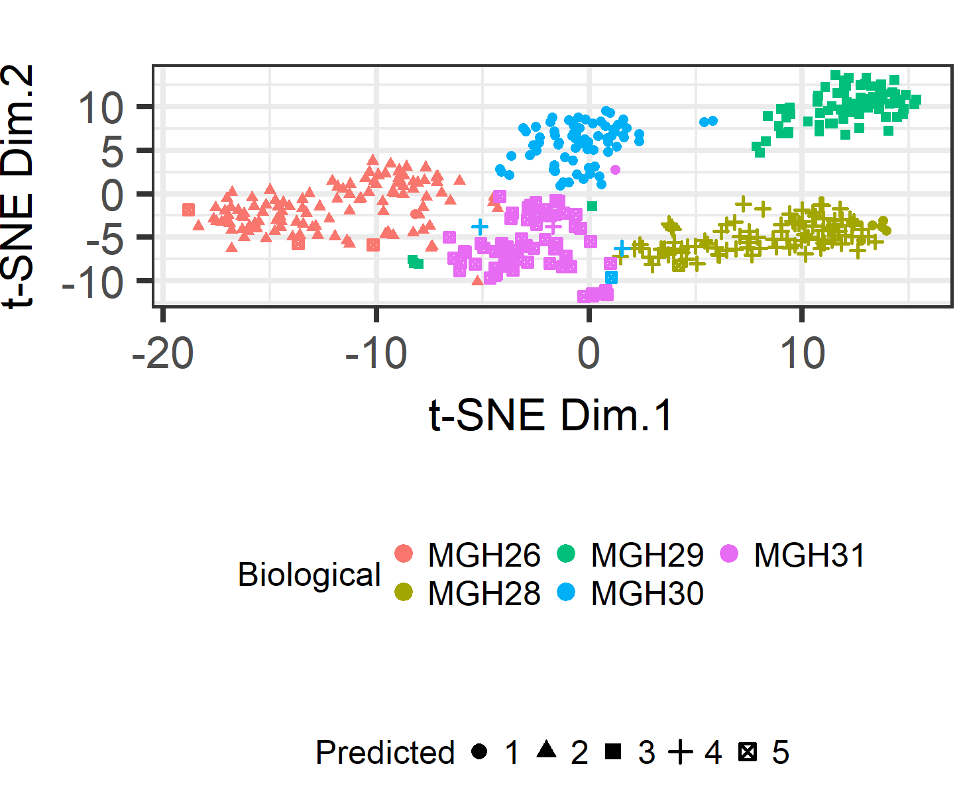
Results

Slide 7
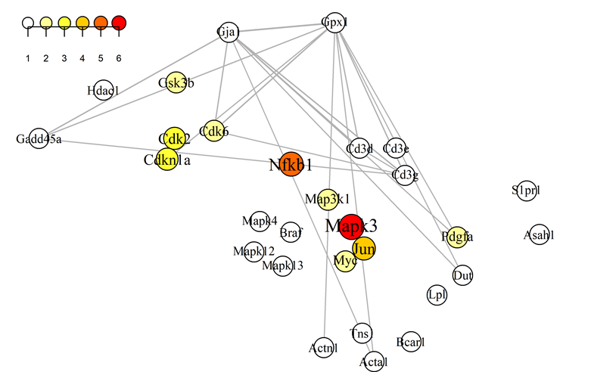
Results

Slide 8
Acknowledgements
Hong Kong Postgraduate Fellowship Scheme
RGC/GRF grant no.: 17157416

Slide 9
References
D. Grun, L. Kester, and A. van Oudenaarden, “Validation of noise models for single-cell transcriptomics,” Nat. Methods, vol. 11, no. 6, pp. 637-640, Jun. 2014.
J.K. Kim et al., “Characterizing noise structure in single-cell RNA-seq distinguishes genuine from technical stochastic allelic expression,” Nat. Commun., vol. 6, pp. 8687, Oct. 2015.
D.A. Lawson et al, “Tumor heterogeneity and metastasis at single-cell resolution,” Nat. Cell Biol., vol. 20, no. 12, pp. 1349-1360, Nov 2018.
B. Hwang et al ,“Single-cell RNA sequencing technologies and bioinformatics pipelines,” Experimental & Molecular Medicine, vol. 50, pp. 96, Aug. 2018.
AA. Kolodziejczyk et al., “Single Cell RNA-Sequencing of Pluripotent States Unlocks Modular Transcriptional Variation,” Cell Stem Cell., vol. 17, no. 4, pp. 471-485, Oct. 2015.
A.P. Patel et al., “Single-cell RNA-seq highlights intratumoral heterogeneity in primary glioblastoma,” Science, vol. 344, no. 6190, pp. 1396-1401, Jun. 2014.
A. Sharma et al., “Longitudinal single-cell RNA sequencing of patient derived primary cells reveals drug-induced infidelity in stem cell hierarchy,” Nat Commun., vol. 9, pp. 4931, Nov. 2018.

Slide 10
Thank you!

