Slide 1
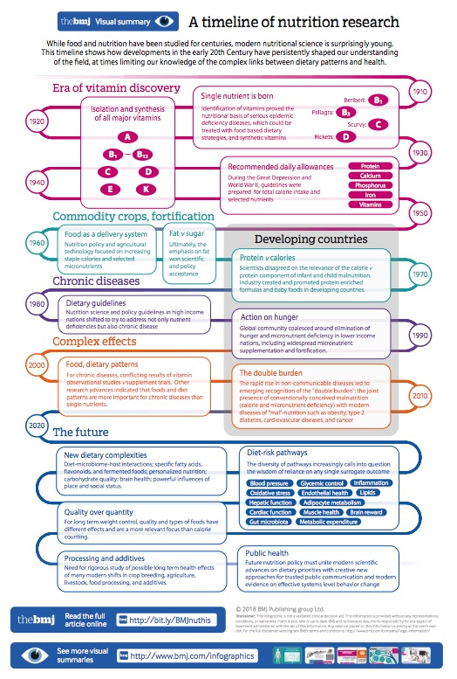
How to annotate what we don’t know
Acknowledgements:
Larry Hunter (Advisor)
Sonia Leach (Advisor)
Michael Bada
Tiffany Callahan
Kevin Cohen
William Baumgartner
Elizabeth White
Emily Dunne
Funding: NLM Training Grant (3T15LM009451-12S1)
Contact: Mayla.Boguslav@CUAnschutz.edu
Notes:
Reliable automated identification and classification of these question statements would open the door to many interesting new text mining applications, like finding open questions relevant to a set of experimental results, or quickly surveying a new area of research. Here I present results that show it is possible for people to agree on what counts as a question, as well as to classify questions into useful categories.
The future in some senses, but really these exists in the literature.
What we could do if we had these:
Survey the literature – timeline based on questions not just answers and what we did – more true to the scientific endeavor – not meant to be able to read this
Use all the NLP information extraction outputs to see if we can find new knowledge (a new form of literature-based discovery)
Linguistically interesting – formalize and understand epistemics
Interesting in itself: for new people + review articles + stakeholders (how questions change over time)
Larry’s comments: Slides 1-3. I think you need to start with a clearer motivation and problem statement. Something like: There are many questions, that is, statements of currently unknown but desirable knowledge, in the scientific literature. Reliable automated identification and classification of these question statements would open the door to many interesting new text mining applications, like finding open questions relevant to a set of experimental results, or quickly surveying a new area of research. Here I present results that show it is possible for people to agree on what counts as a question, as well as to classify questions into useful categories.

Slide 2
How to annotate what we don’t know
KNOWLEDGE
Acknowledgements:
Larry Hunter (Advisor)
Sonia Leach (Advisor)
Michael Bada
Tiffany Callahan
Kevin Cohen
William Baumgartner
Elizabeth White
Emily Dunne
Funding: NLM Training Grant (3T15LM009451-12S1)
GOALS FOR KNOWLEDGE
Contact: Mayla.Boguslav@CUAnschutz.edu
Notes:
The future in some senses, but really these exists in the literature.
What we could do if we had these:
Survey the literature – timeline based on questions not just answers and what we did – more true to the scientific endeavor – not meant to be able to read this
Use all the NLP information extraction outputs to see if we can find new knowledge (a new form of literature-based discovery)
Linguistically interesting – formalize and understand epistemics
Interesting in itself: for new people + review articles + stakeholders (how questions change over time)
Larry’s comments: Slides 1-3. I think you need to start with a clearer motivation and problem statement. Something like: There are many questions, that is, statements of currently unknown but desirable knowledge, in the scientific literature. Reliable automated identification and classification of these question statements would open the door to many interesting new text mining applications, like finding open questions relevant to a set of experimental results, or quickly surveying a new area of research. Here I present results that show it is possible for people to agree on what counts as a question, as well as to classify questions into useful categories.

Slide 3
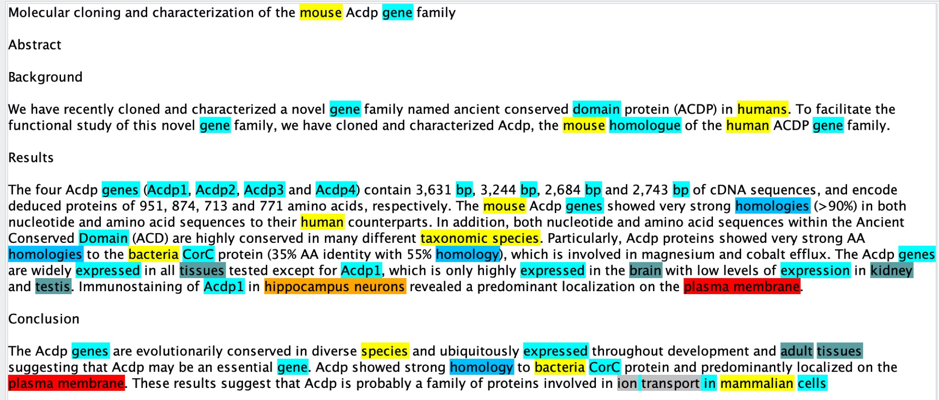
The literature: knowledge + goals for knowledge
CRAFT
Notes:
The literature is full of unknowns and not only does it exist but it also is important and truly what scientists care about!
Also we want to put these genes and taxonomies in a context to be able to understand what is being extracted. For databases we want to ensure we keep only facts or what is known, and not known unknowns. But these exists and we care about them and we don’t want to discard them… so what do we do with them?
Goal: To classify and characterize known unknowns in the literature. And think about the literature in terms of its known unknowns, instead of its knowns.
TURN THESE KNOWN UNKNOWNS INTO GOALS FOR KNOWLEDGE!
Larry’s comments: Slides 1-3. I think you need to start with a clearer motivation and problem statement. Something like: There are many questions, that is, statements of currently unknown but desirable knowledge, in the scientific literature. Reliable automated identification and classification of these question statements would open the door to many interesting new text mining applications, like finding open questions relevant to a set of experimental results, or quickly surveying a new area of research. Here I present results that show it is possible for people to agree on what counts as a question, as well as to classify questions into useful categories.

Slide 4
The literature: knowledge + goals for knowledge
CRAFT
Notes:
The literature is full of unknowns and not only does it exist but it also is important and truly what scientists care about!
Also we want to put these genes and taxonomies in a context to be able to understand what is being extracted. For databases we want to ensure we keep only facts or what is known, and not known unknowns. But these exists and we care about them and we don’t want to discard them… so what do we do with them?
Goal: To classify and characterize known unknowns in the literature. And think about the literature in terms of its known unknowns, instead of its knowns.
TURN THESE KNOWN UNKNOWNS INTO GOALS FOR KNOWLEDGE!
For example, looking at the last sentence it says: these results suggest that Acdp is probably a family of proteins involved in ion transport in mammalian cells. The known unknown would be: there is some evidence that Acdp is most likely a family of proteins involved in ion transport in mammalian cells. The goal then is to find more evidence that Acdp is a family of proteins involved in ion transport in mammalian cells.
Larry’s comments: Slides 1-3. I think you need to start with a clearer motivation and problem statement. Something like: There are many questions, that is, statements of currently unknown but desirable knowledge, in the scientific literature. Reliable automated identification and classification of these question statements would open the door to many interesting new text mining applications, like finding open questions relevant to a set of experimental results, or quickly surveying a new area of research. Here I present results that show it is possible for people to agree on what counts as a question, as well as to classify questions into useful categories.

Slide 5
Taxonomy: classifying by the goal for knowledge
Levels of evidence – GOAL: GATHER MORE EVIDENCE
Full unknown, Explicit question, Alternative options, Incomplete evidence, Probable understanding, Superficial relationship
Future opportunities – GOAL: ASSESS AND TAKE THE FUTURE STEP
Future work, Future prediction, Urgent call to action
Anomaly/curious finding – GOAL: EXPLORE/CONFIRM THE RESULT
Barriers – GOAL: FIND WAYS TO OVERCOME THE OBSTACLE
Difficult task, Problem/complication, Controversy
Questions answered by this work – GOAL: DETERMINE IF SUFFICIENTLY ANSWERED
Notes:
Annotation guidelines include 8 page introduction to task and information.
200+ pages of examples per lexical cue – took a long time to go through (gathered 150 sentences randomly for each cue from PMCOA) – manually reviewed for both positive and negative examples. If no negative example in 150, then no negatives included. If no positive examples then either excluded or deemed rare depending on lexical cue.
The categories help determine what stage of research the known unknown is in and where it needs to go. Further categories are more details and nuanced.
Larry’s comments: Slide 4-5. Would be helpful to explain why knowing which category a question is in would be useful to someone.

Slide 6
Taxonomy: classifying by the goal for knowledge
Levels of evidence – GOAL: GATHER MORE EVIDENCE
Full unknown, Explicit question, Alternative options, Incomplete evidence, Probable understanding, Superficial relationship
Future opportunities – GOAL: ASSESS AND TAKE THE FUTURE STEP
Future work, Future prediction, Urgent call to action
Anomaly/curious finding – GOAL: EXPLORE/CONFIRM THE RESULT
Barriers – GOAL: FIND WAYS TO OVERCOME THE OBSTACLE
Difficult task, Problem/complication, Controversy
Questions answered by this work – GOAL: DETERMINE IF SUFFICIENTLY ANSWERED
Preprocess Documents – 835 Lexical Cues
Annotators: known unknown or not using extensive annotation guidelines with many examples
If known unknown: add subject (adapted from BioScope Corpus)
Notes:
Annotation guidelines include 8 page introduction to task and information.
200+ pages of examples per lexical cue – took a long time to go through (gathered 150 sentences randomly for each cue from PMCOA) – manually reviewed for both positive and negative examples. If no negative example in 150, then no negatives included. If no positive examples then either excluded or deemed rare depending on lexical cue.
The categories help determine what stage of research the known unknown is in and where it needs to go. Further categories are more details and nuanced.
Larry’s comments: Slide 4-5. Would be helpful to explain why knowing which category a question is in would be useful to someone.

Slide 7
Preliminary Results: Inter-Annotator Agreement (IAA)
3 annotators beyond the preprocessing: Emily, Elizabeth, and Mayla
Preprocessed: keeping ~40% and discarding ~60%
Huge increase in % match if include overlap
Annotators | Total class annotations | % exact match class | % match with overlap class | Total subject annotations | % exact match subject | % match with overlap subject
Emily, Elizabeth | 341 | 21% | 22% | 124 | 18% | 40%
Emily, Mayla | 133 | 53% | 53% | 54 | 46% | 87%
Elizabeth, Mayla | 349 | 27% | 27% | 114 | 23% | 59%
Notes:
Syntactic cues, clearer procedure for annotating (trusting your gut reaction first), attention to detail
Larry’s comment: Slide 6. Lesson of these results is that we need better guidelines about span selection, perhaps using syntactic cues. What else do you plan to do to get IAA up?

Slide 8
Preliminary Classification Results
Classification | Precision | Recall | F-measure | Accuracy
Binary | 0.956 | 0.954 | 0.953 | 0.954
5 broad categories | 0.760 | 0.822 | 0.775 | 0.822
Full multinomial | 0.653 | 0.732 | 0.665 | 0.732
Binary Task: easy
5 broad categories: levels of evidence, future opportunities
Full multinomial: incomplete evidence, superficial relationship , non-urgent recommendation, future prediction, anomaly/curious finding, full unknown
Notes:
Weighted averages = weighted by support
Naïve Bayes algorithm using the 736 annotated abstracts to create the taxonomy
Binary task: if has the cue is the not since it is automatically not ignorance without the cue.
Need more examples – better classification with more examples.
Must have lexical cues in it to start and be inputted into my algorithm. If no lexical cue then automatically not known unknown
Larry’s comment: Slide 7. Might say that more sophisticated discrimination approaches than nb might give better performance.

Slide 9
Conclusions and Future Work
1. Goals for knowledge exist in the literature and are important to capture
Need to increase IAA
Need more manual annotations
2. Classifying goals for knowledge vs. not is easy
Need to work on 5 broad categories and full multinomial
Using more sophisticated algorithms
3. Computationally representing goals for knowledge
Need to create an ignorance-base to hold all the goals for knowledge
Questions?
Contact: Mayla.Boguslav@CUAnschutz.edu

