Slide 1
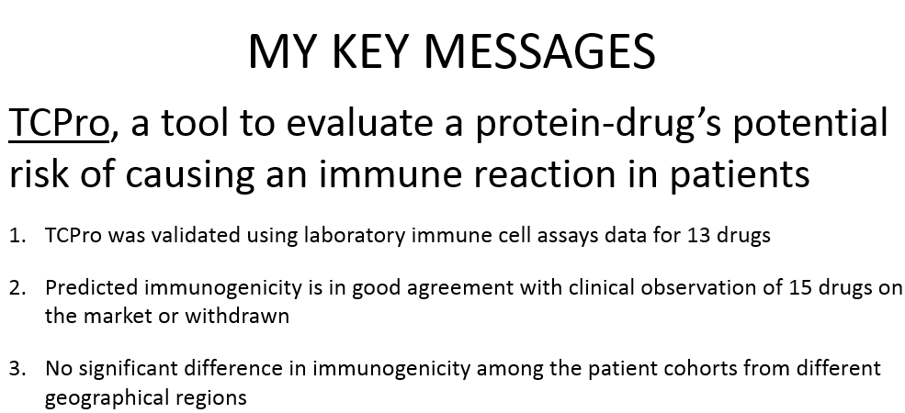
Biotherapeutic Protein Immunogenicity Risk Assessment with TCPro
DISCLOSURE
“I have no relevant financial relationships to disclose for this session.”
“My comments and contributions are an informal communication and represent my own best judgment. These comments do not bind or obligate FDA.”
Osman N Yogurtcu, FDA/CBER/OBE/ABRA [osman.yogurtcu@fda.hhs.gov]
ISCB ROCKY 2019 | Dec 5 – 7, 2019 | Aspen/Snowmass, CO
Notes:
0.25 min

Slide 2
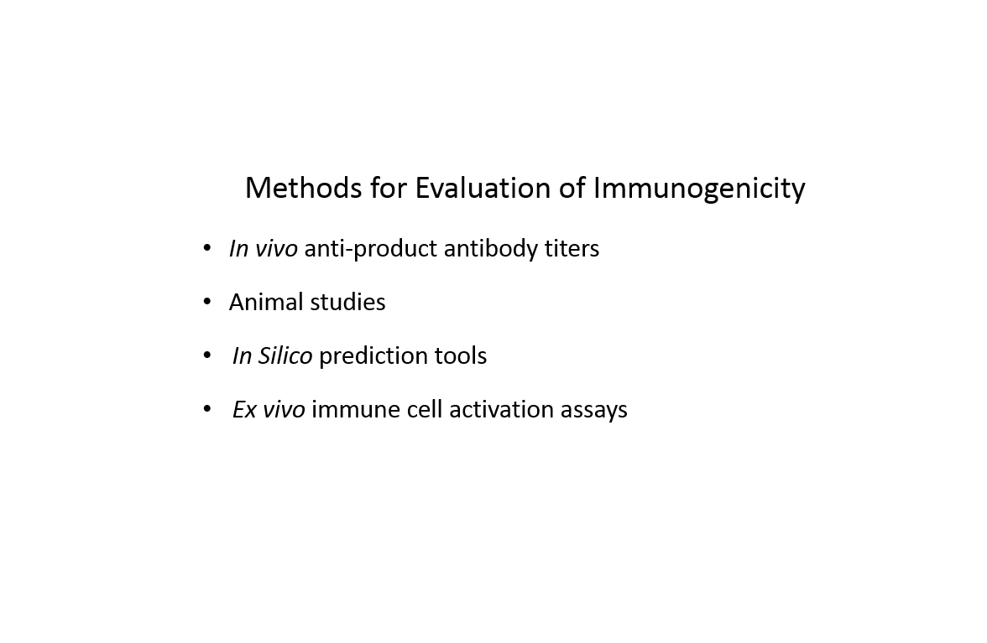
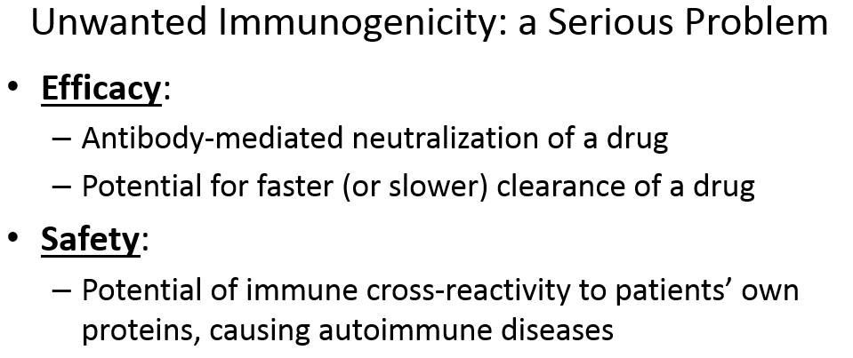

What is Immunogenicity?
Immunogenicity is the ability of a product to trigger an immune response in the body.
TCPro
IMMUNOGENICITY
Wanted Immunogenicity
Unwanted Immunogenicity
Biotherapeutic products
  Nucleotides
  Cells
  Proteins (e.g. Monoclonal antibodies)
TCPro
Notes:
1 min

Slide 3
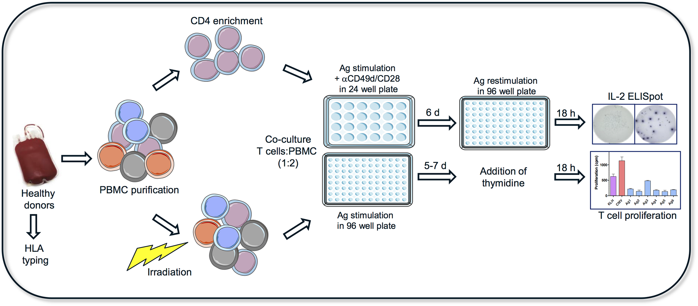
ex vivo T Cell Activation Assays:
Immunogenicity Risk Evaluation in the Lab
2. Collect Peripheral Blood Mononuclear Cells (PBMC) from the donors
4. Measure T Cell activation
1. Genetic sequencing of healthy donors for HLA allele
1
2
3
4
3. Coculture immune cells with the protein biotherapeutic
Schultz, Heidi S., et al. "Quantitative analysis of the CD4+ T cell response to therapeutic antibodies in healthy donors using a novel T cell: PBMC assay." PloS one 12.5 (2017): e0178544.
TYPICAL WORKFLOW OF ex vivo T CELL ACTIVATION ASSAYS
PRO: Successful predictor of clinical immunogenicity||CON: Very expensive, limited number of donors, takes ~2 Months
Notes:
1.5 min

Slide 4
What is TCPro?
TCPro is a computational tool that mimics ex vivo T cell activation assays to evaluate product immunogenicity risk using immunogenetic information of a larger population.
TCPro was written on Matlab
  Immune cell reaction mechanisms modeled with Ordinary Differential Equations
  All model parameters were obtained from published in vitro data
To run TCPro, the users would need three inputs:
  Amino acid sequence of the test product
  Immunogenomics of humans in the cohort - a list of patient HLA-DRB1 alleles
  Number of drug-cognizant Helper T cells in a patient’s body

Slide 5
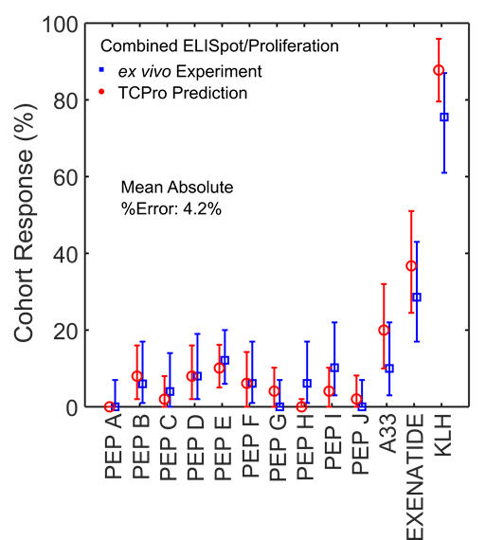
Validation of TCPro using Data from ex vivo T Cell Activation Assays
Immunogenicity assay data (FDA-OTAT)
  Blood samples from 50 healthy donors
  Donors are HLA allele-typed
  13 protein drugs tested
  %donors demonstrating immune response calculated
Use TCPro:
  Simulate the same assays in silico
  Absolute %error in the mean with TCPro is 4.2
ALSO, significant correlations with preclinical and clinical immunogenicity measurements of 15 protein-based biotherapeutics (on the market or withdrawn)

Slide 6
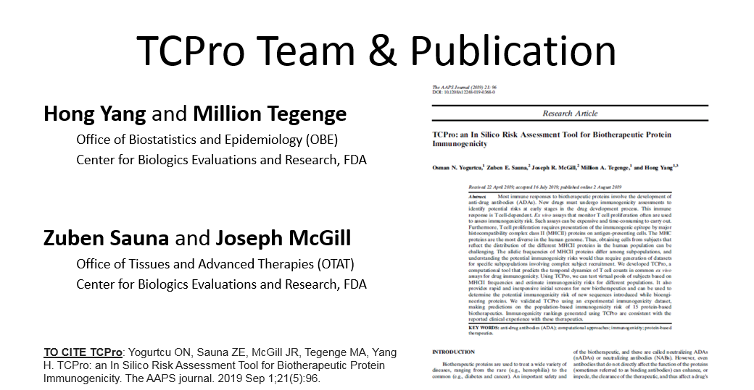

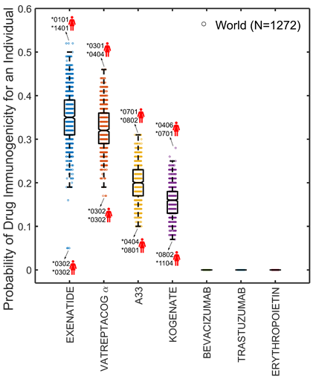
TCPro Predicts Large Variability in Immunogenicity of Individual Patients
1272 Virtual Patients tested on TCPro
  Obtained HLA-DRB immune allelic information from the 1000 Genomes*
We treated this virtual cohort with different full-length protein-based biotherapeutics
Our analysis showed a large degree of variability in patient responses for some of the drugs
  Each dot on the figure represents the probability of immunogenicity of one virtual patient with distinct set of immune alleles.
TCPro predicts insignificant differences among different ethno-geographic cohorts*
*1000 Genomes: www.internationalgenome.org/data
www.fda.gov/media/106725/download

