Slide 1



Enabling structure-based data-driven selection of targets for cancer immunotherapy
Dinler Amaral Antunes
Postdoctoral Research Associate
Rice University
Kavraki Lab at Rice University
Lizée Lab at UT MD Anderson
Houston/TX
Notes:
Thank you for the introduction,
My name is Dinler Antunes and I am a Postdoctoral Research Associate at Rice university, under Dr. Lydia Kavraki.

Slide 2
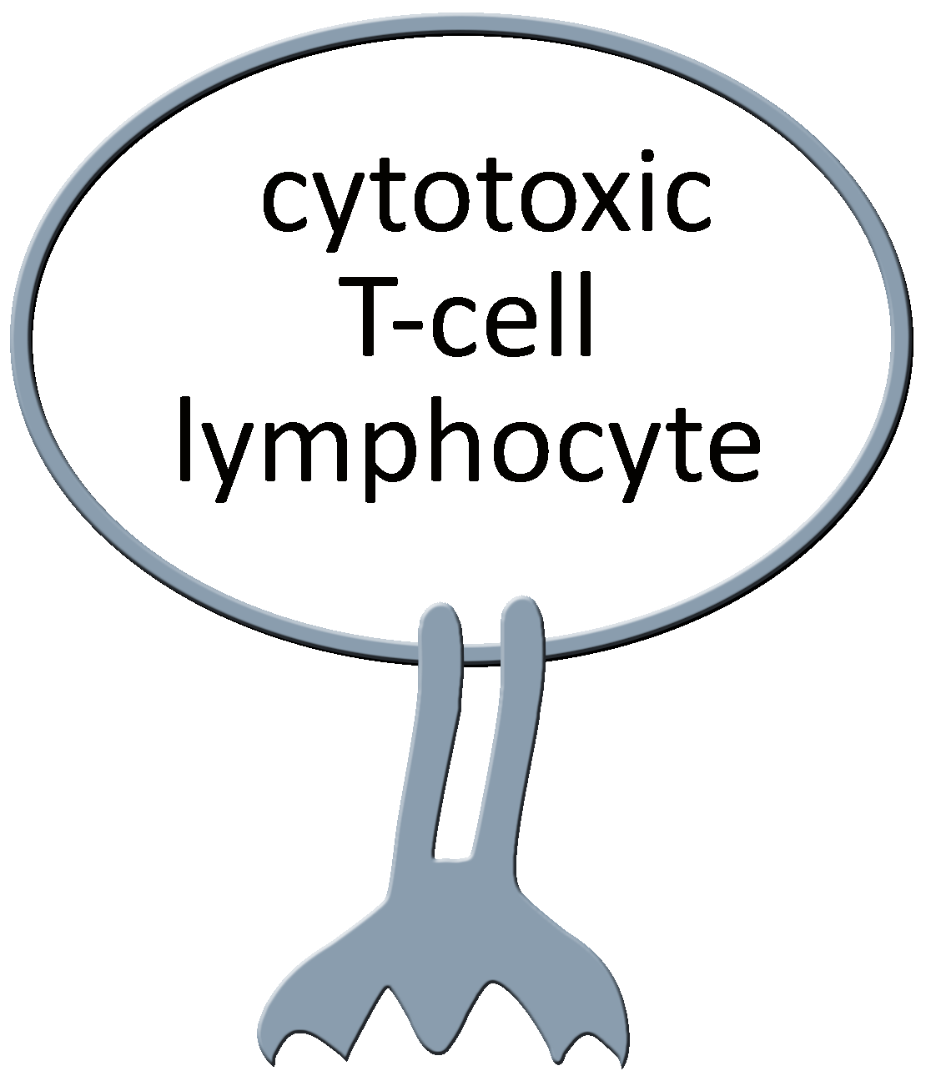
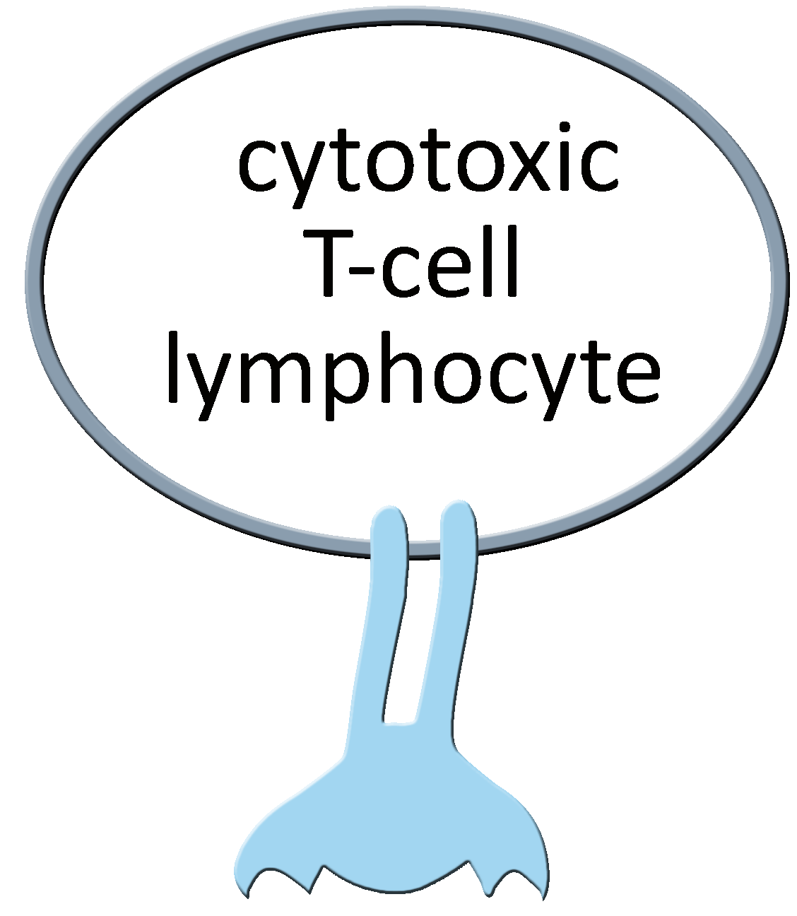
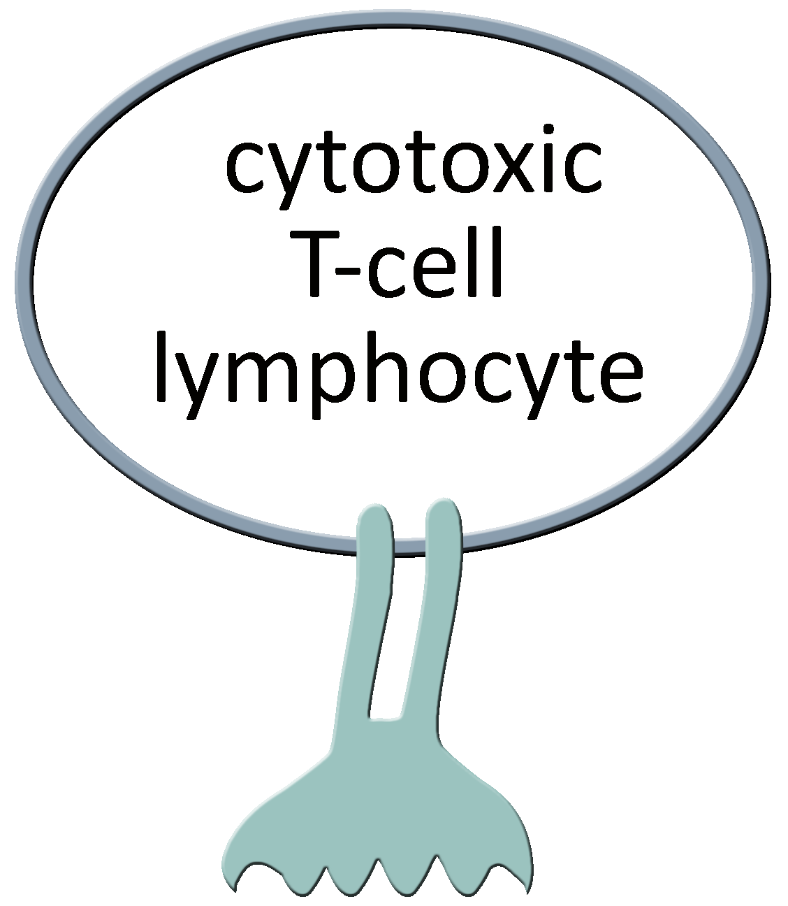
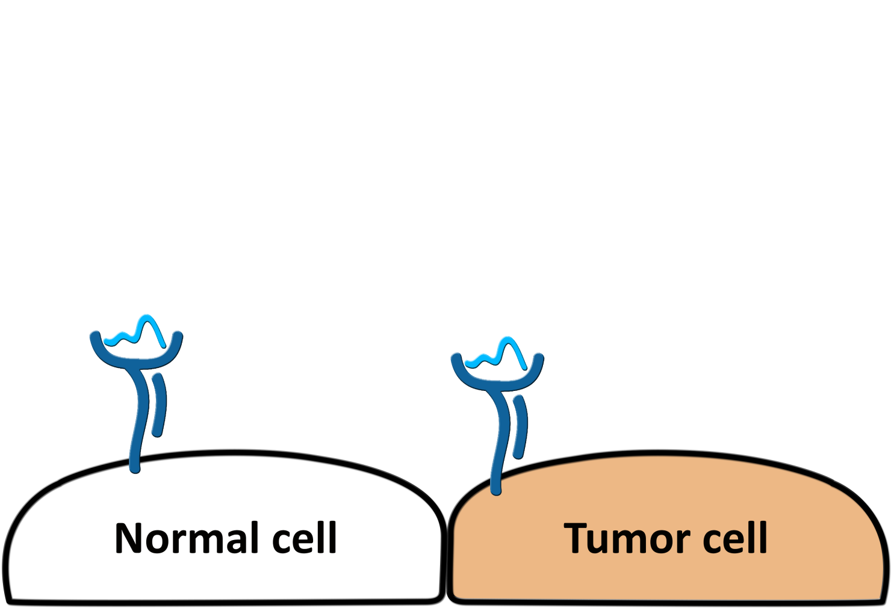
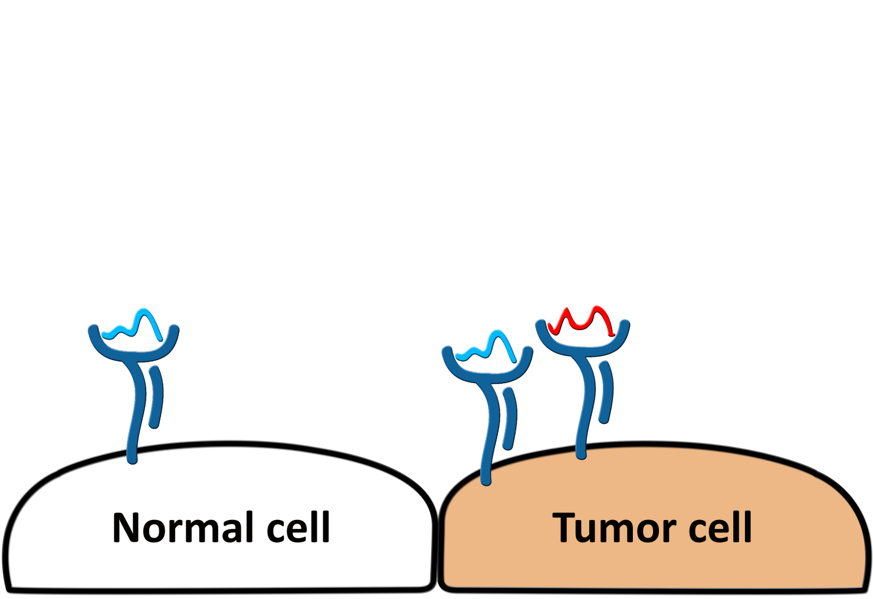
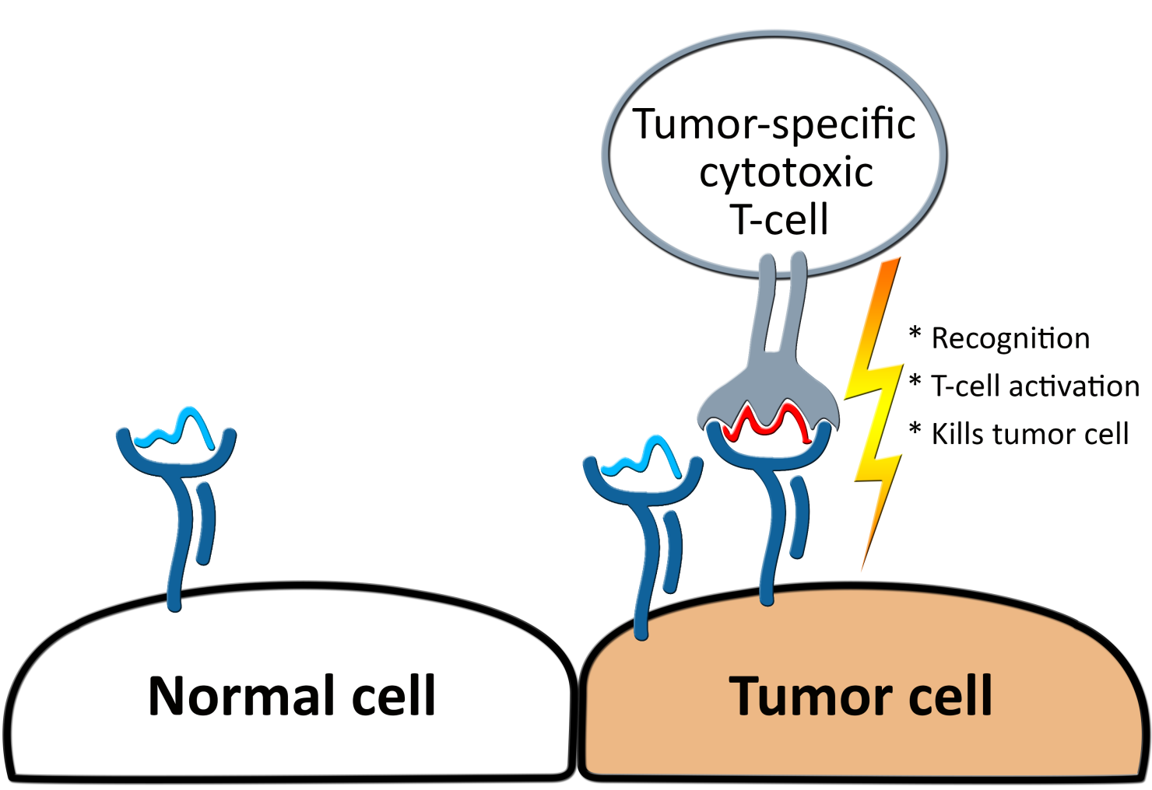
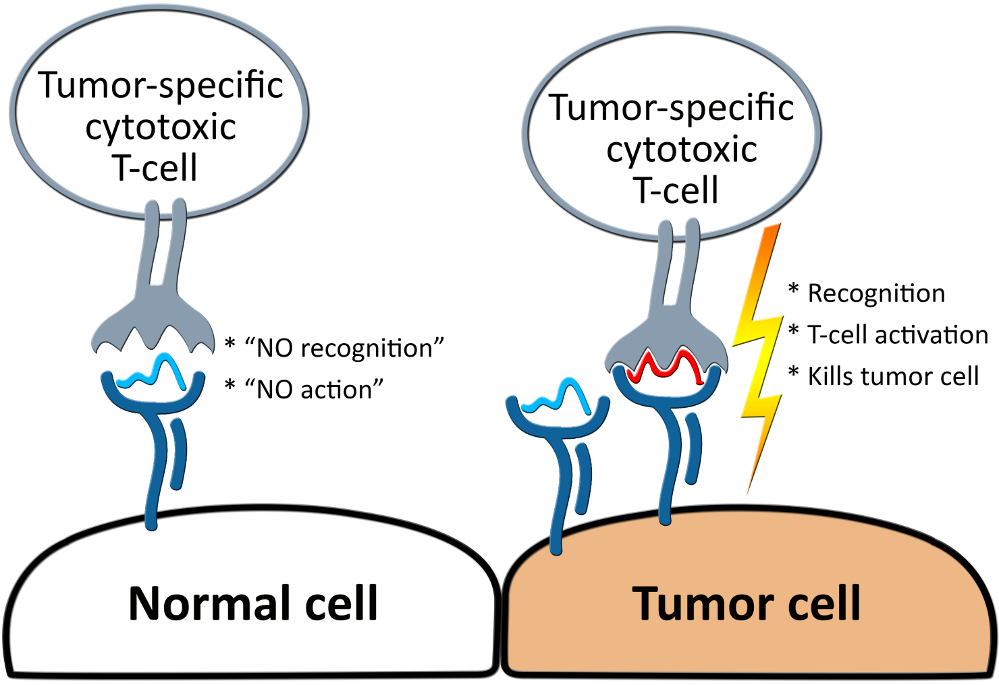
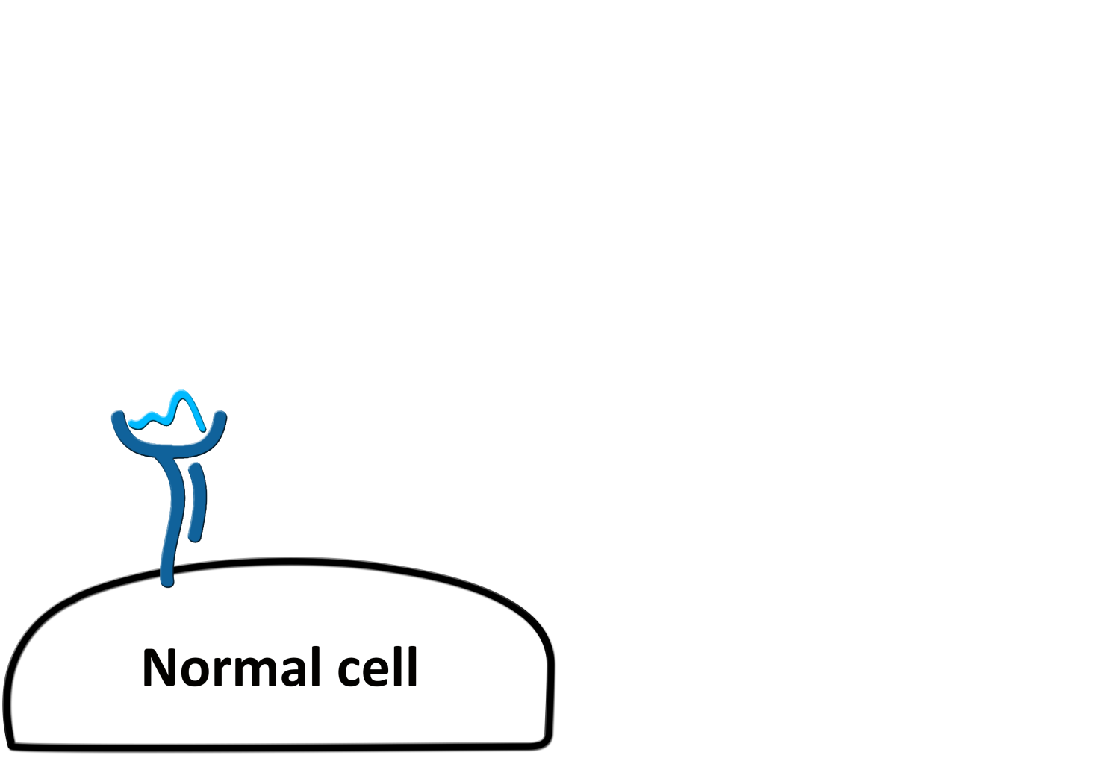
Cellular immunity to cancer
TCR
peptide
peptide-HLA (pHLA) complex
Class I HLA receptor
(Human Leukocyte Antigen)
Notes:
So let’s start by the key role of the HLA molecules in cellular immunity.
There is a sort of “quality control” mechanism that is present in almost every cell, through which a sample of intracellular proteins is cleaved into small peptides, which are in turn bound to a specific family of receptors (known as Human Leukocyte Antigens, or HLAs), and the resulting peptide-HLA complexes are displayed at the cell surface.
Through this mechanism, these intracellular peptides are now exposed to immune cells, such as tumor-specific cytotoxic T cell, which which can distinguish between self and foreign peptides. This is a pathway that evolved to identify and eliminate cells infected by viruses.
However, the same pathway is also present in tumor cells, which among regular self-peptides will also present some tumor-specific peptides (red). This unusual peptides will be recognized by tumor-specific T-cells, activating the T-cell that will kill the cancer cell.
And I refer to this particular T-cell as being “tumor-specific” in the sense that in a normal situation, this cell would not recognize any self peptide. Of course things are always more complicated, you have tumor evasion mechanisms, you might have off-target recognition, but the main point is that we can leverage this natural mechanism of tumor immunity, to have a treatment that is targeting only tumor cells, and that will find them, wherever they are.
A remarkable aspect of this mechanism is that a lot of the consequences of this molecular interaction, in terms of the level of activation of the T-cell, the specificity of this recognition and so on, is highly determined by structural features of the peptide-HLA complex.
REFs:
[1] Siegel RL, Miller KD, Jemal A. Cancer statistics, 2015. CA: a cancer journal for clinicians. 2016;66(1):7–30.
doi:10.3322/caac.21332.
[2] A. Rotte, M. Bhandaru, Y. Zhou, and K. J. McElwee. Immunotherapy of melanoma: present options and
future promises. Cancermetastasisreviews, 34(1):115–28, mar 2015. ISSN 1573-7233. doi: 10.1007/s10555-
014-9542-0. URL: http://www.ncbi.nlm.nih.gov/pubmed/25589384.
[3] G. Lizée, W. W. Overwijk, L. Radvanyi, J. Gao, P. Sharma, and P. Hwu. Harnessing the power of the
immune system to target cancer. Annual review of medicine, 64:71–90, 2013. ISSN 1545-326X. doi:
10.1146/annurev-med-112311-083918. URL: http://www.ncbi.nlm.nih.gov/pubmed/23092383

Slide 3
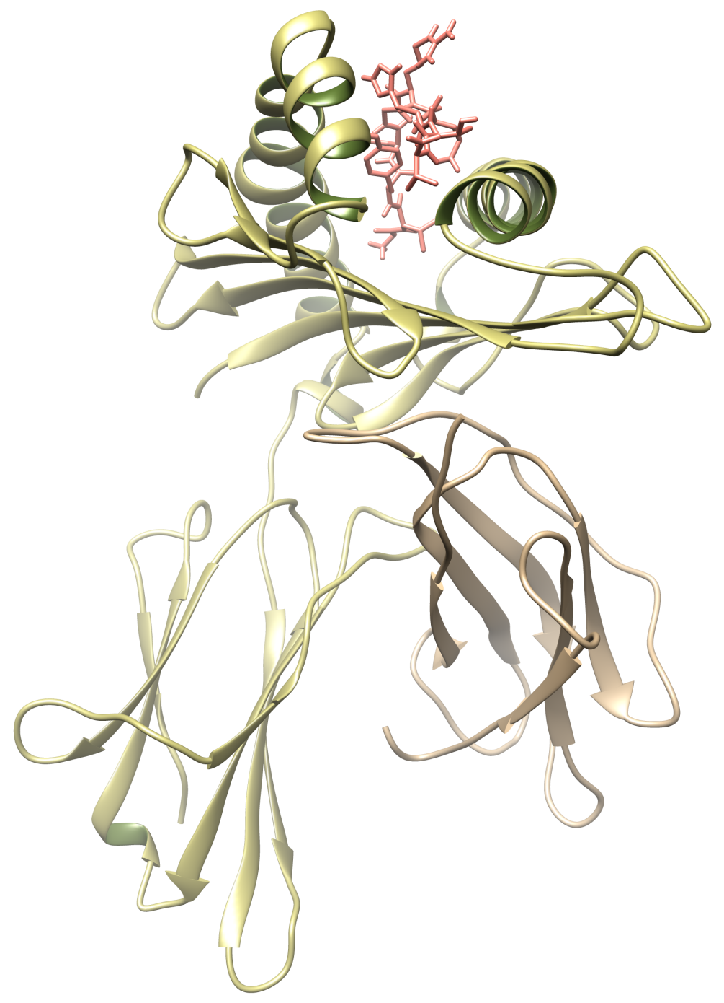
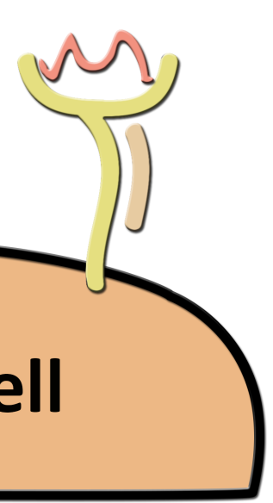

Structure of the pHLA complex
peptide
Heavy chain
(α chain)
Light chain
(β2-microglobulin)
peptide + HLA
(pHLA)
Notes:
To give you a better idea of the structure of this complex, here you have a cartoon representations of the two chains that form the HLA receptor, and a sticks representation of the peptide ligand bound to the HLA cleft.

Slide 4
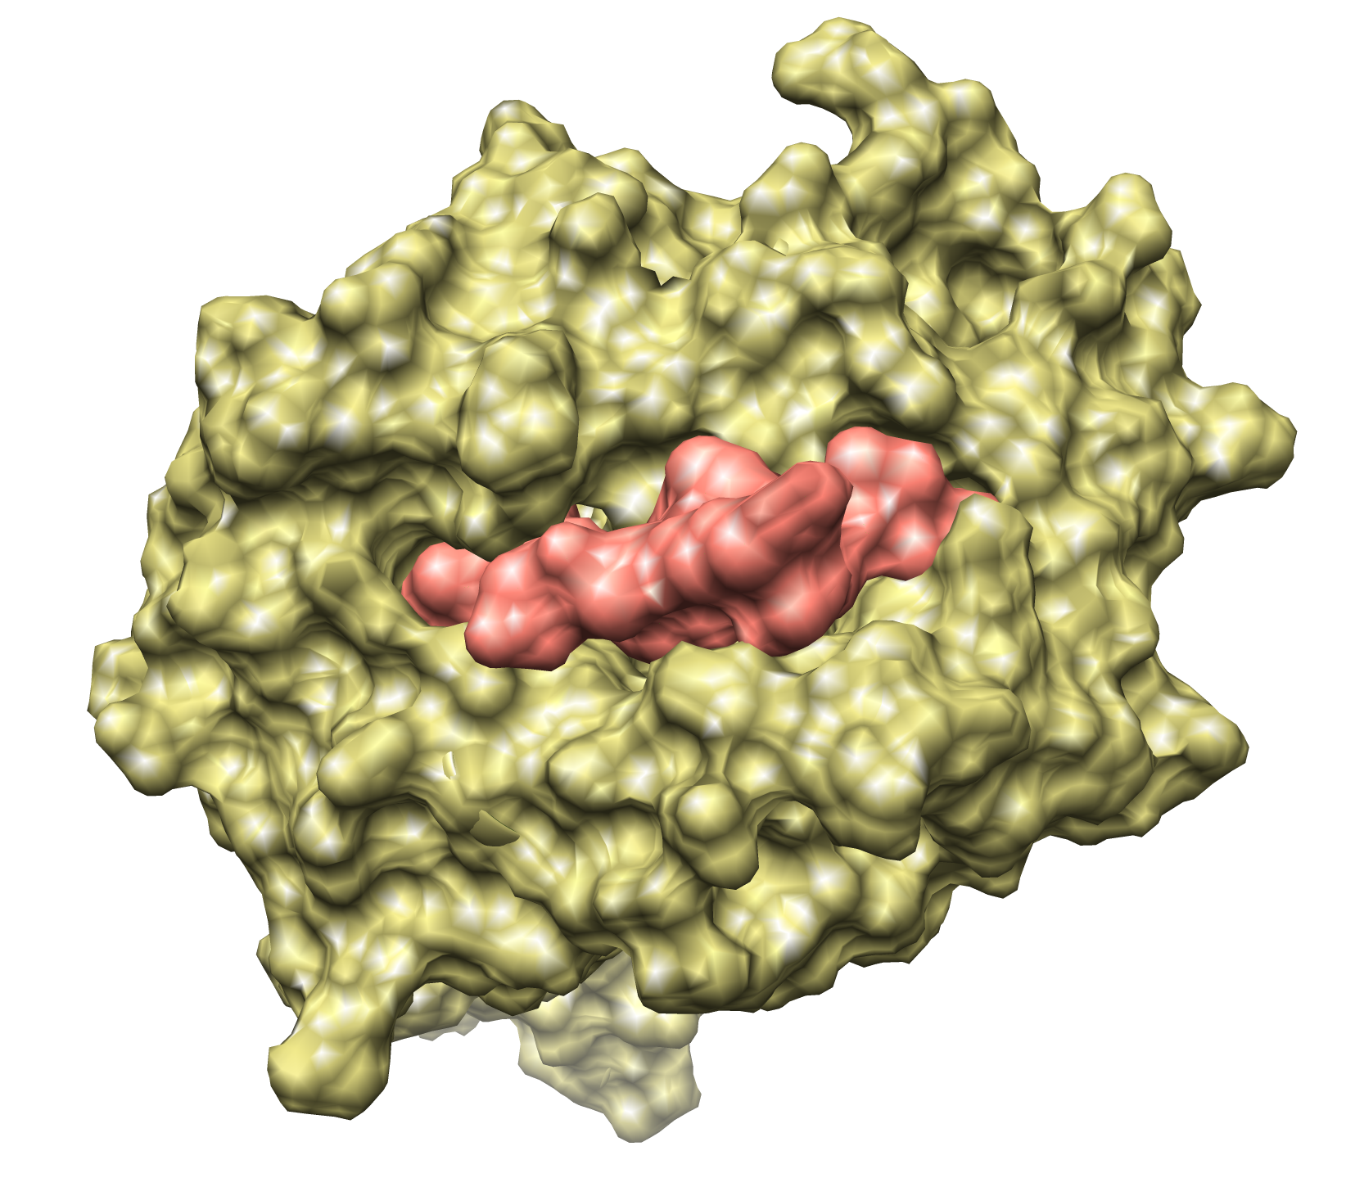
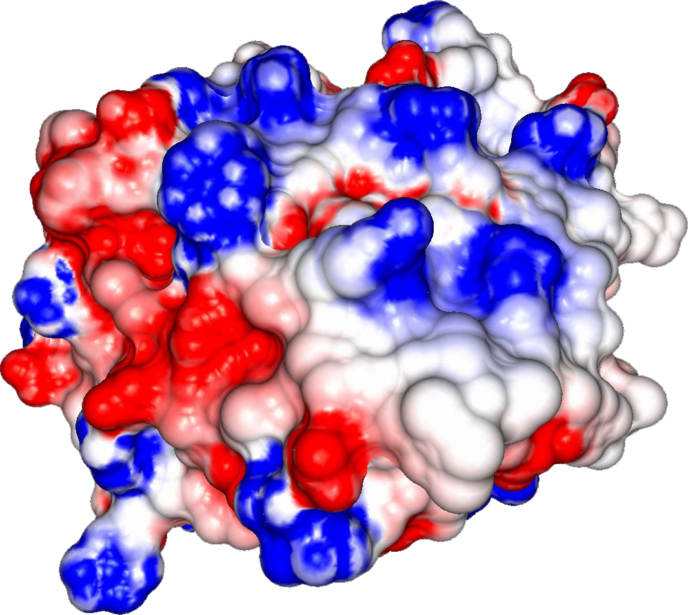
Structure of the pHLA complex (top view)
Notes:
Going one step forward, we can compute the electrostatic potential over this surface, here represented by colors (negatively charged regions in red, positive regions in blue).
This is the surface exposed for interaction with the T-cell receptor. And as you can see, there is no boundaries between ligand and receptor, it is actually one combined surface.
And this is a very important point, because each individual has a different subset of HLAs.

Slide 5
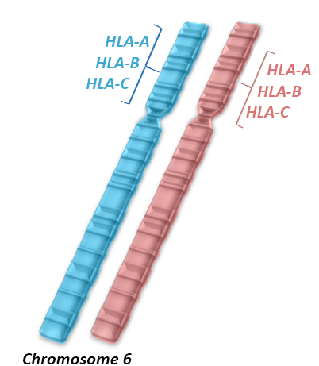
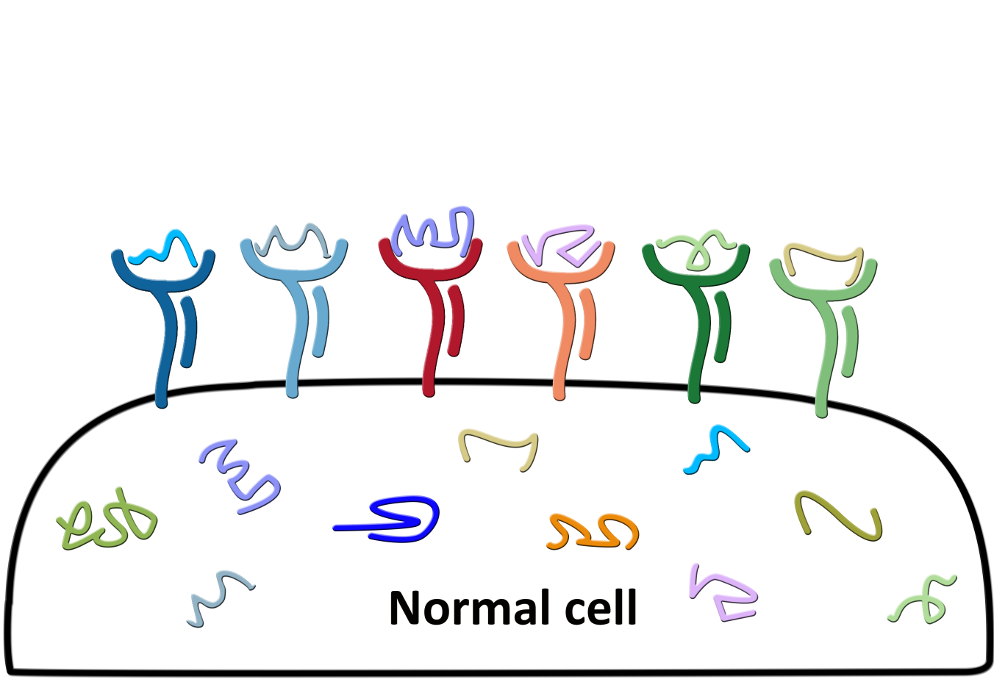
HLA diversity
More than 17,000 known alleles of class I HLAs in the human population!!!
Different HLAs display different pools of peptides
Notes:
These receptors are encoded by the most polymorphic genes in the human genome, and there are more than 10,000 alleles of the so called class I HLA genes (referred to as HLA-A, HLA-B, HLA-C). And each person will have two sets of these genes, therefore up to 6 different class I HLA receptors.
And each different HLA receptor will bind different subsets of peptides, they have affinity for different sequences. And even if you some overlap, that two HLAs can bind to the same peptide, they likely to present them in a different way.

Slide 6
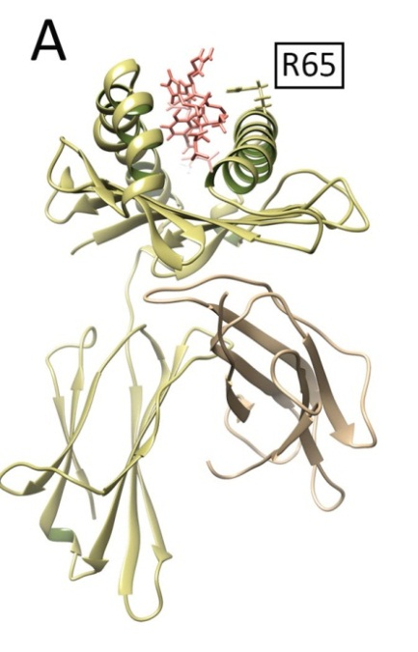
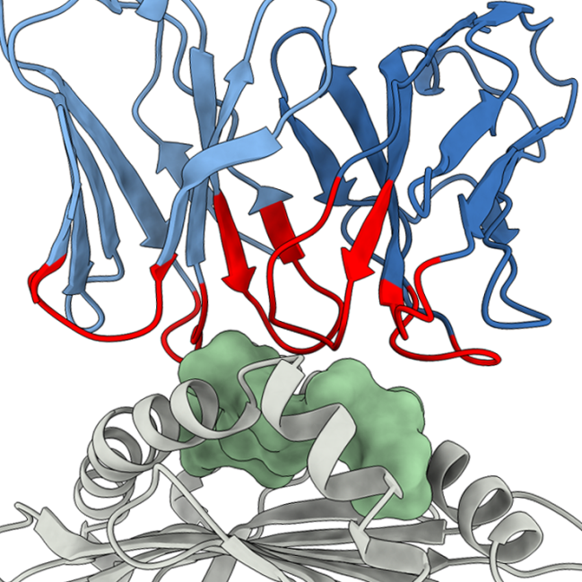
The Problem
T-cell-based Immunotherapies require
personalized analyses of peptide-HLA complexes
tumor-derived peptide
however…
Limited or unavailable data for most HLA alleles
patient-specific HLA
Lack of structural data prevents
the development of more general methods for HLA binding prediction, immunogenicity prediction,
off-target toxicity
Incomplete training
datasets lead to
inaccurate binding
affinity prediction
for HLA binders
Notes:
Therefore, our goal is to use computational methods to perform…

Slide 7
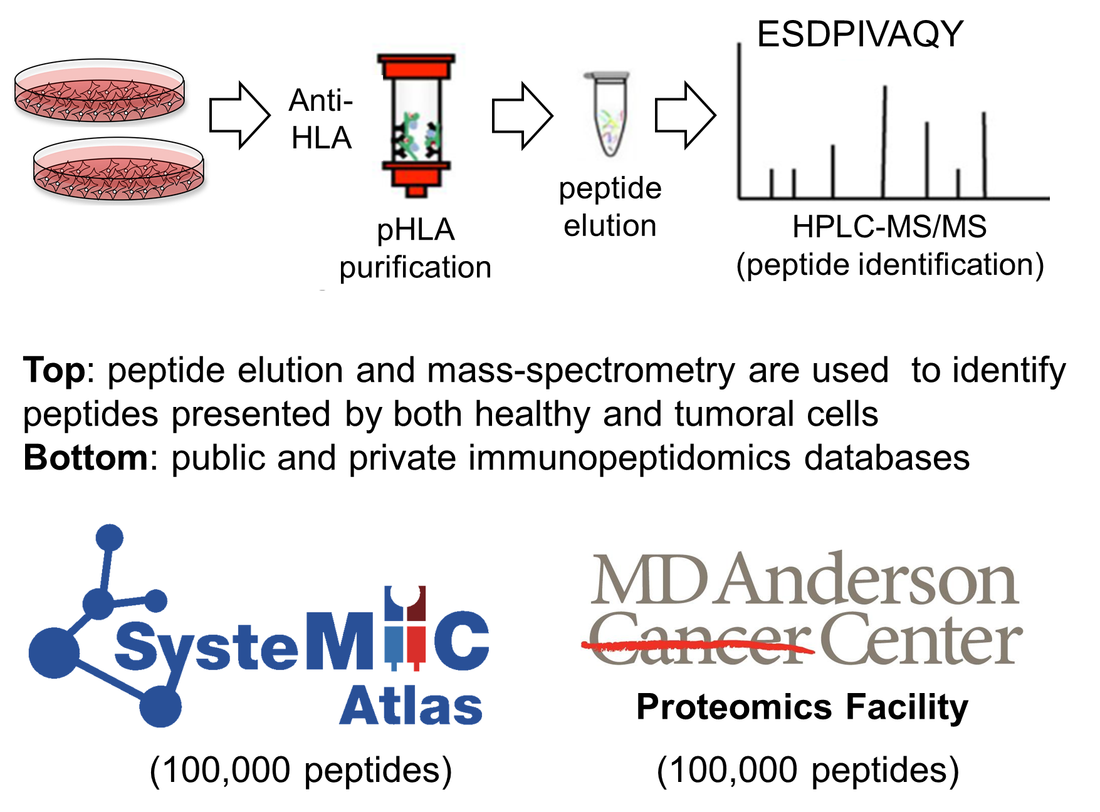
Growing body of immunopeptidomics data
Less than 800 crystal structures of pHLAs
currently available on the PDB

Slide 8
Objective
    Perform large-scale modeling
    of peptide-HLA complexes,
    using immunopeptidomics data
Notes:
Therefore, our goal is to use computational methods to perform…

Slide 9
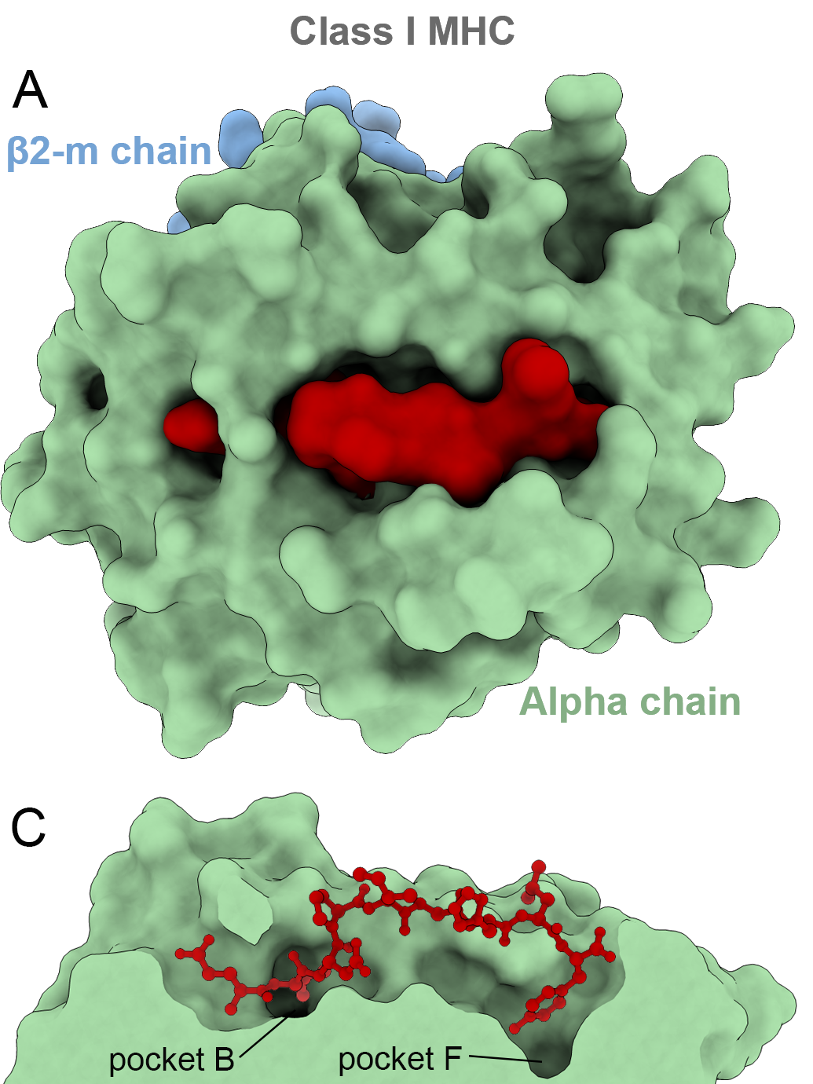
Docking-based prediction of pHLA complexes
APE-Gen:
Anchored
Peptide-HLA
Ensemble
Generator
(Abella et al., 2019)
Notes:
During the last 13 years or so, many groups have tackled this challenge
But since the flexibility of peptides is such a strong barrier for most docking-based approaches, the best alternative so far has been to provide ad hoc solutions.
Using information from crystal structures or using expert-knowledge to somehow constrain or bias the search.
Which means that these solutions only work for a few HLAs for which we have enough data. And if you remember the 10,000 HLA alleles that I have mentioned before, you will understand that a general solution is needed if we hope to provide personalized predictions

Slide 10
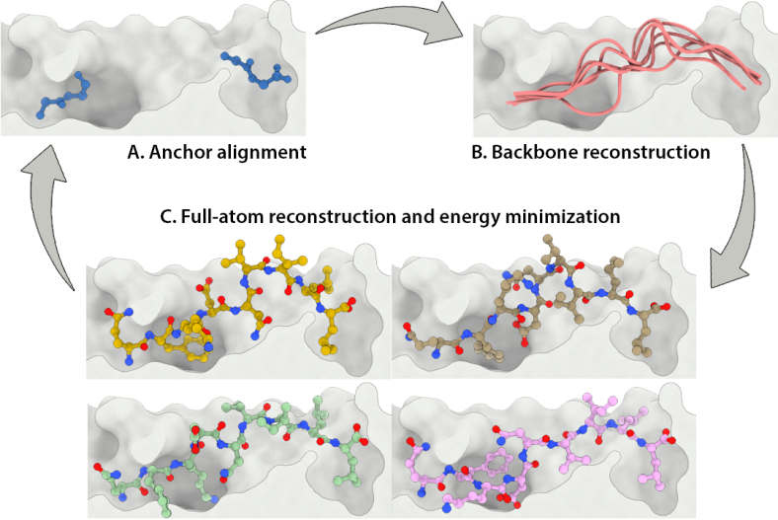
Fast generation of pHLA structures with APE-Gen
Abella et al., 2019
Notes:
During the last 13 years or so, many groups have tackled this challenge
But since the flexibility of peptides is such a strong barrier for most docking-based approaches, the best alternative so far has been to provide ad hoc solutions.
Using information from crystal structures or using expert-knowledge to somehow constrain or bias the search.
Which means that these solutions only work for a few HLAs for which we have enough data. And if you remember the 10,000 HLA alleles that I have mentioned before, you will understand that a general solution is needed if we hope to provide personalized predictions

Slide 11
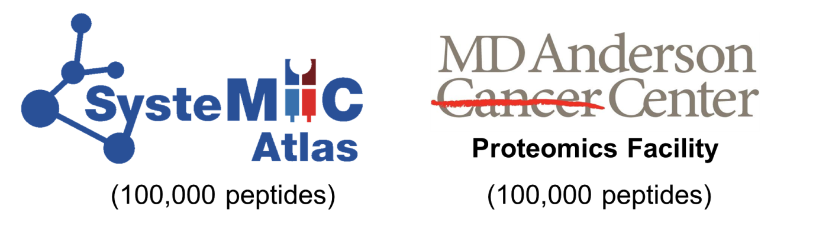


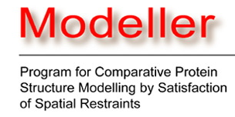

Large-scale 3D modeling of pHLA complexes
HLA 3D template
peptide sequence
3D ensemble
APE-Gen
HLA structure
HLA sequence
Local database
of pHLA structures
with eluted peptides

Slide 12
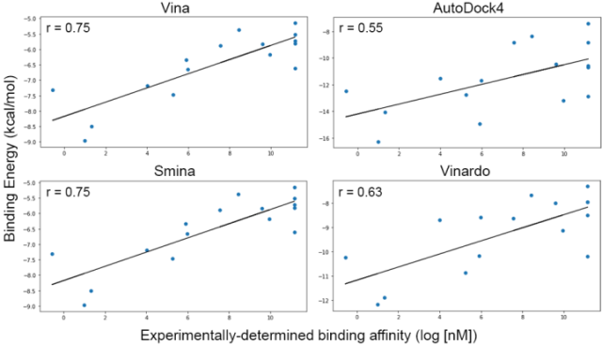
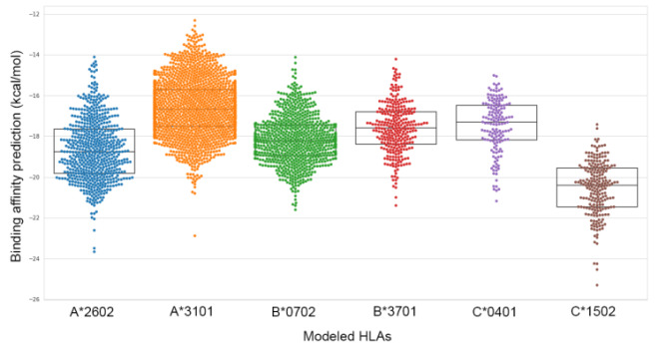
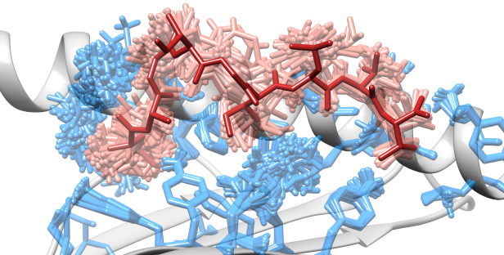
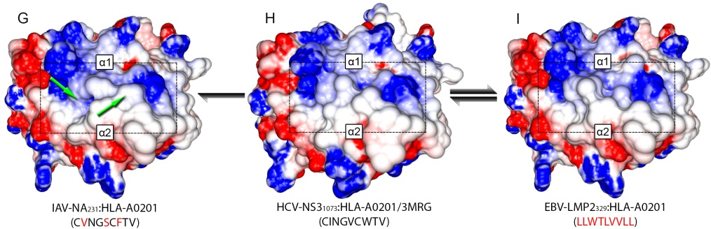
New avenues for pHLA structural analyses
Benchmark and development of new scoring functions
Local database
of pHLA structures
with eluted peptides
(> 130,000)
Structure-based virtual screening/classification
Analysis of pHLA
stability and dynamics
Prediction of off-target toxicity in cancer immunotherapy

Slide 13
Conclusions
    APE-Gen is a fast method to model pHLA structures
    We have modeled more than 130,000 pHLAs with peptides from immunopeptidomics projects
    This database of modeled 3D structures opens new avenues for structural and data-driven analysis
    We plan to make all our resources available to the community (methods and datasets)
Notes:
Therefore, our goal is to use computational methods to perform…

Slide 14






Acknowledgements
Rice University (TX, US)
  Lydia Kavraki
  Jayvee Abella
  Didier Devaurs
  Sarah Hall-Swan
  Mark Moll
  Nicole Mitchell
  Anja Conev
UT MD Anderson (TX, US)
  Gregory Lizée
  Cassian Yee
  Kyle Jackson

Slide 15
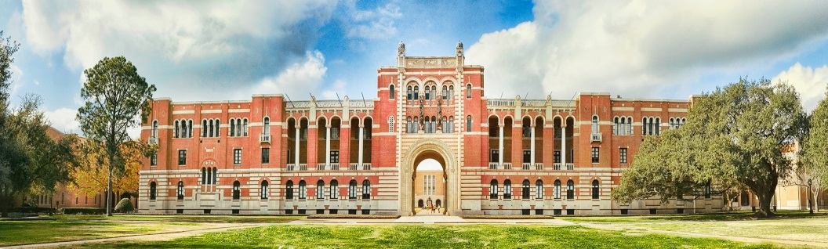

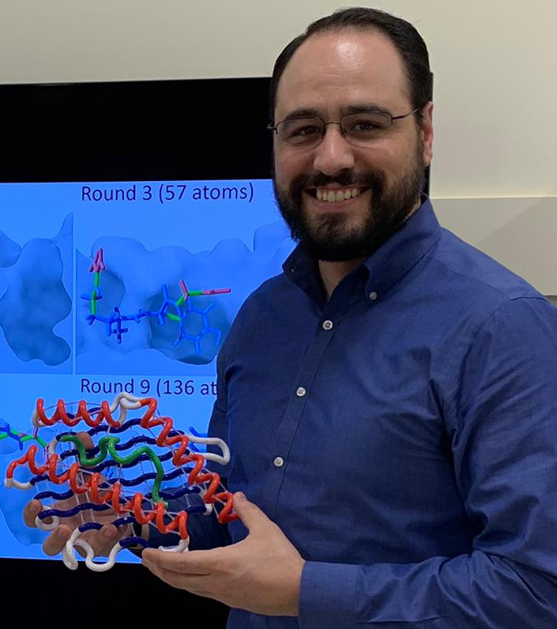
Rice University
Houston – Texas/US
dinler@rice.edu
dinlerantunes.com

