Slide 1
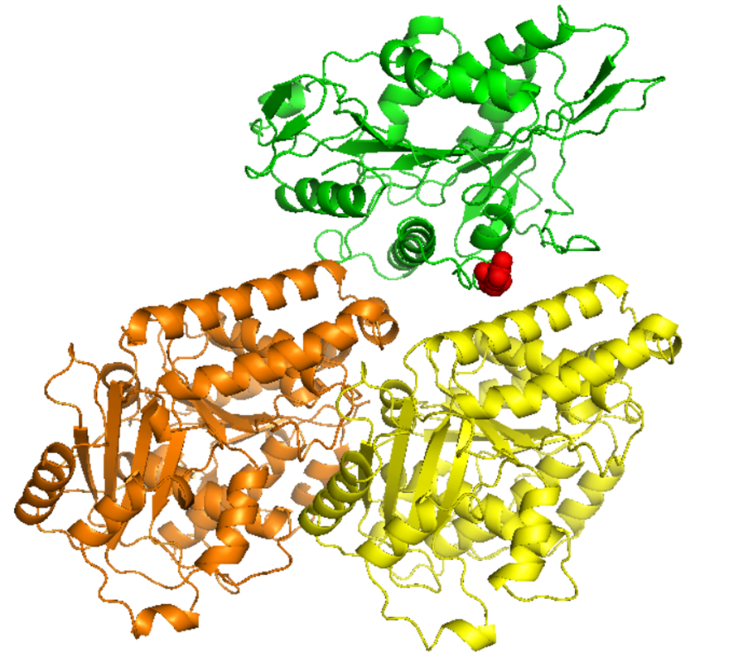
Rocky 2019
Computational Analysis of Kinesin Mutations Implicated in Hereditary Spastic Paraplegias
Shaolei Teng
Department of Biology
Howard University

Slide 2
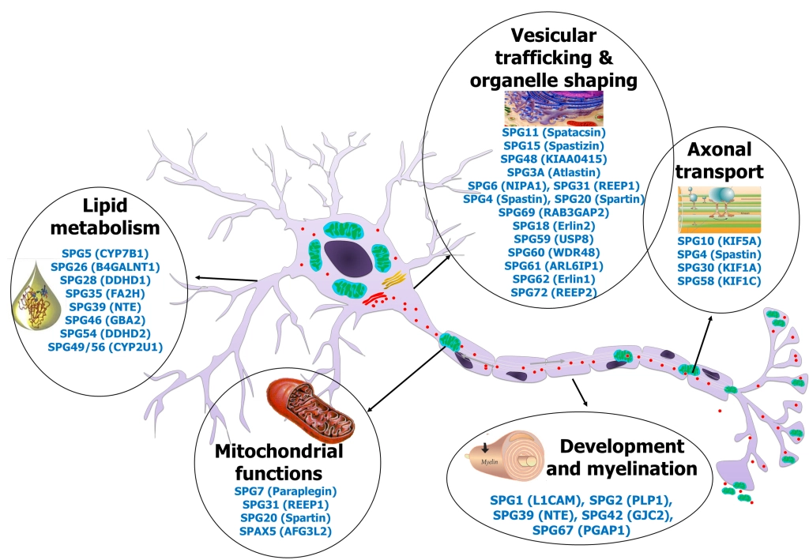
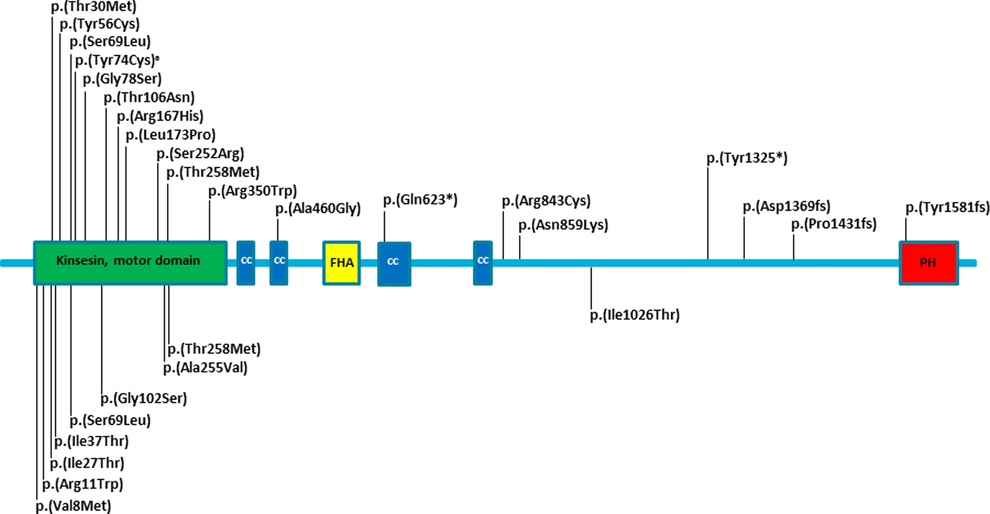
Hereditary Spastic Paraplegia (HSP) and Kinesin Mutations
HSPs: rare genetically neurodegenerative disorders characterized various neurological features including progressive spastic weakness, urinary sphincter dysfunction, extra pyramidal signs and intellectual disability (ID).
> 76 different spastic gait disease-loci with 59 corresponding spastic paraplegia genes (SPGs): Spartin (SPG20), KIF1A (SPG30), KIF5A (SPG10), etc.
Kinesin family proteins (KIFs): microtubule-dependent molecular motors that directionally transport membrane vesicles, protein complexes and mRNAs.
https://spatax.wordpress.com/
“Variants in the KIF1A gene can cause autosomal recessive spastic paraplegia 30, autosomal recessive hereditary sensory neuropathy, or autosomal (de novo) dominant mental retardation type 9.”
Eur J Hum Genet. 2019 Sep 5.

Slide 3
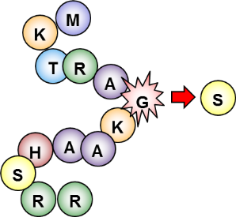
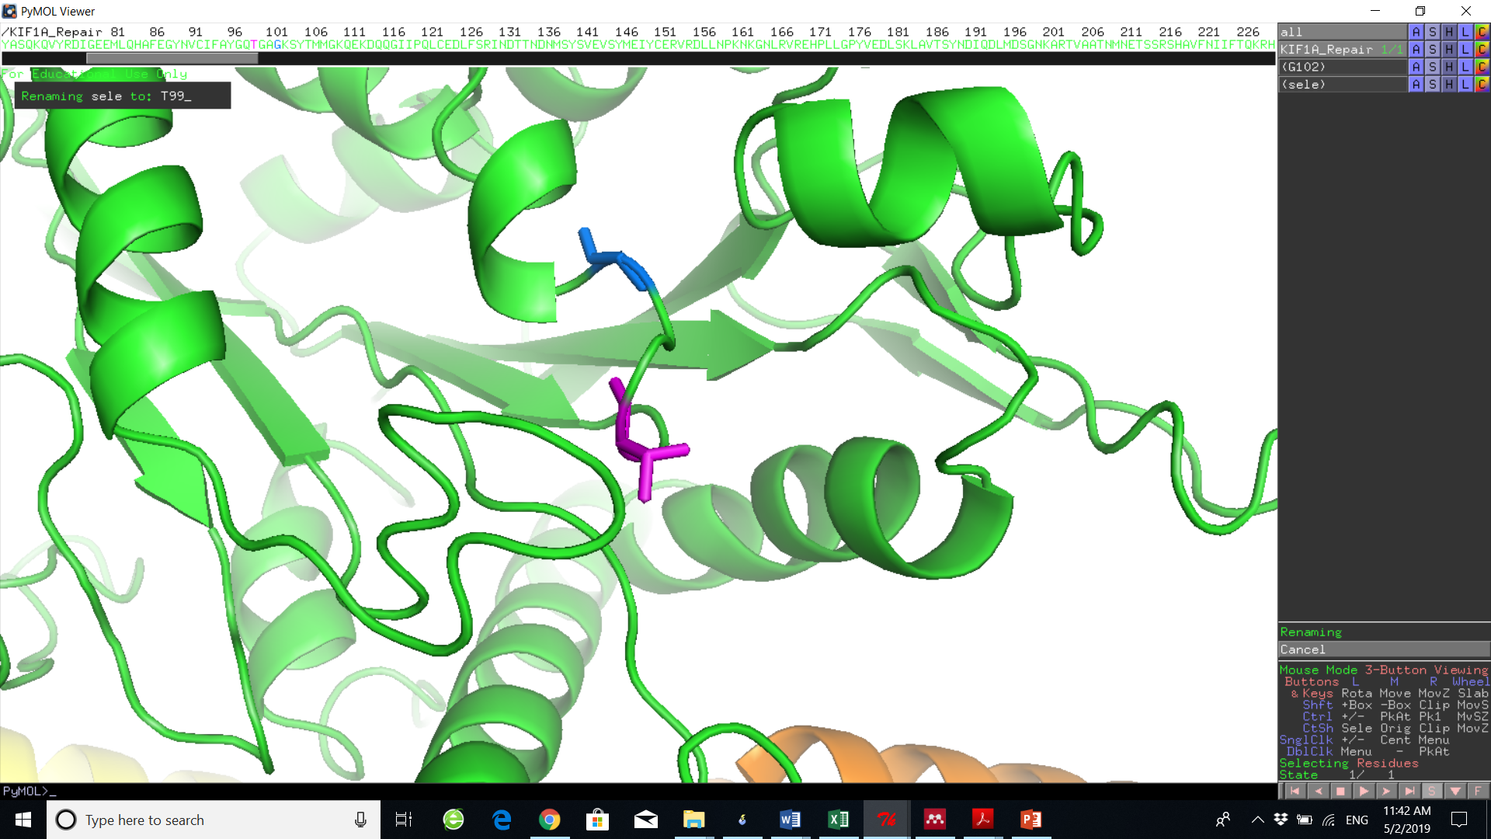
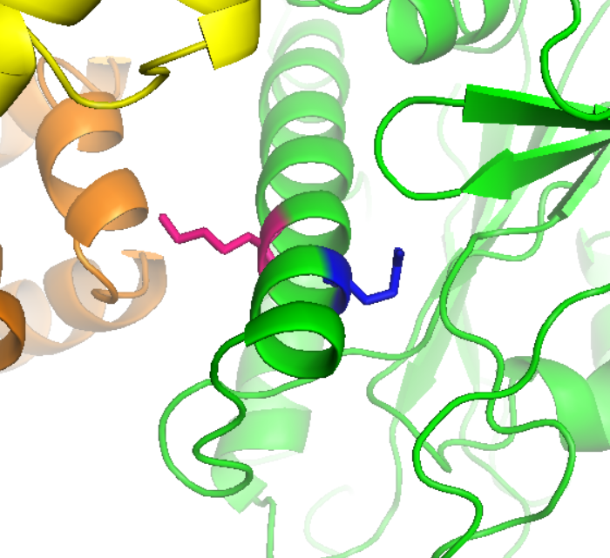
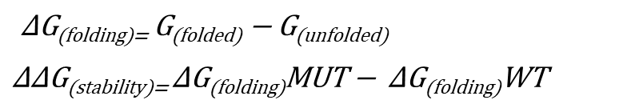
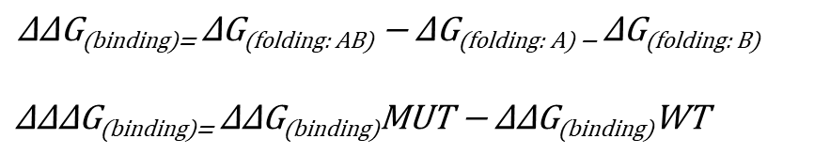
Approach
40 HSP & ID
Mutations
PDB
KIFs
Mouse
HGMD
Homology modeling
KIF1A & 5A
Motor Domain (MD)
Human
ClinVar
Tubulin
Mutation Pathogenicity
CADD
Protein Stability
(Folding Energy Change)
Protein-Protein Interaction
(Binding Energy Change)
Destabilize MD
Destabilize Kinesin-Tubulin
Conservation Score
phyloP
> 0
> 0
Stabilize MD
Stabilize Kinesin-Tubulin
< 0
< 0
ΔΔG > 0: Destabilize monomer
ΔΔΔG > 0: Destabilize complex, weaken affinity
ΔΔG < 0: Stabilize monomer
ΔΔΔG < 0: Stabilize complex, strengthen affinity

Slide 4
The Effects of Kinesin Mutations
Protein Stability (ΔΔG: Folding Energy Change)
Protein-Protein Interaction (ΔΔΔG:Binding Energy Change)

Slide 5
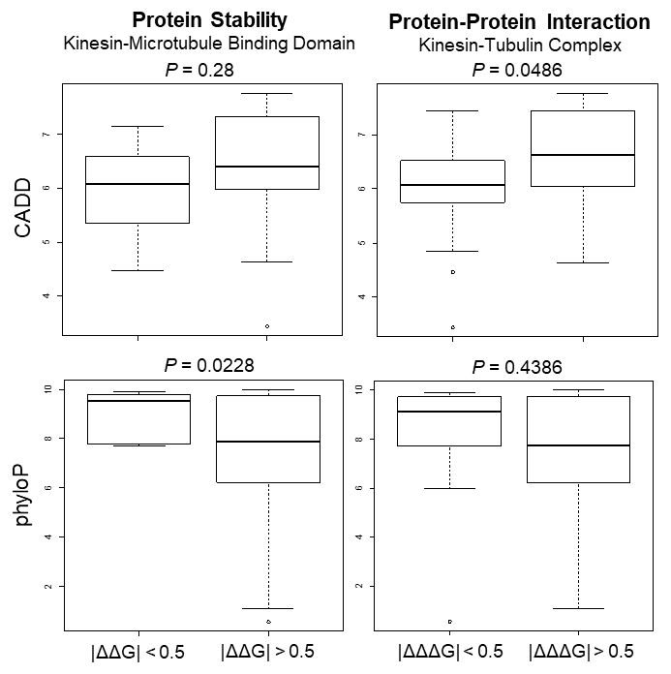
Mutation Pathogenicity and Conservation
The mutations affecting protein-protein interaction could cause significant damaging effects on kinesin function
Kinesin mutations with small effects on protein stability of kinesin monomer domains are more conserved in mammalians.
S69

Slide 6
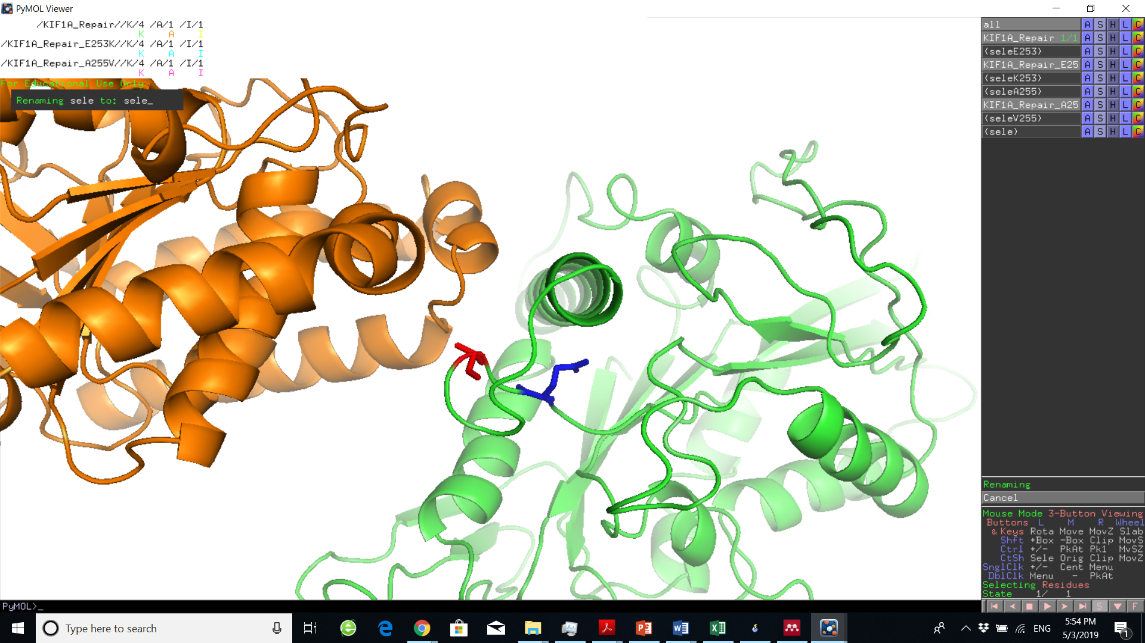
Kinesin Mutations associated with ID and HSP
KIF1A Mutations associated with ID and HSP
KIF5A Mutations associated with HSP
Mutation | ΔΔG | ΔΔΔG | phyloP | CADD | Disease
E253K | 12.95 | -0.789 | 7.67 | 7.303 | ID
A255V | 1.543 | 2.194 | 9.693 | 5.979 | HSP
Mutation | ΔΔG | ΔΔΔG | phyloP | CADD | Disease
E251K | 7.924 | -0.68 | 10 | 7.322 | HSP
K253N | -1.83 | 1.401 | 1.092 | 6.094 | HSP
K253
A255
E251
E253
ID-related mutation E253K in KIF1A can significantly destabilize the protein stability of kinesin-microtubule binding domains.
HSP mutation K253N in KIF5A, located in complex interface, can reduce the binding affinity of kinesin-tubulin complex.

