Slide 1
Development of clinically relevant tests from human serum samples: a look at the circulating proteome
Heinrich Roder, Biodesix Inc.
Rocky 19

Slide 2
Outline
The circulating proteome
Machine learning, “Big Data” and “Deep Data”
  Diagnostic Cortex® platform – machine learning approach optimized for Deep Data setting
    Incorporating elements of traditional and modern machine learning
Examples of validated, clinically relevant molecular diagnostic development based on the circulating proteome
Biology
  Set enrichment analysis of proteomic tests

Slide 3
The Circulating Proteome

Slide 4
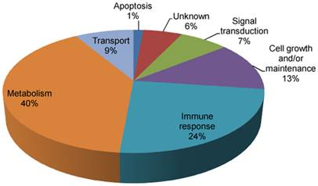
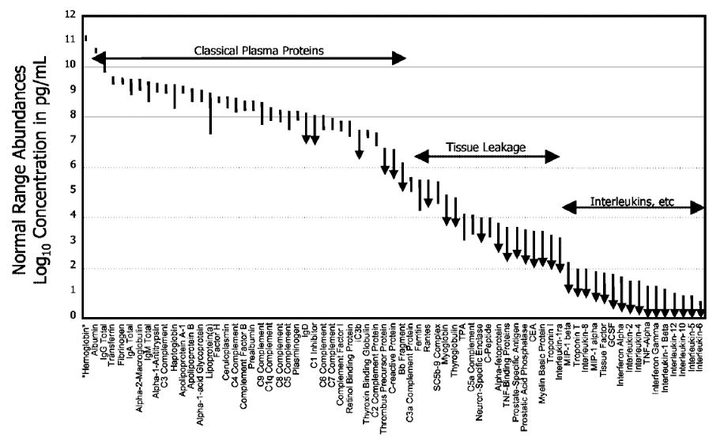
The Circulating Proteome and Cancer Immunology
The circulating proteome may reflect the host immune state.
The circulating proteome is derived from tumor, tumor microenvironment, and normal host tissues¹
The circulating proteome changes during tumor development and as a result of treatment
Circulating proteins have direct regulatory effects on the immune system
Dynamic range of circulating proteins²
From pre-treatment samples Biodesix developed and validated multiple tests for different indications combining measurements of circulating proteome with outcome data via modern machine learning.
¹S. Pitteri et al. Cancer Research (2011) ; ²Gautam P et al. (2013)

Slide 5
Machine learning, Big Data and Deep Data

Slide 6
Impacts of machine learning and artificial intelligence
Everyday life
NLP, speech recognition (smart speakers, phones, call centers, …)
Image recognition (Google Images, facial recognition,….)
Recommender systems (search engines, shopping, …)
Software as a Medical Device
“FDA permits marketing of clinical decision support software for alerting providers of a potential stroke in patients”, 2/13/2018 (https://www.fda.gov/news-events/press-announcements/fda-permits-marketing-clinical-decision-support-software-alerting-providers-potential-stroke)
“FDA permits marketing of artificial intelligence-based device to detect certain diabetes-related eye problems, 4/11/2018 (https://www.fda.gov/news-events/press-announcements/fda-permits-marketing-artificial-intelligence-based-device-detect-certain-diabetes-related-eye)
“FDA permits marketing of artificial intelligence algorithm for aiding providers in detecting wrist fractures, 5/24/2018 (https://www.fda.gov/news-events/press-announcements/fda-permits-marketing-artificial-intelligence-algorithm-aiding-providers-detecting-wrist-fractures

Slide 7
Why can’t we use ‘out-of-the-box’ deep learning nets?
Deep Learning works well with Big Data (very many training examples)
“As of 2016, a rough rule of thumb is that a supervised deep learning algorithm will generally achieve acceptable performance with around 5,000 labeled training examples per category and will match or exceed human performance when training with a dataset containing at least 10 million labeled examples.”
- Deep Learning, Goodfellow, Bengio, and Courville, MIT Press 2017
Molecular diagnostics problems are characterized by few training examples and Deep Data
Curse of dimensionality (“p>N”, i.e. more attributes (features) than samples)
Data augmentation difficult

Slide 8
What aspects of deep learning can we use?
Hierarchical approaches
Abstractive approaches
Avoid feature selection by allowing the machine to decide how to combine all attributes
Regularization (methods used to solve an ill-posed problem or prevent overfitting): deep learning makes extensive use of regularization, often by “drop-out”¹
And from traditional machine learning:
Ensemble averaging (“bagging”²)
“Boosting”³
References: 1. Srivastava et al, J Mach Learn Res 15:1929 (2014); 2. Breiman, Mach Learn 24:123 (1996); 3. Shapire, Mach Learn 5:197 (1990).

Slide 9
How should we incorporate subject matter expertise?
Do use subject matter knowledge for things the ML cannot learn:
Assessing suitability of training set (population, confounders)
Defining clinically relevant endpoints to measure test performance
Preprocessing of proteomic/genomic data
  Minimization of batch effects
  Correcting for differences between data measurement platforms
  Preprocessing to maximize data accuracy and reproducibility
Do not use subject matter knowledge for things the ML can learn:
Selecting features/attributes to include in the ML
Constraining the learning to yield an “easy-to-understand” model

Slide 10
Diagnostic Cortex® Platform: A machine learning platform optimized for the design of molecular diagnostic tests

Slide 11
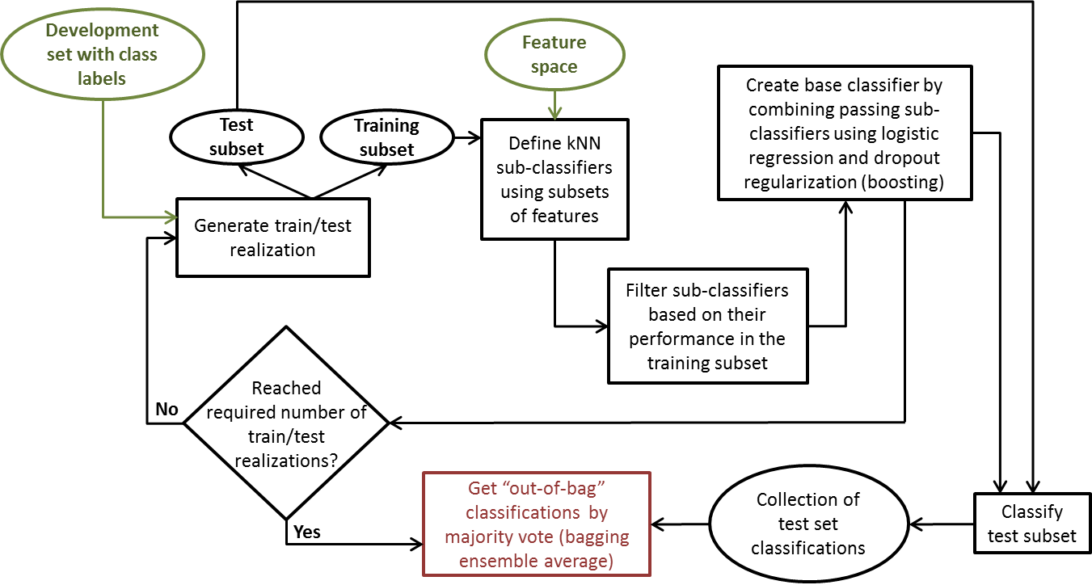
The Diagnostic Cortex Platform
References: Roder et al, BMC Bioinformatics 20:325 (2019) .

Slide 12
Ensemble Averaging - “bagging”
Minimize risk of overfitting
Avoid extremes in test or
training sets
Get reliable (‘test set’)
classifications for all
samples via “out-of-bag
estimates”²
Reliable test performance
estimates from
development set
References: 1. Breiman, Mach Learn 24:123 (1996); 2. Breiman Stanford University Technical Report (1996).

Slide 13
Abstraction and Hierarchy
Increase robustness to noise
in input data
“Information bottleneck”¹
Learning on multiple levels
References: 1. Tishby et al, arXiv:physics/0004057 [physics.data-an];

Slide 14
Regularization via “drop-out”
No need for feature
reduction or selection
Minimize risk of overfitting
References: 1. Srivastava et al, J Mach Learn Res 15:1929 (2014); 3. Shapire, Mach Learn 5:197 (1990).

Slide 15
Definition of Training Classes
Assigning training class labels
  Training class labels can have errors, e.g. histology
  Gold standard endpoints (e.g. overall survival) may not be categorical
  It may not be clear from outcome data who benefits from therapy
Generate test and training labels simultaneously…
Start with a guess of labels
Build a test for these labels
Classify samples and use the classifications as new training labels
Build a new test for these new labels
Iterate to convergence
5
1
At convergence we find labels that are consistent with the molecular data.
We want to discover a robust molecular phenotype associated with a clinically relevant endpoint
  Molecular data have measurement errors
  Training data (instances) give sparse coverage of molecular feature space
4
2
3
References: Roder et al, BMC Bioinformatics 20:273 (2019)

Slide 16
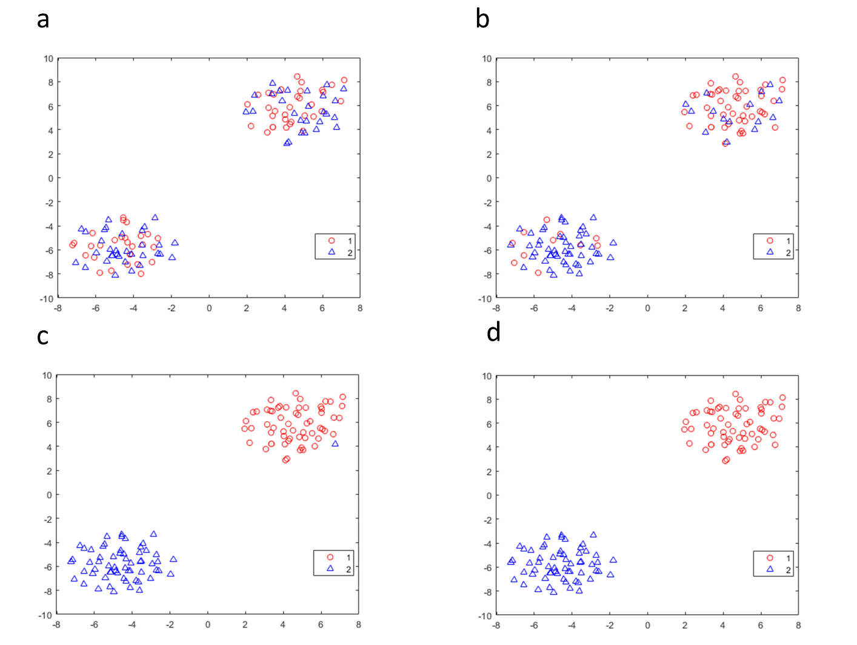
Illustration with Synthetic Data
Create a dataset with 1,000 attributes measured for 60 samples each for 2 phenotypes 1 and 2.
Phenotypes 1 and 2 defined by distribution of attributes
Attributes assigned at random
Survival assigned at random, survival rescaled for Phenotype 2 depending on attribute values to give this phenotype worse prognosis.
Kaplan-Meier plots of dataset, Hazard ratio = 0.75
t-SNE plots of development set samples with initial training class labels and final classification labels a. Initial median dichotomized b. initial classifier results c. results after 1 iteration d. final results (2 iterations)
References: Roder et al, BMC Bioinformatics 20:273 (2019)

Slide 17
Applications

Slide 18
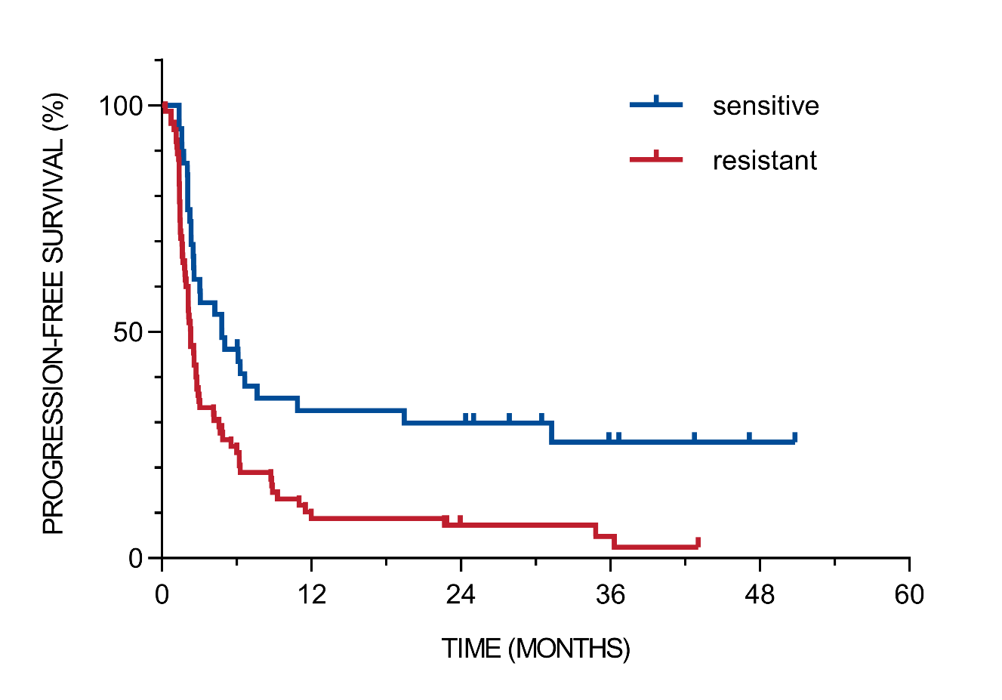
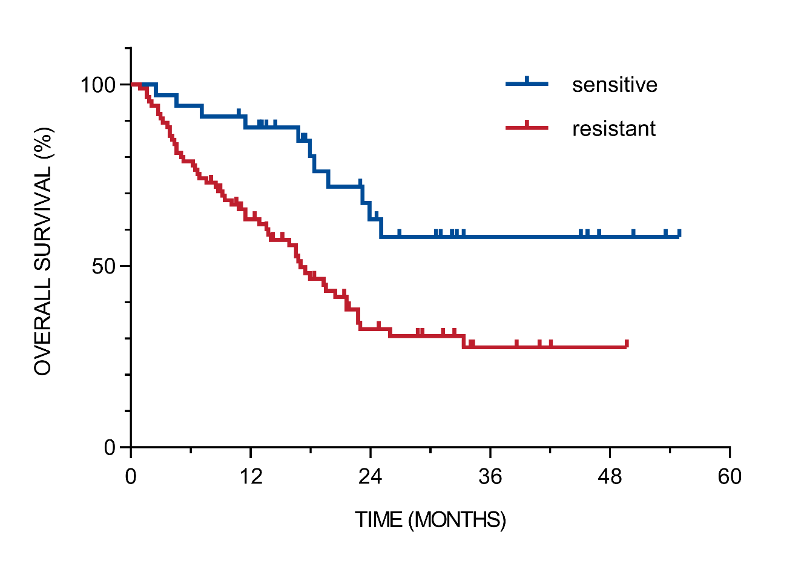
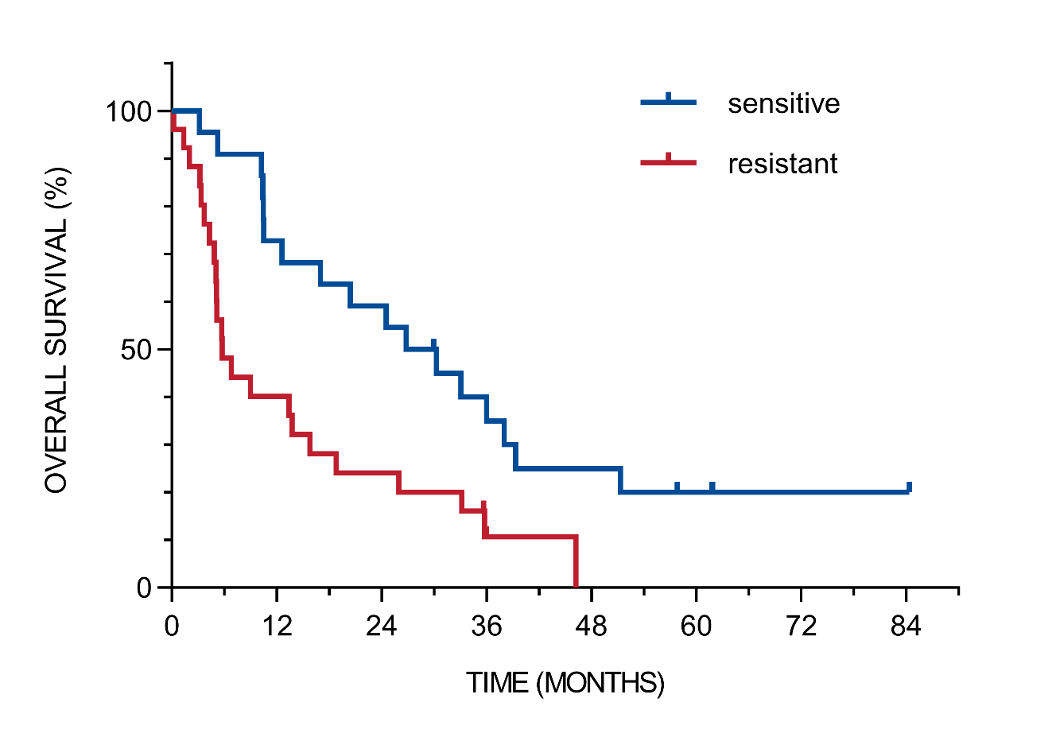
Detection of Primary Immunoresistance in Melanoma
Across different immunotherapies in melanoma
CP test in anti-PD1 (N=119)
CP test in anti-CTLA (N=48)
HD-IL2 test (N=114)
Two separate tests developed for checkpoint efficacy (CP)¹ and high dose IL-2 (HD-IL2) benefit² identify a group of patients that may obtain little long term benefit from anti-PD1, anti-CTLA4, and HD-IL2 treatment.
  Test classifications are independent predictors of outcomes when adjusted for other markers, such
  as LDH and PD-L1 expression
References: 1. Weber at al, Cancer Immunol Res 6:79 (2018); 2. Sullivan et al. J Immunother Cancer 4(Suppl):6 (2016).

Slide 19
Detection of Primary Immunoresistance in NSCLC
A test was developed to identify patients with primary resistance on single arm data (atezolizumab specific test)
Results from fully blinded validation on POPLAR: Phase II, randomized study of atezolizumab vs. docetaxel
OS
PFS
interaction p = 0.001
interaction p = 0.005
References: Kowanetz et al, J Immunother Cancer 6(Suppl1):114 (2018).

Slide 20
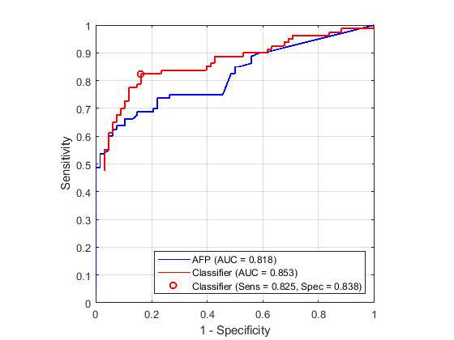
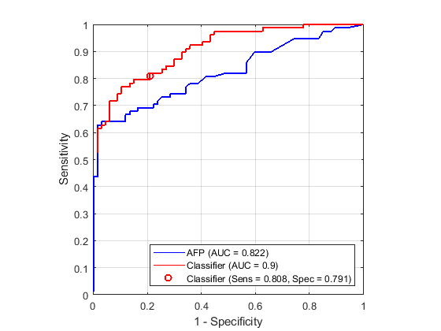
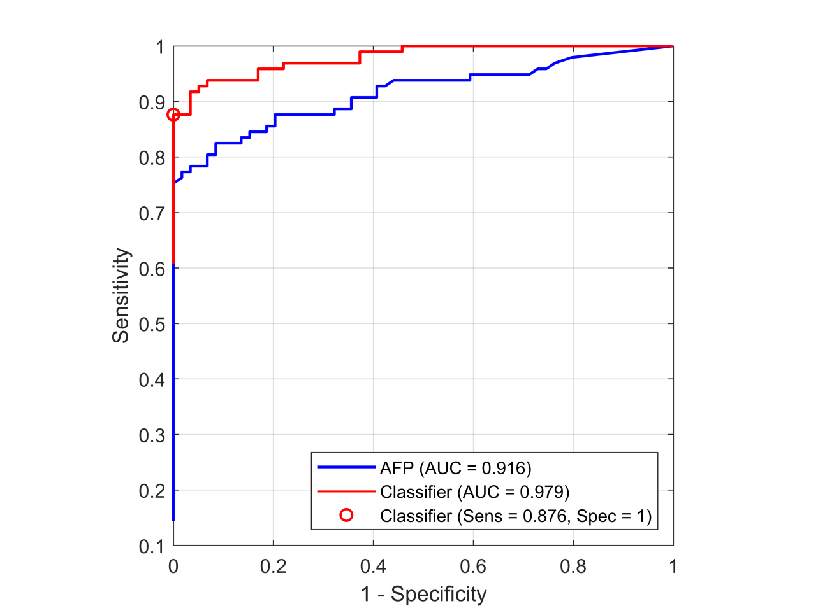
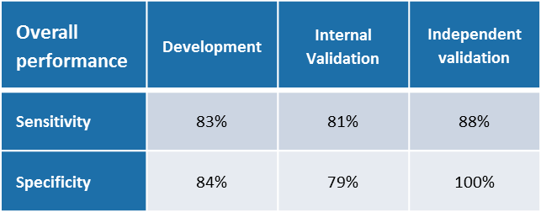
Detection of HCC in high risk population
Development set
Internal validation set
Independent validation set
Test shows significantly improved performance over current biomarker, AFP.
It is able to detect small/early stage tumors (100% sensitivity for tumors <3cm, 75% sensitivity stage I (independent validation)) where curative approaches are feasible.
References: Lee et al, Cancer Res 79(13 Suppl) 4530 (2019).

Slide 21
Set Enrichment Analysis

Slide 22
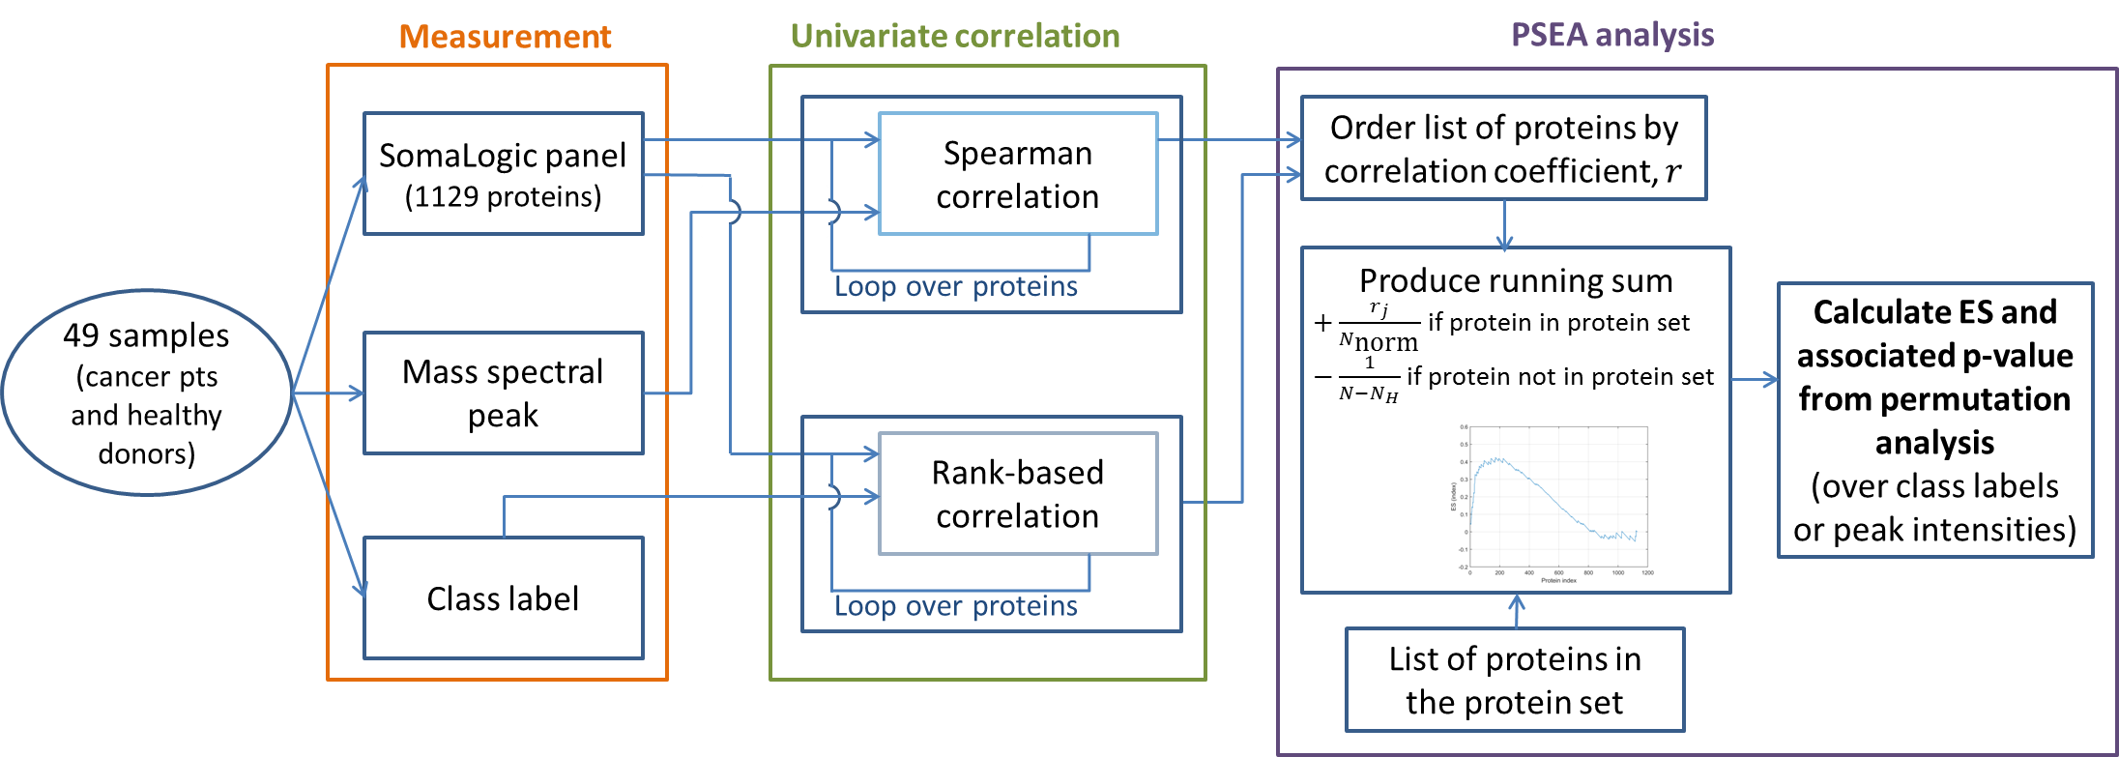
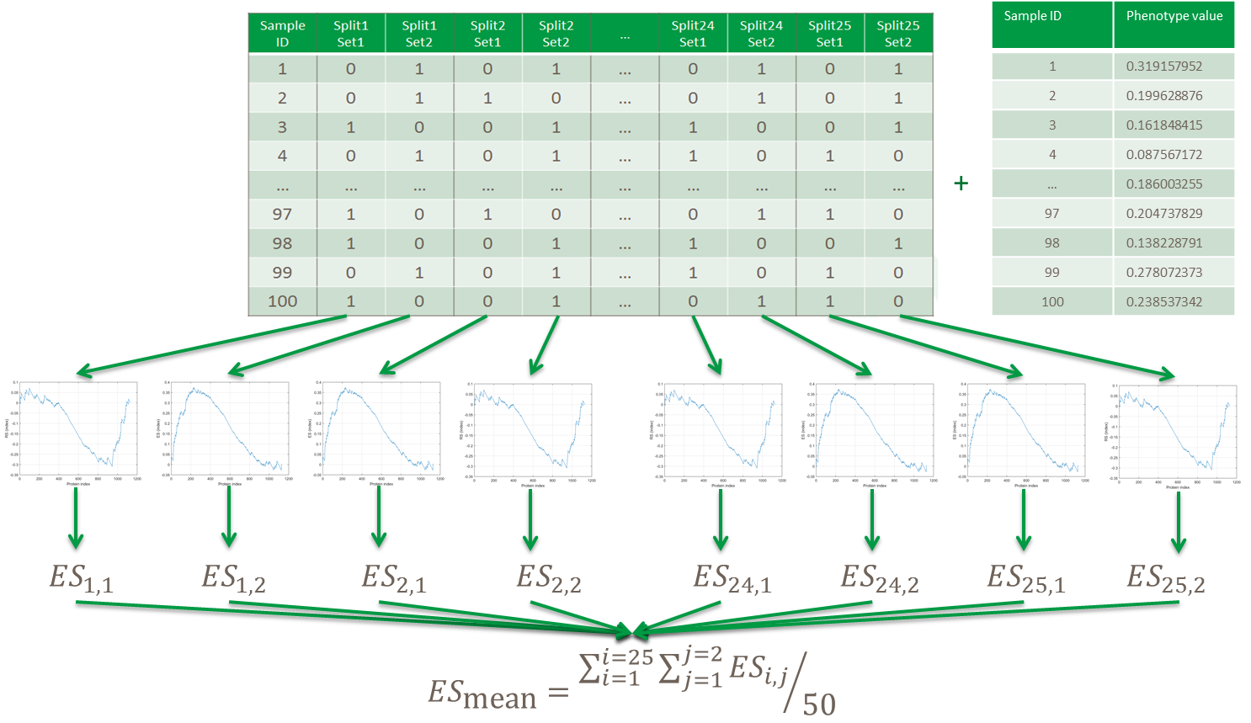
Protein Set Enrichment Analysis
Uses a reference set with well characterized protein data: SomaLogic
Proteins related to process from databases (Amigo, GO): Complement, wound healing, IR17, … ( e.g. Hallmark set)
Power of set enrichment analysis can be increased by bagging
  Also allows to combine different reference sets
Uses:
  Association of test defined phenotypes with biological processes
  Association of mass spec peaks with processes → score related to a process
Subramanian, A. et al Proc Natl Acad Sci U S A 102, 15545-50 (2005).
Grigorieva, J. et al. Clinical Mass Spectrometry 2019.https://doi.org/10.1016/j.clinms.2019.09.001.
Roder J, et al. BMC Bioinformatics 2019, 20(1):257.

Slide 23
Example: What Characterizes Patients with IO Resistance?
Association of sensitive and resistant groups with biological processes (subset)
PSEA
Across indications resistant patients have elevated levels of:
Acute inflammatory processes
Complement
Wound healing
In NSCLC IR2 and ECM (for nivolumab) are elevated in poor outcome groups.
Signaling process | Nivolumab Melanoma | HD-IL2 Melanoma | Atezolizumab NSCLC | Nivolumab NSCLC
Acute inflammatory response | NS | p < 0.01 | p <0.10 | p < 0.10
Activation of innate immune response | NS | NS | NS | NS
Regulation of adaptive immune response | NS | NS | NS | NS
Positive regulation of glycolytic process | NS | NS | NS | NS
Immune T-cells | NS | NS | NS | NS
Immune B-cells | NS | NS | NS | NS
Extra cellular matrix | NS | NS | NS | p < 0.01
Natural killer regulation | NS | NS | NS | NS
Complement system | p < 0.05 | p < 0.01 | p < 0.10 | p < 0.01
Wound healing | p < 0.01 | p < 0.05 | NS | p < 0.01
Interferon | NS | NS | NS | NS
Interleukin-10 | NS | NS | NS | p < 0.10
Growth factor receptor signaling | NS | NS | NS | NS
Immune Response Type 1 | NS | NS | NS | NS
Immune Response Type 2 | NS | NS | p < 0.10 | p < 0.01
Acute phase | p < 0.01 | p < 0.01 | NS | p < 0.01
Similar effects were seen by others, e.g.:
Combined blockade of complement signaling and anti-PD-1 can enhance anti-PD-1 efficacy; Cancer Discovery 6 (9) :1022-35 June 2017
A transcriptional signature (IPRES) identified related to innate anti-PD-1 resistance; wound healing is one of the pathways; Cell 165: 35-44 March 2017
NS: Not significant

Slide 24
Summary
Ideas from traditional machine learning can be combined with concepts from deep learning to develop multivariate tests even in the p >> N setting.
Using bagging one can reliably estimate effect sizes even from small development sets.
The circulating proteome is informative for primary resistance to checkpoint inhibition.
Set enrichment analysis can be used to elucidate biological underpinnings of multivariate tests.

Slide 25
Acknowledgments
Biodesix Research Team
Joanna Roder
Carlos Oliveira
Arni Steingrimsson
Lelia Net
Julia Grigorieva
Maxim Tsypin
Senait Asmellash
Krista Meyer
Benjamin Linstid
Conde Benoist
Brandon Touchet
Steven Rightmyer
External collaborations
J Weber (NYU)
M Sznol, H Kluger, R Halaban (Yale)
R Sullivan (MGH)
P Ascierto (Naples, Italy)
D Mahalingam (Northwestern)
L Chelis (Dammam, Saudi Arabia)
R Iyer (Roswell Park)
S Lee (MD Anderson)

