Slide 1
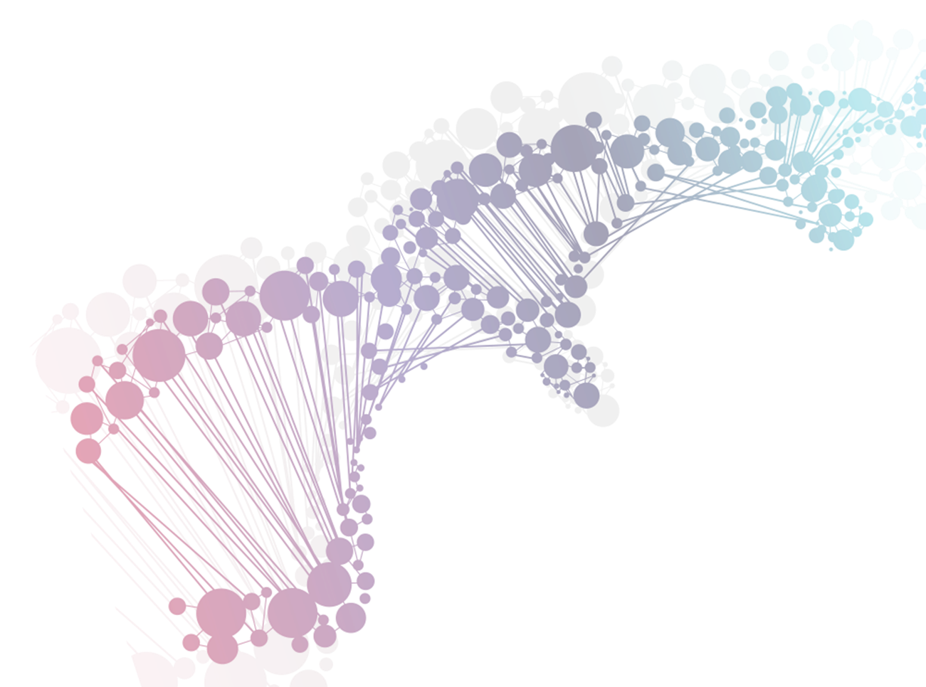


Discovering Subclones in Tumors
Sequenced at 30x Depths
Li Liu, M.D., M.S. (liliu@asu.edu)
Navid Ahmadinejad, Shayna Troftgruben
http://liliulab.com

Slide 2

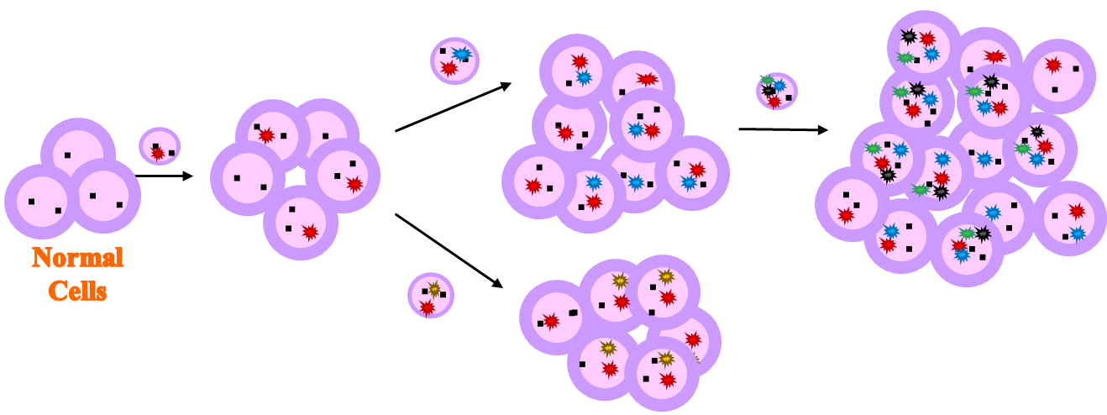
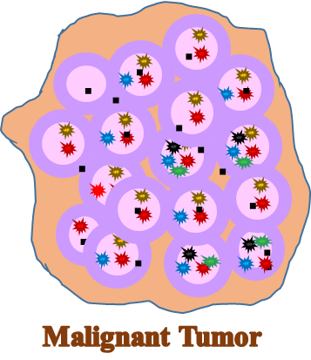
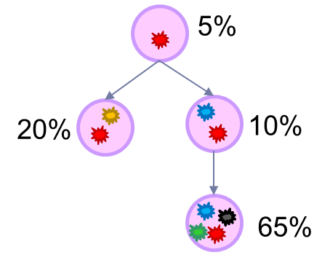
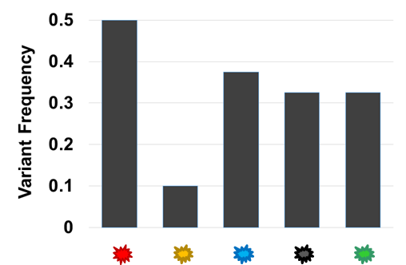
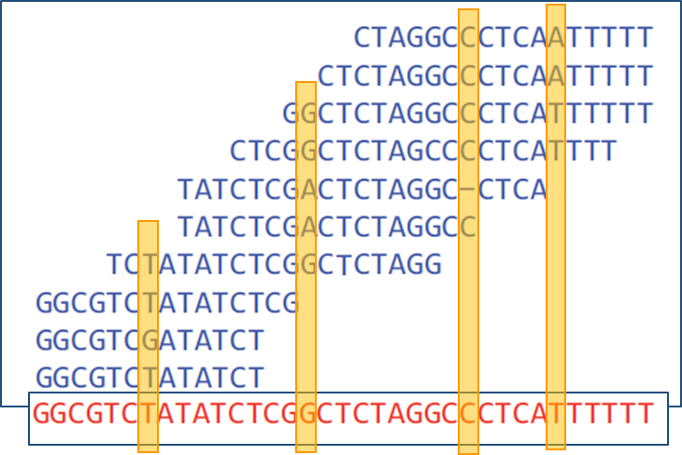
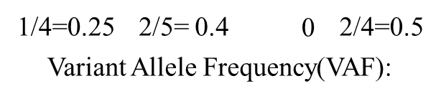
Cancer Evolution & Subclone Inferences

Slide 3
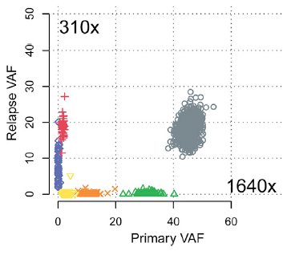
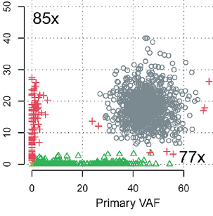
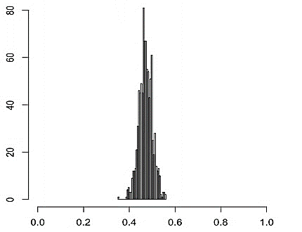
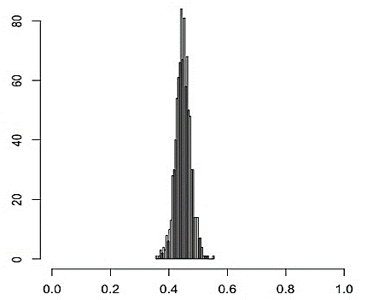
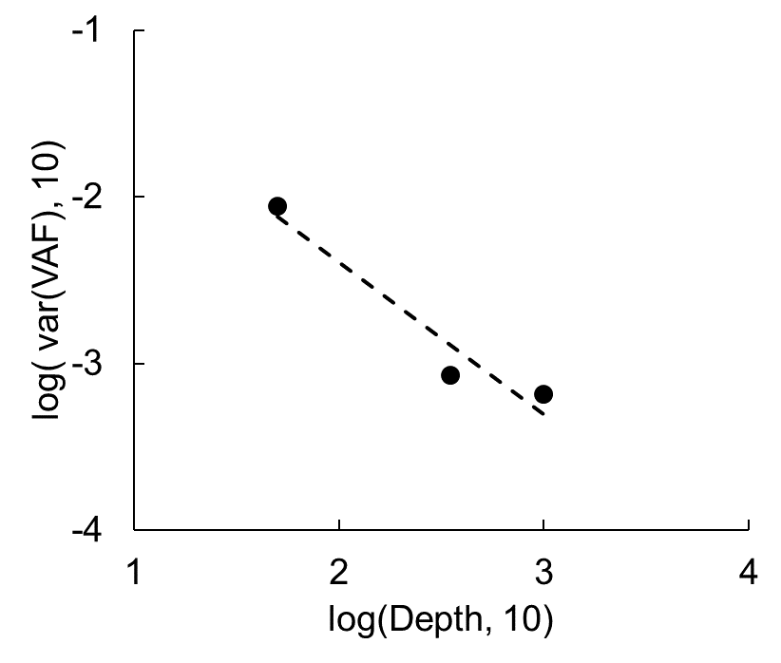
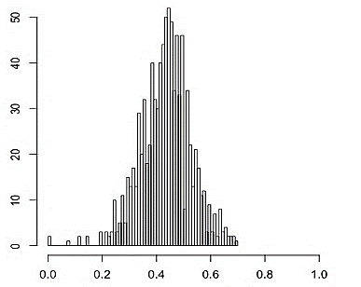
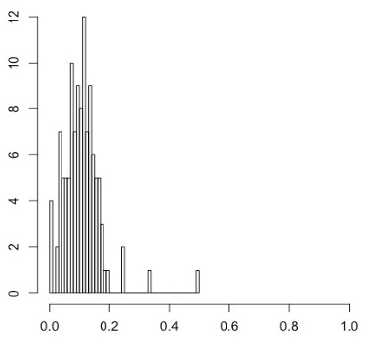
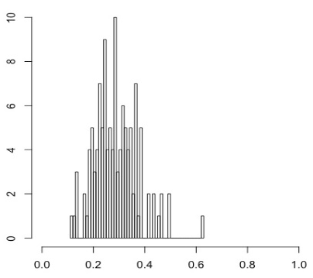
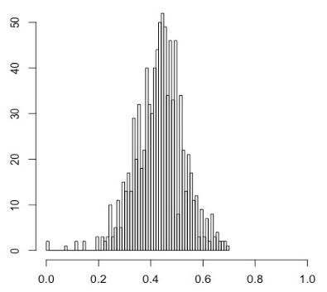
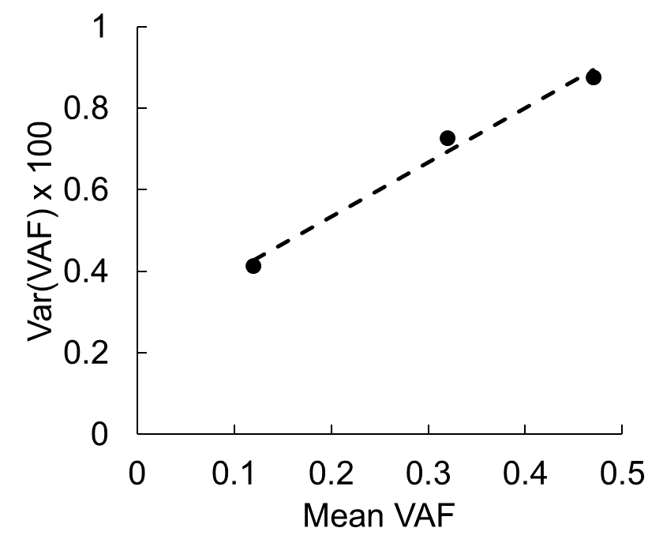
Challenges to Existing Methods
PyClone^{[1]}, SciClone^{[2]}, Expands^{[3]}, etc.
Requirement of deep-sequencing data
  Minimum depth of 100x ^{[1,2,3]}
  Optimal depth of >300x ^{[4]}
  But most tumors are sequenced at depths of 30x-50x
Mean depth=50x
1000x
350x
Depth-variance dependence
Frequency
VAF
Mean VAF=0.12
Mean-variance dependence
0.31
0.47
Frequency
[1] PMC4864026 [2] PMC4125065 [3] PMC3866558 [4] PMC4669575

Slide 4
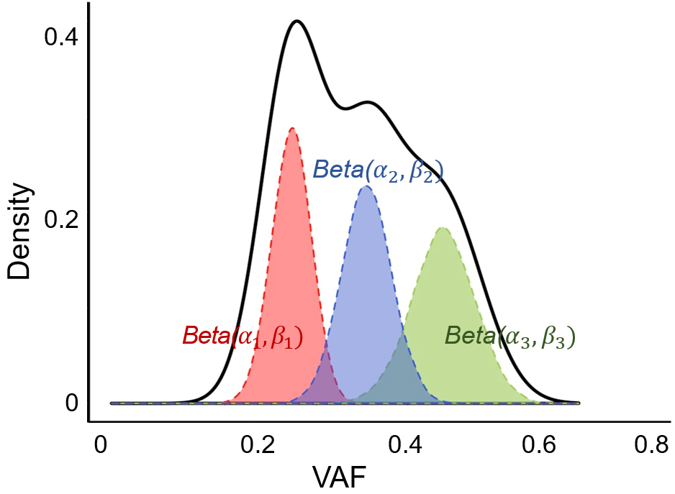
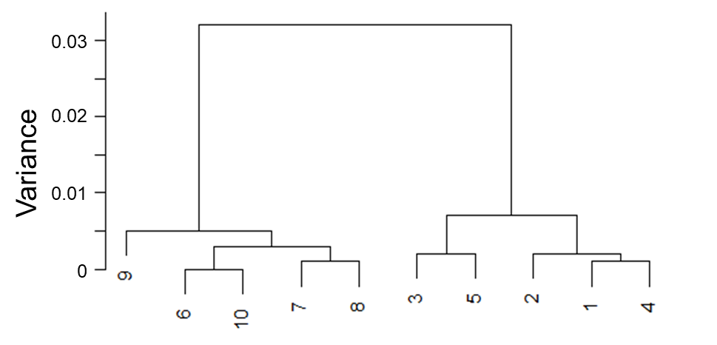
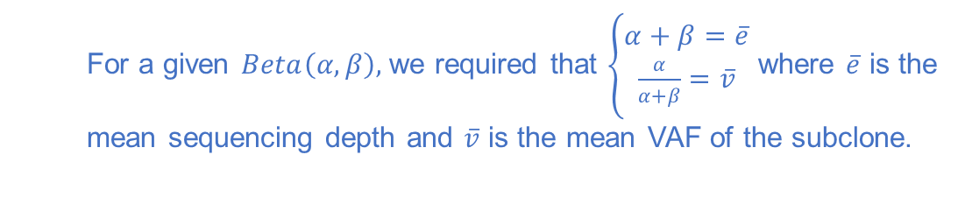


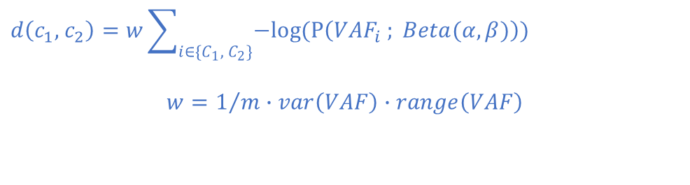
MAGOS
Model-based Adaptive Grouping of Subclones
  Model: VAFs of variants from $K$ subclones form a mixture of beta distributions
  For a given $Beta\left(α,β\right),$ we required that $\left\{\begin{aligned}α+β=\overline{e} \\ \frac{α}{α+β}=\overline{v}\end{aligned}\right.$ where $\overline{e}$ is the mean sequencing depth and $\overline{v}$ is the mean VAF of the subclone.
$$var\left(VAF\right)=\frac{\left.\overline{v}(1−\overline{v}\right)}{\overline{e}+1}. For \overline{v}∈(0, 0.5],var\left(VAF\right)↑as \overline{v}↑and \overline{e}↓,$$
Procedure: agglomerative hierarchical clustering + adaptive partitioning
$$d\left(c_{1}, { c}_{2}\right)=w\sum_{i∈\{C_{1}, { C}_{2}\}}{−log⁡(P\left({VAF}_{i} ; Beta(α, β)\right))}$$
$${w=1}/{m∙var\left(VAF\right)∙range\left(VAF\right)}$$
X
X
X
?
$$var(VAF) ≤\hat{var(VAF)}$$

Slide 5
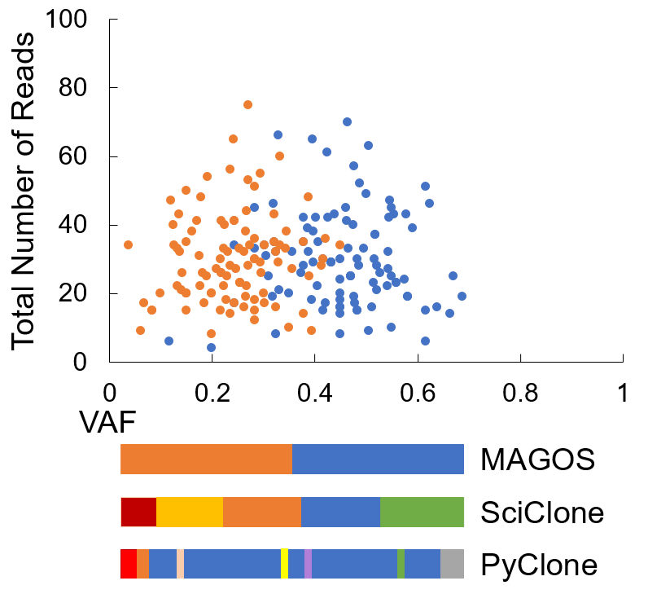
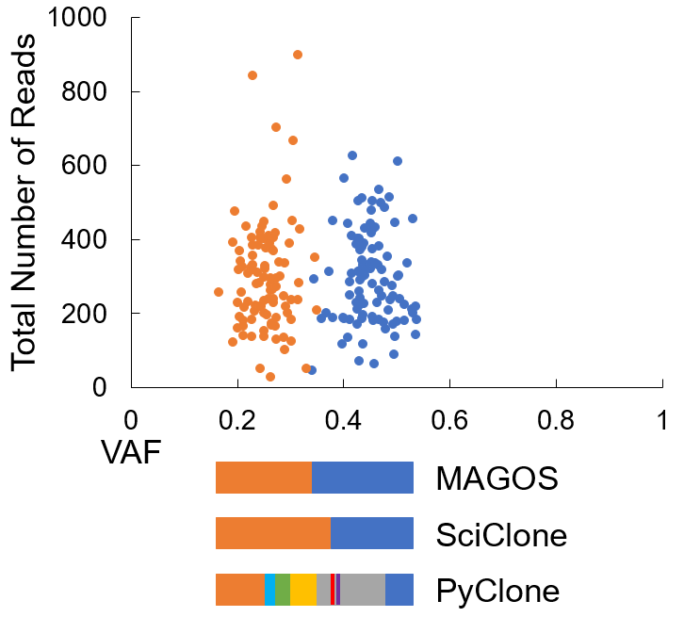
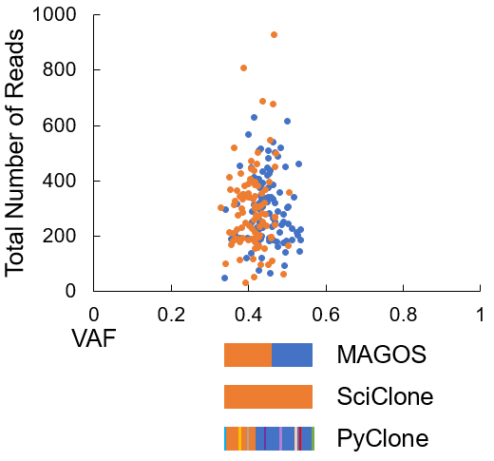
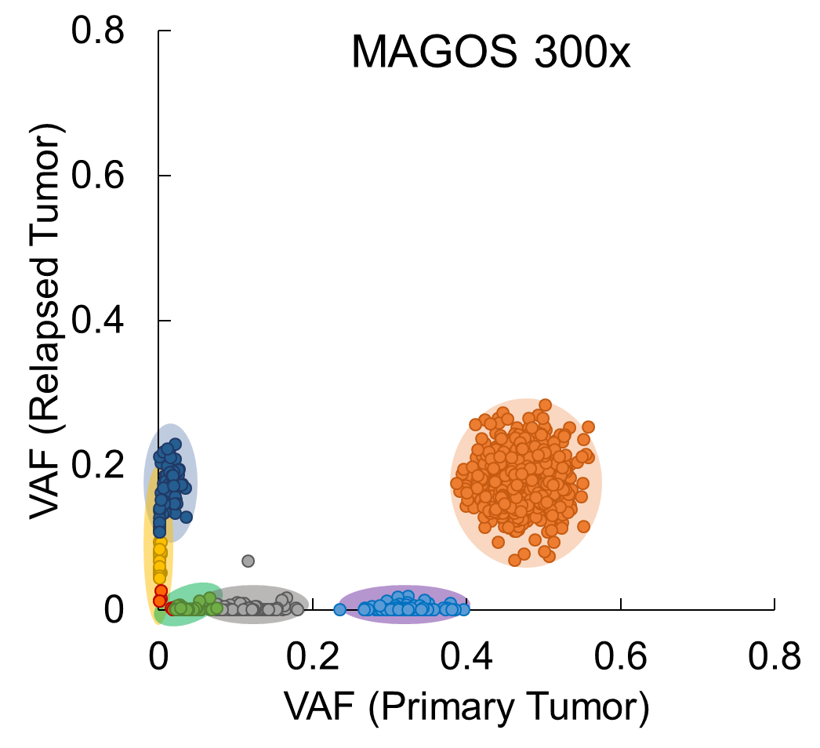
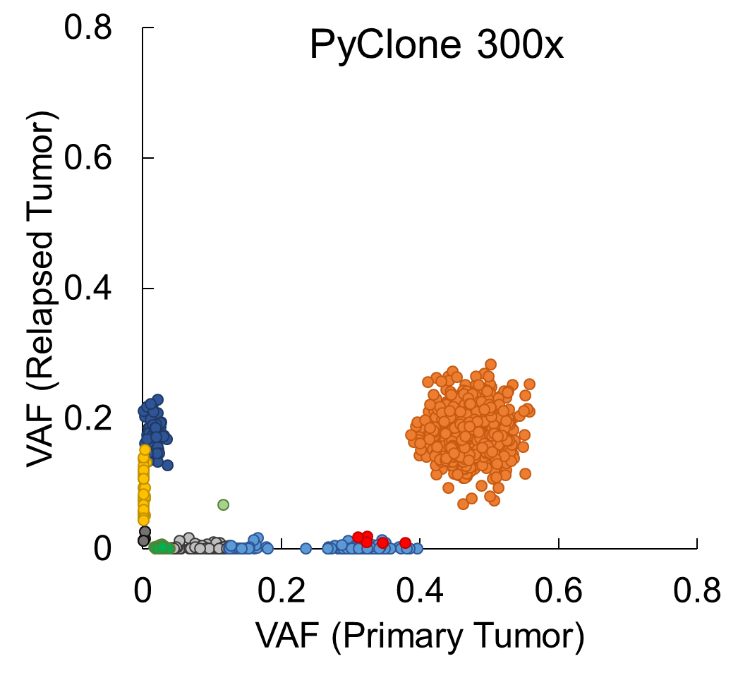
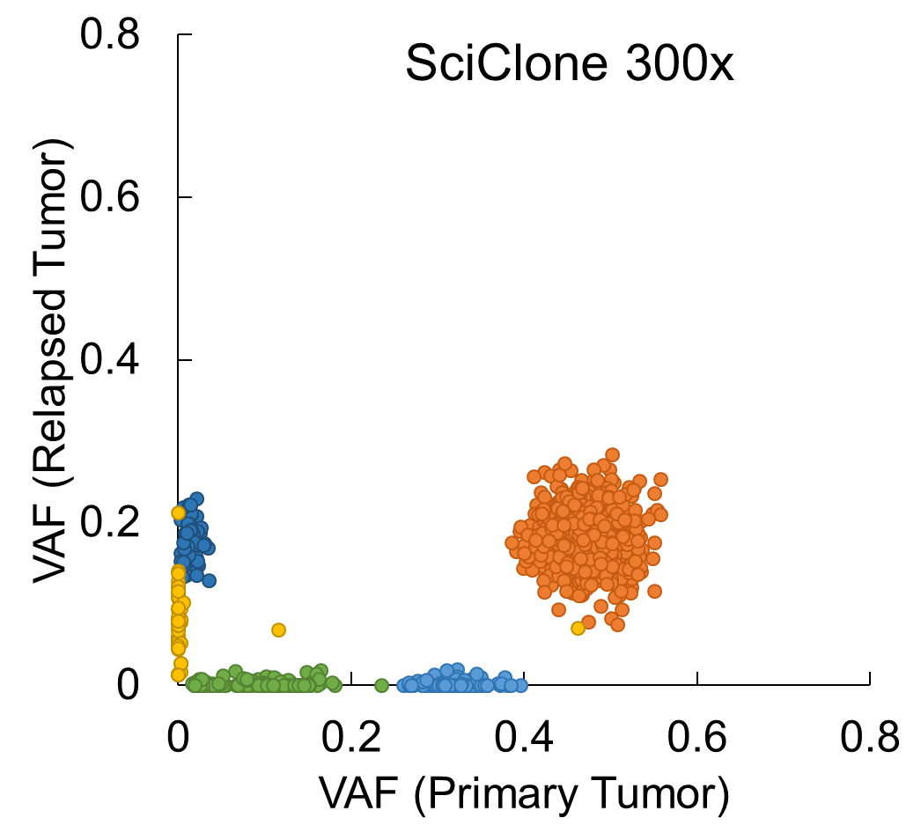

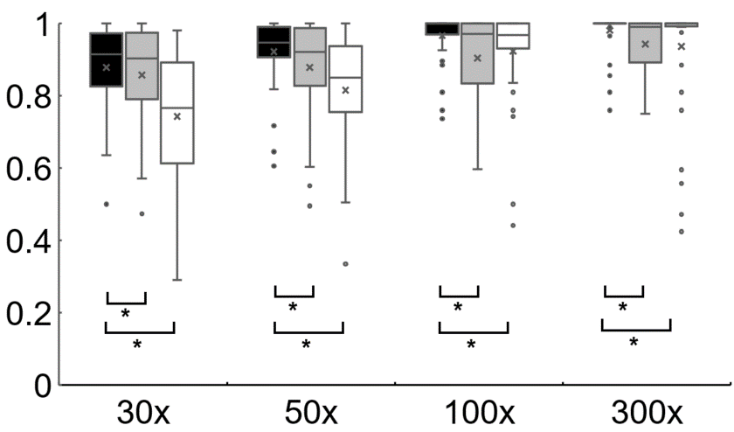
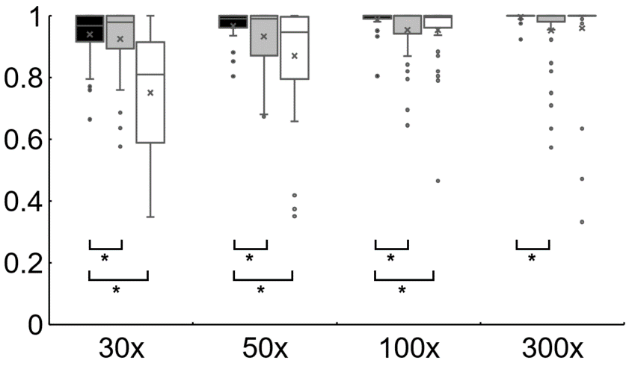

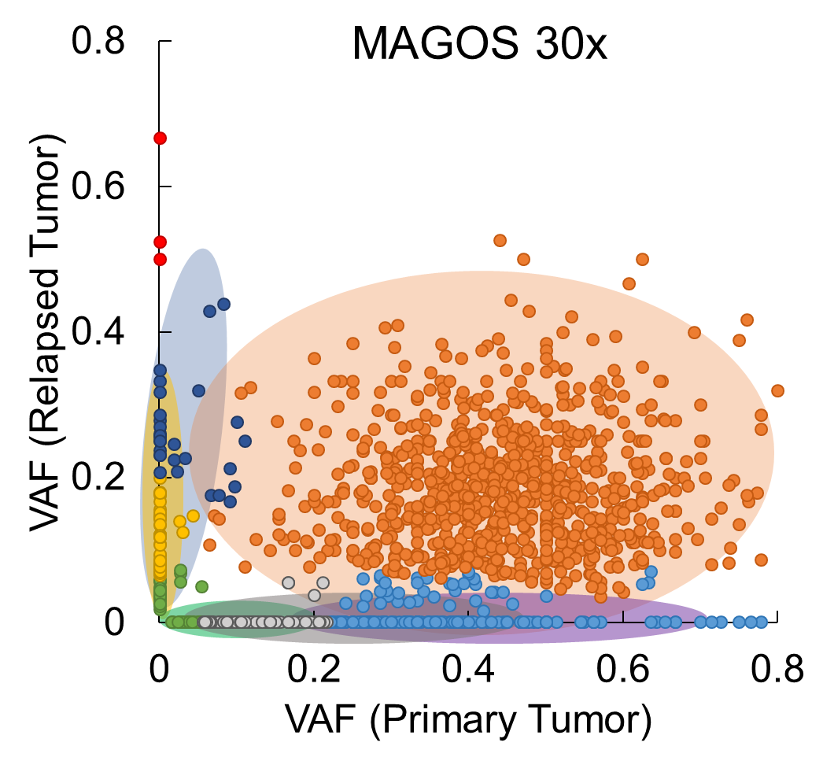
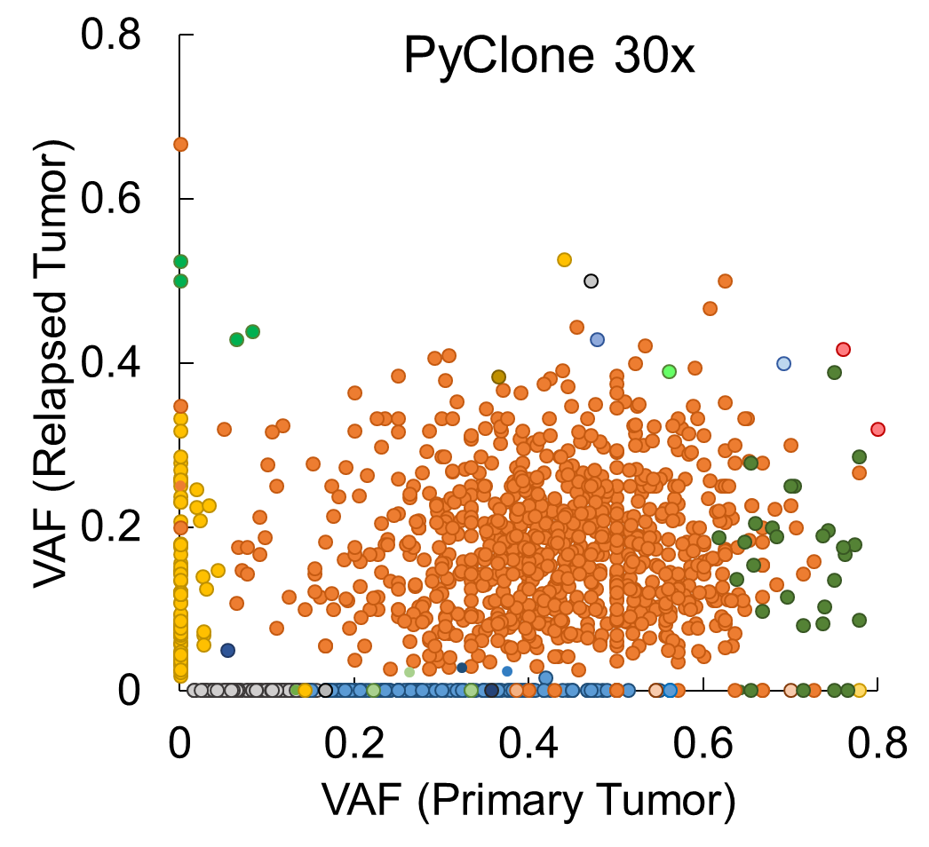
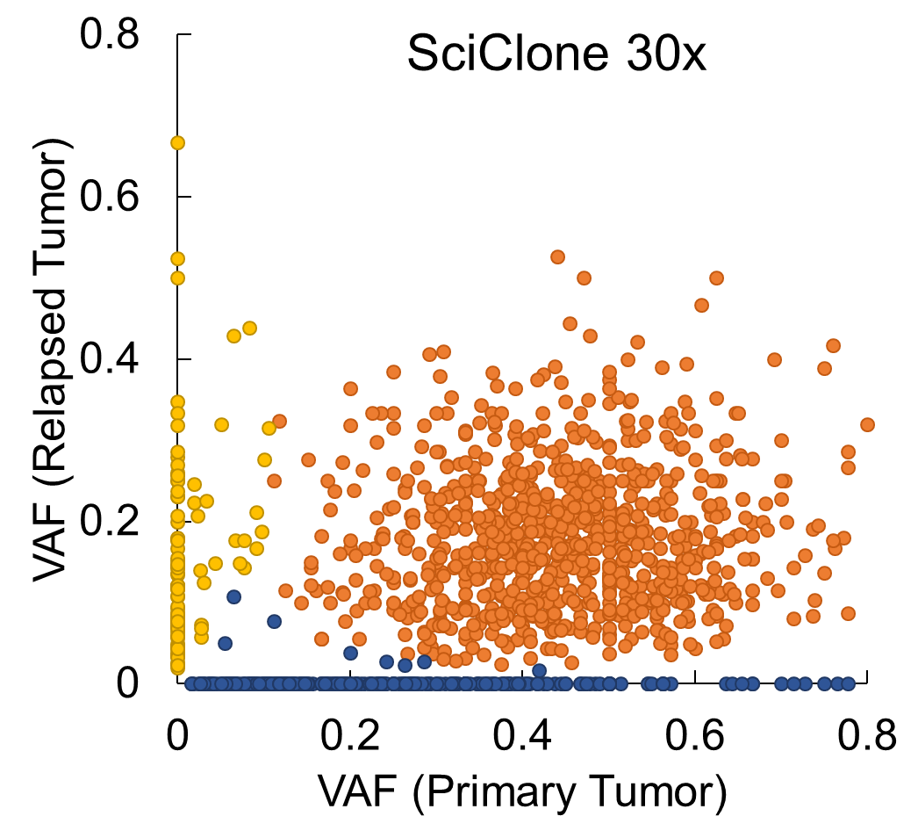
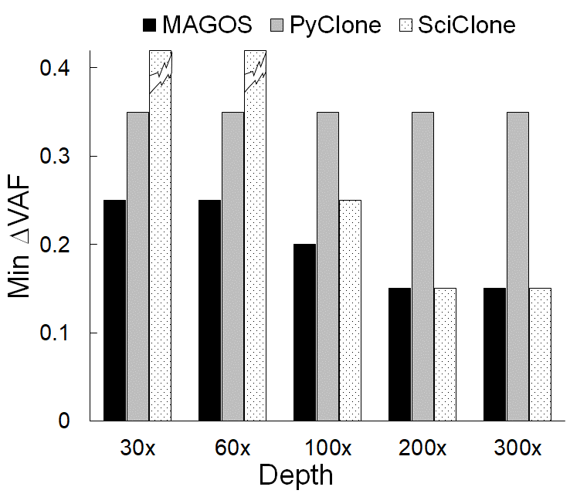
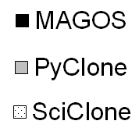
Performance
30x
300x
300x
3-samples
4-samples
Accuracy
Accuracy

Slide 6
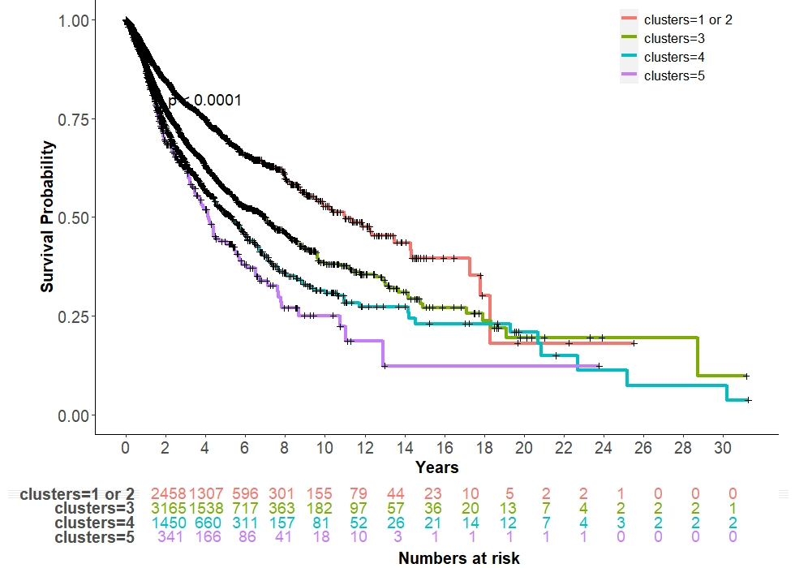
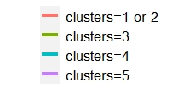
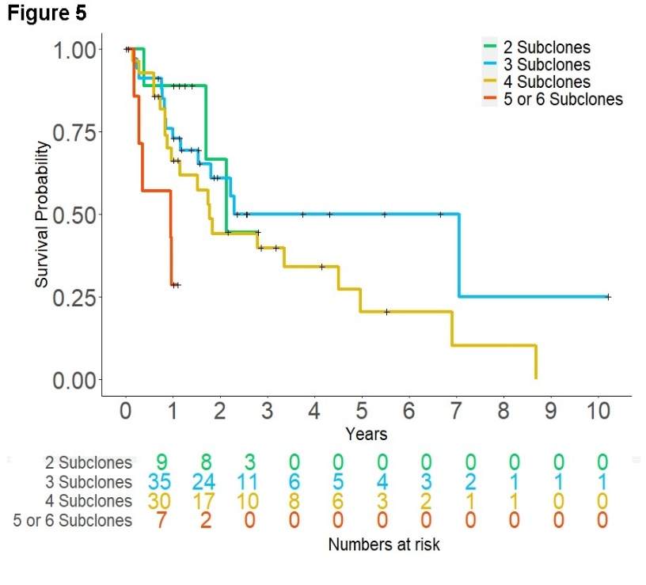
Analyze TCGA Whole-Exome Data
Number of subclones in primary tumors is an independent prognostic factor.
Covariates: age of diagnosis, sex, and tumor stage
The fewer subclones a tumor has, the longer the patient survives.
7,468 tumors of 33 types
Cox regression P<0.0001
331 liver adenocarcinomas
Cox regression P=0.01

