Slide 1
Landmark and Cancer-Relevant Gene Selection of RNA Sequencing Data for Survival Analysis
Rocky Mountain Bioinformatics Conference 12/6/2019
Carly L. Clayman, Ph.D. ^{a*}
Satish M. Srinivasan, Ph.D. *
Raghvinder S. Sangwan, Ph.D.*
* Pennsylvania State University
School of Graduate and Professional Studies
Engineering Department
a Data Analytics M.S. program

Slide 2
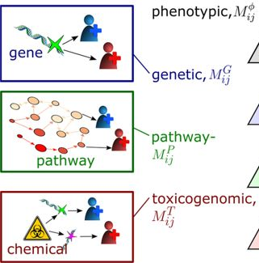
Introduction: Research Topic
Complex disease factors:
  Genetic
  Environmental
  Comorbid conditions
  Pathways and mechanisms (relevant genes/proteins)
Multi-locus polymorphisms in GWAS studies:
  Predictive analytics / machine learning (ML)
  Environmental factors

Slide 3
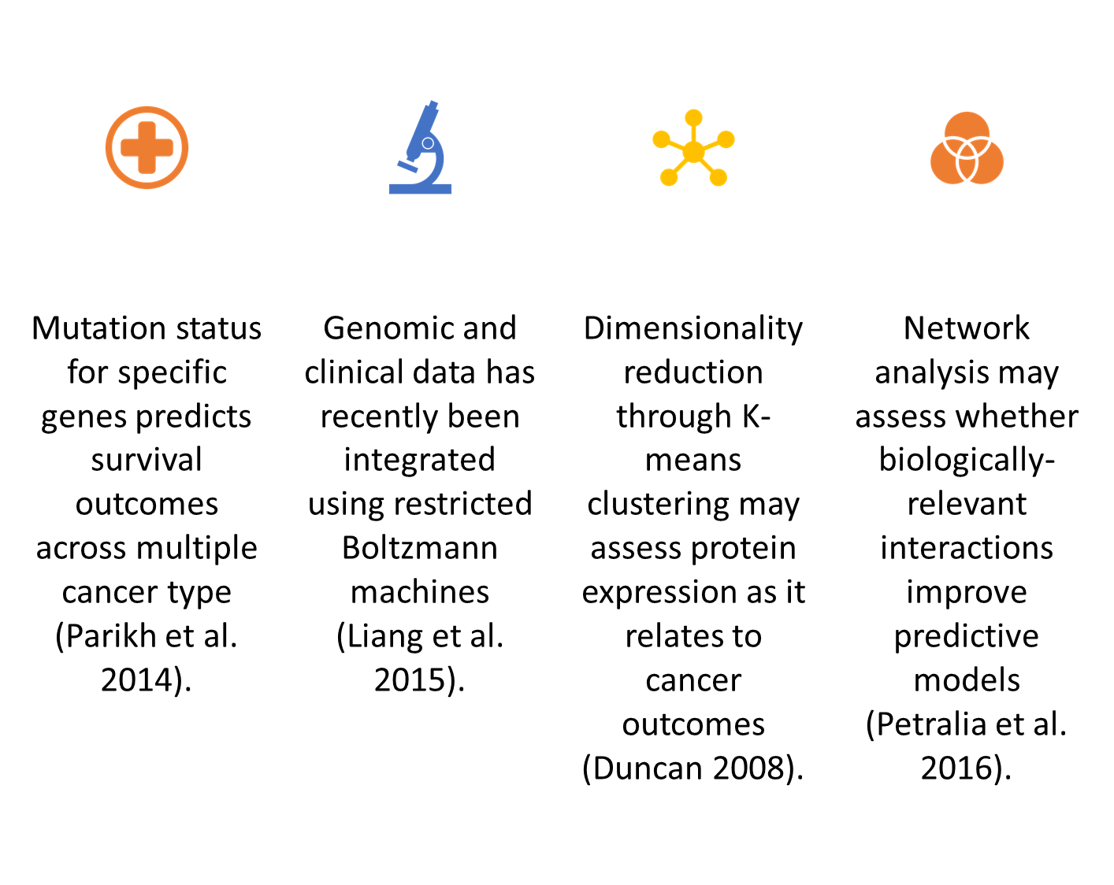
Background

Slide 4
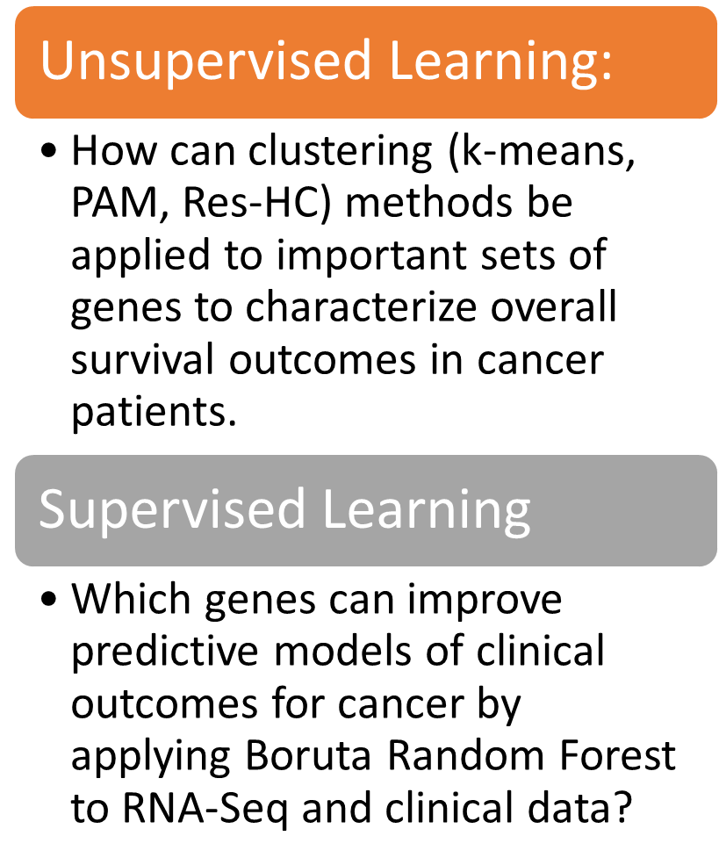
Research Questions and Hypothesis

Slide 5
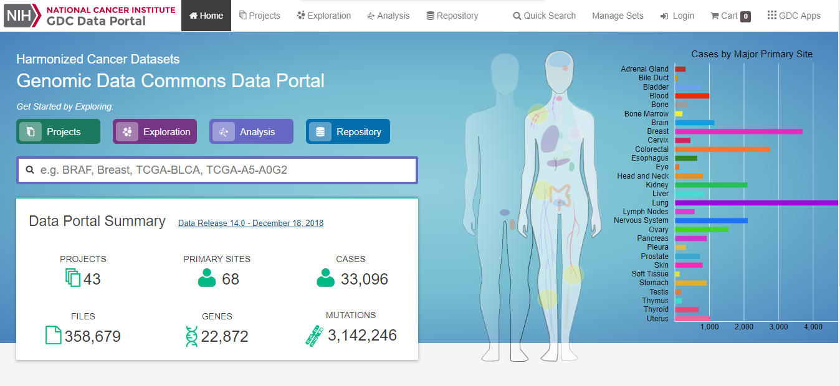
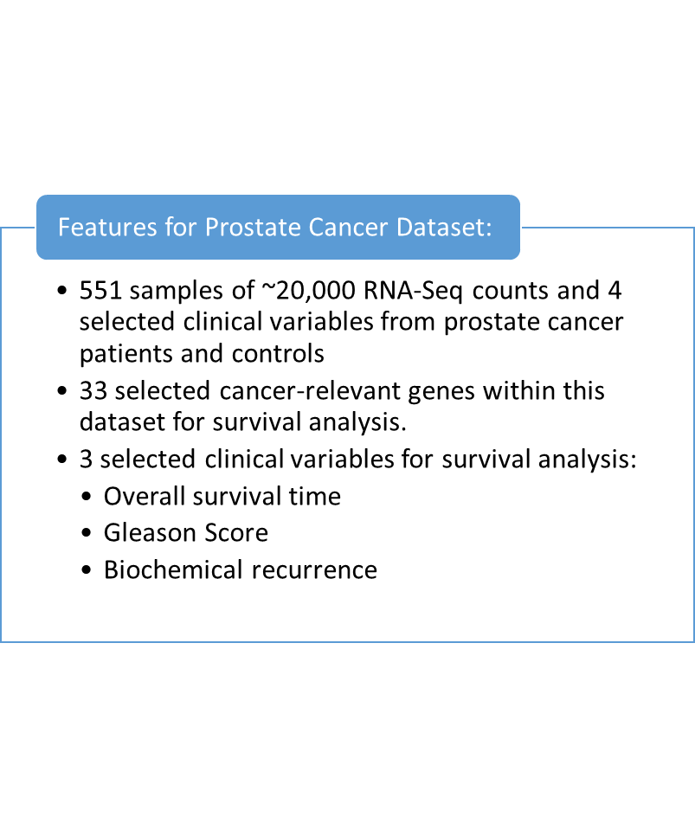
Data Features and Observations

Slide 6
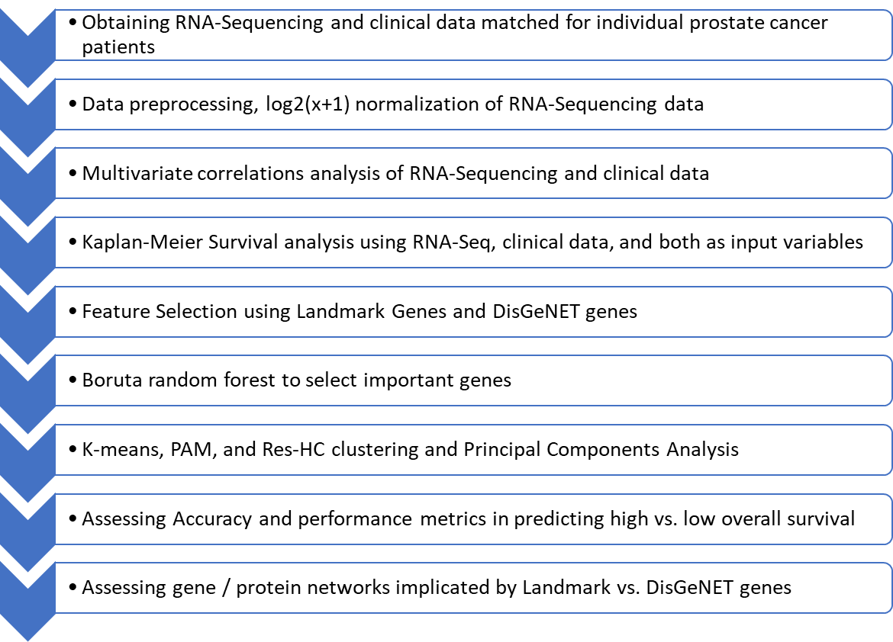
Analysis Methods

Slide 7
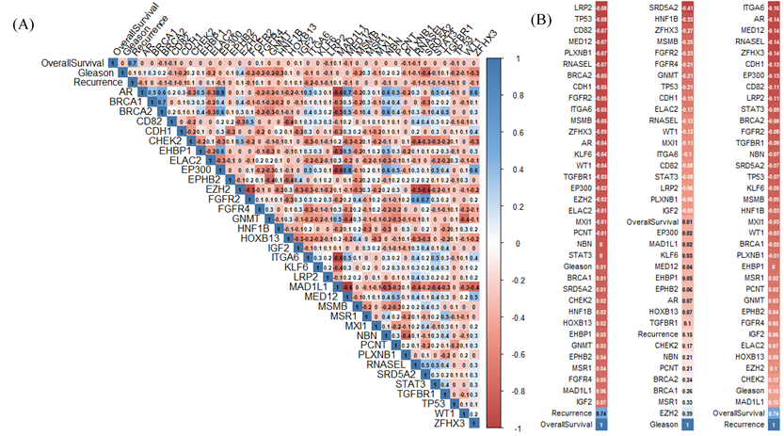
Selection Method 1: Cancer Relevant Genes (Oncogenes)

Slide 8
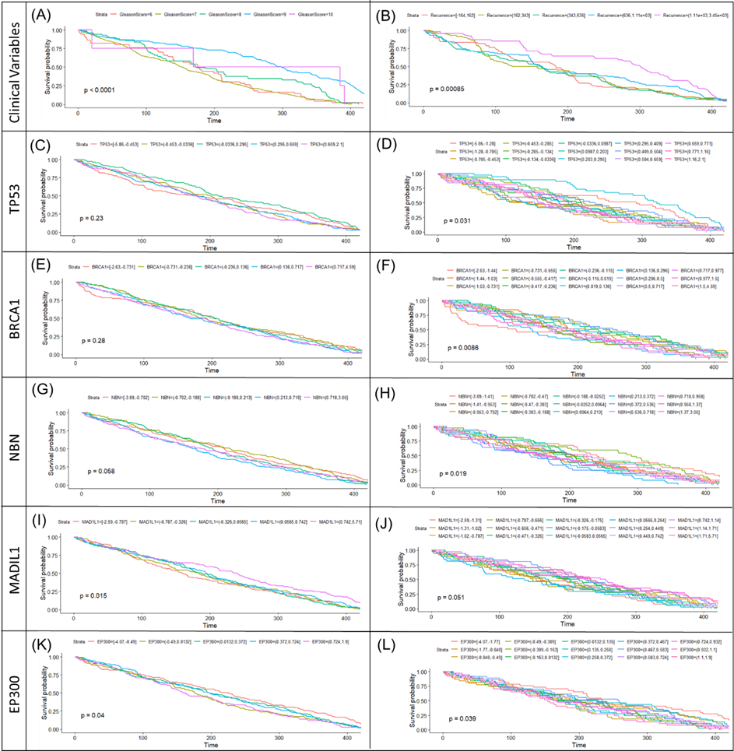
Kaplan Meier
Survival Analysis
Significant Genes (p<0.05)
MADIL1
EP300
BRCA1
TP53
NBN

Slide 9
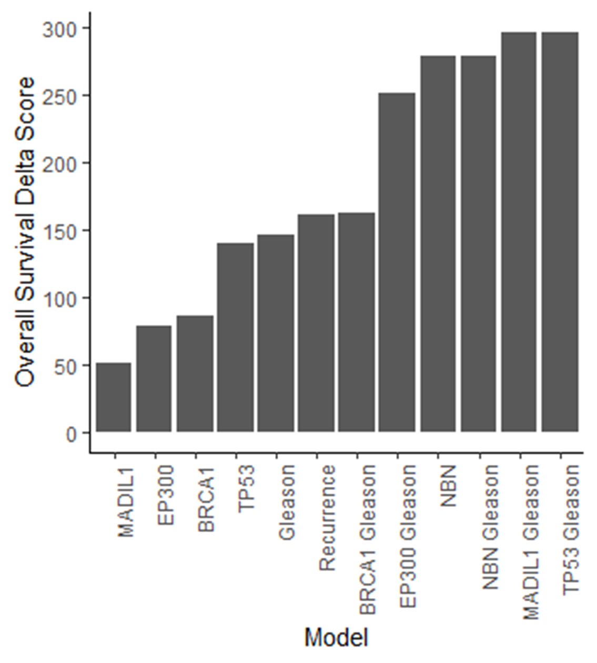
Clinical and RNA-Seq Variables Improve Overall Survival Delta Score in Kaplan Meier Survival Analysis

Slide 10

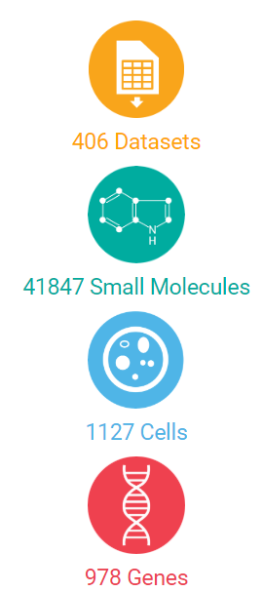
L1000 Landmark Genes
Landmark gene expression levels measured with L1000 microarray
NIH: Library of Integrated Cellular Signatures (LINCS)
Using expression of ~1,000 landmark genes to capture ~21,000 target gene expression levels
Applied to heterogeneous disease and normal samples
Image retrieved from:
http://lincsportal.ccs.miami.edu/dcic-portal/

Slide 11
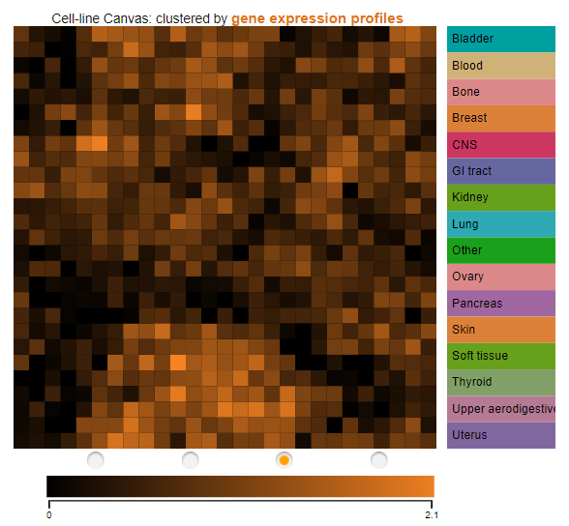
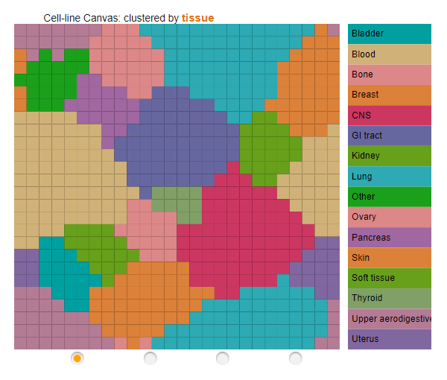
L1000 Landmark Genes
Similar gene expression of genes with similar functions represent similar mechanisms underlying treatment response in distinct tissue samples (Graham et al. 2016; Shah et al. 2016).
Genes within the same cluster display similar gene expression patterns, compared to genes in separate clusters (Shah et al. 2016).
Image retrieved from:
https://www.maayanlab.net/LINCS/DCB/

Slide 12
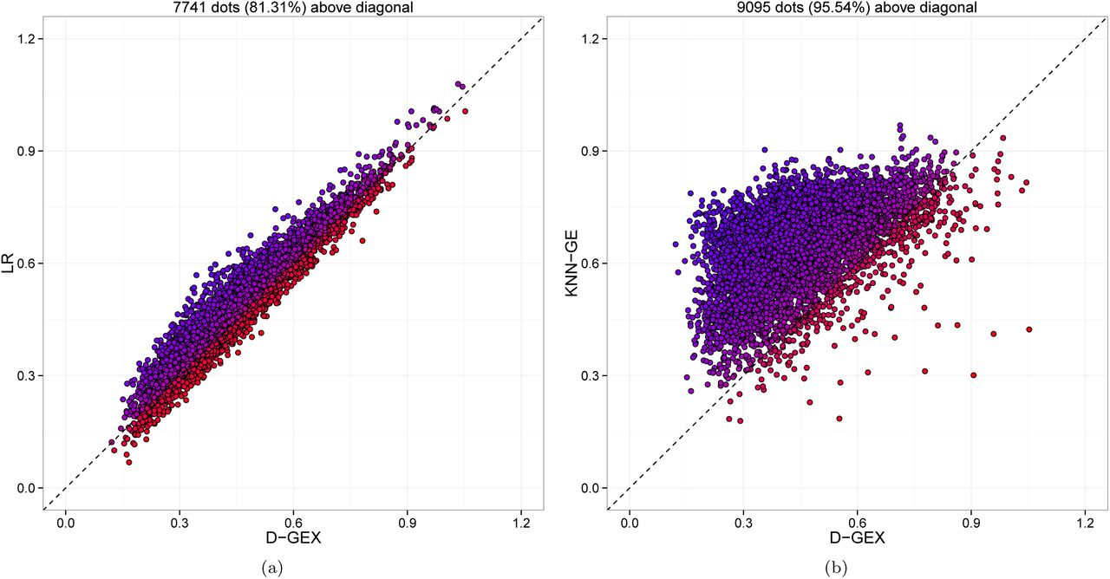
L1000 Landmark Genes
Initially applied linear regression to designate 1k landmark gene expression levels used to infer ~21k target gene expression levels.
Deep learning methods (D-GEX) improves the ability to predict gene expression levels of target genes beyond linear regression (Chen et al. 2016).
Image retrieved from:
(Chen et al. 2016)

Slide 13
Summary of Models:
 | Features / Predictors | Dataset
Model 1 | Boruta-selected Landmark Genes | RNA-Sequencing Data
Model 2 | Boruta-selected DisGeNET Genes | RNA-Sequencing Data
Model 3 | Union of Boruta-selected Landmark & DisGeNET Genes | RNA-Sequencing Data

Slide 14
RNA-Sequencing Analysis Framework
Landmark Genes
Boruta Random Forest
Important
Landmark Genes
K-means,
PAM,
Res-Hierarchical
Clustering & plotting clusters against first 2 principal components
Accuracy Score: Predicted cluster assignment vs actual clinical survival status
Full Set of Genes
DisGeNET Oncogenes
Important
DisGeNET Oncogenes
Union of Landmark and DIsGeNET genes
Important Landmark & DisGeNET genes
Predicted Cluster 1 Majority
Actual High Survival
Predicted Cluster 2 Majority
Actual Low Survival
Accuracy =
Total Number of Samples

Slide 15
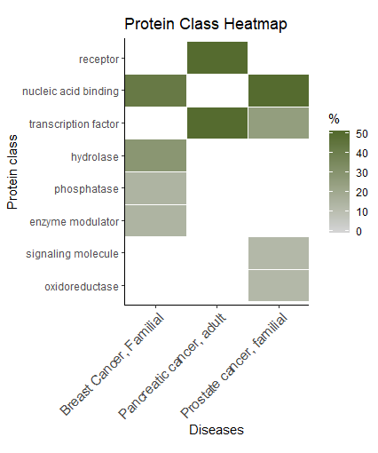
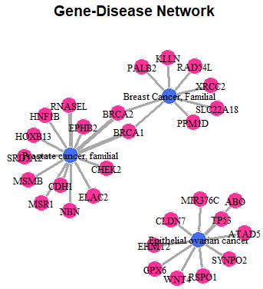
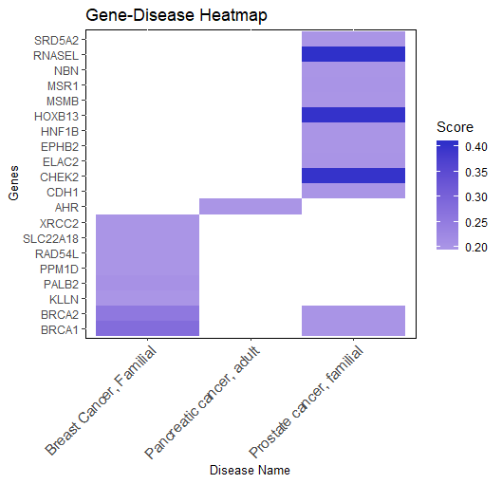
Selection Method 2: DisGeNET Cancer-specific genes

Slide 16
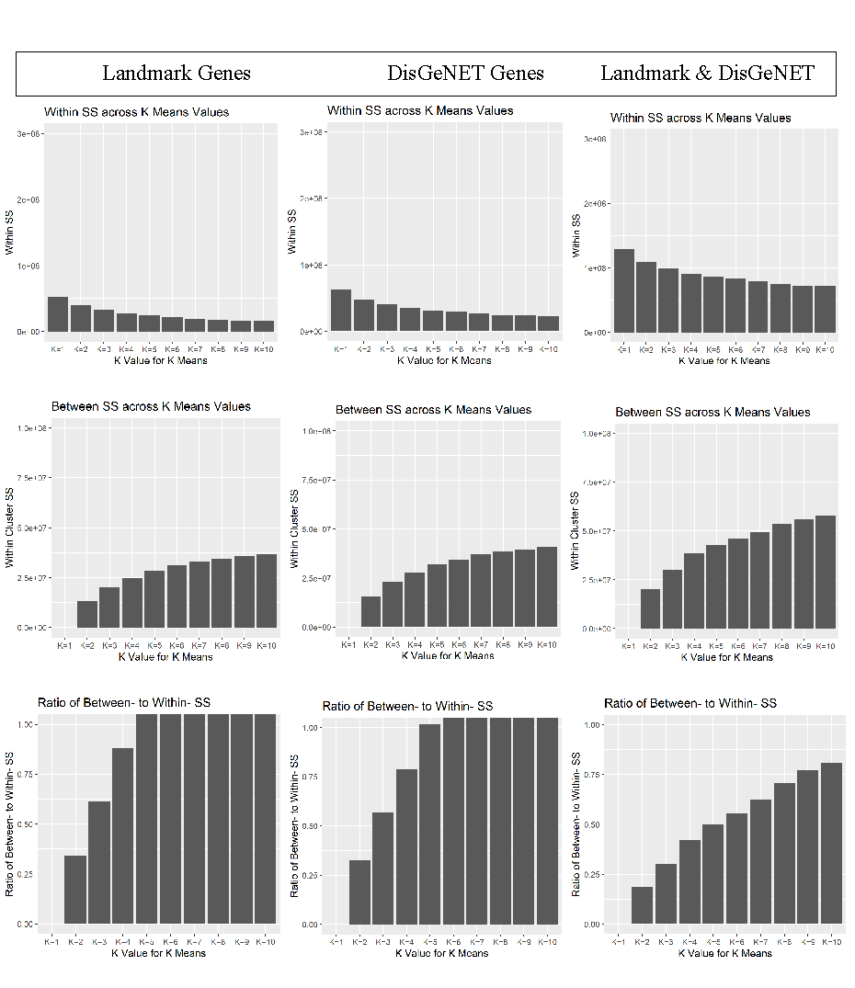
K-Means clustering has the lowest ratio of between- to within-cluster SS for Union of Landmark & DisGeNET

Slide 17
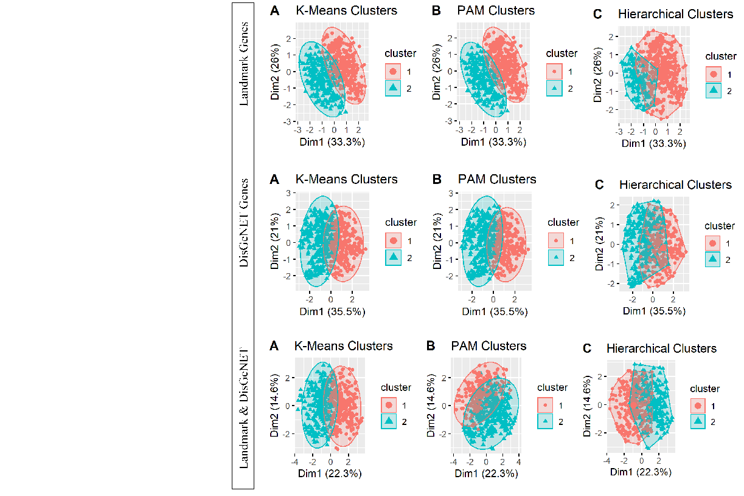
The first 2 principal components capture more variability for Landmark (33.3%, 26%) and DisGeNET (35.5%, 21%) vs.Union (22.3%, 14.6%)

Slide 18
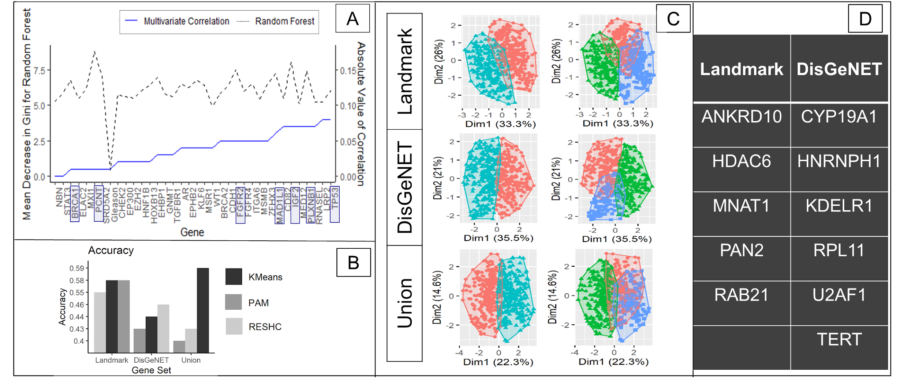
Landmark Genes Improve Overall Survival Prediction Accuracy, vs. DisGeNET genes

Slide 19
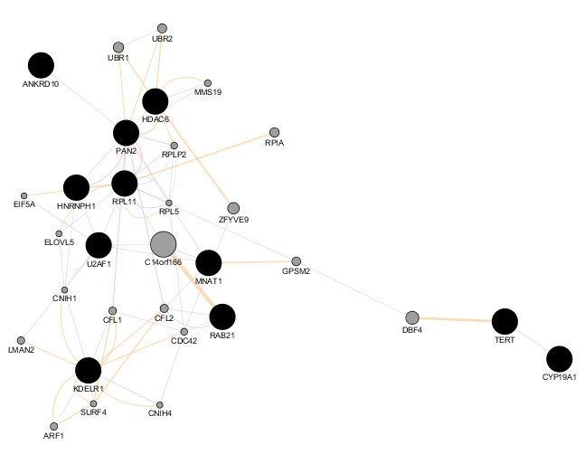
Networks for Union of Important Landmark and DisGeNET Genes Visualized in GeneMania Cytoscape
Gene Set:
DisGeNET
Landmark

Slide 20
Implications of Important Genes for Cancer Pathways
DisGeNET Gene | Encodes
ANKRD10 | Ankyrin repeat domain-containing protein 10
HDAC6 | Protein tagging epigenetic repression for cell cycle and transcription regulation
MNAT1 | Component of CDK activating kinase
PAN2 | Catalytic subunit of polyA nuclease complex
RAB21 | Rab monomeric GTPase which regulates membrane traffic and cell adhesion through integrins
Landmark Gene | Encodes
CYP19A1 | Aromatase enzyme
HNRNPH1 | RNA-binding protein
KDELR1 | ER protein retention receptor 1
RPL11 | Ribosomal protein L11
U2AF1 | U2 small nuclear RNA auxiliary factor 1
TERT | Telemorase reverse transcriptase

Slide 21
Conclusions
While individual gene expression levels, including TP53, and clinical variables were significant predictors of overall survival when assessed separately, the combination of genes along with clinical variable levels provided the most predictive power for overall survival (Clayman et al., in press 2019 a).
Important landmark genes selected by the Boruta random forest algorithm resulted in improved clustering performance consistent with high vs. low overall survival, compared to important disease-relevant (DisGeNET) genes.
These findings indicate that multiple cancer types should be assessed to determine which genes are relevant for cancer outcomes given that landmark genes have been shown to represent id groups within heterogeneous data vs. homogeneous data (Clayman et al., in press 2019 b).

Slide 22
Acknowledgements
M.S. thesis advisor:
  Satish M. Srinivasan, Ph.D.
Thesis committee members:
  Raghu Sangwan, Ph.D.
  Youakim Badr, Ph.D.
Penn State Great Valley Department of Engineering and Data Analytics program

Slide 23
Questions?

Slide 24
Landmark and Cancer-Relevant Gene Selection of RNA Sequencing Data for Survival Analysis
Rocky Mountain Bioinformatics Conference 12/6/2019
Carly L. Clayman, Ph.D. ^{a*}
Satish M. Srinivasan, Ph.D. *
Raghvinder S. Sangwan, Ph.D.*
* Pennsylvania State University
School of Graduate and Professional Studies
Engineering Department
a Data Analytics M.S. program

Slide 25
References
Chen, Y., Li, Y., Narayan, R., Subramanian, A., & Xie, X. (2016). Gene expression inference with deep learning. Bioinformatics, 32(12), 1832–1839. https://doi.org/10.1093/bioinformatics/btw074
Clayman, C.L., Srinivasan, S.M., Sangwan, R.S. (In press a). Cancer Survival Analysis Using RNA Sequencing and Clinical Data. Proceedings of the 2019 Complex Adaptive Systems Conference, Penn State Great Valley, Malvern, PA.
Clayman, C.L., Srinivasan, S.M., Sangwan, R.S. (In press b). K-Means Clustering and Principal Components Analysis of Microarray Data of L1000 Landmark Genes. Proceedings of the 2019 Complex Adaptive Systems Conference, Malvern, PA.
Duncan, R., Carpenter, B., Main, L. C., Telfer, C., & Murray, G. I. (2008). Characterisation and protein expression profiling of annexins in colorectal cancer. British journal of cancer, 98(2), 426.
Graham, E. M., Burd, I., Everett, A. D., & Northington, F. J. (2016). Blood biomarkers for evaluation of perinatal encephalopathy. Frontiers in pharmacology, 7, 196.
Liang, M., Li, Z., Chen, T., & Zeng, J. (2015). Integrative Data Analysis of Multi-Platform Cancer Data with a Multimodal Deep Learning Approach. IEEE/ACM Transactions on Computational Biology and Bioinformatics, 12(4), 928–937. https://doi.org/10.1109/TCBB.2014.2377729
Parikh, N., Hilsenbeck, S., Creighton, C. J., Dayaram, T., Shuck, R., Shinbrot, E., … Donehower, L. A. (2014). Effects of TP53 mutational status on gene expression patterns across 10 human cancer types. Journal of Pathology, 232, 522–533. https://doi.org/10.1002/path.4321
Petralia, F., Song, W., Tu, Z., & Wang, P. (2016). New Method for Joint Network Analysis Reveals Common and Different Coexpression Patterns among Genes and Proteins in Breast Cancer. Journal of Proteome Research, 743–754. https://doi.org/10.1021/acs.jproteome.5b00925
Shah, S., Lubeck, E., Zhou, W., & Cai, L. (2016). In situ transcription profiling of single cells reveals spatial organization of cells in the mouse hippocampus. Neuron, 92(2), 342-357.

