Slide 1
Bridging the Bioinformatics Knowledge Gap in the Pediatric Cancer Research Community with the Childhood Cancer Data Lab workshops
“Our mission is to empower pediatric cancer experts poised for the next big discovery with the knowledge, data, and tools to reach it.”
Chante J. Bethell, Candace L. Savonen, Deepashree Venkatesh Prasad, Casey S. Greene, and Jaclyn N. Taroni
Notes:
Today I am going to talk to you about the training workshops held by the Childhood Cancer Data Lab, an initiative of Alex’s Lemonade Stand Foundation,
in order to assist the pediatric cancer research community in fighting childhood cancer.

Slide 2
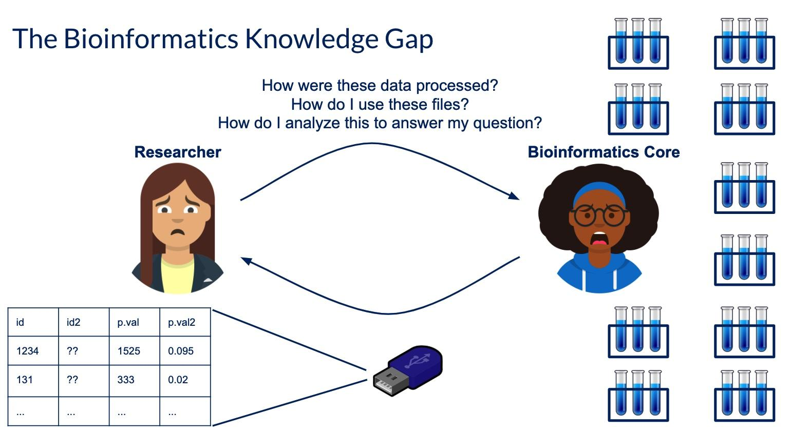
The Goal of the Childhood Cancer Data Lab workshops
To equip pediatric cancer researchers with the necessary tools to independently perform basic analyses on their own experimental data and to gain confidence for continued self-directed learning

Slide 3
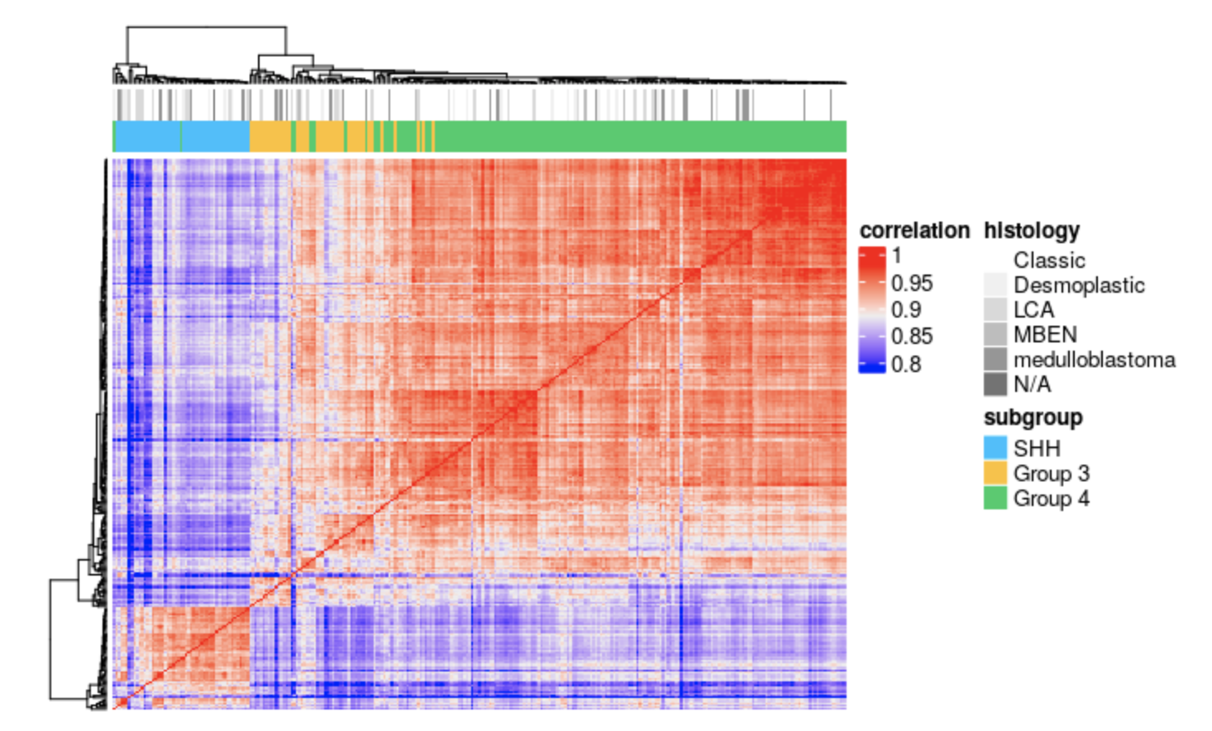
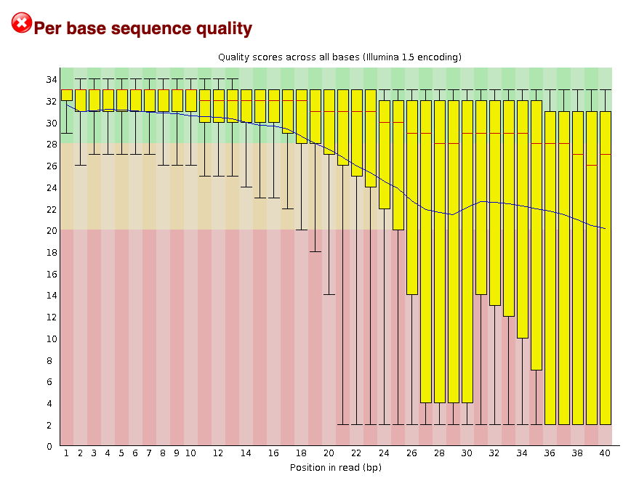
Participant needs we cover:
How to create publication ready plots
Workflows that can be used for bulk RNA-seq and single-cell RNA-seq data
How to interpret quality control reports
https://github.com/AlexsLemonade/training-modules
Notes:
These workshops are hands-on 3 day workshops designed to:
Focus on the most pressing data issues that researchers face
Encourage reproducible practices
Train others to host workshops at their own institutions
Utilize a curriculum that can be easily accessed and developed

Slide 4
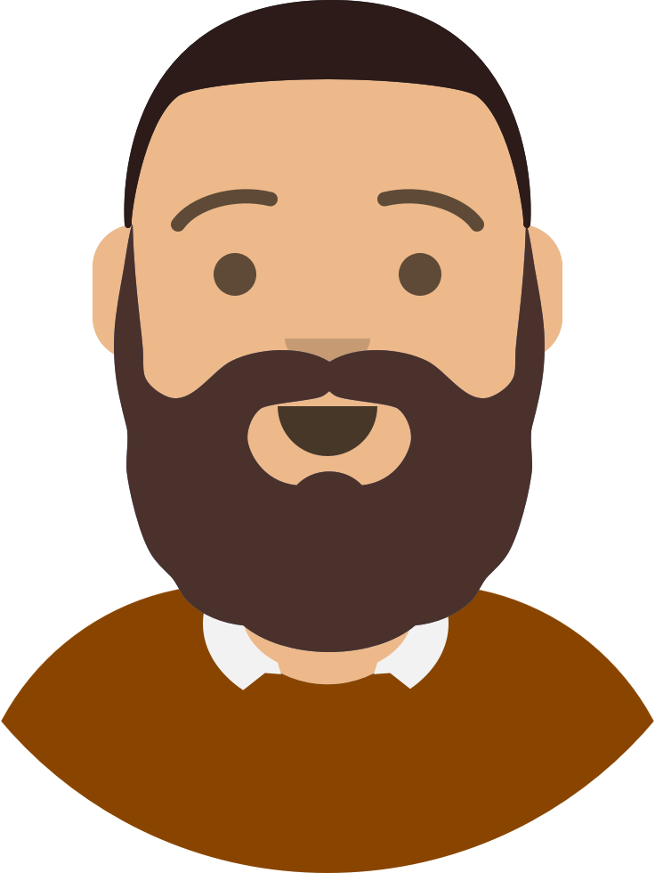





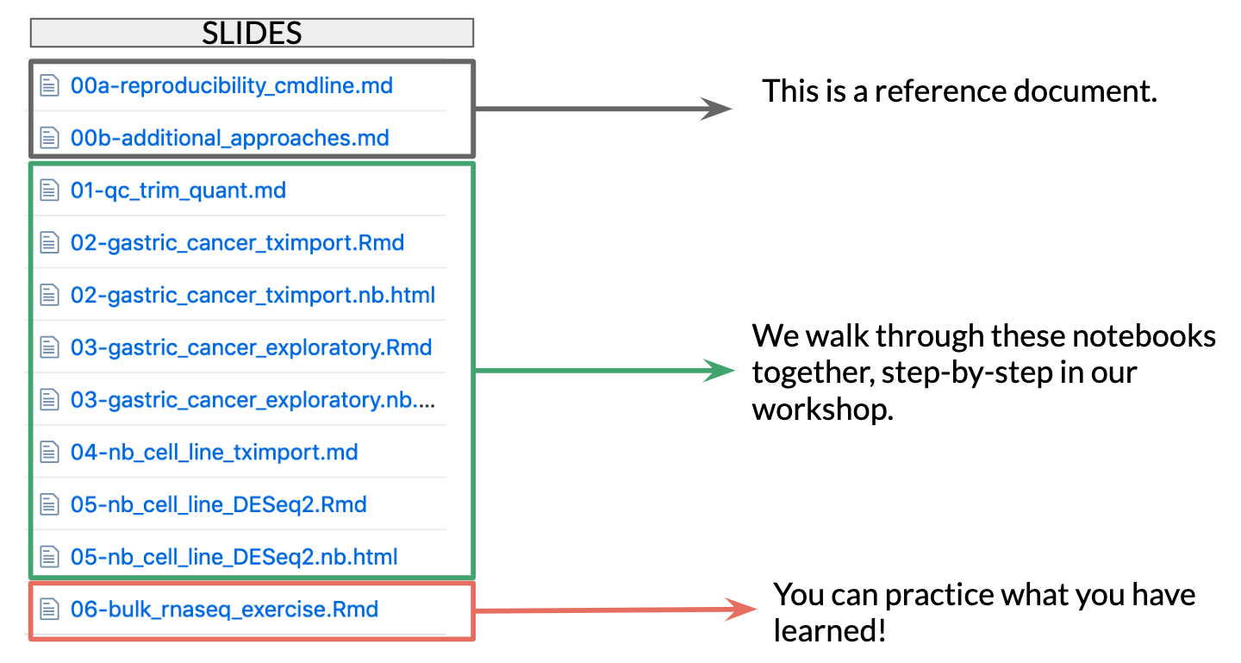
Why do we use Docker?
Why do we use R Notebooks?
p.adj = 0.01
p.adj = 0.01
p.adj = 0.01
Install one hard thing once
Increased control over versions
Participants are able to take away the packages and tools for future use
R Notebooks encourage participants to:
Look at their data
Document their analyses
Work reproducibly
Our exercise notebooks are framed like a scientific question, for increased usefulness and relevance.
Notes:
You can imagine the major headache being saved when we are able to put all of these packages and their versions into a Docker container
And transfer the original code environment to a different computer and operating system, instead of having every install the same packages, versions, and dependencies as needed.
Install one hard thing once instead of attempting to install many things of various levels of difficulty
Increased control over versions helps in the classroom and in preparing material, and saves some time
Participants are able to take away the packages and tools for future use

Slide 5
Participant Feedback
Compliments
Challenges
“It was an extremely valuable use of my time. I was a novice when I started, and now I feel confident that I will be able to work through my data and troubleshoot using the information I learned…”
“Although it was easy to follow, it went quickly so retention will be in question.”
“I thought the training was great for every skill level. It seemed like R was introduced in a way that beginners could grasp yet experienced users wouldn’t be bored.”
“Have more intro work involved or create a beginner and intermediate course.”
“I have gained the ability to engage with my bioinformatic colleagues on a new level.”
“Ideally having even more time, maybe a week of training? To really have time to go from the beginning of an analysis until the end.”
“It was comprehensive and covered topics that are very applicable to my datasets.”

Slide 6
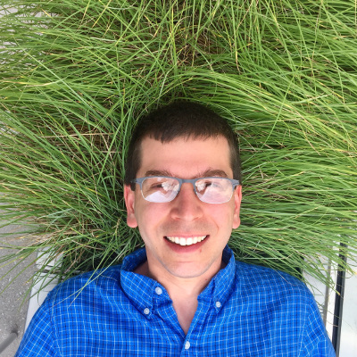
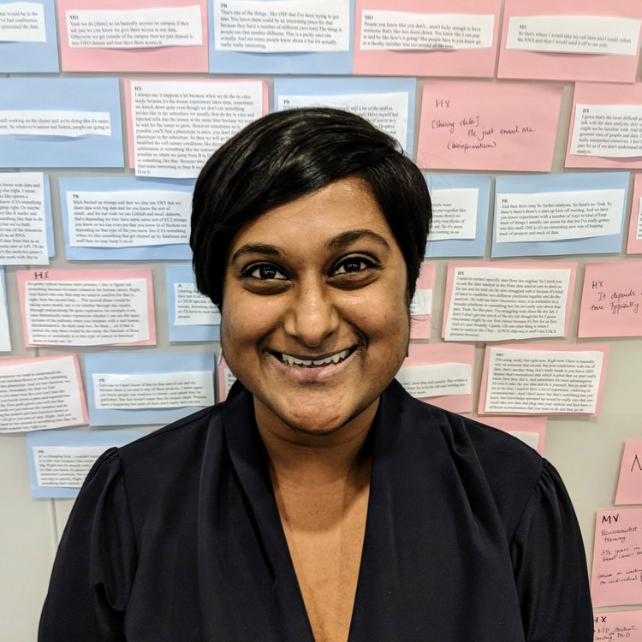
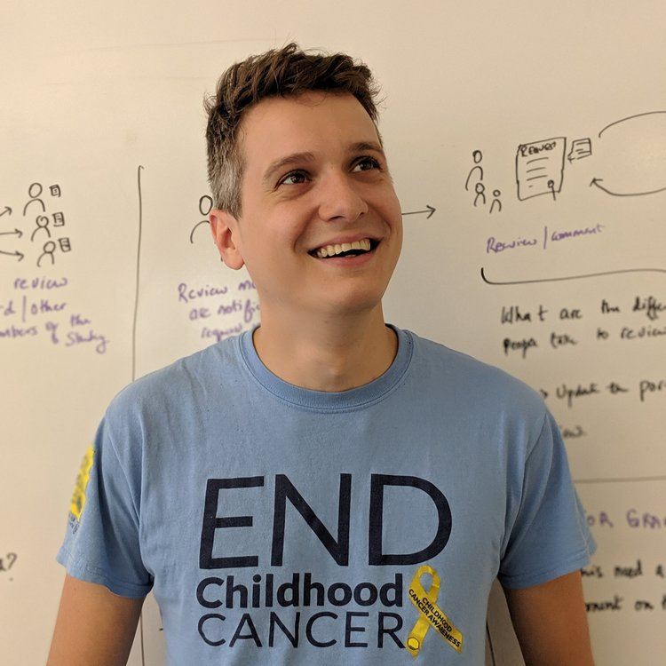
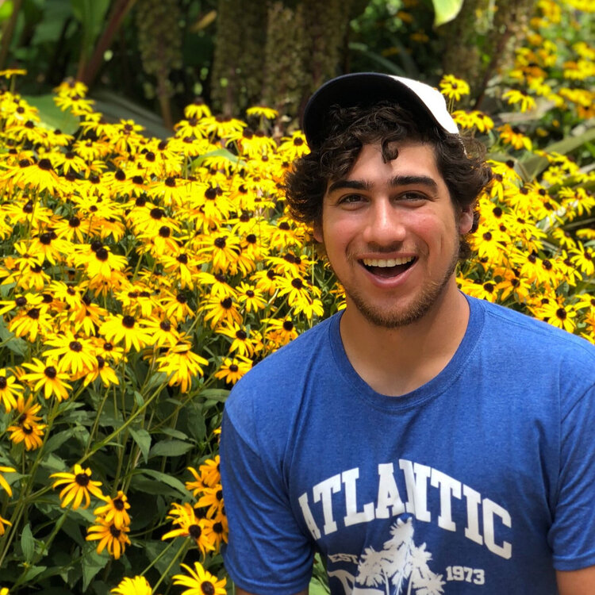
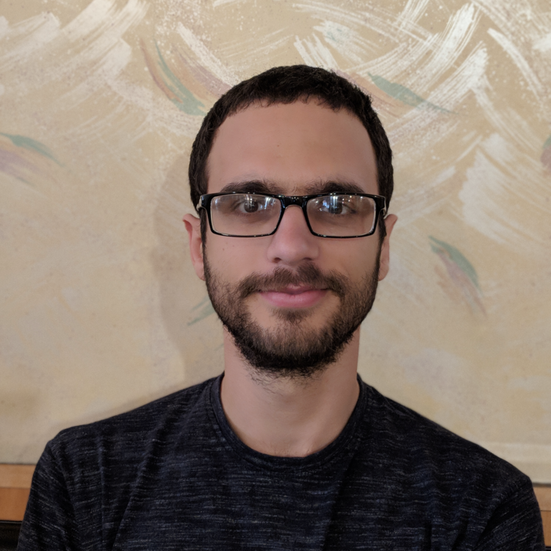
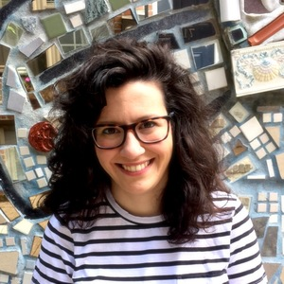
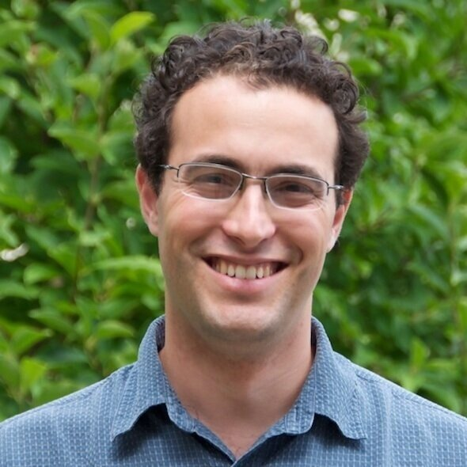
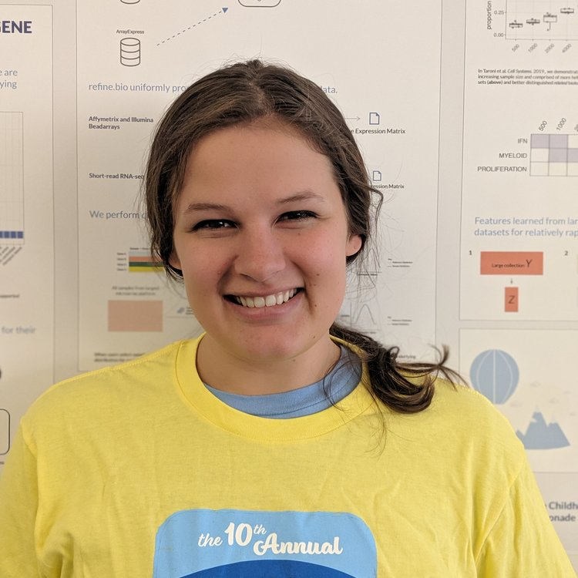
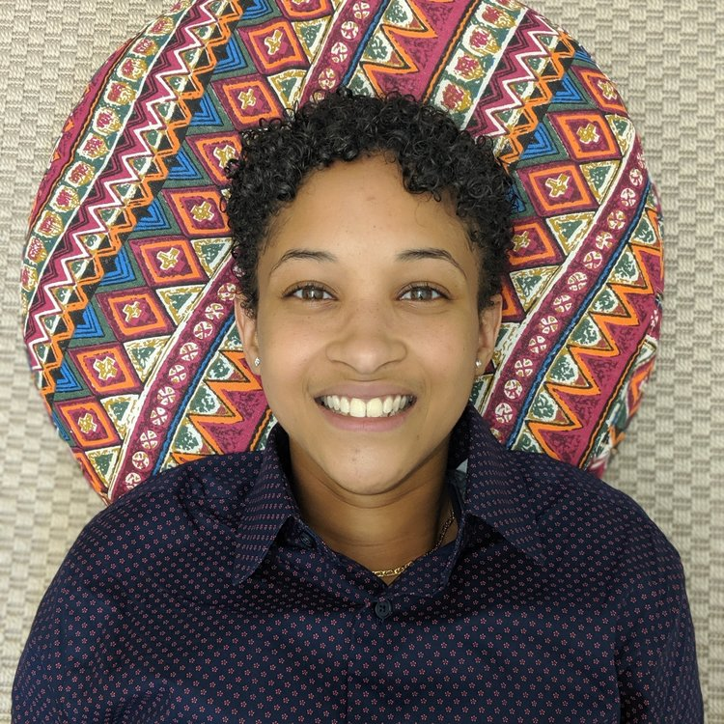
MEET THE CCDL
Casey Greene, PhD (Director)
Deepashree V. Prasad (UX Designer)
Kurt Wheeler (Data Engineer)
David S. Mejia (Full Stack Engineer)
Ariel Rodriquez Romero (Full Stack Engineer)
Website:
ccdatalab.org
Github:
github.com/AlexsLemonade
Twitter:
@CancerDataLab
Curriculum:
github.com/AlexsLemonade/training-modules
Come to Poster 10!
Jaclyn Taroni, PhD (Principal Data Scientist)
Joshua Shapiro, PhD (Data Scientist)
Candace Savonen (Biological Data Analyst)
Chante Bethell (Biological Data Analyst)

