Slide 1
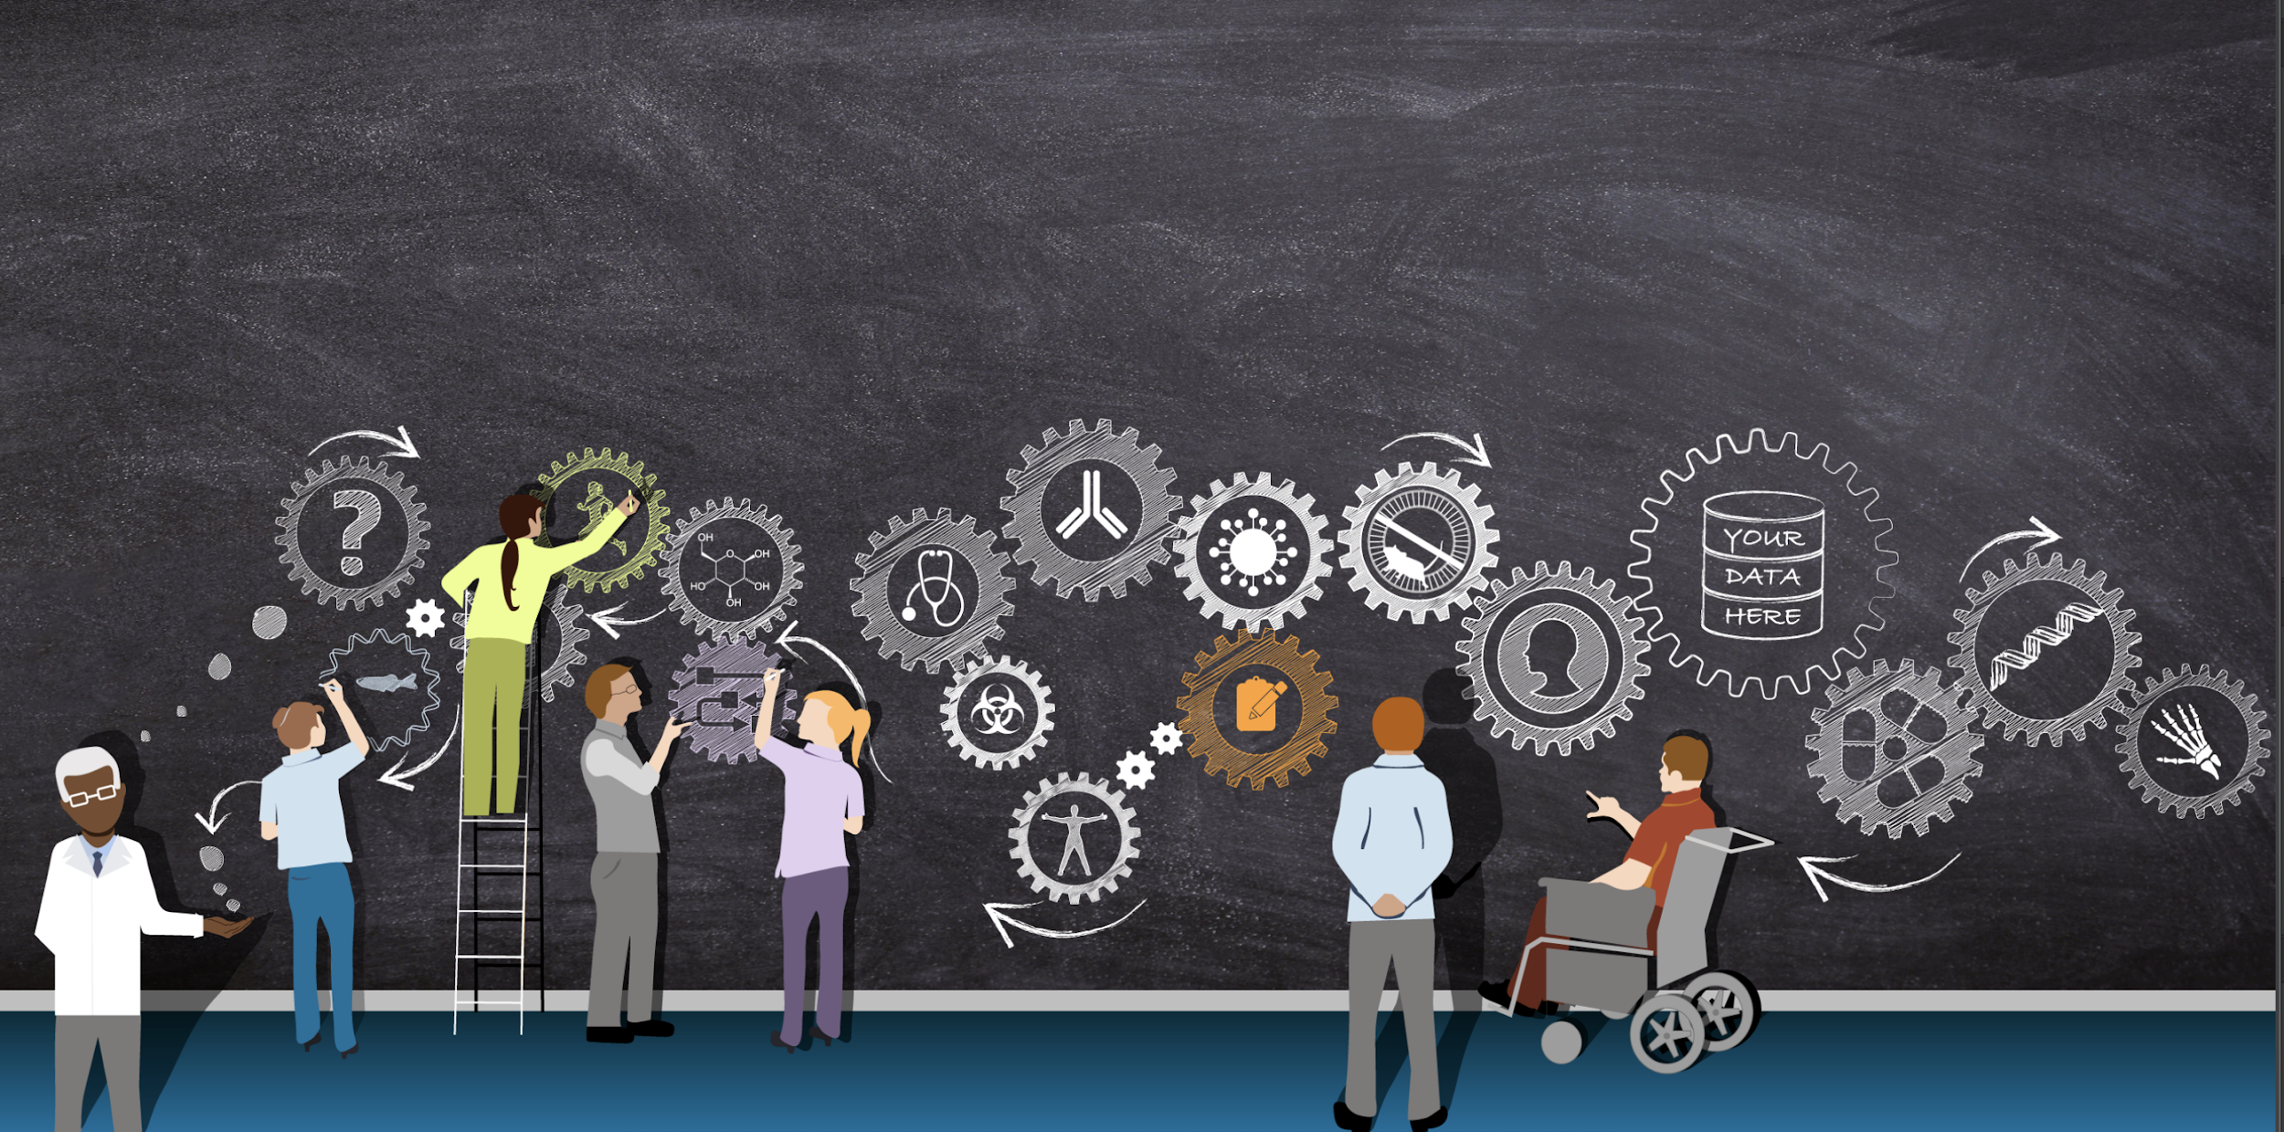



Giving credit where credit is due: How to make more meaningful connections between people and their roles, work, and impact
Nicole Vasilevsky, OHSU
Rocky Bioinformatics
December 06, 2019
@n_vasilevsky

Slide 2
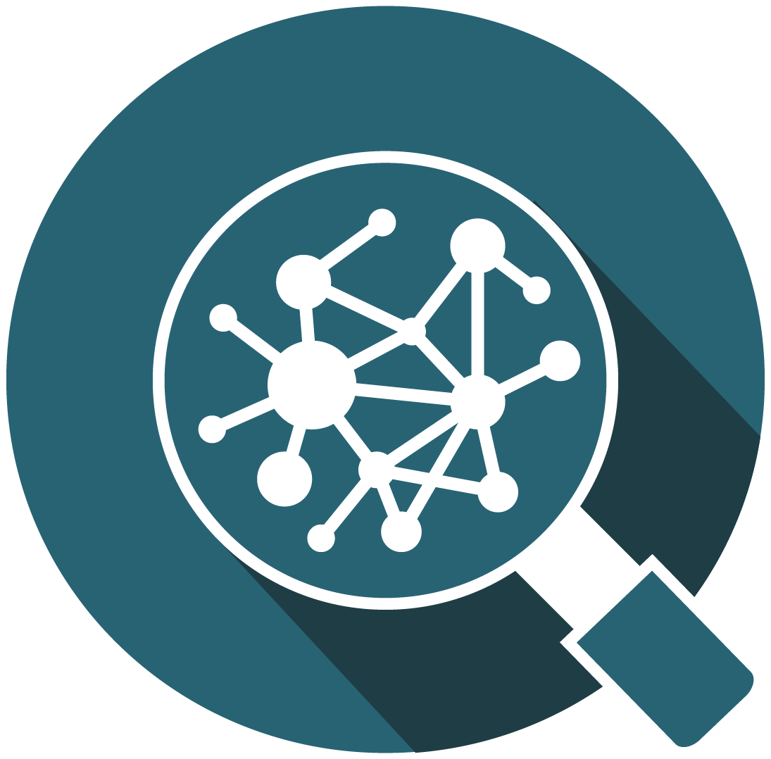
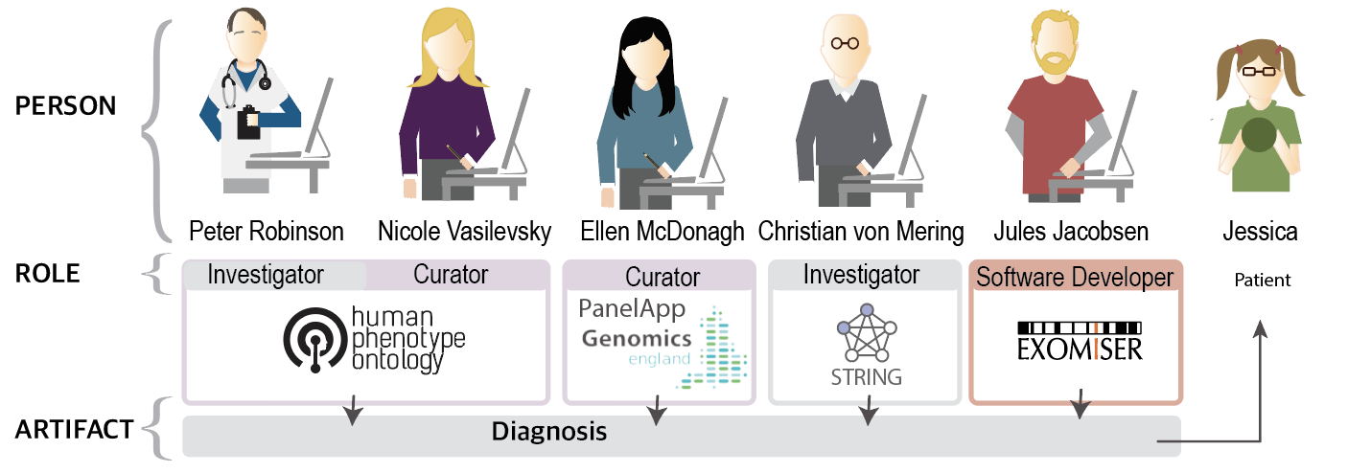
@n_vasilevsky
Contributors needed for a genetic diagnosis
How can we credit diverse expertise and roles?
What work is being done, who is doing it, and what outputs are being created?
Goals:
Understand deeply the requirements for a computable attribution system from a large diversity of stakeholders;
Build model(s) to meet these requirements;
Evaluate the models in real pilot systems with real data.
By using contribution roles & research outputs to develop infrastructure to understand the scholarly ecosystem, we can better understand, leverage, and credit a diverse translational community

Slide 3
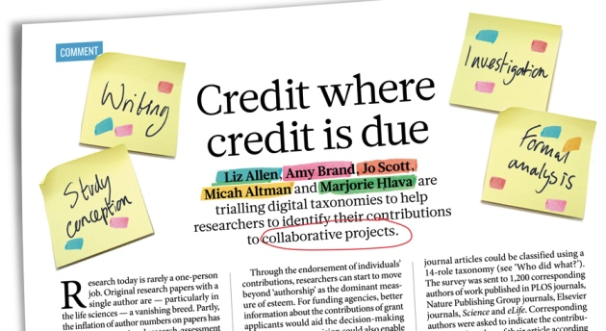
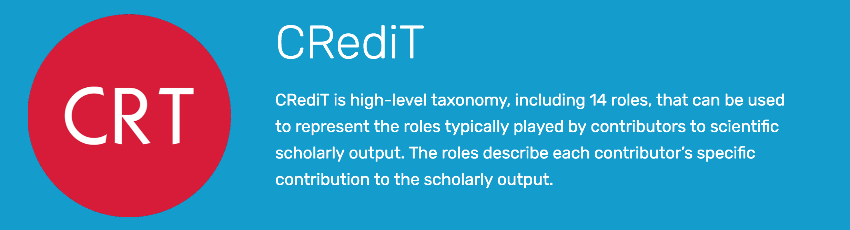
CRediT
CRediT ontology in OWL: https://github.com/data2health/credit-ontology
https://casrai.org/credit/
Notes:
The original CRediT taxonomy has been materialized as an OWL ontology for use in other applications.

Slide 4

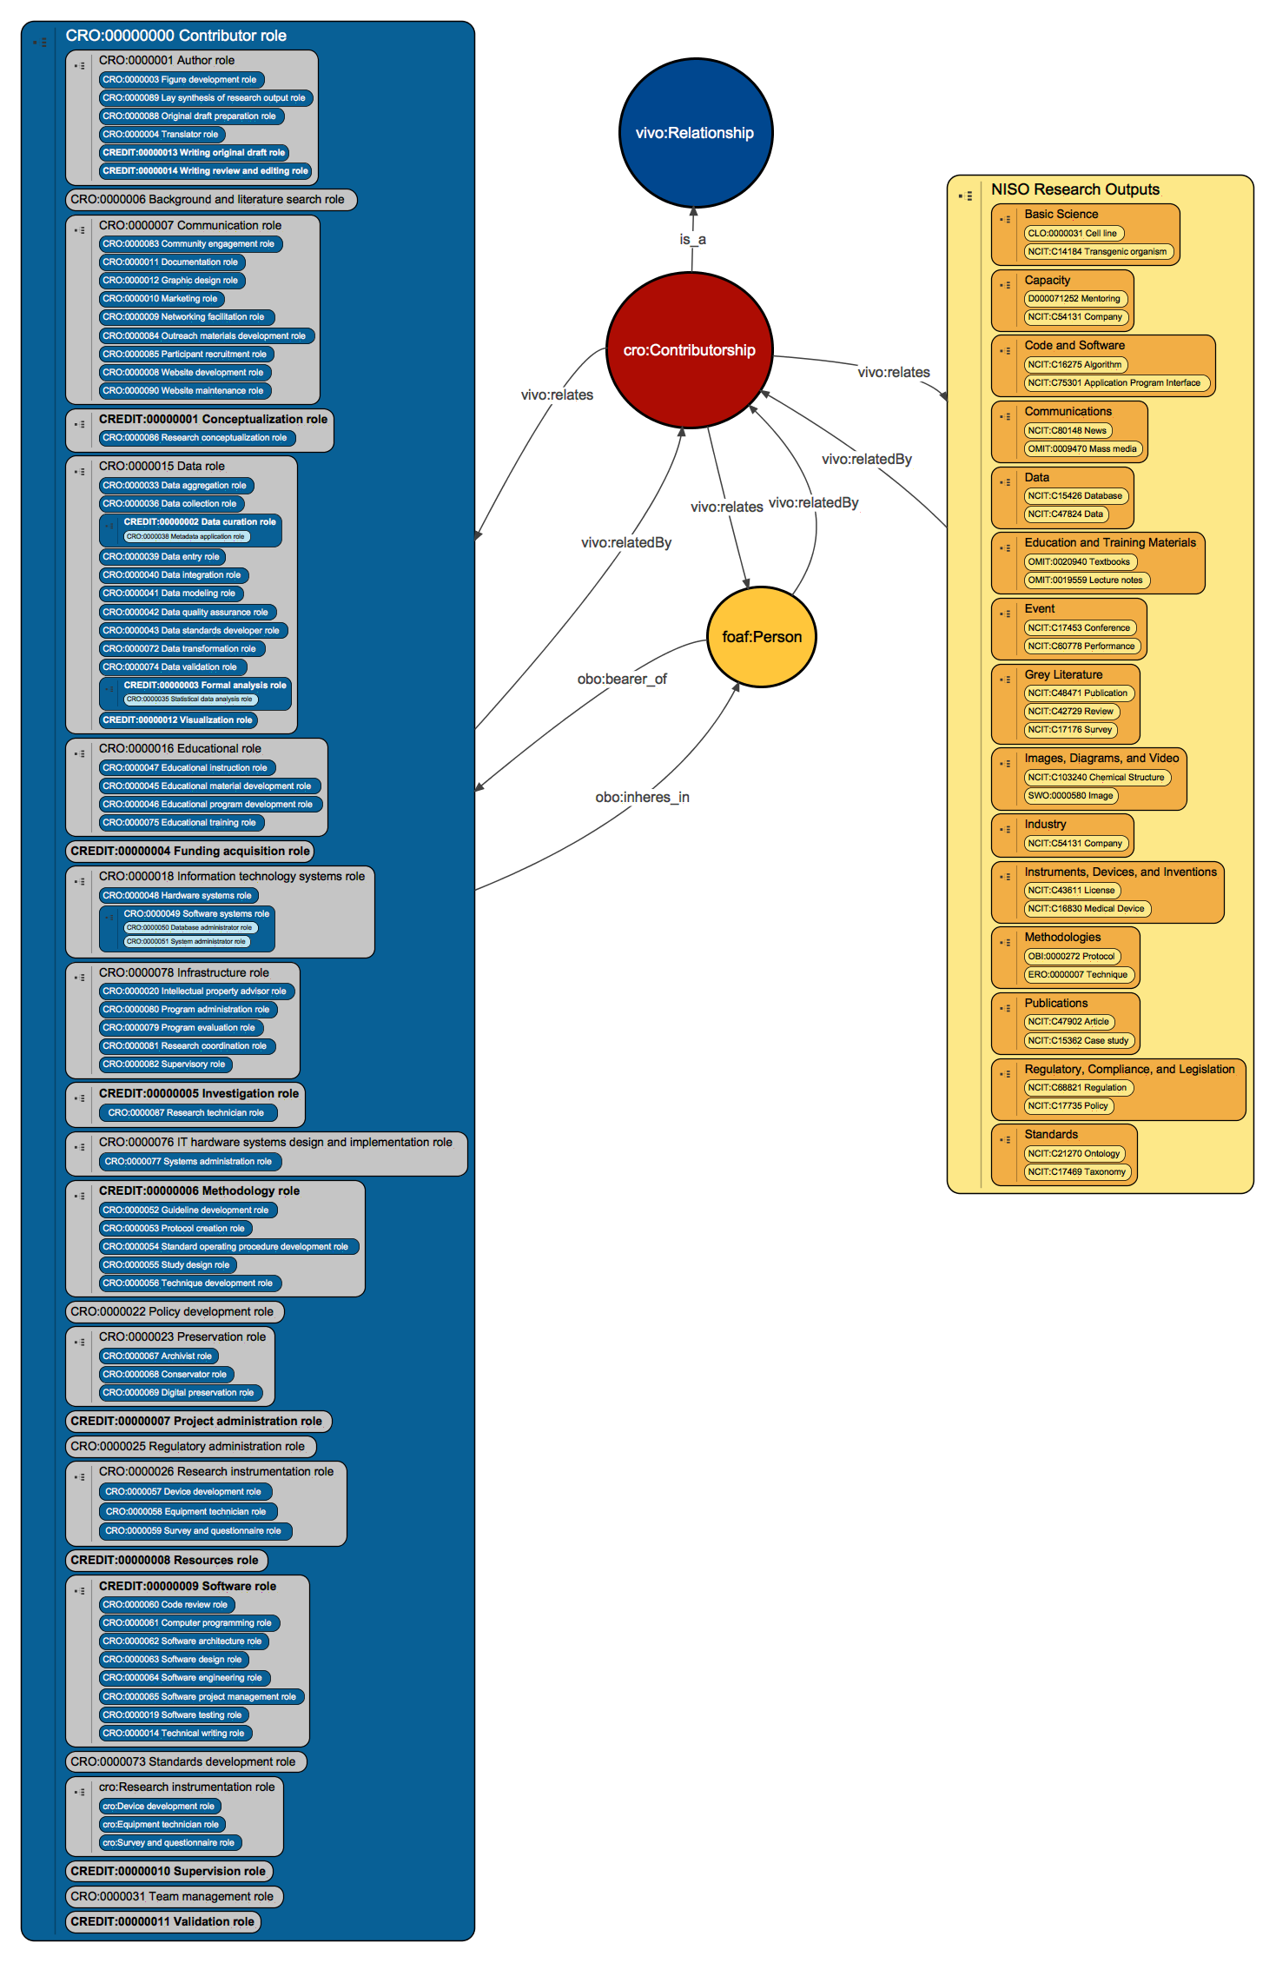
Contributor Role Ontology
Contributor Role Ontology
The CRO imports classes from the CRediT ontology (a computational version of the CRediT taxonomy), in bold.
Learn more!
https://data2health.github.io/contributor-role-ontology/

Slide 5

@n_vasilevsky
Contributor Attribution Model
Artifact
Contribution
Agent
The thing to which contributions are made.
It can be any research related artifact/product - physical or digital.
The actions taken by a particular Agent in the creation, modification, assessment, or deprecation of an entity.
The entity that makes the contribution. It can be an individual Person, an Organization of multiple individuals acting together, or a Computational Agent such as a software program or algorithm.
Qualified contribution
Contribution made by
Contribution made to
Qualified contribution
A format-agnostic Information Model of the domain.
A formal JSON-LD schema serialization of the Information Model.
A TSV format and curation template, based on the Information Model.
Ontologies and LD-Context Mappings to support creation of RDF linked data.
A code library and services to support data creation and format interchange.
An Implementation Guide to support creation of CAM-compliant data in
different formats and contexts.
cd2h.org/attribution

Slide 6
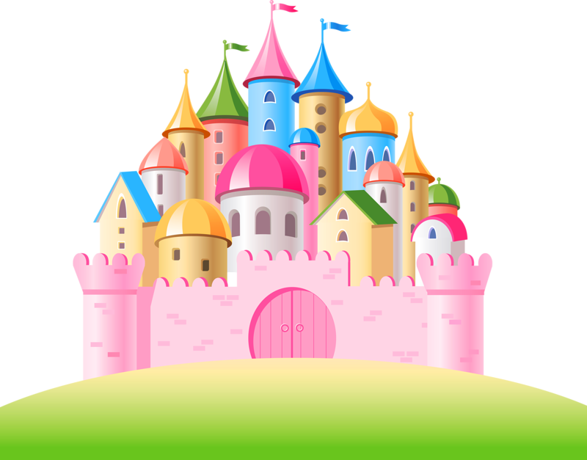

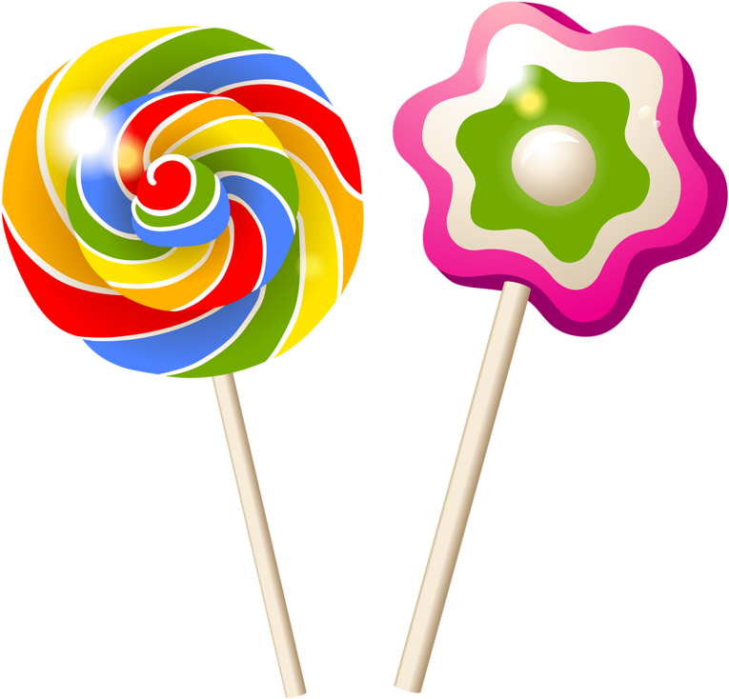
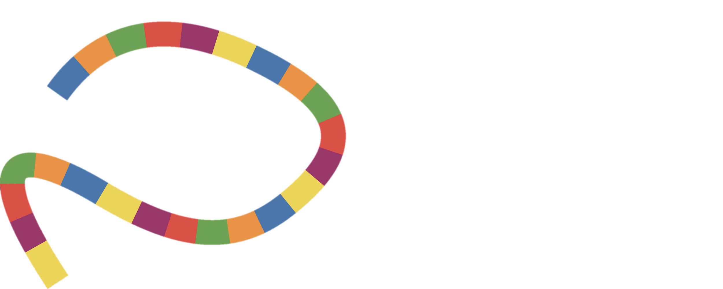




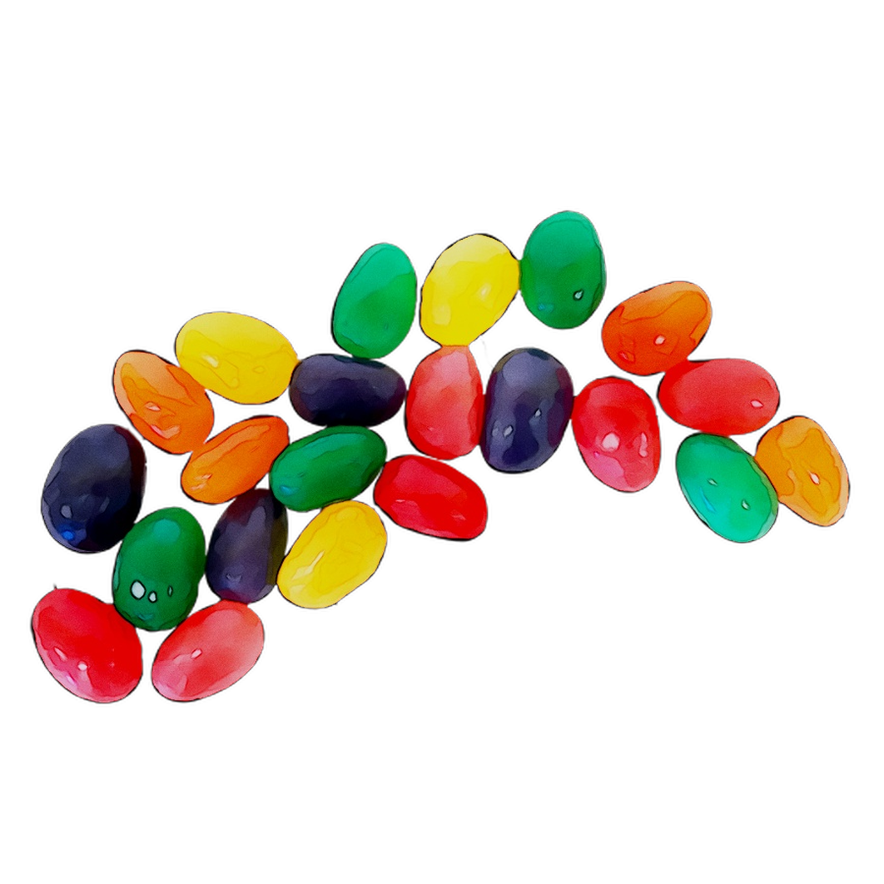
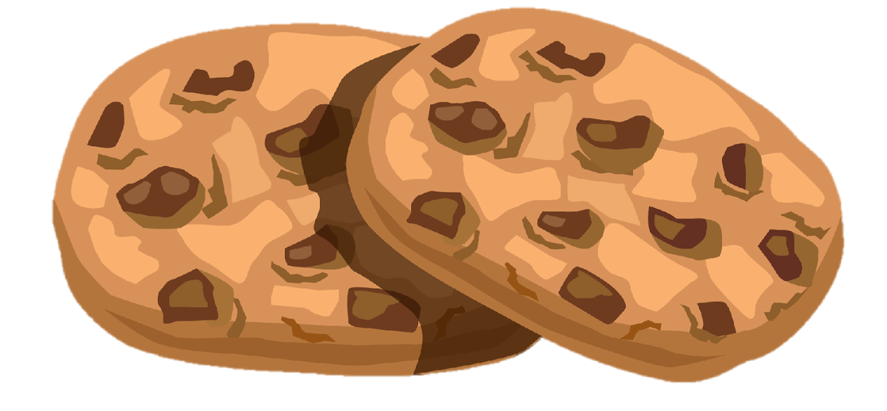

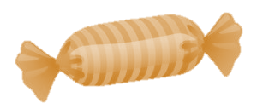
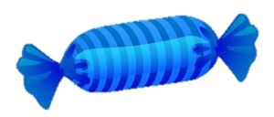

Come visit us at Poster P83
Acknowledgements
Northwestern University team: Karen Gutzman, Patty Smith,
Sara Gonzales, Lisa O’Keefe, Kristi Holmes
Oregon Health & Science University team: Marijane White, Matthew Brush, Anne Thessen, Melissa Haendel
Northwestern University Clinical and Translational Sciences Institute
OpenVIVO collaborators, Force11 Attribution WG, NISO,
Cathy Sarli & Becker Library, Galter Library, NUCATS, ChicagoCHEC, FIRST DailyLife, Health for All
NIH Support
U24TR002306 (NCATS)
UL1TR001422 (NCATS)
U54CA202995, U54CA202997
U54CA203000 (NCI)
Contact us!
vasilevs@ohsu.edu
cd2h.org/attribution
@data2health
Reproducibility
Lookout

