Slide 1
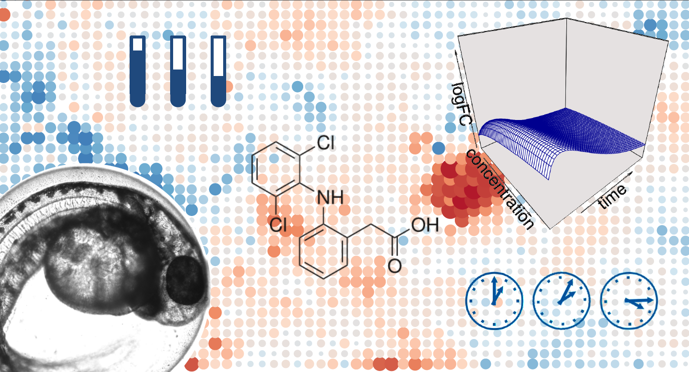

Map and Model – from observation to prediction in zebrafish toxicogenomics
GigaScience 8 (6), June 2019, giz057 https://doi.org/10.1093/gigascience/giz057
Wibke Busch
Andreas Schüttler,
Janet Krüger,
Rolf Altenburger, et al.
Department Bioanalytical Ecotoxicolgy Leipzig, Germany
www.ufz.de
Notes:
Welcome everybody to my talk which is about a map and a model for zebrafish toxicogenomics data.
I am a toxicologist at the environmental research centre in Leipzig Germany and most of the work I will present was conducted by my PhD student Andreas Schüttler.
This work was published this year in gigascience.

Slide 2
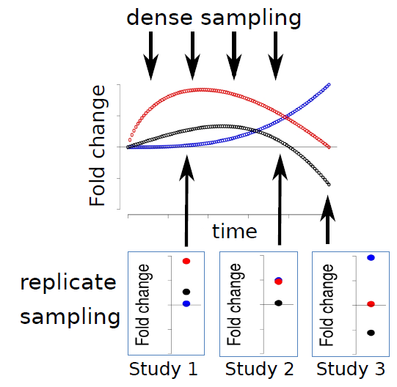
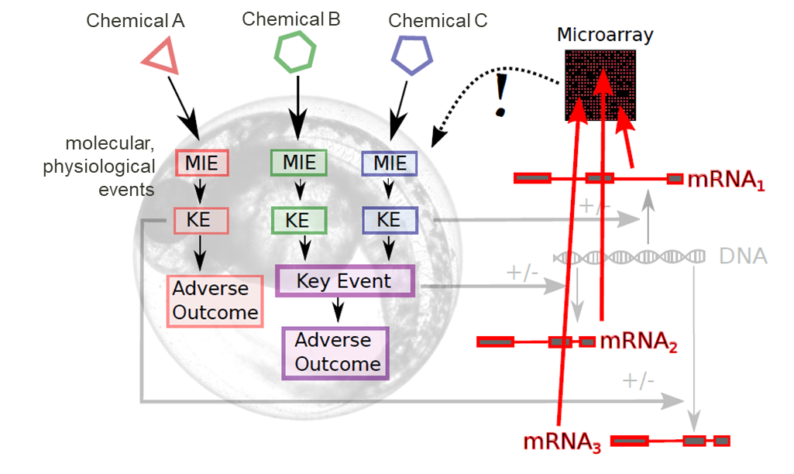
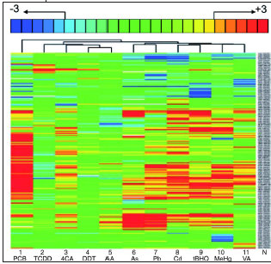
Toxicogenomics
From: Schüttler et al., Toxicological Sciences, 2017
→ Comparability between toxicogenomic findings is limited
From: Yang et al., Genome Biology, 2007
Time/Concentration dependency often neglected
Commonly only subset of genes is reported/evaluated
Notes:
What is toxicogenomics at all? Idea behind is, that if we expose a cell or an organism (here this is a zebrafish embryo) to a certain chemical or stressor, certain molecular or physiological events that take place before it comes to an adverse outcome.
If we measure changes in RNA expression or abundance in a comprehensive way for example with MA or RNA seq after such an exposure we might get an idea about these key events...
However the comparability of such toxicogenomic findings is often limited due to several reasons and I want to focus on two challenges here.
the first is that in many studies replicate sampling is still preferred over resolving time/conc dependency of responses
and another factor is that although we always measure the whole transcriptome – further analyses are usually focussed only on subset of genes.

Slide 3
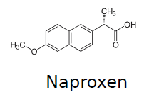
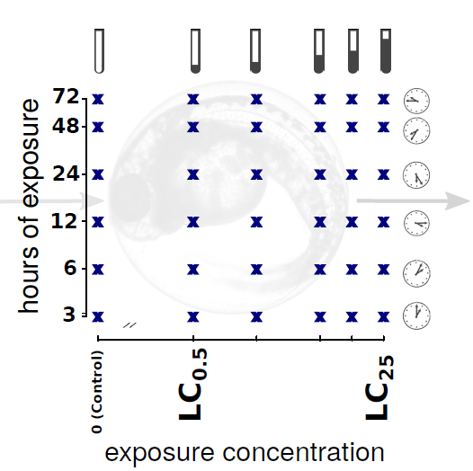
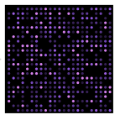
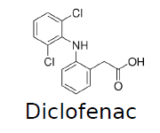
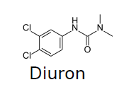
Questions and Approach
How to see the complete picture?
How to compare toxicogenomic effects of different substances?
Experiment
Data analysis
integration of previous data
aggregation of fingerprints
→ modeling of responses
Notes:
We asked how can we see the more complete picture and how can we better compare toxicogenomic effects of different substances.
Therefore, we conducted a model experiment with three environmentally relavant chemicals. We exposed zfe with 5 concentrations and took samples at six different time points. We measured the zebrafish trancscriptome at every point in this matrix.
and then we developed a data analysis pipeline where we integrated this data with other data, aggregated fingerprints and modeled the responses. I will explain this in detail.

Slide 4
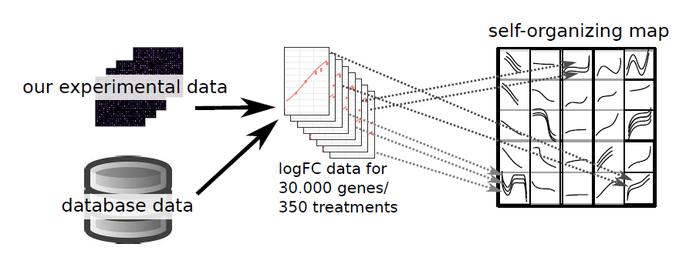
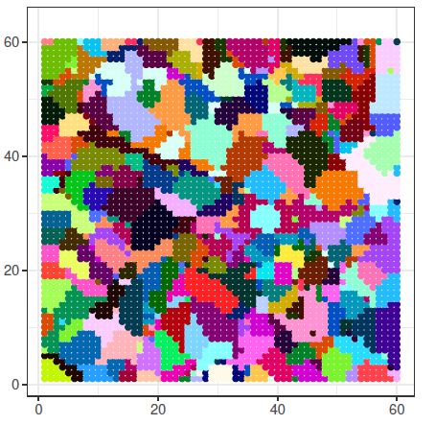
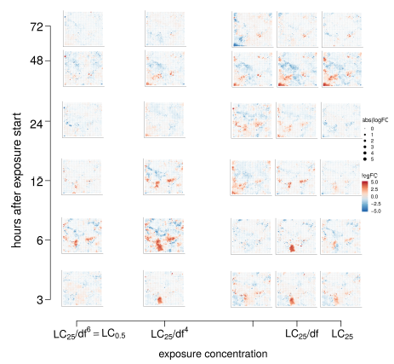
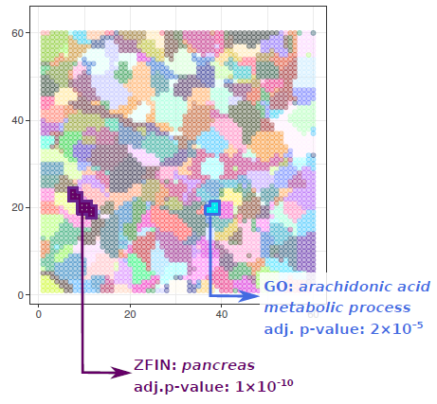
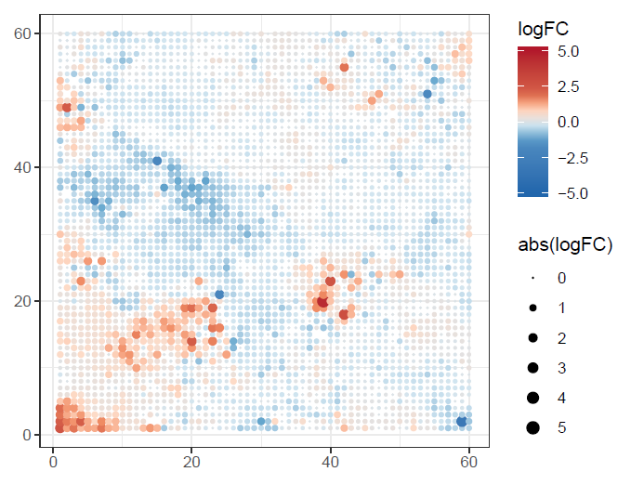
Integration and aggregation of data
functional enrichment
Interpro: beta/gamma crystallin
(ZFIN: lens) adj. p-value: 3x10⁻⁸⁹
clustering
60x60 rectangular grid
3600 nodes
118 clusters
Diclofenac, 48 hours exposure, 7.4 µM
Schüttler et al., GigaScience, 2019
Notes:
First, we integrated our data and other zebrafish toxicogenomics data that we retrieved from databases. We analysed this data and got FC information for about 30000 genes and 350 different chemical treatments.
And then we used the self organizing map algorithm to sort all genes of the zebrafish transcriptome onto such a 2D map based on the co-expression accross all the data.
This you can see here. We got a map with 3600 nodes and we additionally clustered these nodes into 118 clusters.
And the advantage of this is that we could do functional enrichment analysis for the clusters. For examples – this little cluster is enriched for crystallin genes (these are proteins of the lens in the eye), genes of this cluster here are associated with zebrafish pancreas and and here we have a cluster enriched for arachidonic acid metabolism
Every gene of the ZF genome has now a fixed place on that map and now we can plot individual results on that map.
Here we see the results of the diclofenac 48h exposure with a certain concentration. The red nodes are upregulated and the blue ones are downregulated.
Now if we look into our experiment with the matrix design we get such a map for every timepoint and concentration. we see how the whole transcriptome changes with exposure time and concentration.
And to better quantify this we intended to set up a regression model that describes the time and cocnetration dependet changes for each node on the map.

Slide 5
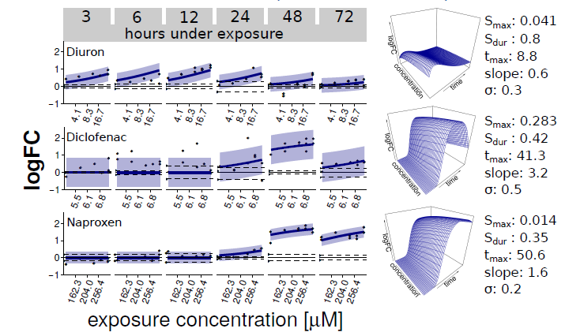
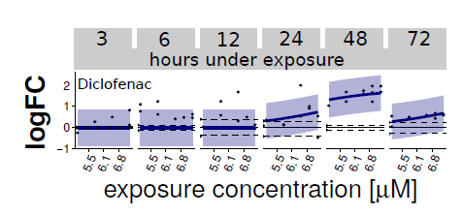
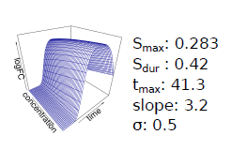
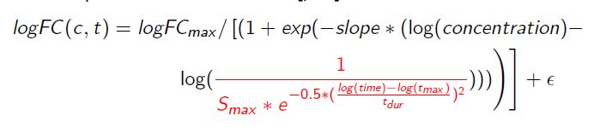
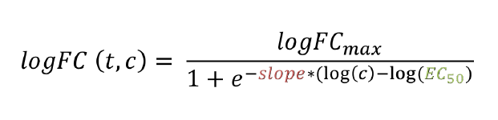
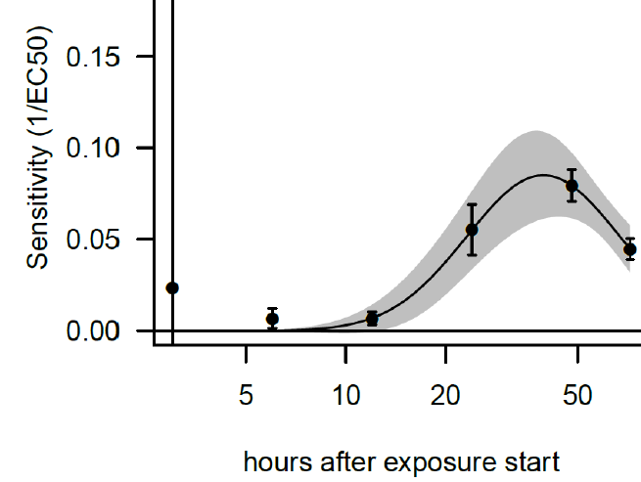
Regression modeling
gene:
NRF2
Notes:
How did we do that? I show you this on the example of this single node here which contains only one gene, (the NRF2 gene which is related to oxidative stress.)
So here you see the concentration dependent regulation of this gene at the different time points. Such a dose response relationship can be described with a classical sigmoidal dose response model.
and then we found that the time dependence of this parameter here, EC50 which is the concentration where 50% effect is reached (or more precisely the inverse of EC50) can be very well captured with a biphasic (logGauss) model – which we included then in the dose response model.
The result here is a 3D regression model which has some meaningful parameters. For example the tmax parameter which is the timepoint of maximum response. Here it is 41 h.
And now we can compare this to the other substances - this node is much earlier affected with this chemical and later with this compound.
Now, instead of looking at fold changes for every single condition, we can plot our model parameters on the map and get a more comprehensive picture about what happens on the whole transcriptome.

Slide 6
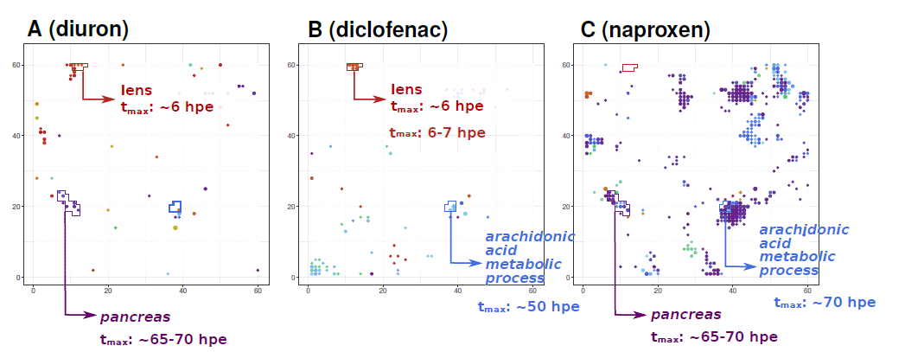
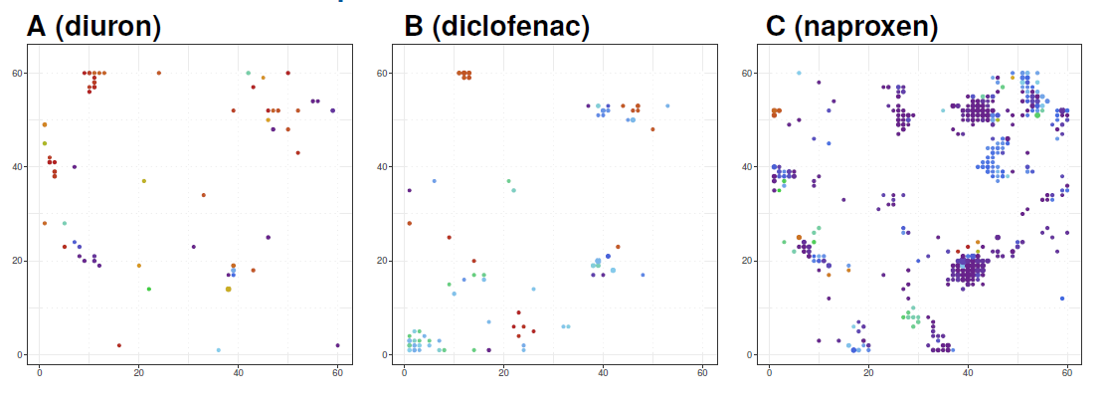







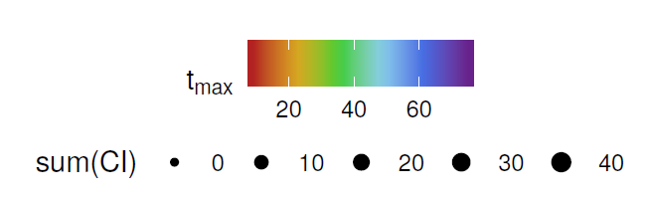
Mapping model parameters
Enhanced comparability of toxicogenomic findings:
  zebrafish embryo toxicogenomic map: common reference frame for biological interpretation
  3D-regression model: quantitative characterisation of biological responses and inference on a concentration and time scale
  fingerprint browser: https://webapp.ufz.de/itox/tfpbrowser/
  further read: GigaScience 8 (6), June 2019, giz057 https://doi.org/10.1093/gigascience/giz057
Summary
Acknowledgement
Notes:
Here you see the maps where for each chemical the responding nodes are coloured for their tmax value.
and now we can directly compare the effects between the different chemicals. we see for example, that our lens cluster is affected quite early with these two compounds, whereas the pancreas genes are affected with these two chemicals but much later ... (and here we have different time points for example) and we also see individual effects for the different compounds
this is the summary – we achieved to enhance comparability of toxicogenomic findings with a map (that serves as a common reference frame) and a regression model (for quantiative charactereisation and the inference on teh cocnentration and time scale)
we published a browser where you can click into the maps and see which genes are in the nodes and how they are affected with the chemicals and all the details are in the paper.
these are some european funding sources where we got money from and this is my group – thank you very much for your attention!

