Slide 1

OP17: Pathogenic Synonymous Variants are More Likely to Affect Codon Usage Biases than Benign Synonymous Variants*
Justin Miller, Ph.D.
Brigham Young University

Slide 2

Codon Usage Dynamics
Codon Aversion
Codon Pairing
Ramp Sequences

Slide 3
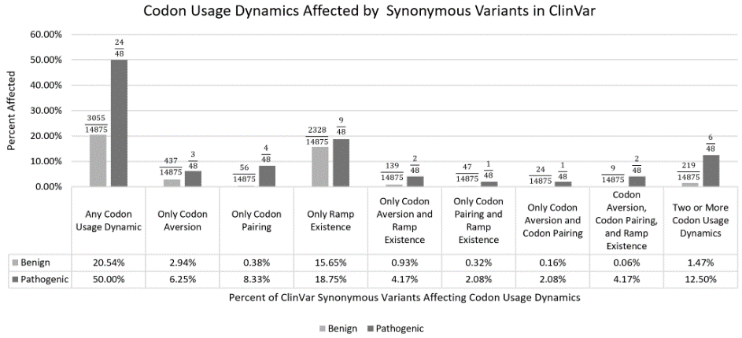
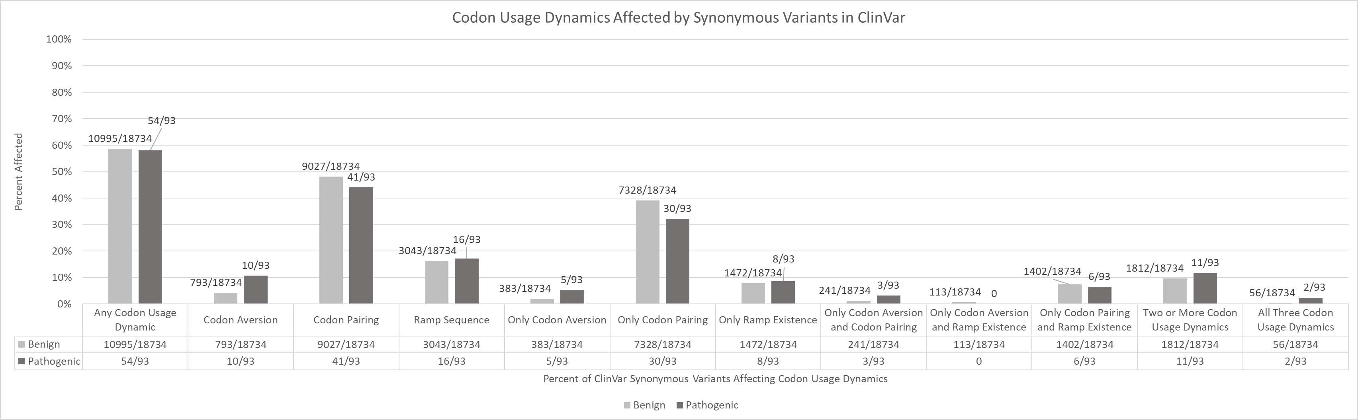
ClinVar 2018
ClinVar 2019
Significant Differences in
Affected Codon Usage Dynamics
Any codon usage dynamic (p-value=7.24x10⁻⁶)
2+ codon usage dynamics (p-value=5.23x10⁻¹⁰)
All three codon usage dynamics (p-value=1.30x10⁻²⁵)
48 synonymous pathogenic variants
14,875 synonymous benign variants
Few Significant Difference in
Affected Codon Usage Dynamics
Only codon aversion (p-value=0.00239)
All three codon usage dynamics (p-value=0.00133)
93 synonymous pathogenic variants
18,734 synonymous benign variants

Slide 4
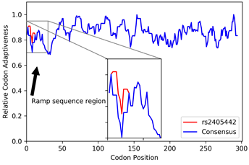
Paired Immunoglobin Like Type 2 Receptor Alpha (PILRA) rs2405442:T>C
13 synonymous variants in high LD with GWAS hit for Alzheimer’s disease
1 SNP is predicted to destroy a ramp sequence and increases codon aversion
Leucine TTG codon changed to CTG
Relative synonymous codon usage (RSCU) of 0.335 changed to 1.0
GC content previously shown to be associated with higher mRNA levels

Slide 5
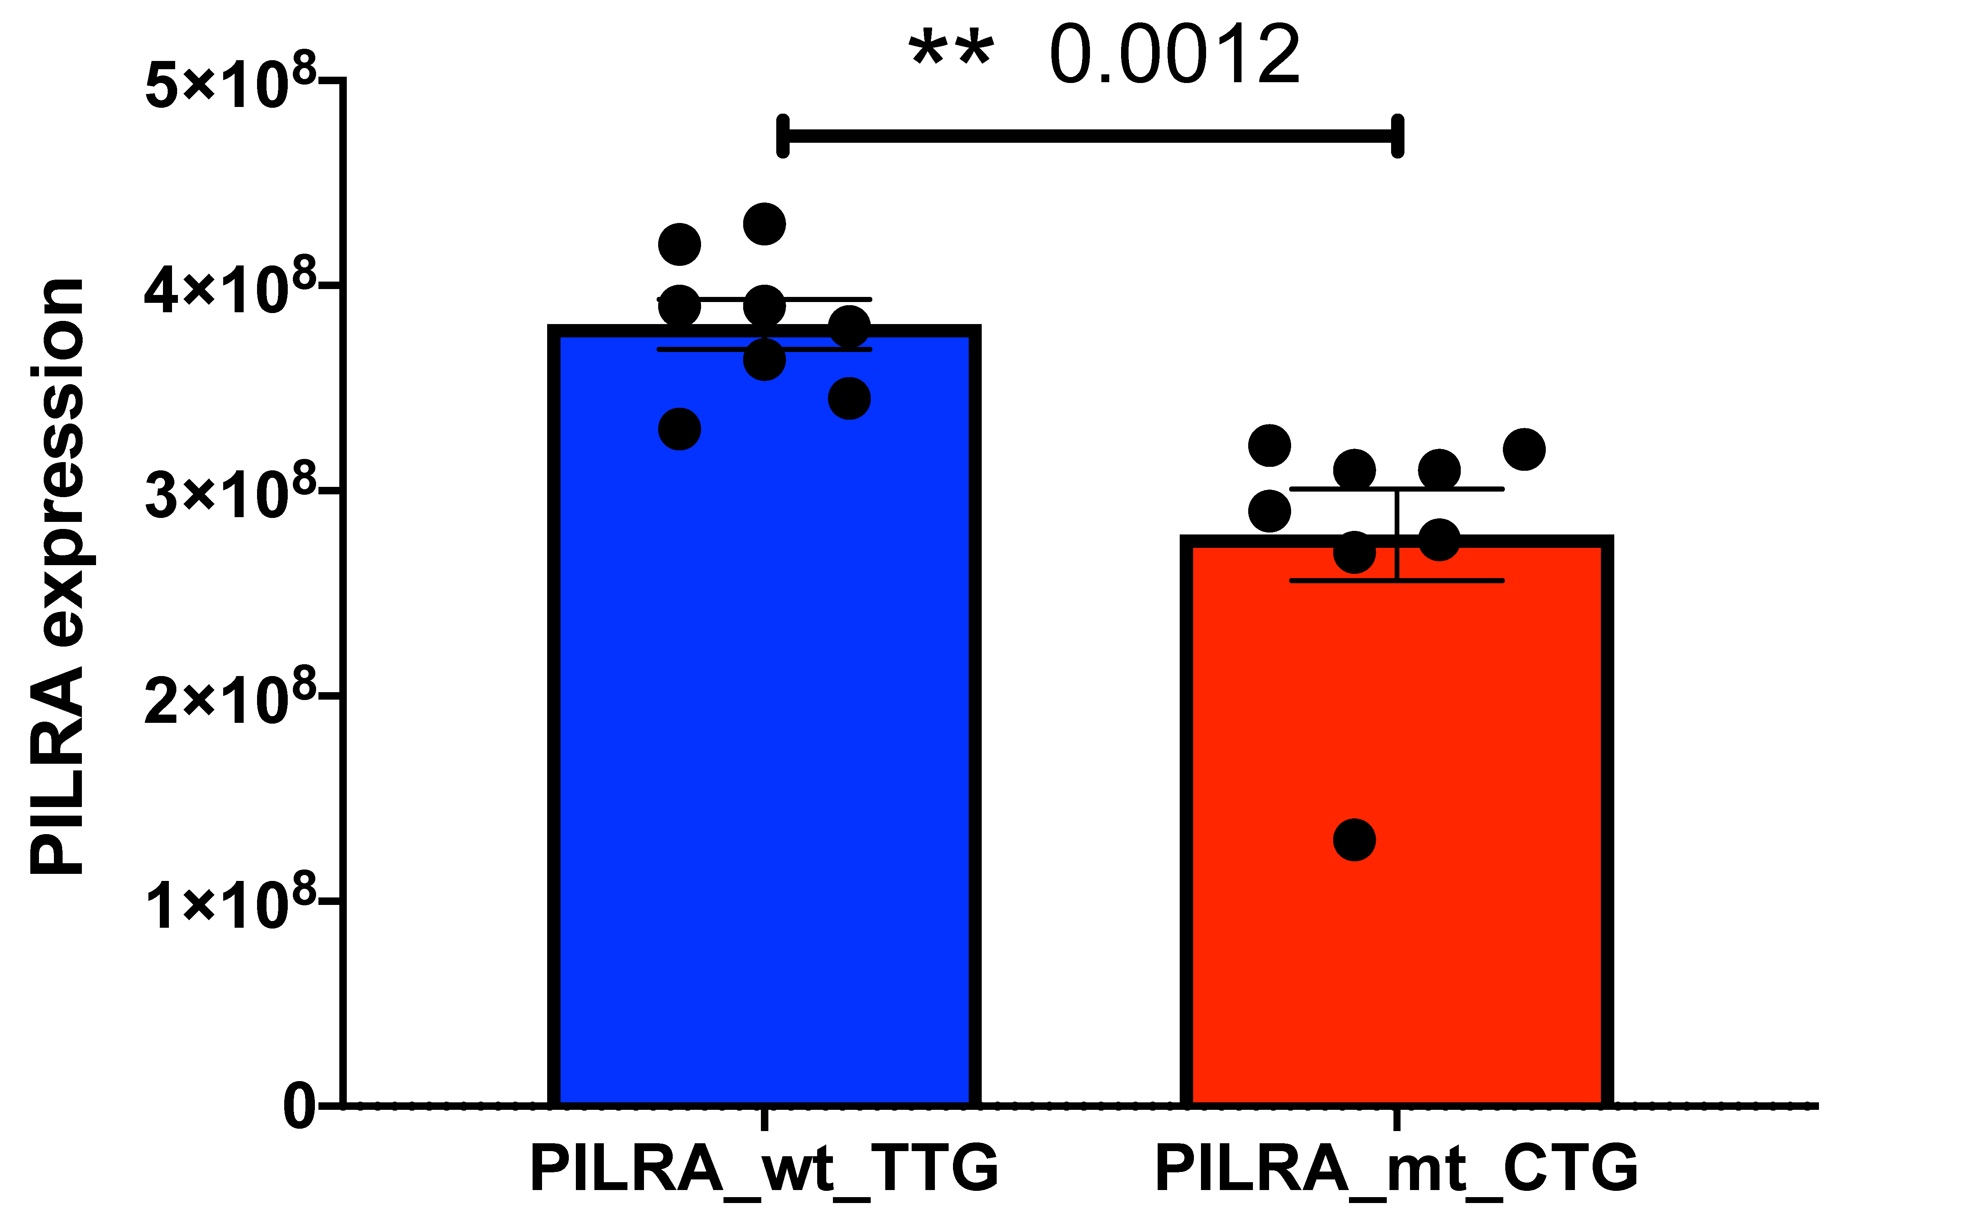
PILRA mRNA levels measured with qPCR
Wildtype and mutant sequences synthesized using cloning and in site mutagenesis
Three qPCR replicates
Significantly lower PILRA mRNA expression from the mutant
A silent mutation in PILRA that is in high LD with rs1859788, which is associated with Alzheimer’s disease, destroys a predicted ramp sequence and increases codon aversion, causing decreased mRNA expression.

Slide 6

Please See Our Other Posters About
Codon Usage Dynamics
Lauren Cutler, Justin Hunt, Lauren McKinnon, Justin Miller, Perry Ridge
Matthew Hodgman, Taylor Meurs, Justin Miller, John S.K. Kauwe
Lauren McKinnon, Josue Gonzalez, Perry Ridge, Justin Miller, John S.K. Kauwe
Taylor Meurs, Matthew Hodgman, Justin Miller, John S.K. Kauwe
Justin Miller and John S.K. Kauwe
P18: A comprehensive analysis of orthologous genes across all domains
P33: CUBAP: An interactive web portal for analyzing codon usage bias across populations
P50: Using ramp sequences to identify causes of disease association
P52: Codon usage biases have significant implications in population stratification
P54: Pathogenic synonymous variants are more likely to affect codon usage biases than benign synonymous variants

