Slide 1
The Model-to-Data Paradigm: Overcoming Data Access Barriers in Biomedical Competitions
Justin Guinney, PhD
VP Computational Oncology, Sage Bionetworks
Chair, DREAM Challenges

Slide 2
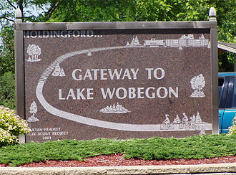
Self-Assessment Trap
“Where the women are strong, all the men are good-looking, and
all the children are above average.”

Slide 3
Problem Statement
“Self-assessment” has impeded the translation and dissemination of biomedical tools and methods.
New paradigms for data sharing are needed to unlock critical datasets.
New incentives are required to convene research communities to develop domain standards and benchmarks.

Slide 4

The Case for Crowd-Sourced
Biomedical Challenges
Open, biomedical Challenges can coalesce research communities to develop standards & benchmarks, while stimulating innovation.

Slide 5
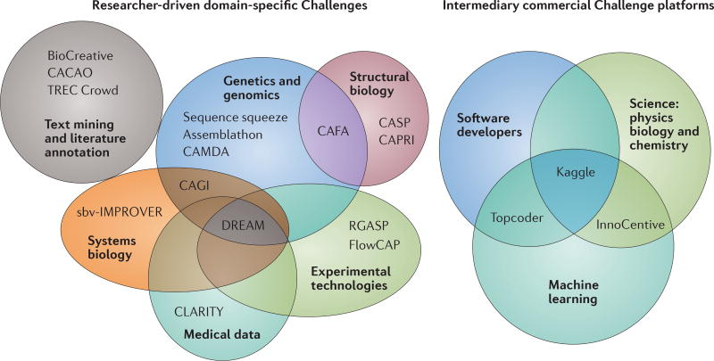
Landscape of Challenge Platforms
Nat Reviews Genetics, 2016

Slide 6

Dialogue for Reverse Engineering
Assessment and Methods
Pioneer of biomedical challenges
since 2006
Contributes to the solution of important biomedical problems
Fosters dialogue collaboration between research groups
Accelerates research
Framework for objective assessment of methods & tools

Slide 7
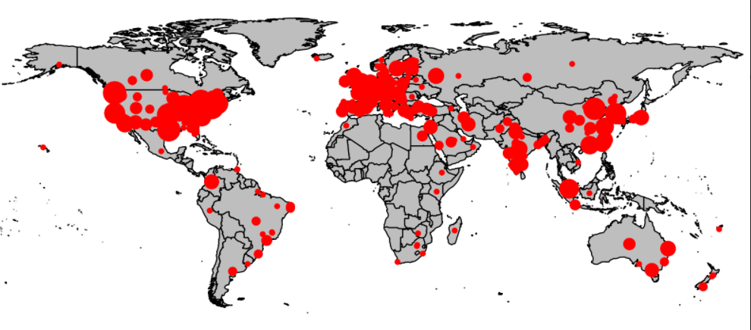
DREAM Impact
50+ Challenges across many biomedical disciplines.
68+ papers in leading journals.

Slide 9
Most of the data needed to answer impactful clinical questions is not open data.

Slide 10
Open vs closed

Slide 11
Alternative data sharing paradigms
Data-to-user
User-to-data
Model-to-data

Slide 12
Many Data Sharing Paradigms
Open
Model-to-data
DUA required
Sandbox
Accessibility
Collaboration
Closed &
restricted
Closed
Other dimensions:
Cost
Security
Reproducibility
Data use

Slide 13
Model-2-Data: how is it implemented
Scalable cost & compute
Algorithm portability
Standards
DICOM
OMOP

Slide 14
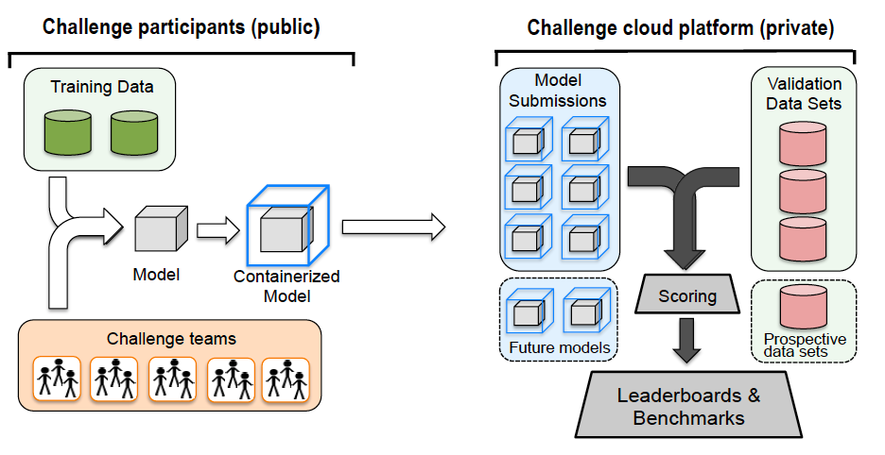
Model-2-Data Challenge
“Alternative models for sharing confidential biomedical data”, Nat Biotech, 2018

Slide 15
Model-2-Data Challenges completed / in-progress
ALS Stratification
Drug-kinase target
RNA fusion
Proteogenomic
Multiple myeloma prognosis
Digital mammography
Electronic healthcare record
Tumor deconvolution

Slide 16
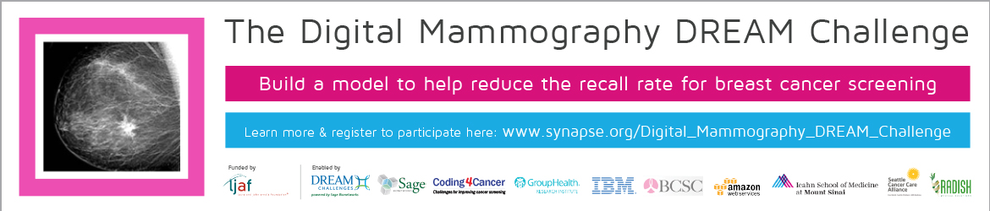

Model-2-Data In Action

Slide 17
Model-2-Data In Action

Slide 18
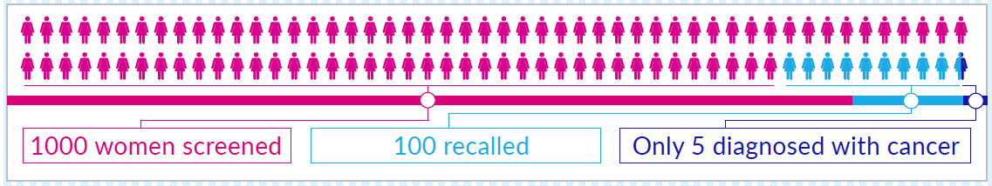
Limitations in Mammography Screening
As many as 5–15% of breast cancers are not detected mammographically (false negatives)
Approximately 10% of all women will be called back from screening for additional work-up
However, only 5 women out of 1000 screened (and of the 100 called back) will be diagnosed with breast cancer (high false positive)

Slide 19
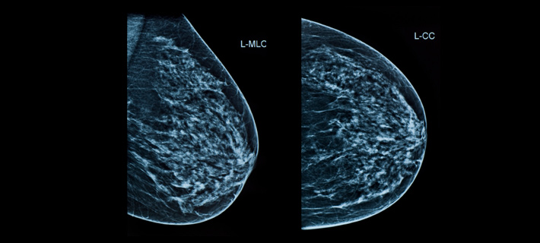
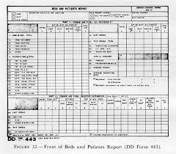
Challenge
Can machine / deep learning approaches beat the radiologist in detecting cancer from mammography screening?
Left
Today
Algorithm
Probability of cancer [0,1] within 1 year of exam
Right
Clinical &
Demographic
Information

Slide 20
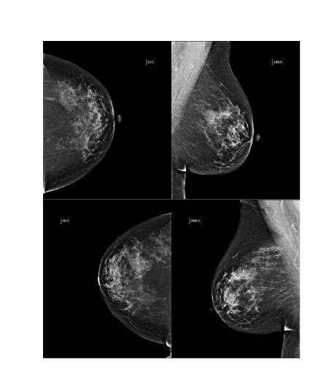

Primary Challenge Data
86,801 women
146,201 exams
1,006 cancer positive
640,394 images (DICOM, 14 TB)
Clinical/demographic information (metadata)
Data cannot be shared with participants!
Notes:
The largest digital mammography dataset (unfortunately small number of positives compared to negatives)
Add number of positive subjects on the slide?
Show metadata in more details?

Slide 21
Data-to-
user
Model-to-data
Kaiser Permanente (640k images)
50%
50%
20%
30%
Pilot (n=500)
Training
Leaderboard
Validation

Slide 22
Data-to-
user
Model-to-data
Kaiser Permanente (640k images)
50%
50%
20%
30%
Pilot (n=500)
Training
Leaderboard
Validation
Karolinska (600k images)
100%
Validation

Slide 23
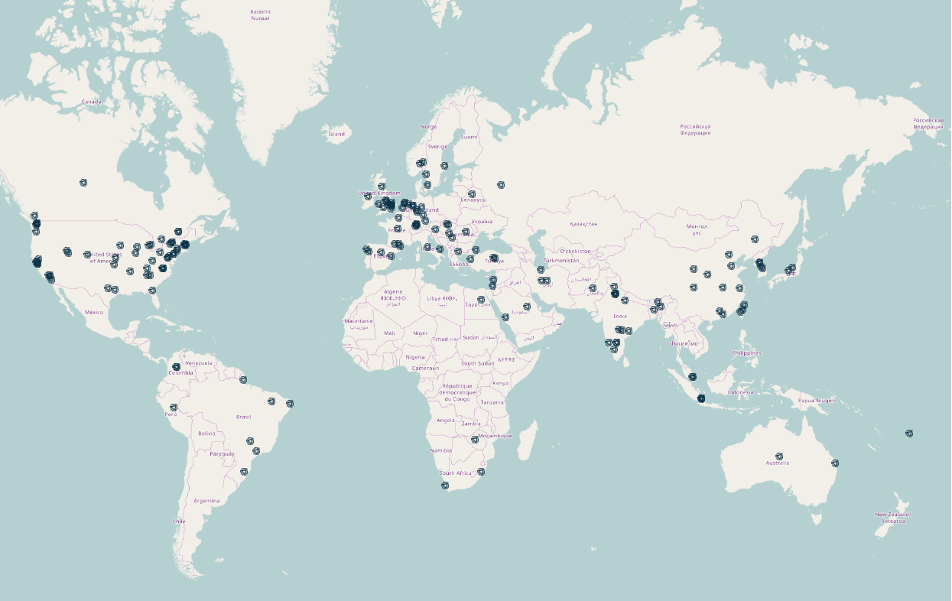
Challenge Participation
1333 registered participants
268 active participants organized into 140 teams
4990 training submissions run on the cloud (Leaderboard Phase)
Notes:
140 teams, 268 individuals, 1333 registrants

Slide 24
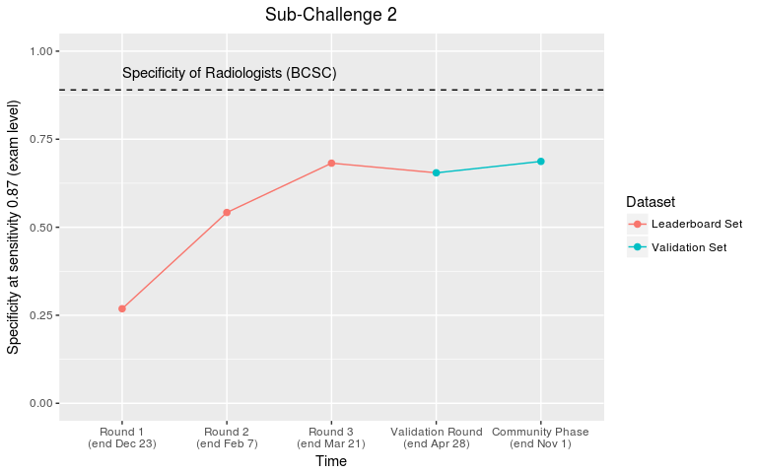
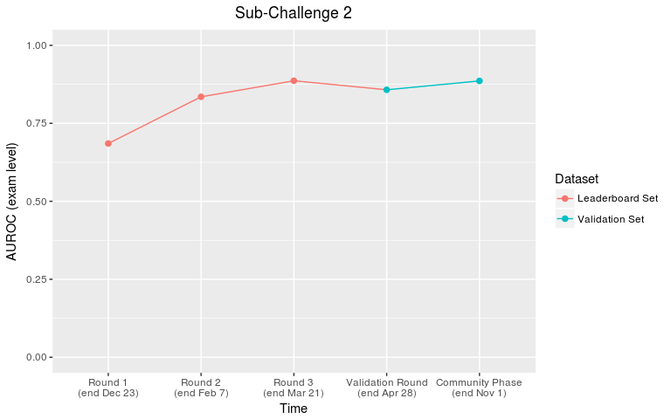
Top Performing Method
0.89 @ 0.87 sensitivity
0.67 @ 0.87 sensitivity
AUC=0.877

Slide 25
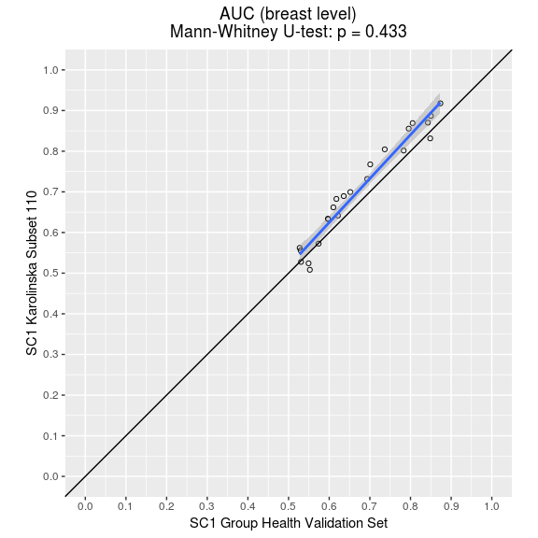
Assessing Model Generalizability
Top model (AUC)
0.877 Kaiser
0.909 Karolinska
Karolinska
Kaiser Permanente

Slide 26
Combining AI + single reader improves performance
Specificity @ fixed sensitivity
Kaiser Perm
Single reader
Karolinska
Single reader
Karolinska
Double reader

Slide 28
Our thesis
AI will transform healthcare for the better.
Existing barriers to translation:
  - Data quality
  - Data access
  - Effective frameworks for assessing performance & generalizability

Slide 29
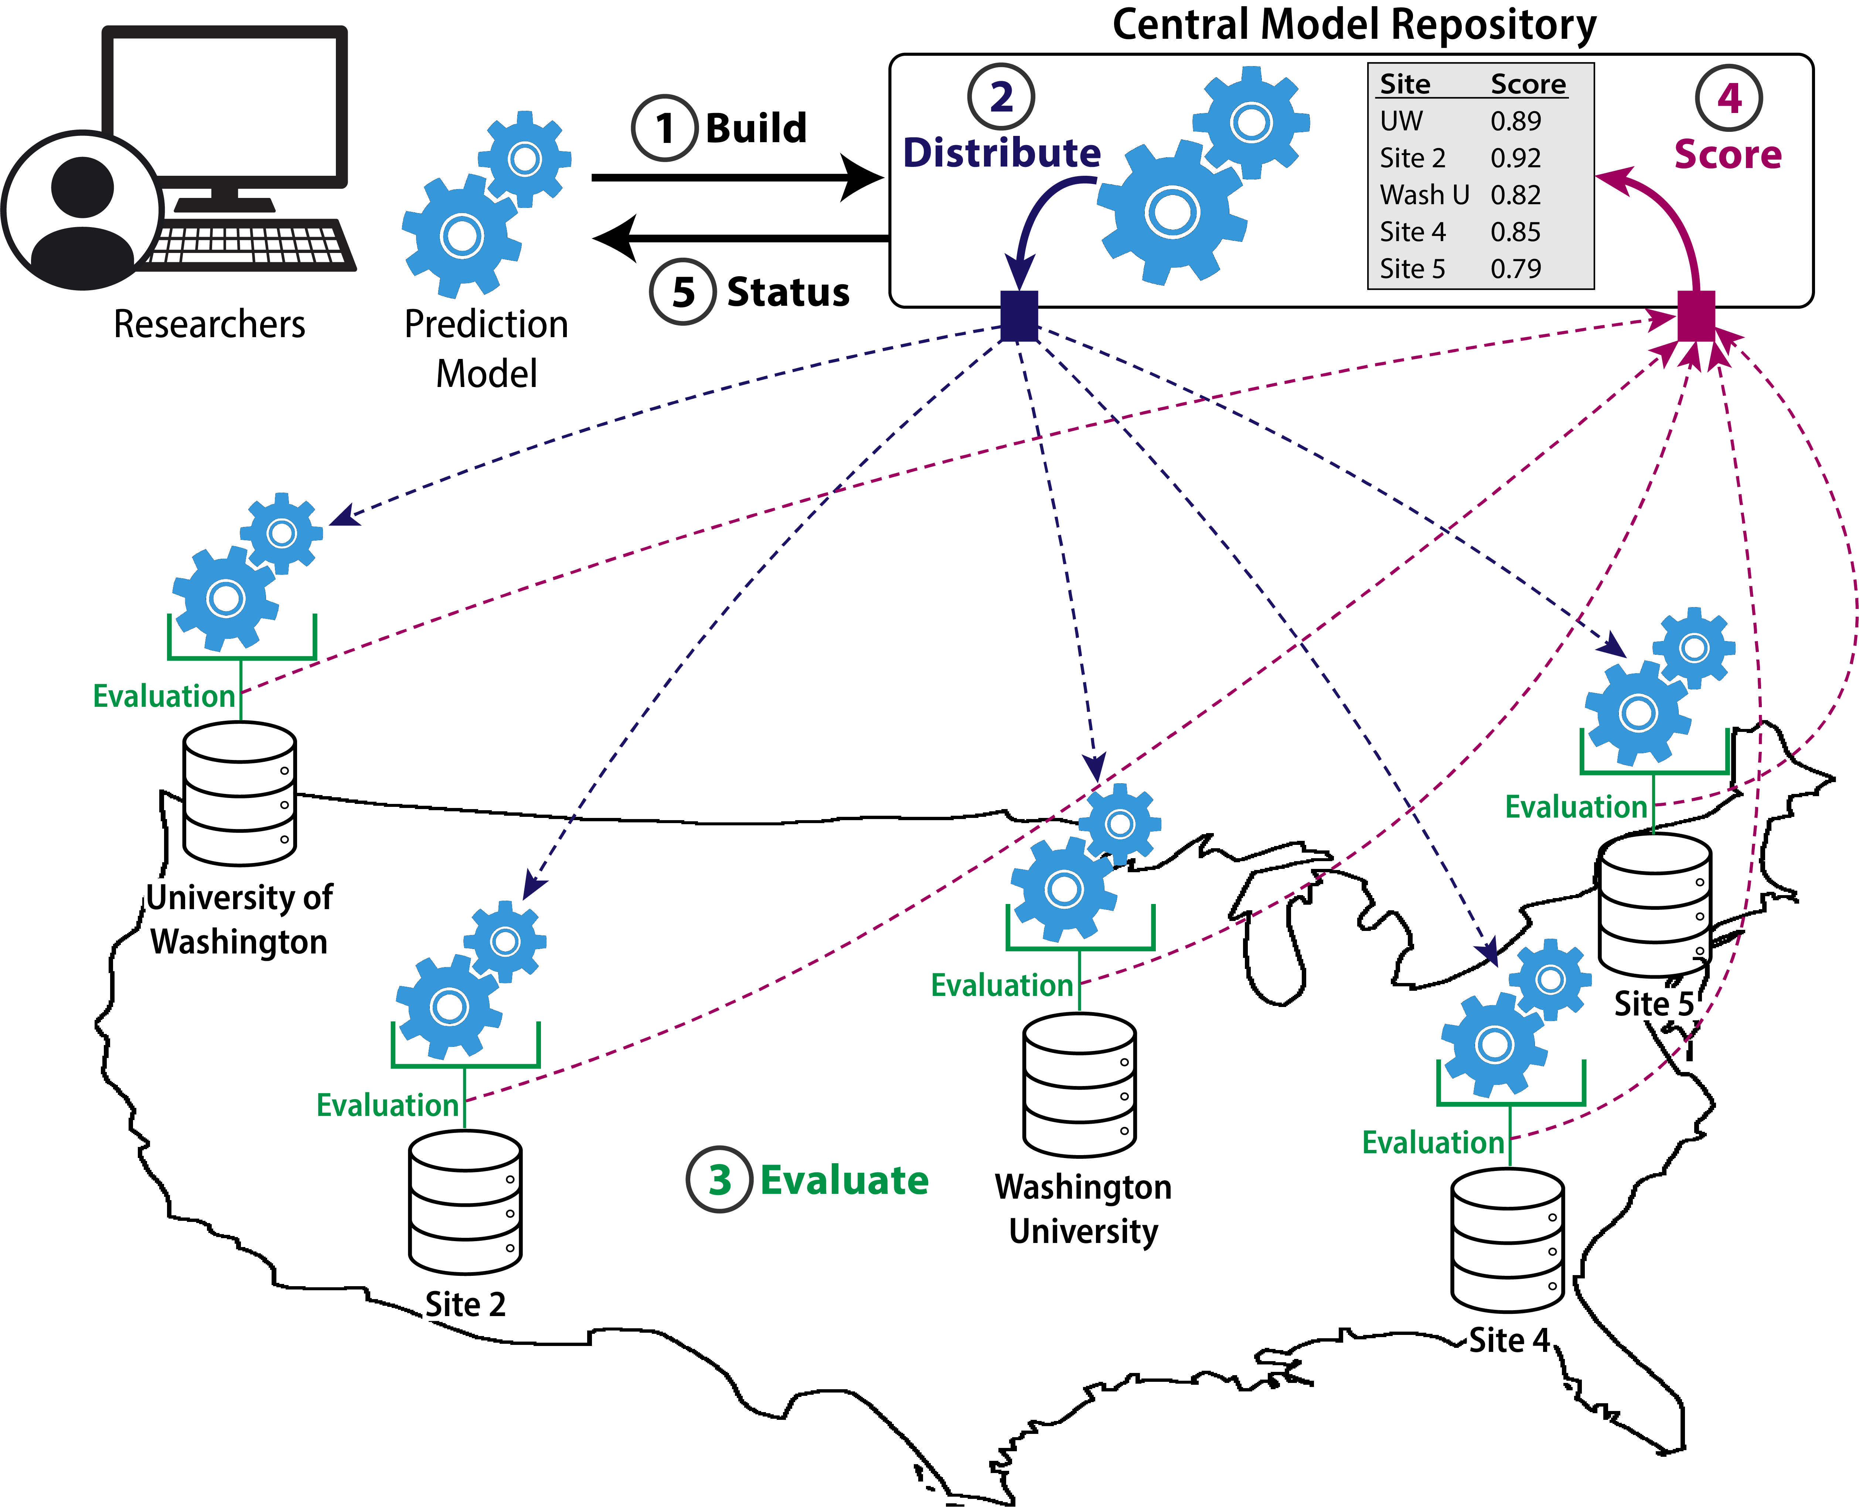
Our vision

Slide 30
Challenge question
Of patients who have at least one hospital visit, can we predict who will pass away within 6 months of their last visit?

Slide 31
Challenge data
  University of WA EHR data warehouse: 2009-2019
  1.3 million patients with at least one visit
  22 million visits with
    5 million drug exposures
    10 million observations
    48 million conditions
    221 million measurements
  Format: OMOP common data model

Slide 32
Predictions & scoring
  TP: patient who had a death record within 6 months from last visit
  TN: patients still alive or who had death record beyond 6 months since last visit
  Submission:
  Probability [0,1] that patient will pass away within 6 months following last available exam.
  Metrics:
  Primary metric: AUROC
  Secondary metrics: AUPRC

Slide 33
Timeline

Slide 34
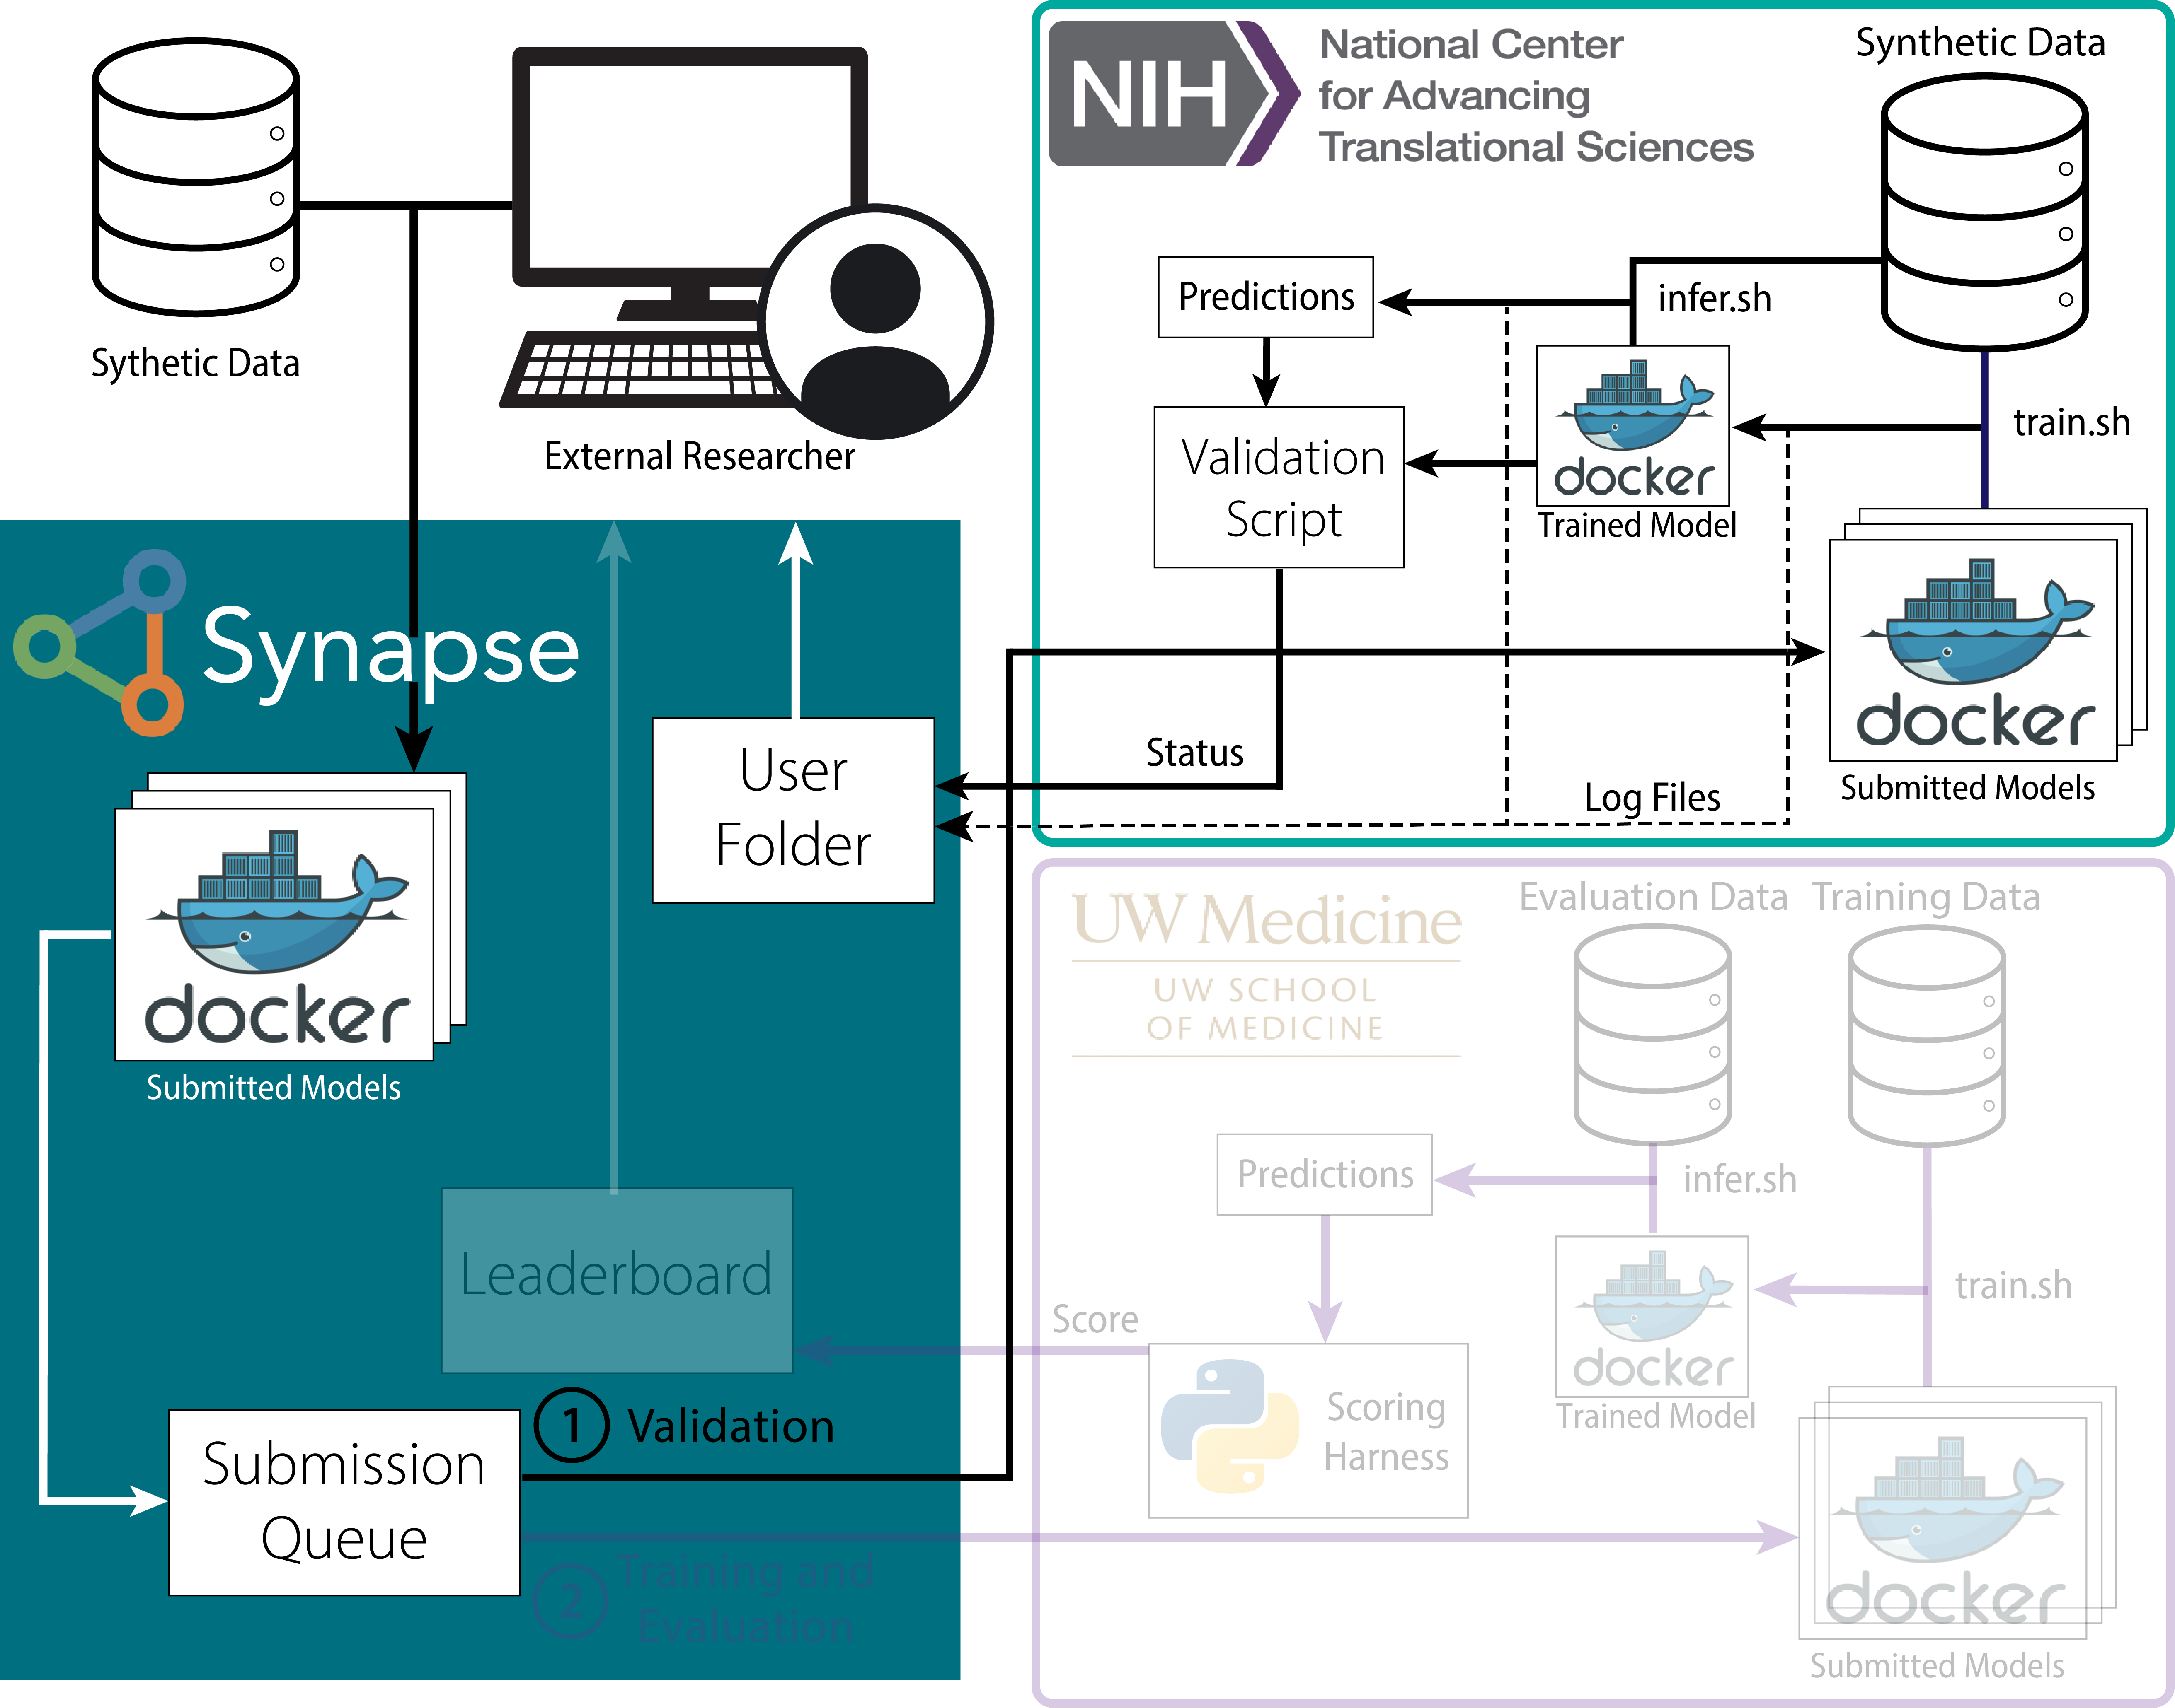
Challenge workflow: two-phased submission

Slide 35
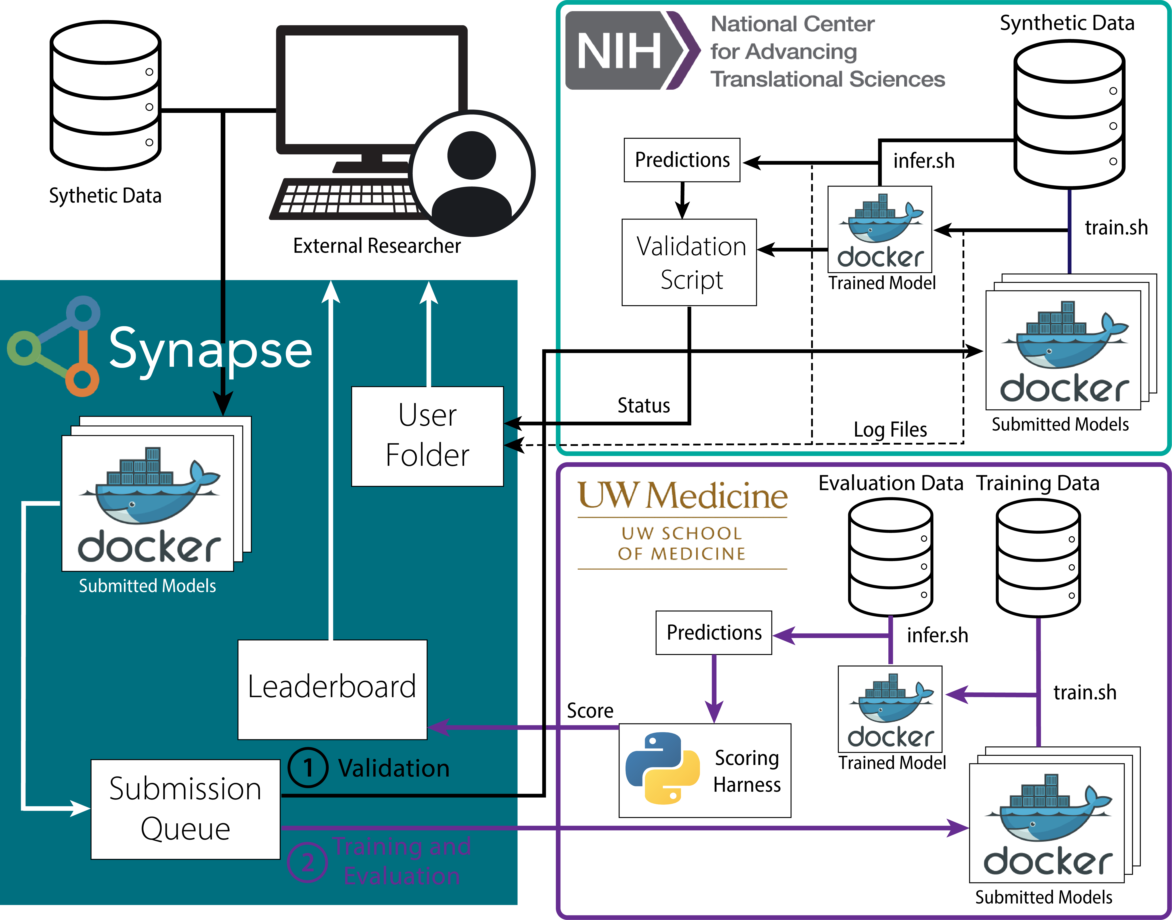
Challenge workflow: two-phased submission

Slide 36
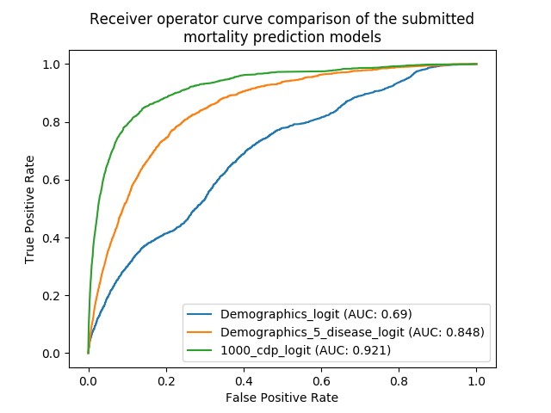
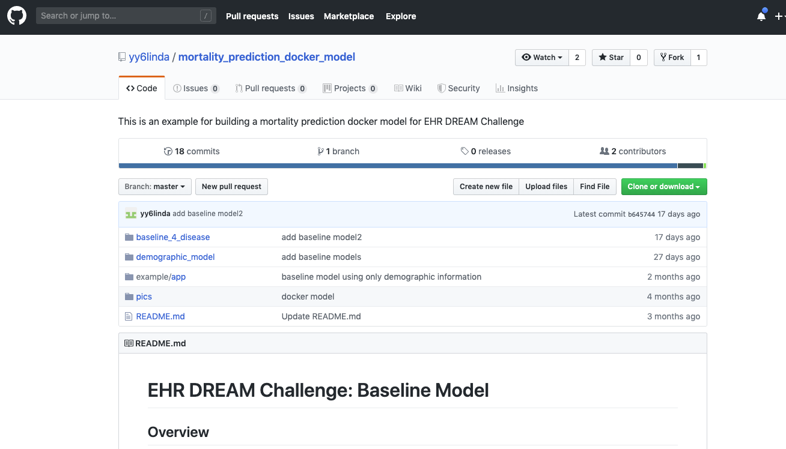
Baseline & example Docker model using demographic data
https://github.com/yy6linda/mortality_prediction_docker_model

Slide 37
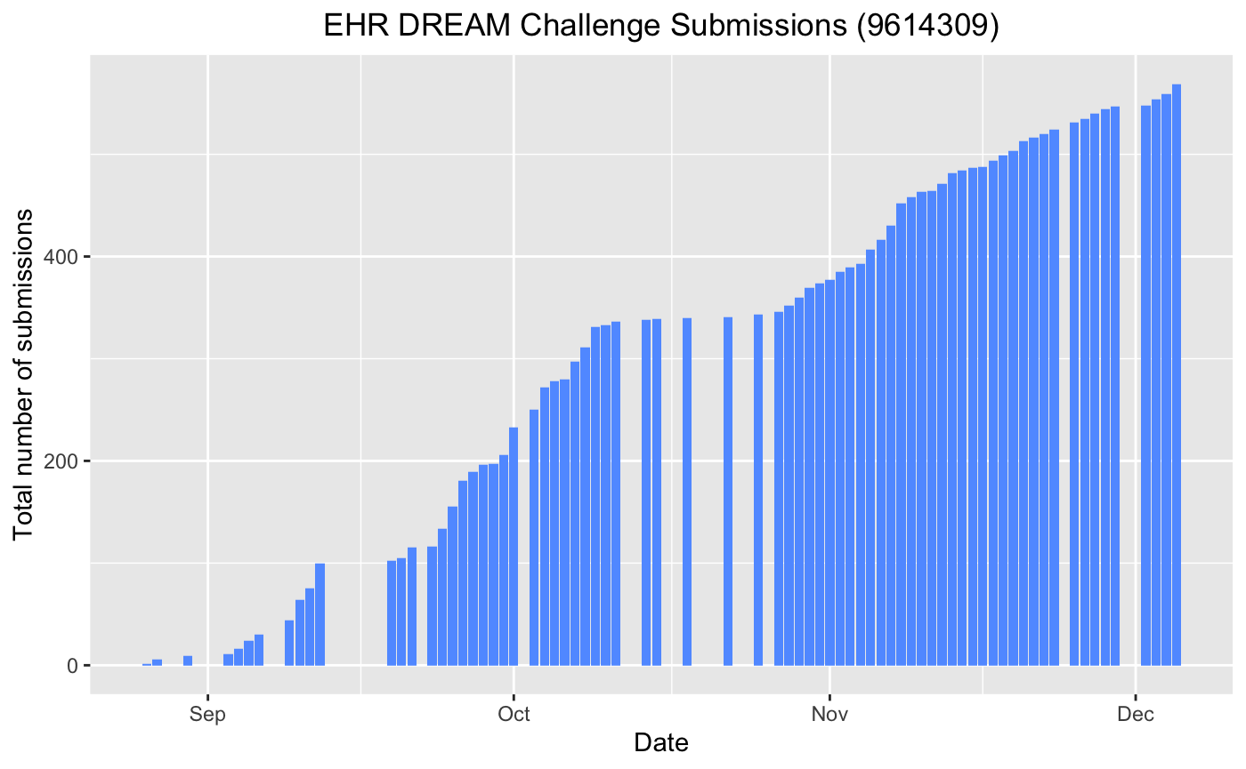
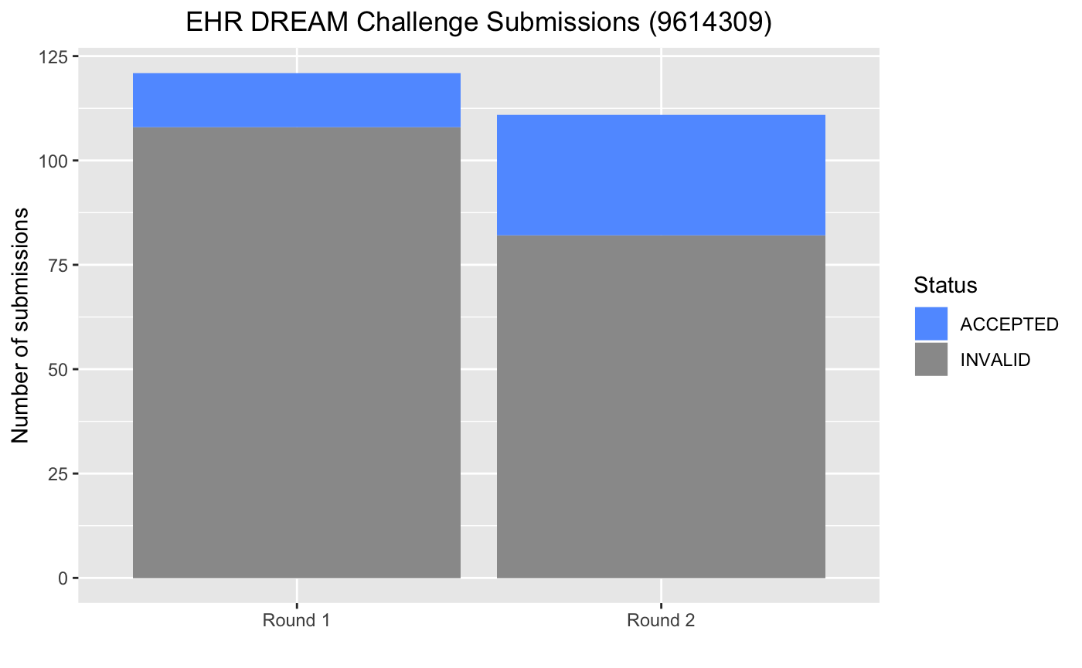
Results: Leaderboard Round 1 & 2

Slide 38
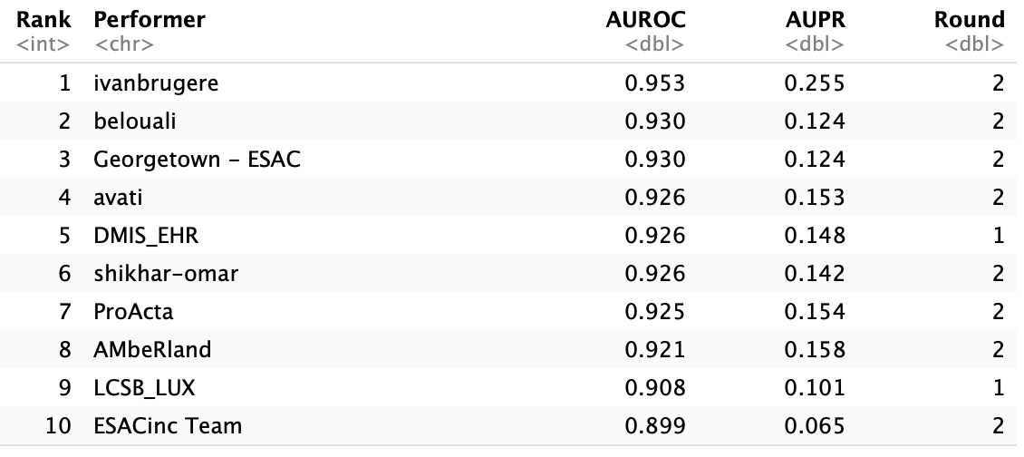
Top 10 performers – Leaderboard round 1 & 2

Slide 39

Beyond the challenge: ecosystem for clinical benchmarking

Slide 40
Expanding set of clinical questions
Pilot Challenge: Mortality Prediction
Future rounds:
  Disease specific mortality
  Sepsis
  Cardiovascular events
  Re-admission
  …

Slide 41



Our future: unlocking data & evaluating AI
NIH / Academic Research
Clinical Trials
Healthcare

Slide 42
Summary
Biomedical Challenges can coalesce research communities to develop standards and benchmarks
Data-2-Model paradigm can …
  … unlock sensitive or proprietary data
  … build ecosystem of distributed benchmarking
  … accelerate translation of AI

Slide 43
Acknowledgments
University of Washington
Tim Berquist
Sean Mooney
DREAM Directors
Gustavo Stolovitzky
Laura Heiser
Jim Costello
Paul Boutros
Pablo Meyer
Julio Saez-Rodriguez
Sage Bionetworks
Brian White
Andrew Lamba
Thomas Yu
Xindi Gao
Mike Mason
Justin Guinney
Funding:
NCI U24 Cancer Systems Biology Consortium
NCATS U24 Center for Data To Health

Slide 44
Thank you

