Slide 1
QuartzBio - Biomarker Data Management
Ted Foss
https://www.quartz.bio
December 6, 2019

Slide 2

Technology-Enabled Services Company
User interface
Translational Informatics & Computational Biology
Sample Inventory Management
Biomarker Data Management
Technology-enabled solution, complementary to Clinical Data Solutions
Consolidate data across labs to generate master sample inventory
Centralized reporting on the broader lab ecosystem (samples, pre-analytical data)
Provide insights on actual samples collected vs. expected samples collected
Harmonize data and report on discrepancies between systems
21 CFR Part 11 compliant and validated infrastructure housed in AWS
Technology-enabled solution, complementary to Clinical Data Solutions
Scales to all types of biomarker data
SMEs to manage, QC and integrate data
Centralized database for all assay data
Suite of visualization, analysis and reporting
Specialty modules for flow and genomics
Link to public databases and other systems to obtain contextual knowledge
21 CFR Part 11 compliant and validated infrastructure housed in AWS
Patient stratification / selection
Signature development
Predictive modeling of drug response
Pre-clinical modeling (target pathway selection, new indications for existing assets based on MOA and disease biology, mapping of pre-clinical model biology to human disease biology)
Characterizing mechanism of action
Co-therapeutic target pathway selection
Integration of prior biological knowledge
Notes:
QB is a technology-enabled services company that works with biotech and pharma companies to solve canonical precision medicine problems: identify patient subtypes, predict response to therapies, evaluate translational models for their ability to recapitulate human biology
Focussed on management and interrogation multi-omic, phenotypic, and clinical data that is generated from pre-clinical and clinical studies
TICB is a

Slide 3

Reproducible computing
QBverse set of R packages wrapping/enhancing docker, tidyverse, devtools, rmd and others
private gitlab/dockerhub
qbrocker - scripts that allow each project to be directly linked to a docker image
100% coverage unit testing of base QBverse, extensive unit testing of each project’s code
in-house node-based R workflow used in conjunction with make + docker
Rmd QC and analysis reports

Slide 4
Why BDM?
Public data sources are absolutely wonderful resources, but much clinical research will eventually rely on specific experiments outside the context of a public resource
Generation of biomarker data is important & $$$
Applying sophisticated analyses to biomarker data is important, and takes sophisticated brains (= $$$)
Re-analysis is annoying, painful, potentially $$$
Making sure the $$$ for important data and the $$$ for powerful brains is best utilized requires a step in the middle.

Slide 5
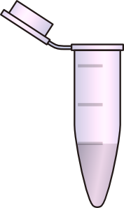
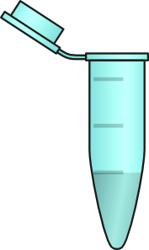

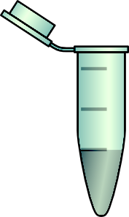
When BDM?
Public, curated data set - you’re golden
1 data type, 1 dataset — no big deal
1 data type/lab, 2+ datasets — maybe no big deal
2+ data types/labs, 1 timepoint — probably a big deal
2+ data types/labs, 2+ timepoints — almost guaranteed big deal
Separate biobanks/EDCs, 2+ data types, 2+ timepoints — unquestionably a big deal

Slide 6
What could go wrong?
Sample id format changes
Sample id typos
Sample collection errors
Duplicated samples
Missing samples / sample ids
Missing timepoints
Timepoint format changes
Timepoint id typos
Incorrect timepoints
Measurable id changes
Measurable id typos
Measurable file format changes
Measurable measurement changes
Measurable format change
Measurable id format change
Incorrectly formatted files
Incorrect file delivery
Incorrect metadata
Lack of vendor mapping information
Incorrect mapping information

Slide 7
What BDM?
Ingesting data & metadata from a variety of sources to generate a clean, harmonized, unionized, accessible, usable dataset

Slide 8
BDM - Parsing
Data comes from labs in wide variety of formats
Some may be in difficult to manage formats
Metadata may be included in file, in separate file
csv, xlsx, sas7bdat, fcs/wsp, rcc, vcf, bam, png, pdf, tiff
1 914876 rs2231453 T C 1342.77 PASS AC=2;AF=1.0;AN=2;DB;DP=38;FS=0.0;MLEAC=2;MLEAF=1.0;MQ=60.0;POSITIVE_TRAIN_SITE;QD=29.07;SOR=1.67;VQSLOD=12.72;culprit=FS GT:GATK:AD:DP:GQ:PL 1/1:1/1:0,38:38:99:1371,114,0

Slide 9
BDM - Harmonization
What do you call the thing which you might drink water from at a school?
drinking fountain
water fountain
bubbler

Slide 10
BDM - Harmonization
Lab measurable identifiers can change format or value
Vendors often refer to measurable by non-standard names
Gene/protein symbols change with some regularity
Indications have significant variation depending on source
Notes:
You have data for FTNB ….. oh wait, you mean ADAM2

Slide 11
BDM - QC
How is the data you received?
Complete? Sporadic missing measurables?
Are there outliers?
Normalized? (appropriately?)
Within-batch variability? Cross-batch variability?
How are OOR values managed?
How are missing values handled?

Slide 12
BDM - Derivation
Raw data is often the starting point for analysis
Common derivations:
Normalization
Batch correction
Temporal data derivations (change from baseline)
Imputation
Filtration based on QC

Slide 13
BDM - Unification
Putting all the varied data together in one place
Harmonized subject/sample information
Common data model for ~all data types

Slide 14




THE QUARTZBIO SOLUTION
Every bit of data matters
Raw data from assays
RAW DATA
Data parsing
Metadata
Biomarker data
PROCESSING, INGESTION, HARMONI-ZATION & QC
Metadata cataloging & harmonization
Biomarker data pipelines
Clinical data pipeline
DATABASE LAYER
Biomarker data management (Amazon Aurora)
REPORTING LAYER
Sponsor data science team
User interface

Slide 15
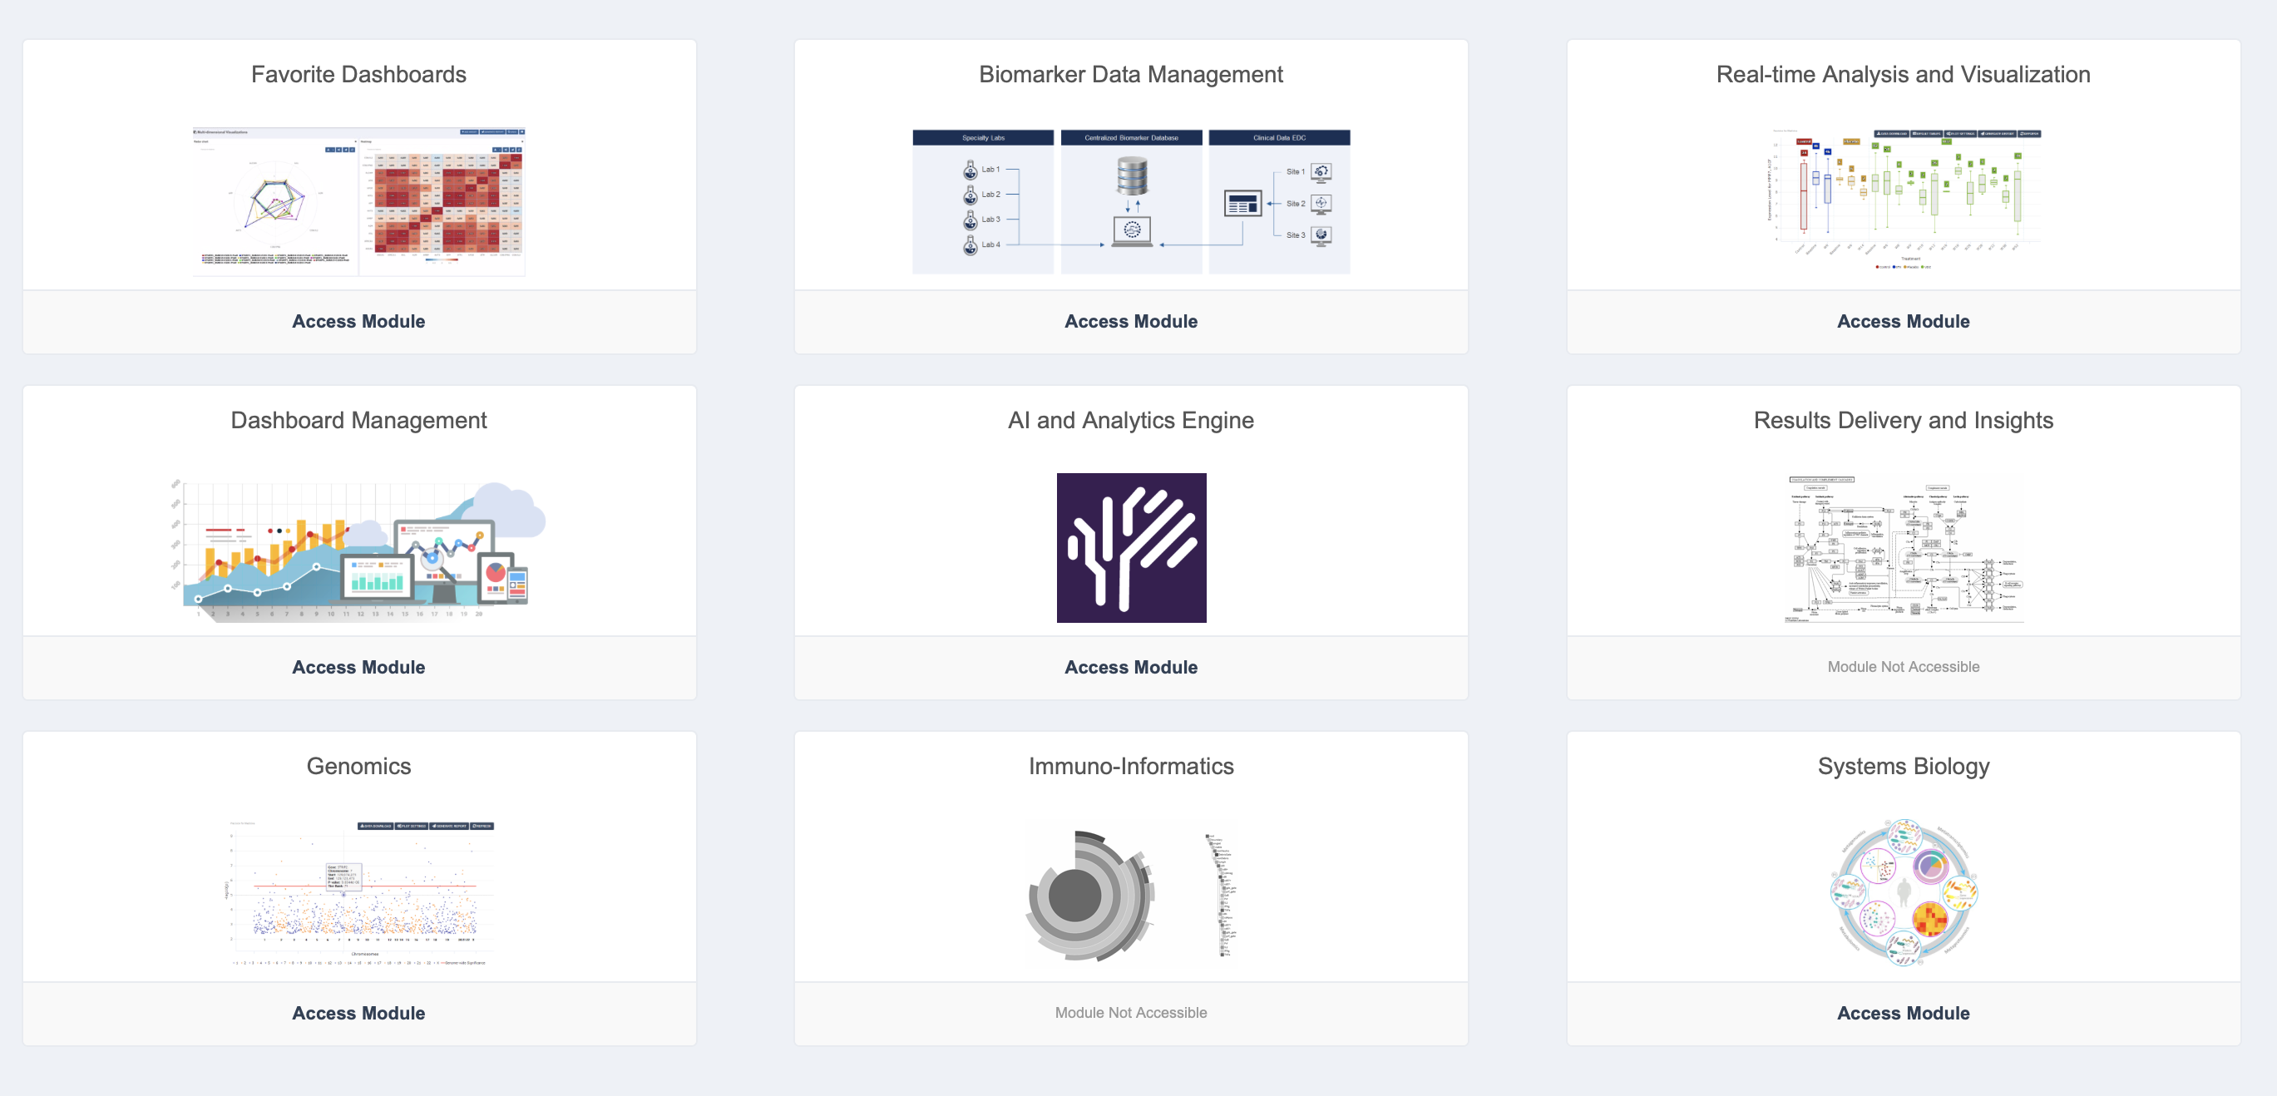
QB BDM Benefits
Multi-modality specialty lab testing results accessible in a standard, harmonized, consistent format accessible via web app or API
We are ingesting various large-scale public data sources (TCGA, CCLE, ArrayExpress, GEO, Reactome, etc) into same platform
Allows QB technology and method development
Clients are also able to augment their private data

Slide 16
House metaphor
Harmonization
2x4s, 2x8s, 1x10s
Rough 2x4s, 2x8s, 1x10s
Norwegian lumber - 48x98, 48x148
Samples
QC
Ordered:
Dimensional
Lumber
27 bundles of 2x4s
17 bundles of 2x8s
7 doors, 2 red 5 black
Received:
27 drafts of 2x4s
15 bundles of 2x8s
4 red doors, 3 “black" doors (one of which is actually red)
Derivation
Lumber comes as 8’,12’,16’
Publication /
Drug / Technique
Plans call for 7.5’, 12’,14.75’

Slide 17
Deriving Mechanistic Insight from Transcriptomic Data by Prior Knowledge-Driven Inferencing
Nimisha Schneider
QuartzBio, Precision for Medicine: Computational Biology and Translational Informatics
December 6, 2019

Slide 18
We Can Use Known Biology + Various Types of Molecular Data to Characterize Patient Groups
Problem: Want to characterize disease- or treatment-relevant biology in a group of patients
Determine drug mechanism of action, confirm target engagement in clinical trial
Data: Multiple modalities from each patient
Protein, RNA, flow cytometry, IHC, chemistry/metabolites…
Approach: Map multiple data types to a biological network built from known causal relationships between functional entities
Qualitative characterization
Harnesses prior knowledge, filtered by available data

Slide 19
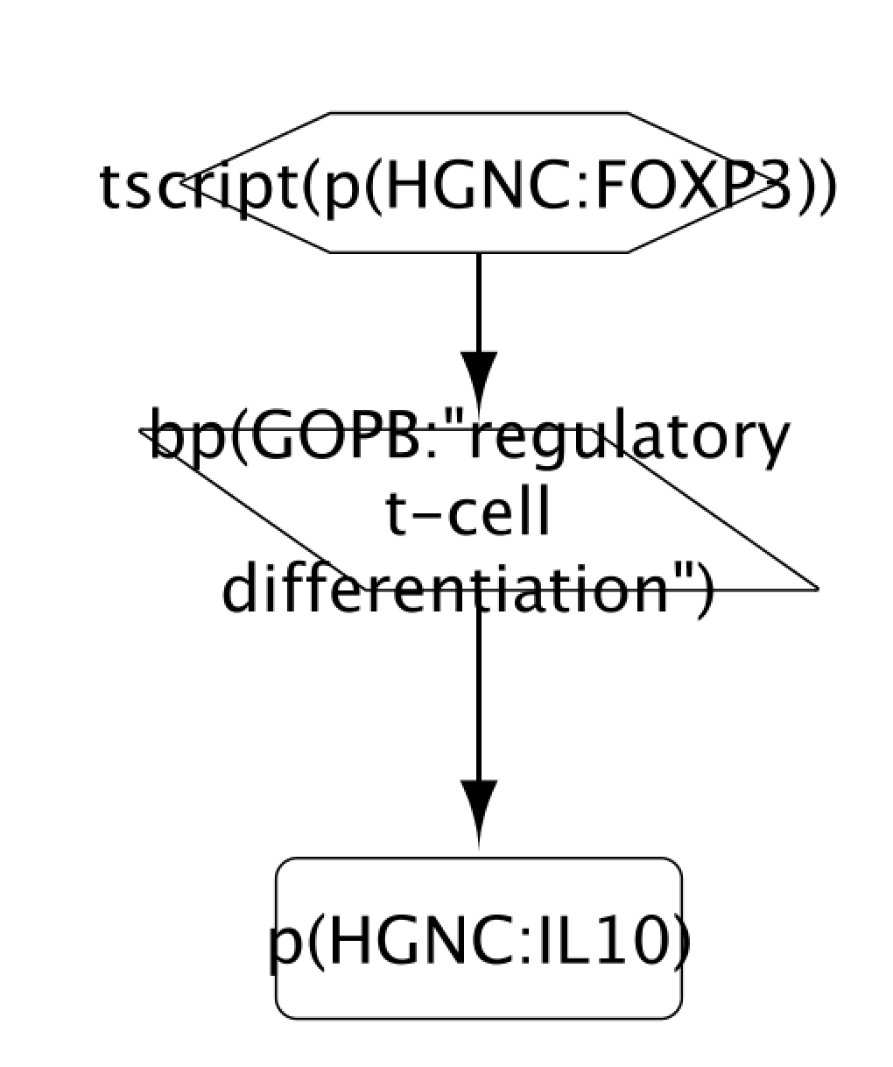
Biological Networks Depict Causal Relationships Between Functional Molecular Units or Processes
Nodes: Entities (protein abundances, protein activities, chemical abundances, biological processes)
Edges: Causal (by experimental evidence) relationships between entities
Encoding is in Biological Expression Language (BEL, https://bel.bio/), a computable/human readable language for representing biology
BEL Statement:
“transcriptional activity of the protein FOXP3 (identifier from the HGNC namespace) increases the biological process Regulatory T-Cell Differentiation (identifier from the GOBP namespace)”

Slide 20
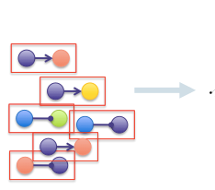
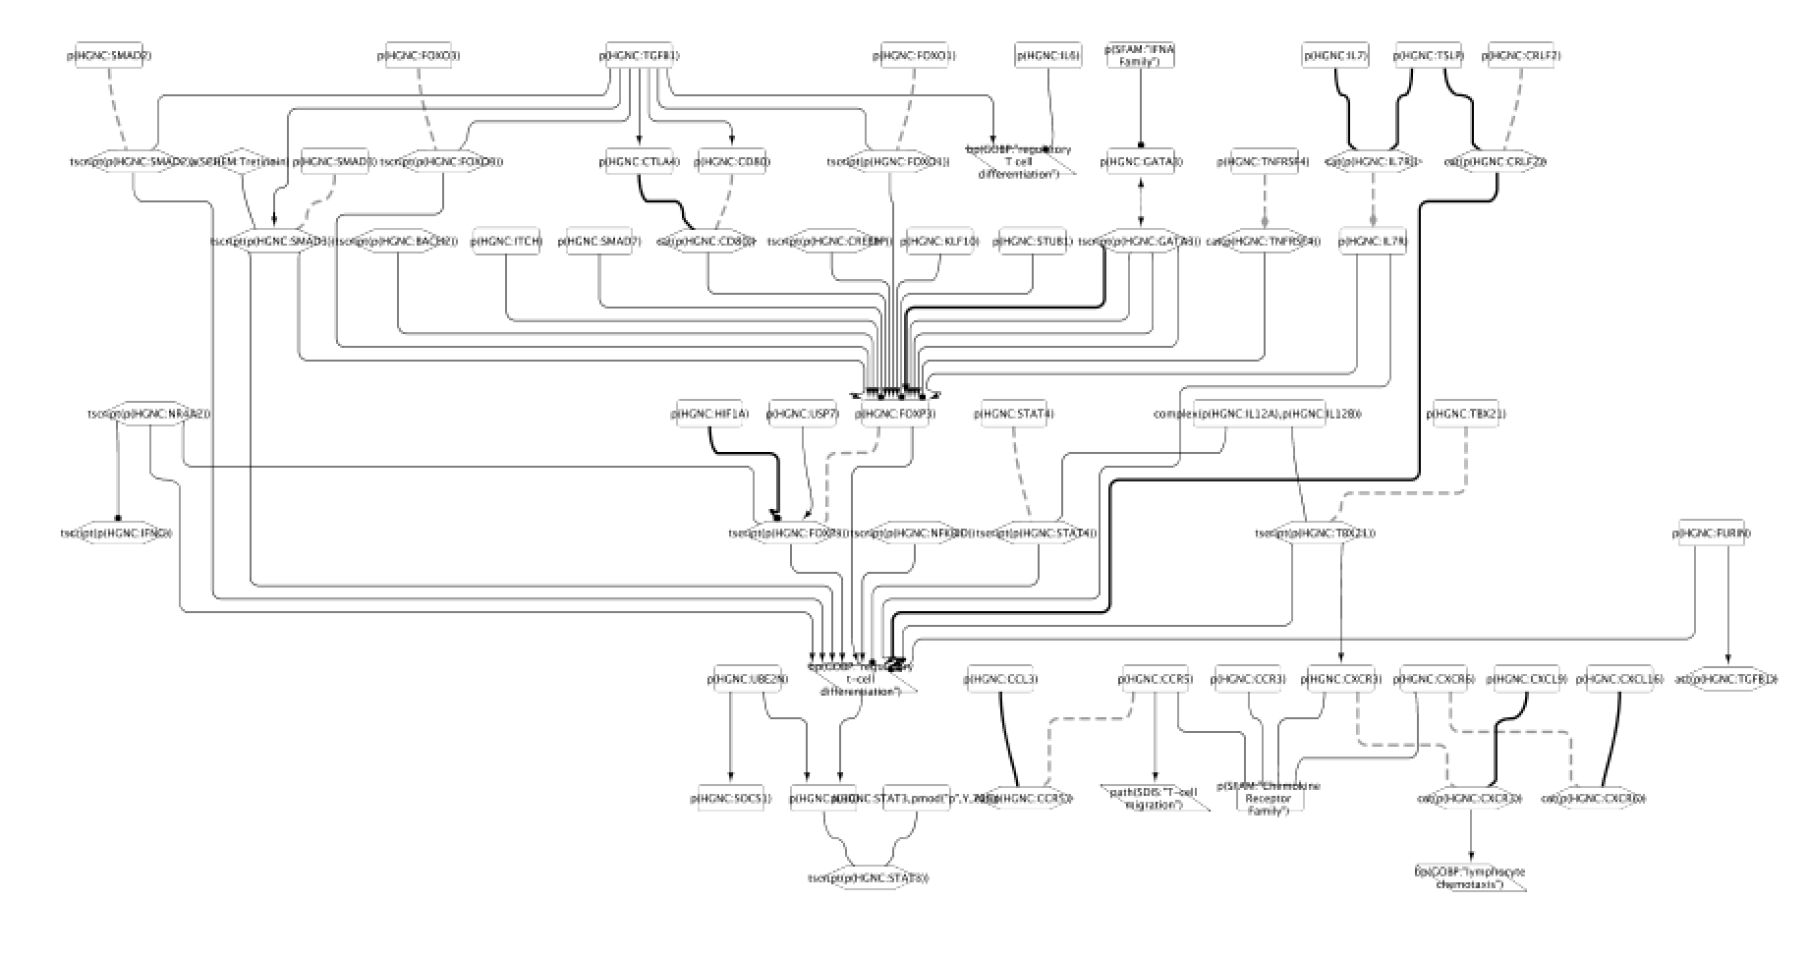
BEL Statements Can Be Assembled Into Networks Representing Relevant Biology
tscript(p(HGNC:FOXP3) -> bp(GOBP:”Regulatory T-Cell Differentiation)
QuartzBio Knowledgebase
Regulatory T-Cell Signaling

Slide 21
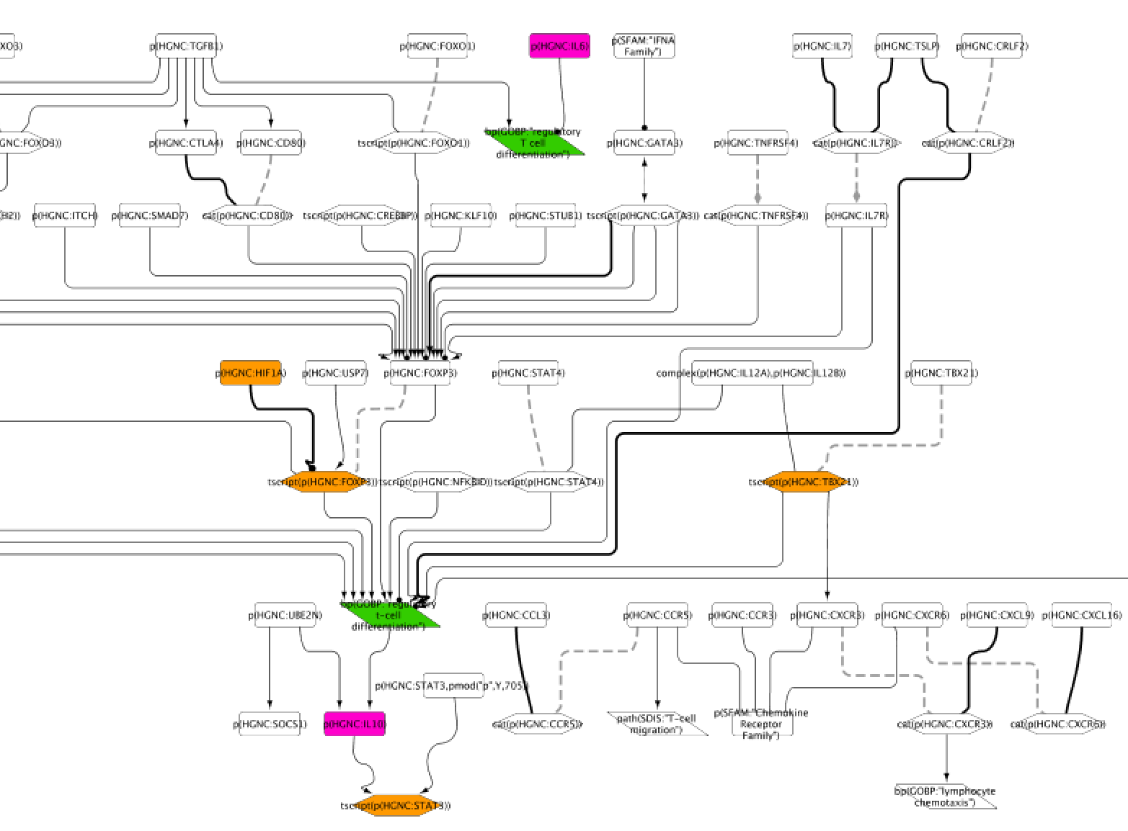
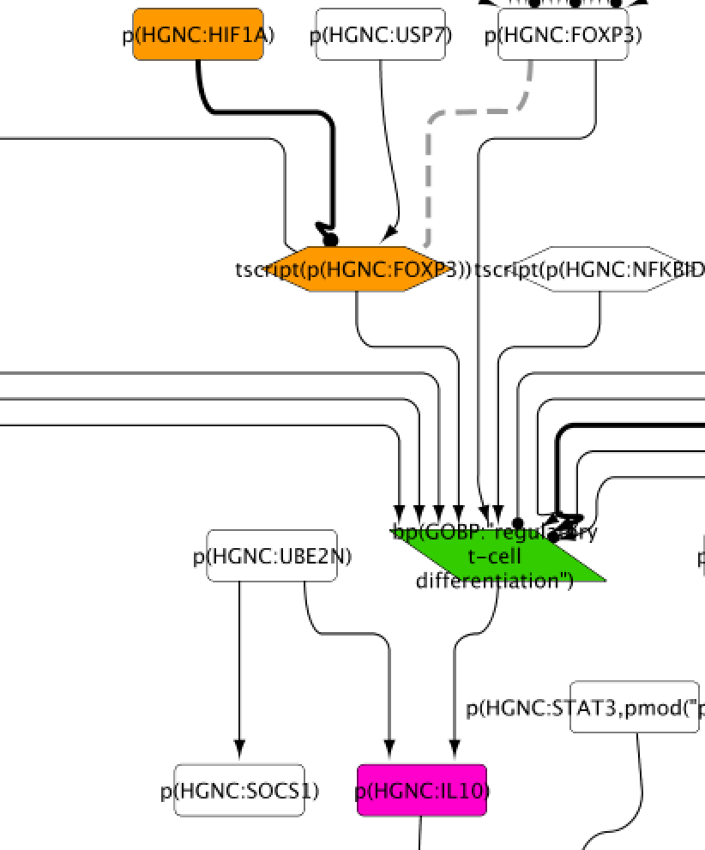
Mapping Molecular Data to Causal Networks Allows Qualitative Characterization of Patient Biology
Network is created from known biology, sourced from published experiments
Available data is mapped to the network (colors indicate an increase in measurement compared to a reference)
Multiple data sources indicate activation of regulatory T-cells
How can RNA be mapped to this network?
RNA
Protein
Flow Cyt

Slide 22
Reverse vs. Forward Reasoning on RNA Expression Data Rest on Different Assumptions
Causes
Question: which changes in signaling can lead to the observed differentially expressed genes?
Assumption: RNA expression changes are caused by upstream signaling mechanisms that control multiple genes
Reverse
Reasoning
Data
Forward
Reasoning
Question: which changes in signaling result from the observed differentially expressed genes?
Assumption: changes in RNA expression result in corresponding changes in protein expression and activity
Consequences

Slide 23
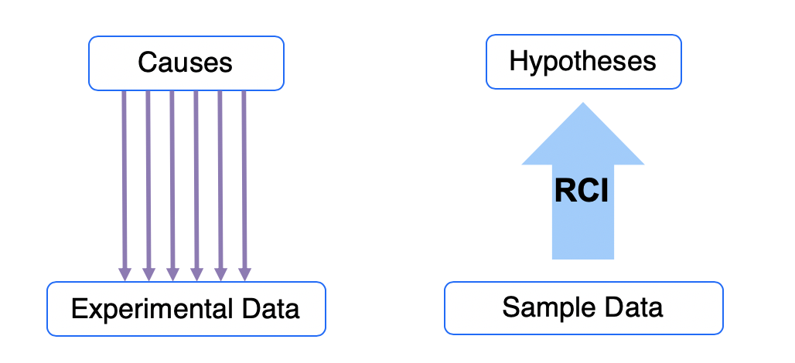
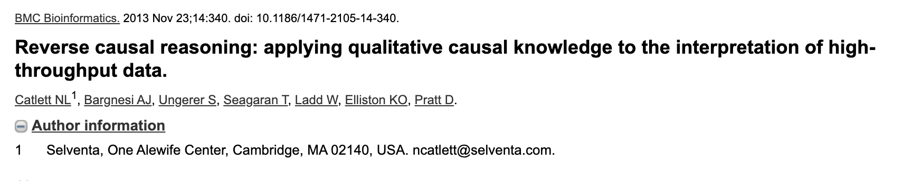
Prior Experimental Knowledge Is a Substrate for Reasoning
Question:
What signaling differences can lead to the differentially expressed genes?
Assumption:
Gene expression changes are caused by upstream signaling mechanisms that control multiple genes
Reverse Causal Inferencing (RCI) generates qualitative hypotheses about molecular mechanisms that may contribute to observed molecular profiling changes (data) based on prior knowledge of transcriptional behavior

Slide 24
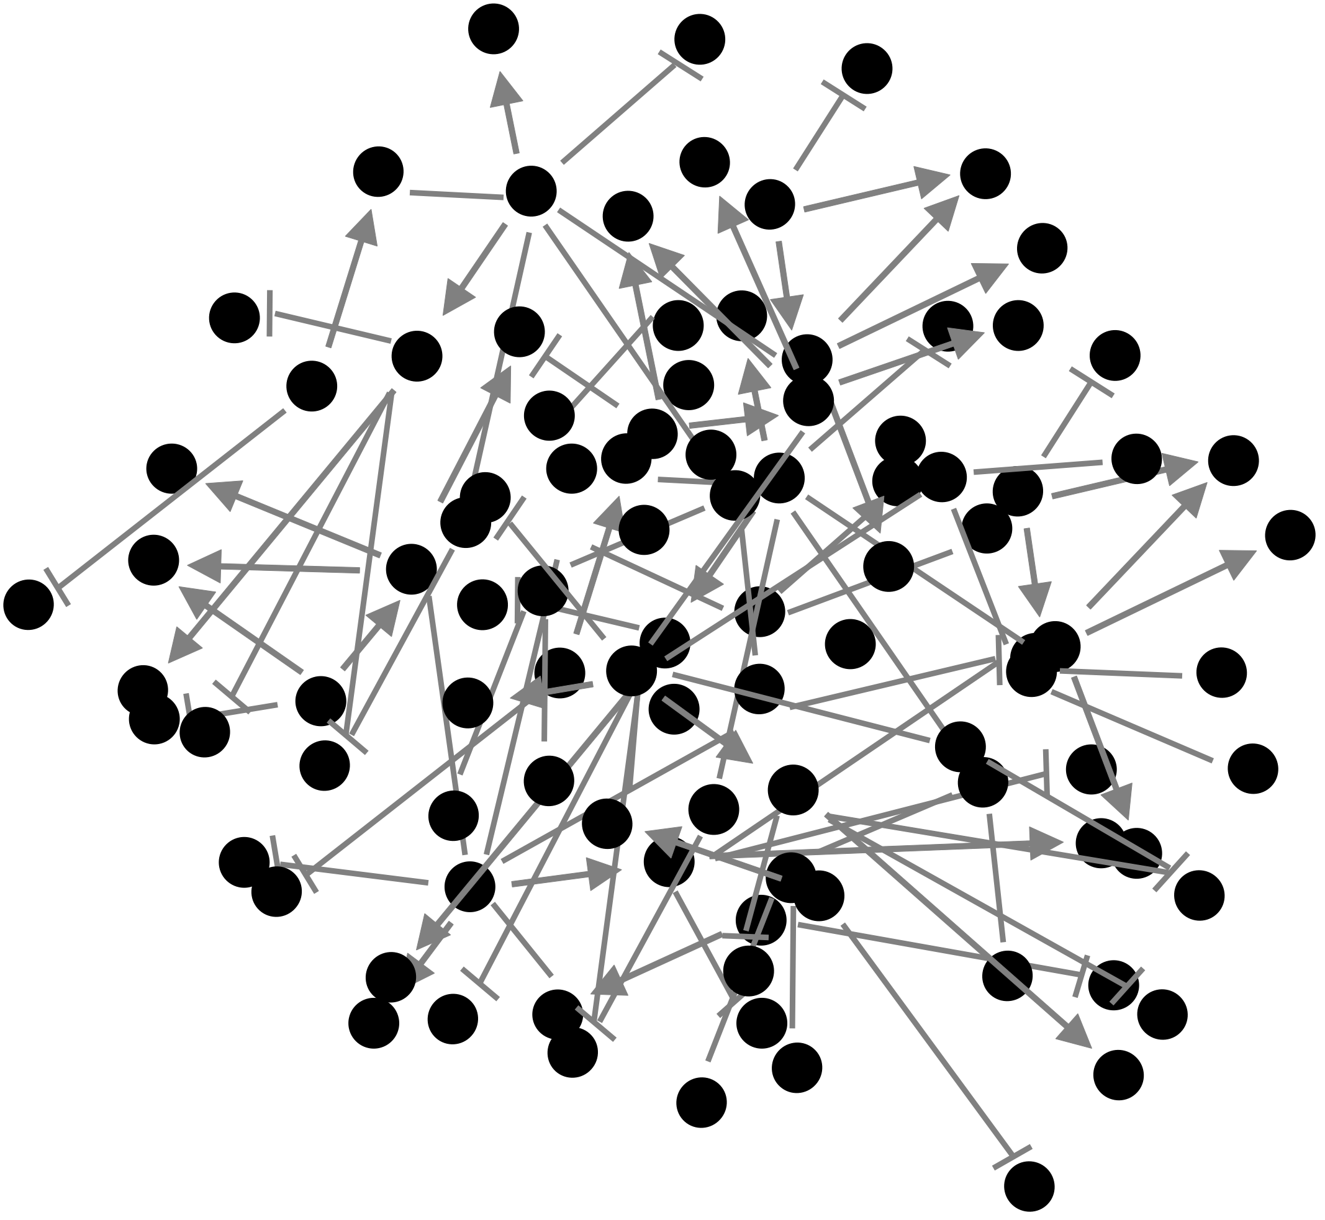
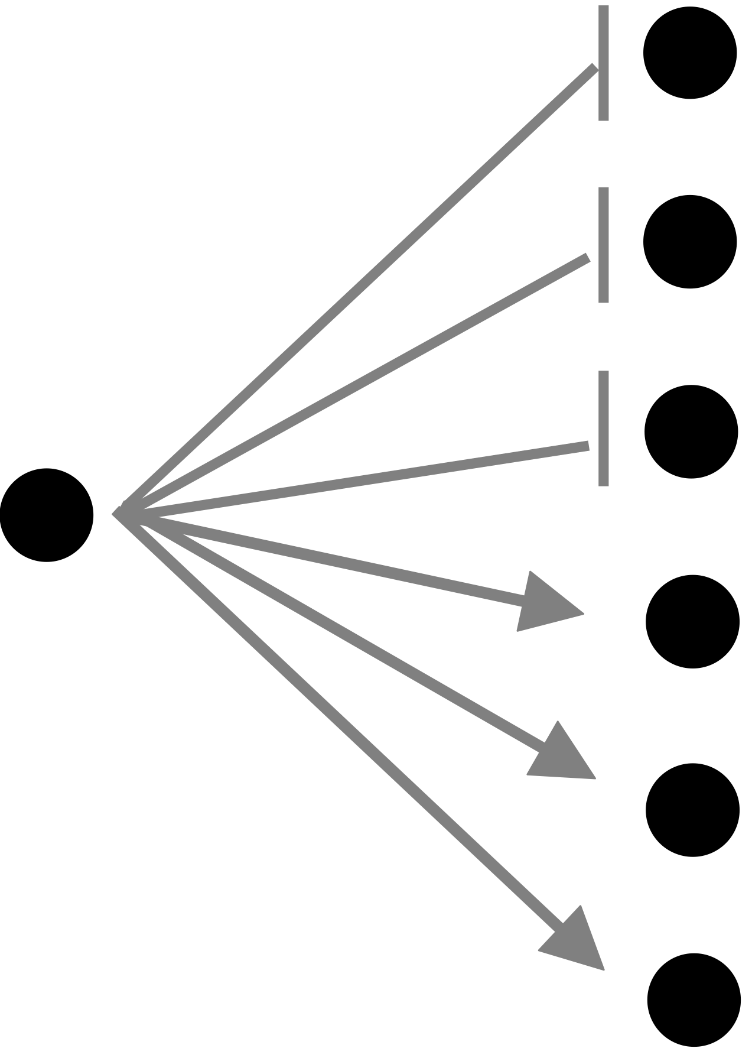
RCI Evaluates Small Gene Networks (HYPs) which Represent Biological Mechanisms
Comparison data file – Gene ID, Fold Change, p-value
unchanged
upregulated
downregulated
1. Small gene networks (upstream biological event, downstream gene expression changes) are extracted from the larger knowledgebase;
2. Differential measurements from data are mapped to the networks
3. Significance statistics are calculated to evaluate and prioritize networks as explanations for the data

Slide 25
Statistics Determine per-HYP Significance Based on Enrichment and Direction
Enrichment – compares significantly differential genes that map to a HYP with those in the dataset overall.
probability of getting at least the given number of differentially expressed genes in the selected HYP given the number of differentially expressed genes in the dataset
Concordance of Direction – tests directionality of measured gene expression vs known pattern of gene expression downstream of the biological event represented by the HYP.
probability of getting at least the given number of differentially expressed genes in the correct direction given the dataset
Results: A set of HYPs that represent molecular mechanisms that represent we hypothesize to be active in our samples

Slide 26
Use Case: TCGA Lung Adenocarcinoma Whole Transcriptomic Dataset
Workflow:
Obtain gene expression from tumor samples
Perform RCI on expression data
Map resulting significant HYPs to causal biological networks
Characterize cancer-relevant biology that is potentially active in samples (hypotheses)

Slide 27
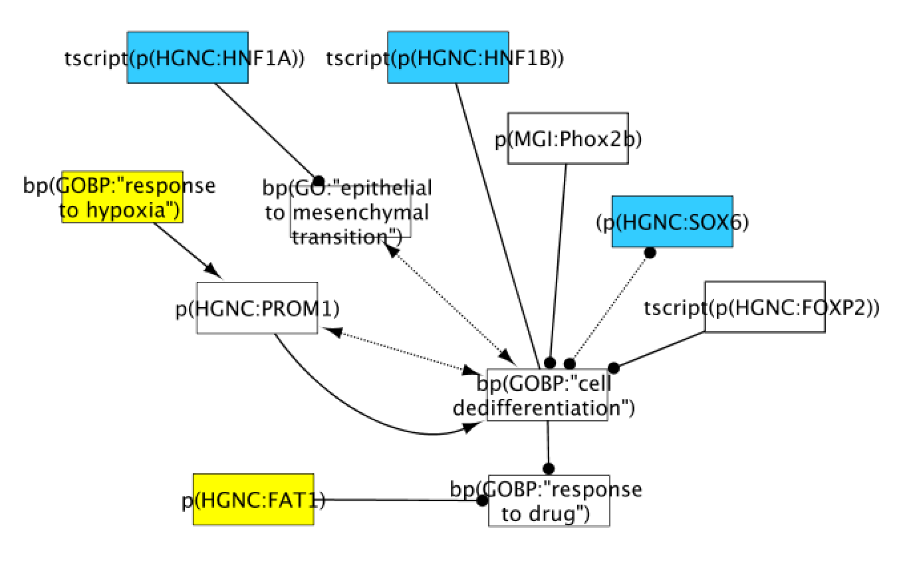
RCI identifies increased dedifferentiation profiles in heavy and light smokers with lung cancer
Cell dedifferentiation network
Dedifferentiation: cancer cell’s ability to behave like a stem cell
Stem cell-like tumors are less likely to respond to drugs
Qualitative result with potential clinical implications
RCI results from Heavy vs Light Smoker Tumor Comparison
HYP increased by RCI
HYP decreased by RCI

Slide 28
RCI HYPs may represent a useful feature compression method for classification of patient samples
Heavy/Light Smoker Prediction from Tumor Samples
Individual gene levels
-top 100 by differential expression in training data
Test set performance:
AUC = 0.5
Samples: 48
23 light smokers
25 heavy smokers
100 genes, 100 features
Classification
(logistic regression)
HYPs scored by aggregate fold changes
-mean differential expression compared to reference samples, adjusted by sign of relationship to HYP
Test set performance:
AUC = 0.7
5,000 genes, 400 features
Caveats: small data; poor clinical translatability
This result is a hint that feature reduction by aggregating gene networks may improve classification in some scenarios

Slide 29
Future Directions
Get the right knowledge into our knowledgebase
Test RCI behavior with different RNA measurement platforms (e.g., nanostring)
Explore utility of RCI-based gene aggregation as a feature reduction method in classification algorithms

Slide 30
Acknowledgements
Renee Deehan Kenney
Natalie Catlett
Sergey Korkhov

Slide 31
Appendix

Slide 32
Using RCI Gene Network Scores Improves Classification Performance in a Held Out Test Set
Model: Heavy vs Light Smokers,
Input: Top 100 Differential Genes (training)
Model: Heavy vs Light Smokers,
Input: RCI Gene Network Scores

Slide 33
Statistics Determine per-HYP Agreement in Direction and Enrichment
Richness – tests enrichment of state changes in a HYP compared to state changes in the dataset overall.
probability of getting at least the given number of state changes in the selected HYP given the number of state changes in the dataset.
Hypergeometric(k; n, N, m) = probability of getting `k` state changes in a HYP of size `n` taken from the population of size `N` with `m` state changes in it.
k = # of state changes in a HYP
n = # of downstream nodes in a HYP
N = # of measured transcripts that map onto the knowledge graph
m = # of state changes among transcripts that map onto the knowledge graph
Richness = 1 – CDF[Hypergeometric(k-1; n, N, m)]

Slide 34
Statistics Determine per-HYP Agreement in Direction and Enrichment
Concordance – tests direction of measured vs know state changes.
Meaning: “probability of getting at least the given number of agreeing state changes”
Binomial(k; n, p) = probability of getting `k` agreement among `n` state changes
k = # of ”concordant” state changes in a HYP
n = # of state changes in a HYP
p = 0.5 (assuming no relation, 50/50 chance that the direction will agree)
Concordance = 1 – CDF[Binomial(k-1; n, p)]

